Slide 1
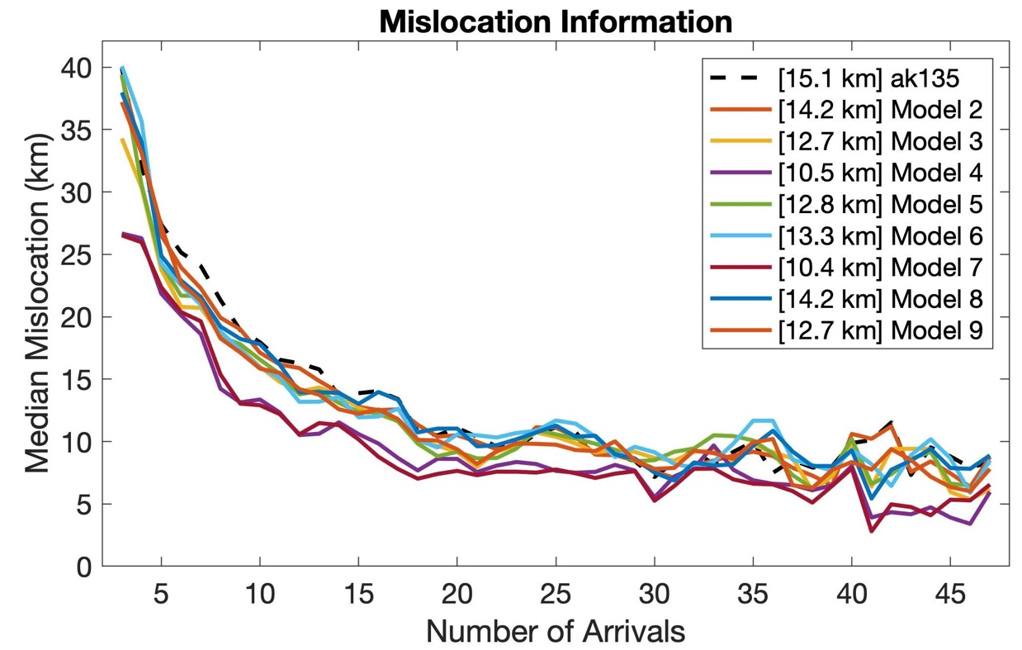
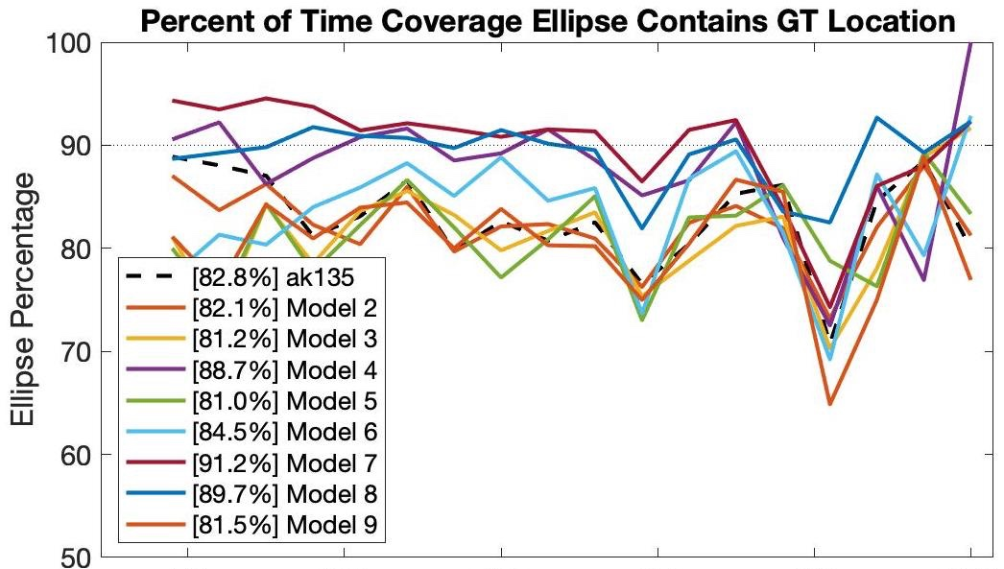
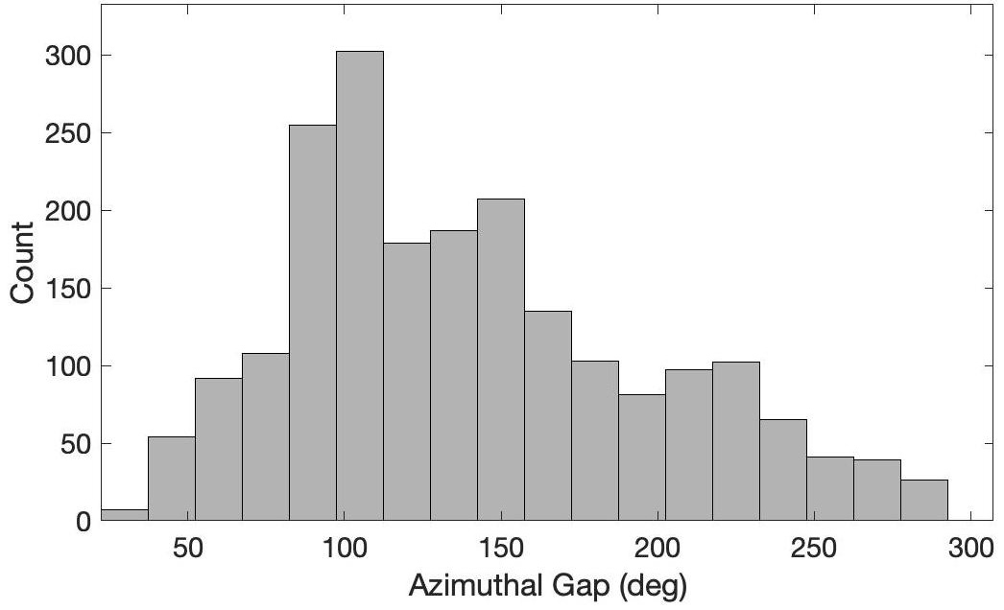
Using a Consistent Travel-time Framework to Compare Three-dimensional Seismic Velocity Models for Location Accuracy
M. Begnaud¹, K. Davenport², A. Conley², R. Porritt², C. Gammans¹, and S. Ballard²
¹Los Alamos National Laboratory, ²Sandia National Laboratories
P1.2-139
Using a 3D, travel-time framework enables fair and consistent comparisons of seismic location accuracy for various higher-dimensional velocity models.
Using an open-source framework designed with 3D tessellated points, we easily store 3D travel-time corrections and uncertainty from ANY 3D velocity model or raytracing algorithm to use with a seismic location algorithm.
  GeoTess, Pcalc
    www.sandia.gov/geotess
    www.sandia.gov/salsa3d
3D travel-time lookup surfaces (3DTTLS) have been created for all IMS primary and auxiliary seismic stations for P and S phases and several 3D velocity models.
  These 3DTTLS were used to relocate GT5 km or better validation events and compare mislocation results.

