Slide 1
Probabilistic seismic hazard (PSH)studies for Madagascar
Tsiriandrimanana RAKOTONDRAIBE
Institute and Observatory of Geophysics Antananarivo, Madagascar (IOGA)
Email: tsitsikel@gmail.com
Place your institution logo here
(remove this text box)
PSH is one of the methods that can determine the probability of exceedance for various level of ground motion, caused by the earthquake during a specific period
PSHA for Madagascar was carried out after determining the three main parameters such as the mean seismic activity rate (λ), the b-value called Gutenberg-Richter value, and the maximum magnitude mmax.
Results of PSHA from combined catalogs NDC and MACOMO show that Madagascar has moderate seismc activity with ML<=6. PGA values near major towns in the central region for 10% and 2% probability of occurrence in 50 years are 0.04g and 0.11g, respectively.
PSHA for seven source areas have been tested for some 2% and 10 % probabilities of exceedance for 50 years. Seismic hazard parameters were estimated for the identified and delineated seismic zones viz Gutenberg Richer b-value,and mmax
Please do not use this space, a QR code will be automatically overlayed
P1.2-532

Slide 2
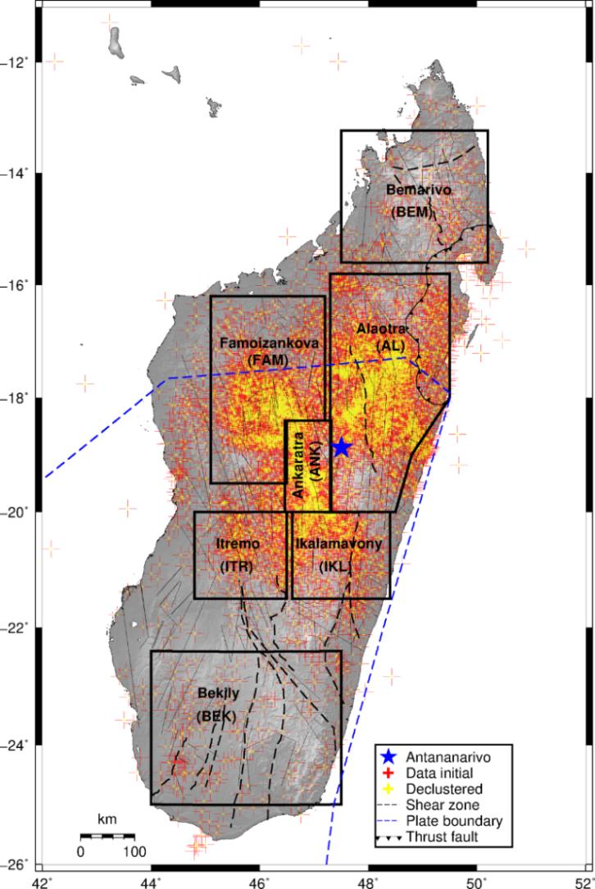
Introduction: Probabilistic seismic hazard studies for Madagascar
Place your institution logo here after removing this text box!
In Madagascar: earthquakes are generally considered moderate in magnitude, but have the potential to become more significant in the future.
Probabilistic seismic hazard assessment (PSHA) is one of the methods that can determine the probability of exceedance for various level of ground motion that caused by the earthquake during a specific period.
Several large earthquakes have been reported according the historical seismicity in Madagascar. Most of the earthquakes occurred in central Madagascar and some of them created damage for the region.
The output of PSHA is typically presented in the form of a probabilistic seismic hazard map, which provides information on the likelihood of different levels of ground shaking in Madagascar over a specified time period.
A probabilistic seismic hazard assessment (PSHA) was conducted using a logic-tree formalism that incorporated two ground motion prediction equations. The results are presented as maps showing the values of the peak ground acceleration (PGA) and spectral acceleration that have 2% and 10% probability of exceedance in 50 years.
Data: The 41-year-long catalog (1975-2016) of the NDC with 18 275 earthquakes was supplemented with data from 23-month-long MACOMO, 695 earthquakes project as well as all historical events since 1897.
Please do not use this space, a QR code will be automatically overlayed
P1.2-532
Email: tsitsikel@gmail.com

Slide 3
Objectives
Place your institution logo here after removing this text box!
The objective of probabilistic seismic hazard studies is to assess the likelihood and potential impact of future earthquakes in a particular area of Madagascar
This study focused on using earthquake data and statistical models to estimate the probability of earthquakes of different magnitudes occurring over a given period of time.
The results can help inform measures to mitigate the risks associated with earthquakes and others, building codes, emergency planning.
Please do not use this space, a QR code will be automatically overlayed
P1.2-532
Email: tsitsikel@gmail.com

Slide 4
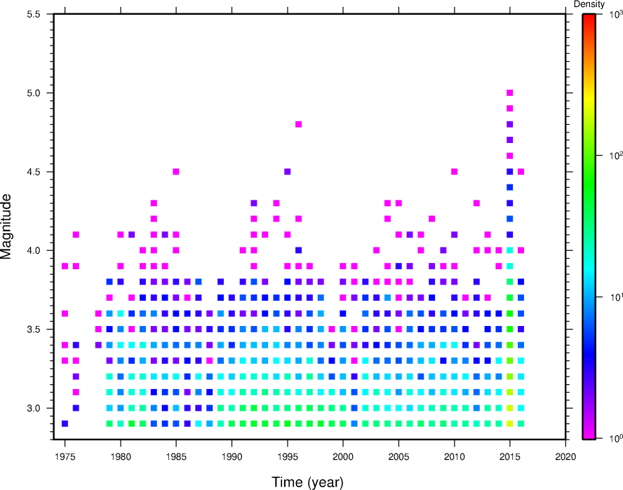
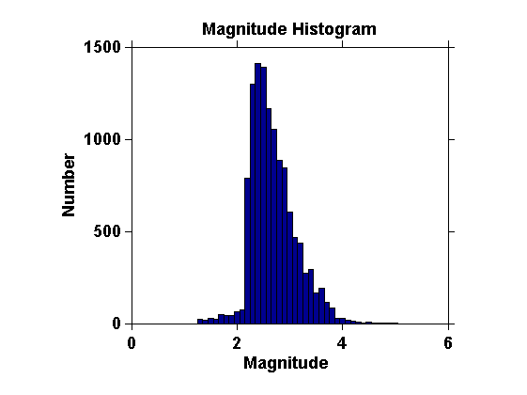
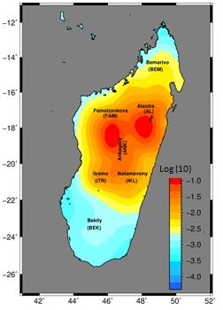
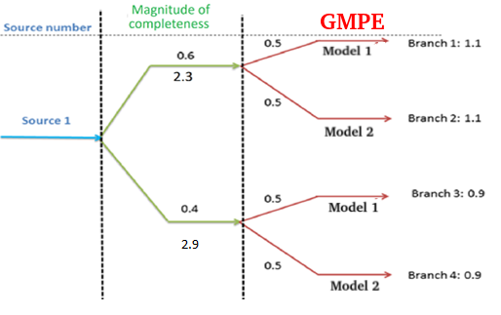
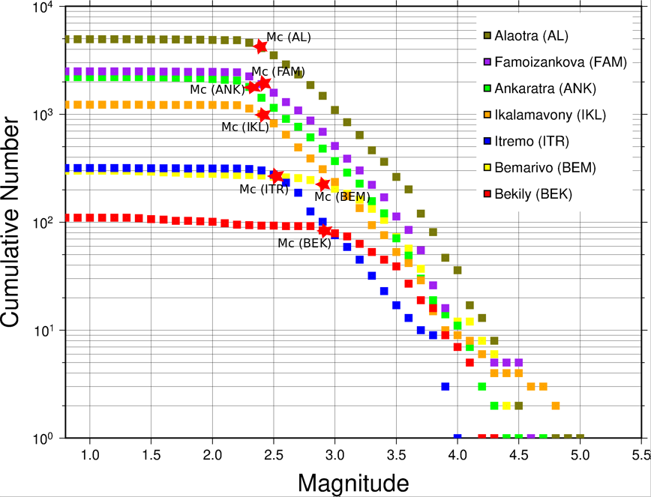
Methods and data
Place your institution logo here after removing this text box!
Earthquake data
Please do not use this space, a QR code will be automatically overlayed
GMPE: Mod1 Boore et al. (2008); Model 2: Chiou and Youngs(2014)
P1.2-532
Email: tsitsikel@gmail.com

Slide 5
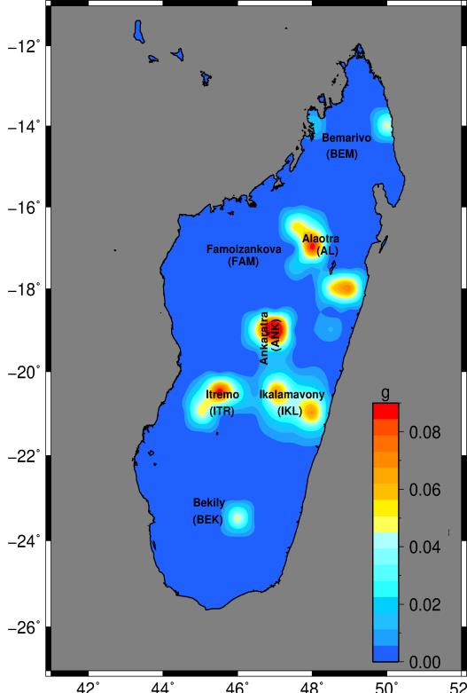
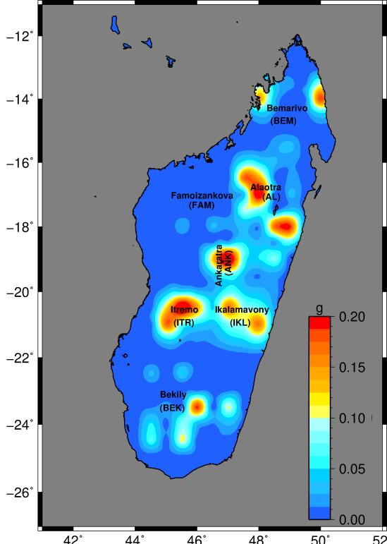
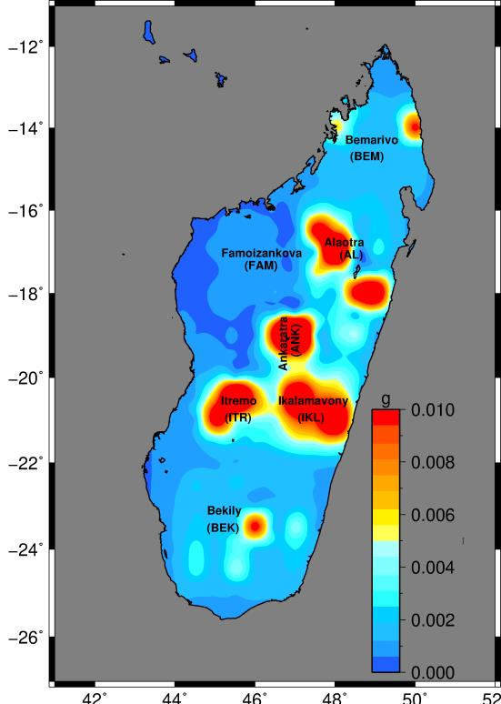
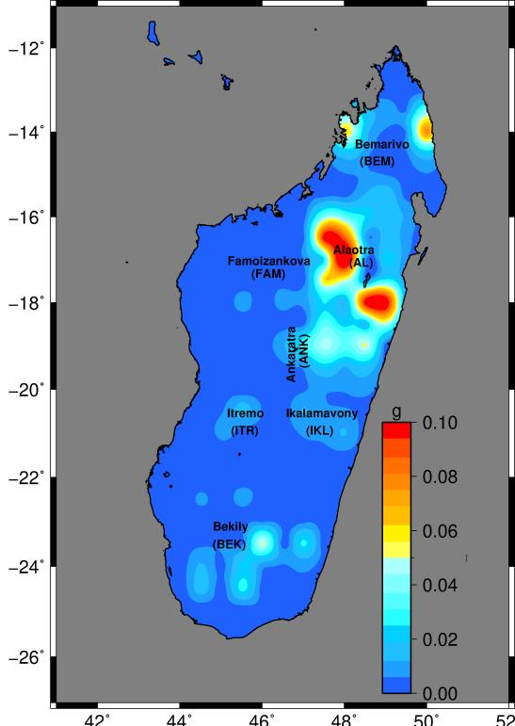
Results
Place your institution logo here after removing this text box!
Results of probabilistic seismic hazard for probabilities of exceedance for 10% and 2% in 50 years, equivalent to return periods of 474- and 2,475-years, respectively,
Produced for peak ground acceleration (PGA) and spectral acceleration of 1.0 s.
Please do not use this space, a QR code will be automatically overlayed
PPGA at 10% probabiity
PPGA at 2% probabiity
hazard map for SA 1.0s at 10% probability
hazard map for SA 1.0s at 2% probaility
P1.2-532
Email: tsitsikel@gmail.com

Slide 6
Conclusion
Place your institution logo here after removing this text box!
- Combined data NDC (1975-2016) and MACOMO (2011-2013) produce a combined bulletin of 18,970 events
- Seismicity catalog for Madagascar homogenized to Mw and then declustered (7020 dependent events removed and leaving a catalog of 11,950 earthquakes event).
- Seven source areas defined, and the maximum magnitude, activity rate, and b-value calculated for each source.
- Highest levels of predicted ground motion found to be in the most active areas, viz. central Madagascar.
- The hazard in central Madagascar may be described as moderate, and elsewhere in the island as low.
- Moderate-sized and potentially damaging earthquake (M>5.5) could occur elsewhere in Madagascar, just that it is a lot less frequent.
From this study we could identify the impact of:
a. Tectonic Activity in Africa: case study East African rift
b. The earthquake swarm in Mayotte, the movement of magma beneath the Earth’s crust
c. Urbanisation within Madagascar
Please do not use this space, a QR code will be automatically overlayed
P1.2-532
Email: tsitsikel@gmail.com

Slide 7
References
Place your institution logo here after removing this text box!
Boore, D.M. and Atkinson, G.M., 2008. Ground motion prediction equations for the average horizontal component of PGA, PGV, and 5% damped PSA at spectral periods between 0.01 s and 10.0 s. Earthquake Spectra, 24, 99-138.
Chiou, B.S.J. and Youngs, R.R., 2014. Update of the Chiou and Youngs NGA model for the average horizontal component of peak ground motion and response. Earthquake Spectra, 30(3), 1117-1153.
Rakotondraibe, T., Nyblade, A.A., Wysession, M.E., Durrheim, R.J., Rambolamanana, G., Aleqabi, G.I., Shore, P.J., Pratt, M.J., Andriampenomanana, F., Rümpker, G. and Rindraharisaona, E., 2020. Seismicity and seismotectonics of Madagascar revealed by the 2011–2013 deployment of the island-wide MACOMO broadband seismic array. Tectonophysics, 790, p.228547.
Rakotondraibe, T., Durrheim, R.J., Rambolamanana, G.,Nyblade, A.A., Wysession, M.E., Andriampenomanana, F., Rindraharisaona, E., (In Prep.). Probabilistic Seismic Hazard study for Madagascar
Please do not use this space, a QR code will be automatically overlayed
P1.2-532
Email: tsitsikel@gmail.com

