Slide 1
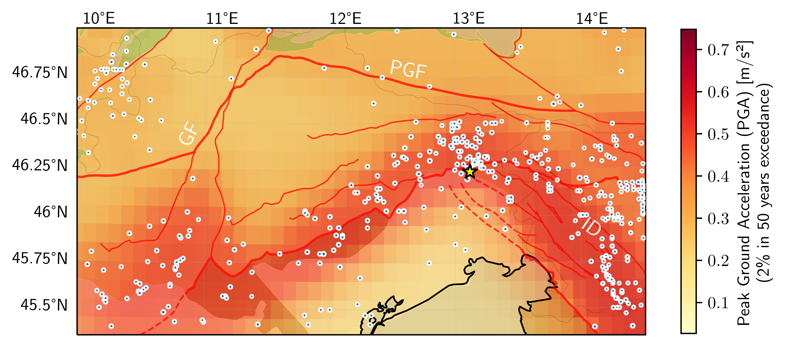
Nonlinear elasticity: Application to resolve the stress-field orientation from ambient seismic noise
Yongki A. Aiman¹, Andrew Delorey², Yang Lu¹, Götz Bokelmann¹
¹University of Vienna, Austria; ²Los Alamos National Laboratory, USA
P1.2-574
Emulate laboratory procedure to perform the „natural“ pump-probe experiment using solid-earth tides (low-frequency vibration) and cross-correlation functions (high-frequency waves).
Measuring stress derivative of seismic velocity with respect to the tidal strain, thus constraining the maximum horizontal compressive stress (S_{Hmax}) orientation in the Earth‘s crust.
Explaining why the two major faults in Northeastern Italy, the Giudicarie Fault and the Periadriatic Line (Pustertal-Gailtal Fault) are currently inactive, while the currently acting stress field allows faults in Slovenia to deform actively
Tidal forcing
Earth
Moon

