Slide 1
Improve Jordan Seismological Observatory Events Location by Reducing Azimuth Gab Using Regional Seismic Travel Time Workshop Recommendation
Shadi Alzoubi
Jordanian Seismological Observatory/Jordan National Data Center
The Jordanian Seismological Observatory (JSO) participated in a workshop in Nepal on improved seismic event location using the regional seismic travel time (RSTT) method. The JSO contributed with a list of selected seismic events to be analyzed and tested. After selecting the most matched event from the list and ensuring it was compatible with RSTT module specification, the result of the analysis of event location by RSTT wasn’t within the expected range. This was because of the high azimuth gab due to lack of stations coverage from all direction. The JSO should start to solve this issue by reducing the azimuth gab by adding stations from Lebanon. Additionally, a study undertaken to add new seismic stations where no station coverage is found and by getting data from the International Data Centre or data from other seismological centers.
First of all we need to check the accuracy of Events Location calculated by Jordanian Seismological Observatory(JSO), so that we use Mining Explosions that occur in Central and South of Jordan by record the Actual location and Time for Each Explosions and compare it with the Calculated Event Location by JSO Seismic Network.
To meet the objective of the study and improve the JSO Event location accuracy we select Two major and recent Seismic event (Earthquake) one in Dead Sea Area (Central Jordan) and the Second one in Gulf of Aqaba (South of Jordan).
By using Mining Explosions to check the accuracy of Calculated Location we found that the Azimuth Gab in Central and North of Jordan less than the Azimuth Gab in South and Southeast of Jordan, and the calculated Location accuracy in Central and North of Jordan Higher than South and Southeast of Jordan(Figure 1).
From this Result we found there is very low Seismic station coverage for Event in South and South east of Jordan, and for Event in Central and North of Jordan need to use waveform data from IDC and/or other Seismological Observatory to Reduce the Azimuth Gab.
The two Seismic event used to compare the Azimuth Gab before and after apply the improvement by import waveform data from other Seismological Observatory and from IDC to our system and reanalyze them again showed the same result from mining explosion azimuth Gab improved for the Event in Central Jordan with improved accuracy but not for the Event in South.
REPLACE THIS TEXT
With your
Conclusions
DO NOT CHANGE or RESIZE the Text or the Textbox
Please do not use this space, a QR code will be automatically overlayed
P1.2-101

Slide 2
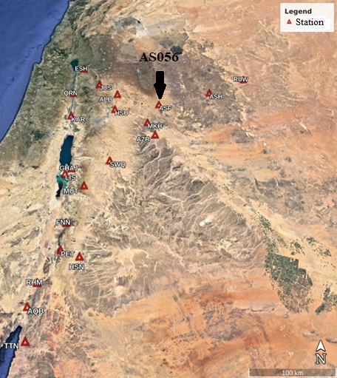
Place your institution logo here after removing this text box!
Improve Jordan Seismological Observatory Events Location by Reducing Azimuth Gab Using Regional Seismic Travel Time Workshop Recommendation
Introduction:
The Jordanian Seismological Observatory (JSO) participated in a workshop in Nepal on improved seismic event location using the regional seismic travel time (RSTT) method. The JSO contributed with a list of selected seismic events to be analyzed and tested. After selecting the most matched event from the list and ensuring it was compatible with RSTT module specification, the result of the analysis of event location by RSTT wasn’t within the expected range. This was because of the high azimuth gab due to lack of stations coverage from all direction.
The JSO should start to solve this issue by reducing the azimuth gab by adding stations from other Seismological Observatory. Additionally, a study undertaken to add new seismic stations where no station coverage is found and by getting data from the International Data Centre or data from other seismological centers.
Please do not use this space, a QR code will be automatically overlayed
Jordan Seismic Station Map
P1.2101

Slide 3
Place your institution logo here after removing this text box!
Improve Jordan Seismological Observatory Events Location by Reducing Azimuth Gab Using Regional Seismic Travel Time Workshop Recommendation
Objectives
improving location accuracy for local seismic events in Jordan.
Reduce Azimuth Gab for local Seismic events.
Enhance Jordanian Seismic Station Network to cover all country Side( specially the Area with high Seismicity) by selecting new location in areas with no seismic coverage.
Use the International Monitoring System (IMS) data and IDC products to get Waveform data to reduce the Azimuth Gab and Improve event location.
Try to get waveform data for Seismic Events with high Azimuth Gab and Low Location Accuracy from other Seismological Observatories.
Use Mining Explosions that occur in all regions in Jordan to check the accuracy of event location calculated by Jordan Seismological Observatory.
Please do not use this space, a QR code will be automatically overlayed
P1.2-101

Slide 4
Improve Jordan Seismological Observatory Events Location by Reducing Azimuth Gab Using Regional Seismic Travel Time Workshop Recommendation
Methods and data:
First of all we need to check the accuracy of Events Location calculated by Jordanian Seismological Observatory(JSO), so that we use Mining Explosions that occur in Central and South of Jordan by record the Actual location and Time for Each Explosions and compare it with the Calculated Event Location by JSO Seismic Network.
The Mining Explosions Used :
Date |  |  | Actual Location |  | Calculated Location
Explosion in Central | Time(GMT) | Azimuth Gab | Latitude | Longitude | Latitude | Longitude
24/05/2023 | 11:16:06 | 173° | 31.151N | 36.263E | 31.154N | 36.281E
Explosion in South | Time(GMT) | Azimuth Gab | Latitude | Longitude | Latitude | Longitude
22/05/2023 | 09:40:07 | 277° | 29.951N | 36.212E | 29.988N | 36.223E
22/05/2023 | 10:58:32 | 270° | 29.874N | 36.307E | 29.917N | 36.345E
Please do not use this space, a QR code will be automatically overlayed
P1.2-101

Slide 5
Improve Jordan Seismological Observatory Events Location by Reducing Azimuth Gab Using Regional Seismic Travel Time Workshop Recommendation
Methods and data:
To meet the objective of the study and improve the JSO Event location accuracy we select Two major and recent Seismic event (Earthquake) one in Dead Sea Area (Central Jordan) and the Second one in Gulf of Aqaba (South of Jordan).
First we analysis this events to calculate the location by using our Jordanian Seismic station, then we reanalysis same events after add waveform data from other sources like IDC Station or other Seismological Observatories.
The Selected events:
Date |  | Calculated Location |  | Improved Calculated Location |  | Azimuth
Dead Sea | Time(GMT) | Latitude | Longitude | Longitude | Longitude | Azimuth | Improved Azimuth
01/04/2023 | 18:25:55 | 31.998N | 35.513E | 31.994N | 35.500E | 188° | 70°
Aqaba | Time(GMT) | Latitude | Longitude | Longitude | Longitude | Azimuth | Improved Azimuth
16/05/2023 | 19:05:53 | 28.755N | 34.878E | 28.742N | 34.707E | 343° | 333°
Please do not use this space, a QR code will be automatically overlayed
P1.2-101

Slide 6
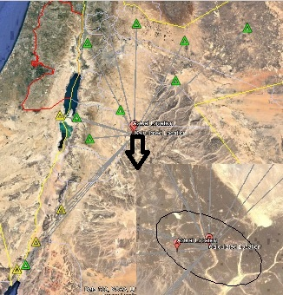
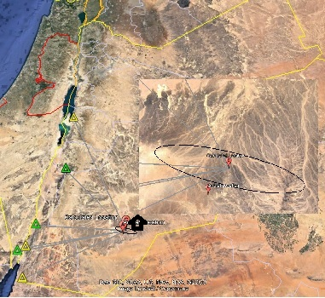
Place your institution logo here after removing this text box!
Improve Jordan Seismological Observatory Events Location by Reducing Azimuth Gab Using Regional Seismic Travel Time Workshop Recommendation
Results:
By using Mining Explosions to check the accuracy of Calculated Location we found that the Azimuth Gab in Central and North of Jordan less than the Azimuth Gab in South and Southeast of Jordan, and the calculated Location accuracy in Central and North of Jordan Higher than South and Southeast of Jordan(Figure 1).
From this Result we found there is very low Seismic station coverage for Event in South and South east of Jordan, and for Event in Central and North of Jordan need to use waveform data from IDC and/or other Seismological Observatory to Reduce the Azimuth Gab.
Figure 1: Show The Accuracy difference between
central Explosion
(1.5km Shifted)
and
South Explosion
(6km Shifted)
Please do not use this space, a QR code will be automatically overlayed
P1.2-101

Slide 7
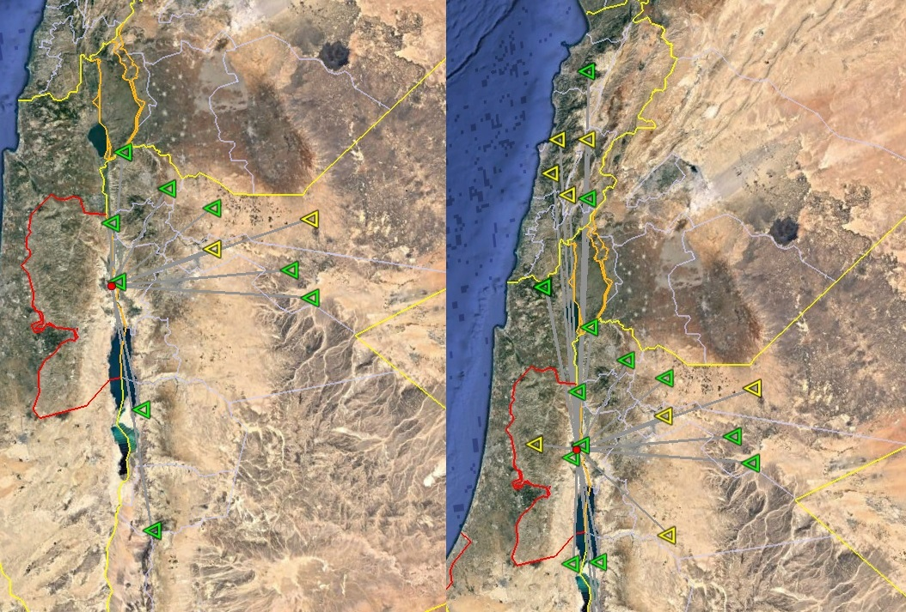
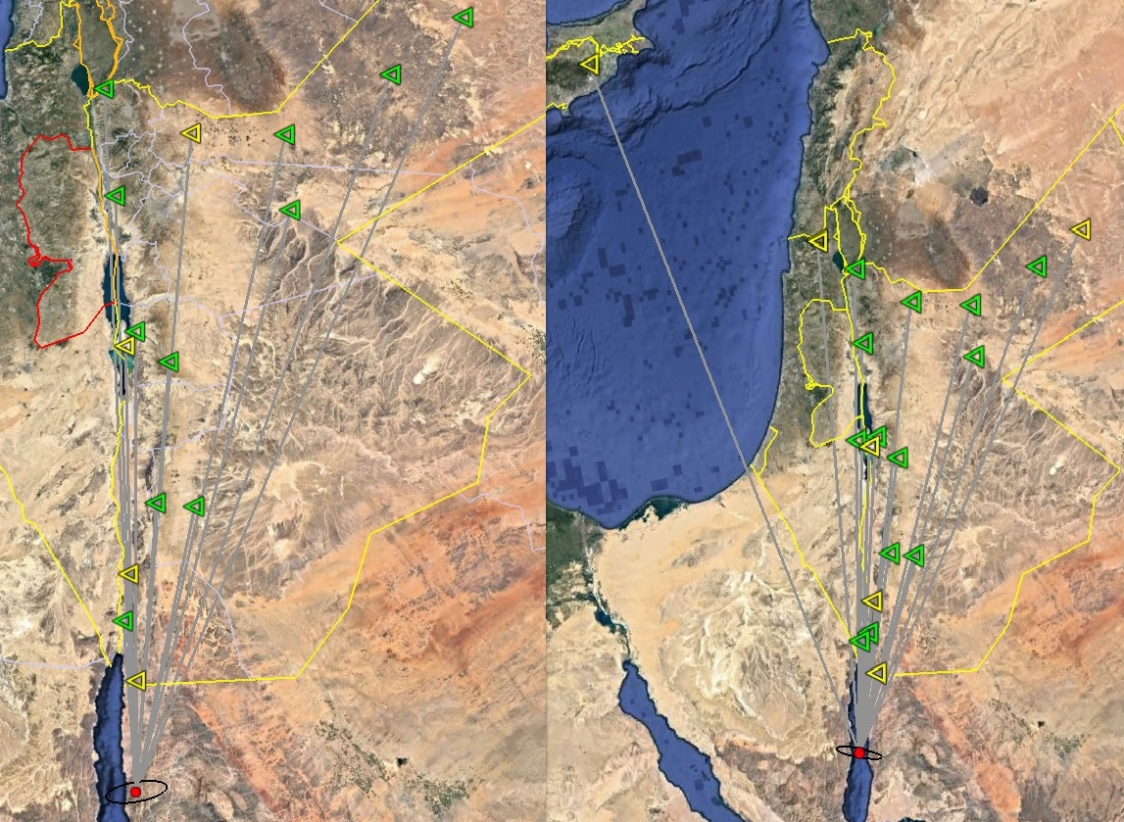
Place your institution logo here after removing this text box!
Improve Jordan Seismological Observatory Events Location by Reducing Azimuth Gab Using Regional Seismic Travel Time Workshop Recommendation
Results:
The two Seismic event used to compare the Azimuth Gab before and after apply the improvement by import waveform data from other Seismological Observatory and from IDC to our system and reanalyze them again showed the same result from mining explosion azimuth Gab improved for the Event in Central Jordan with improved accuracy but not for the Event in South.
Please do not use this space, a QR code will be automatically overlayed
Central of Jordan Event
South of Jordan Event
P1.2-101

Slide 8
Place your institution logo here after removing this text box!
Improve Jordan Seismological Observatory Events Location by Reducing Azimuth Gab Using Regional Seismic Travel Time Workshop Recommendation
Conclusion:
Central and North of Jordan have Azimuth Gab and Location Accuracy improved by applying Recommendation as we success to get waveform data from other Seismological Observatory along with Waveform data from IDC and for this areas we have good Seismic Station coverage.
For the South and Southeast of Jordan the Seismic Station coverage is limited mainly to the north of high Seismicity area, the only improvement we did it was using the IDC waveform data which add a one seismic station to the Northwest from the Event.
we need to work on a cooperation with our neighbors Seismological Observatory to exchange waveform data or real time data especially for the south and east areas.
to enhance the Seismic Coverage in the South we start the process to add new Seismic Station in the East of Jordan and South East of Jordan.
Work more with NDC and NDC in a Box Tools and Software provided to our National Data Center and use it to compare our calculated location for Local Seismic Event with magnitude more than 3.5.
Please do not use this space, a QR code will be automatically overlayed
P1.2-101

