Slide 1
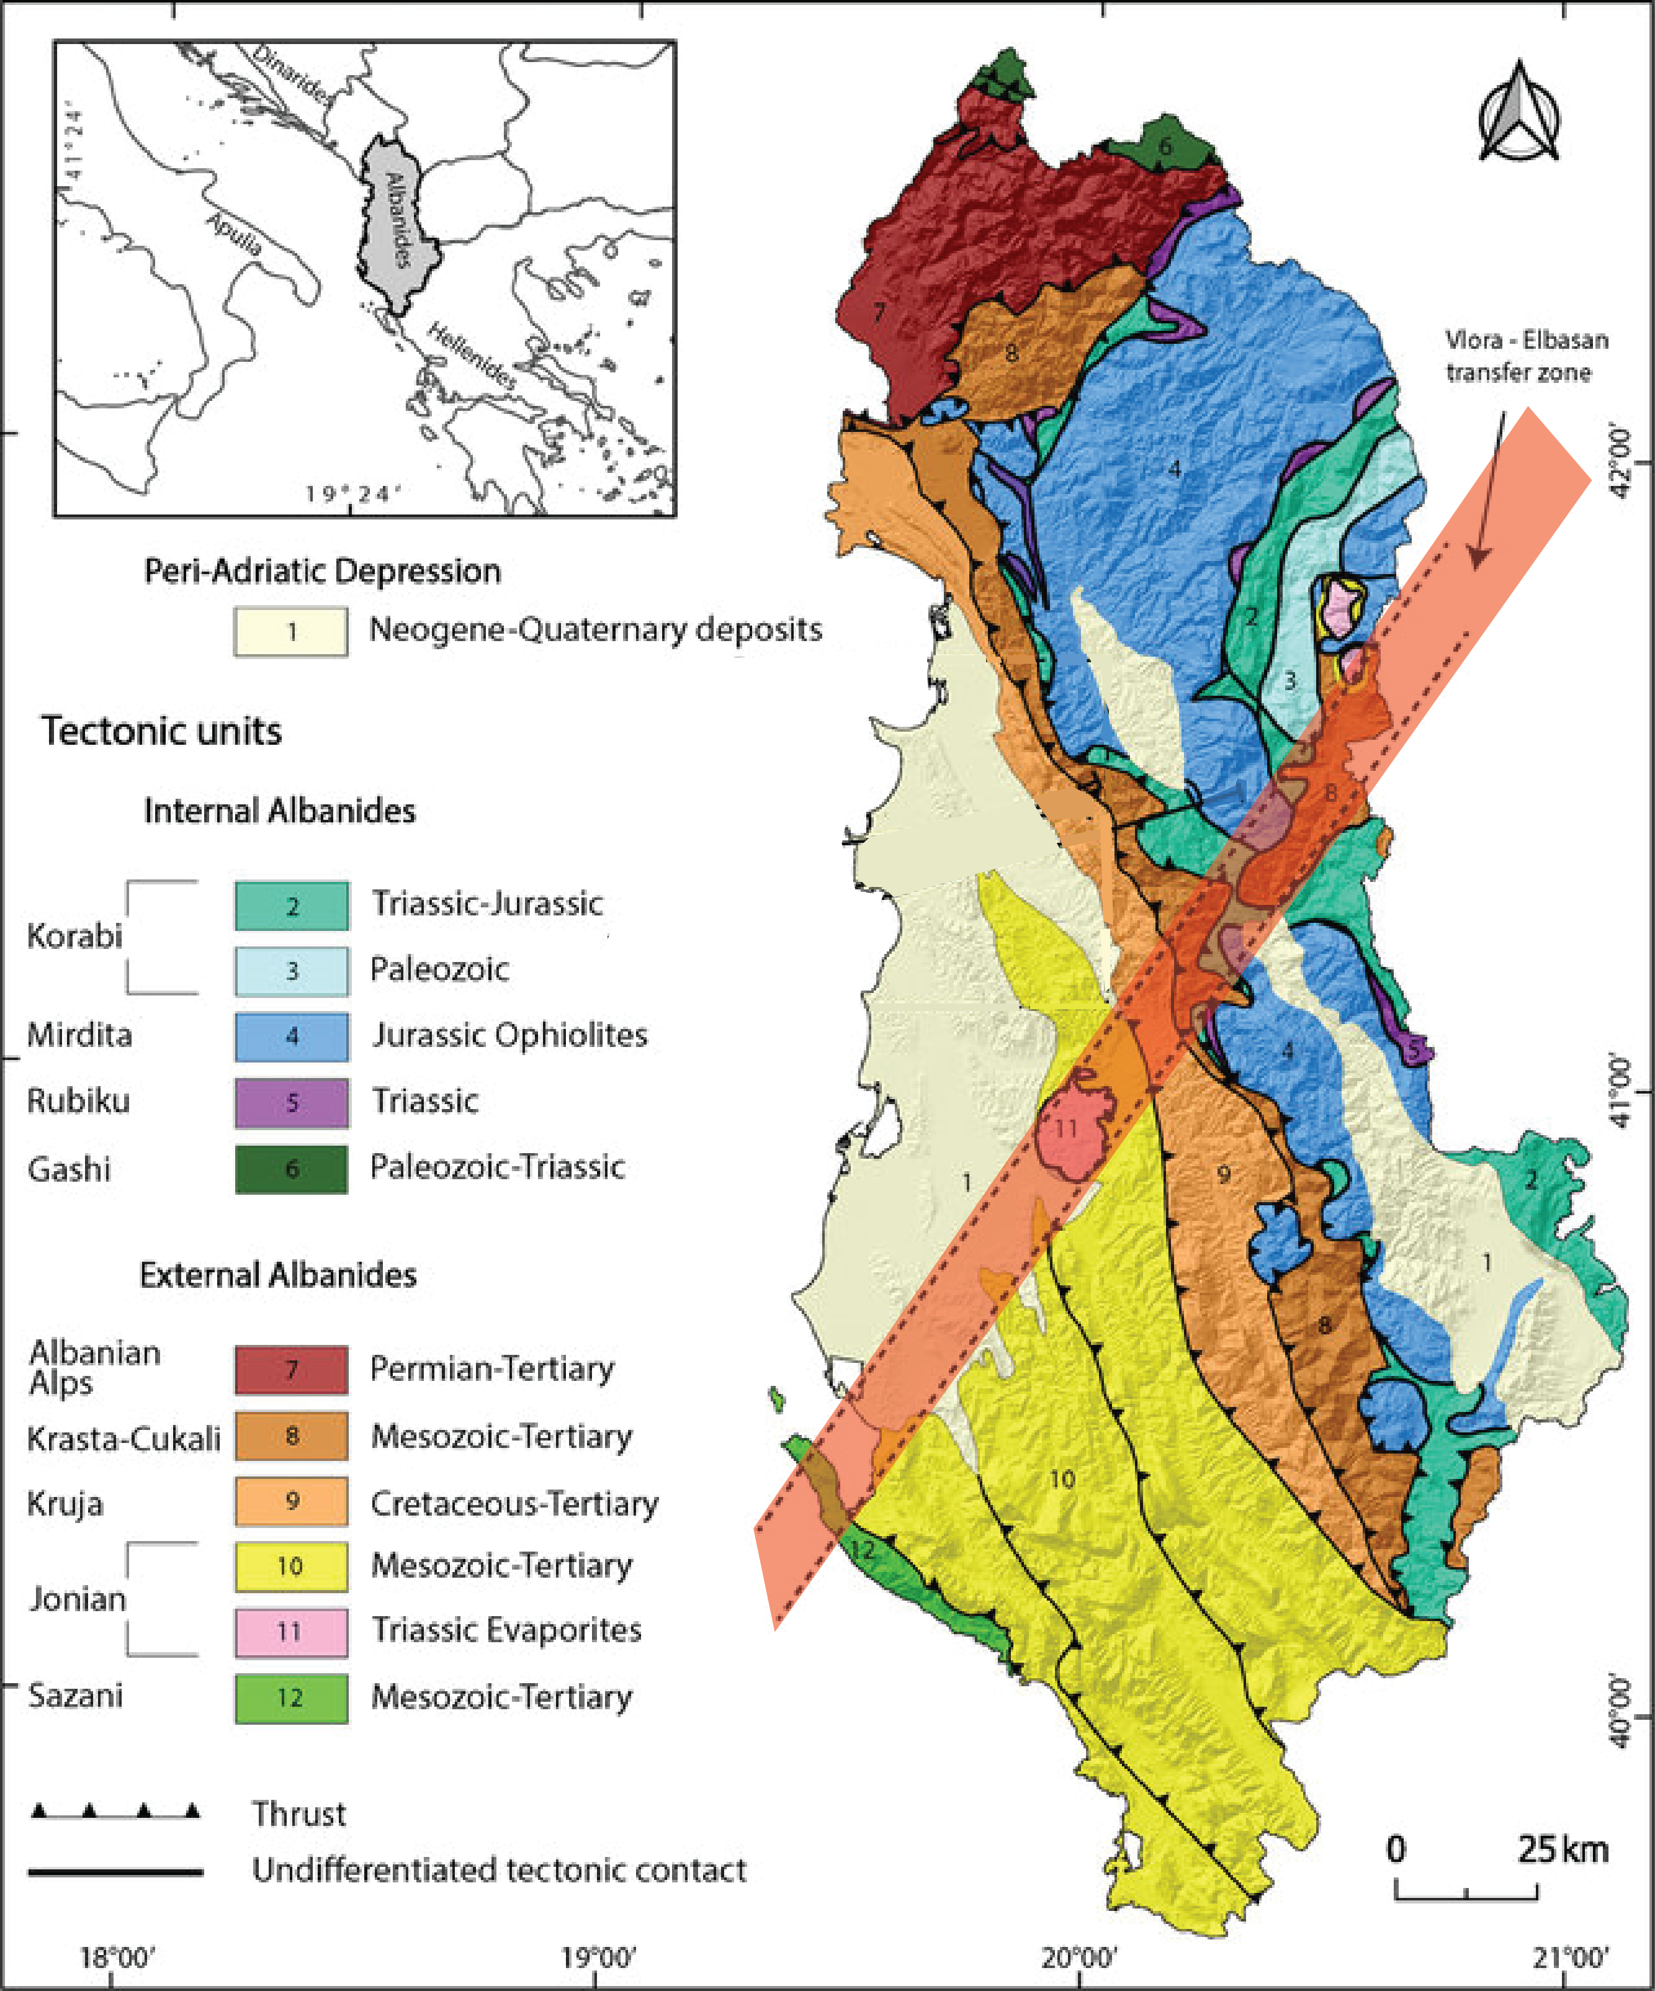
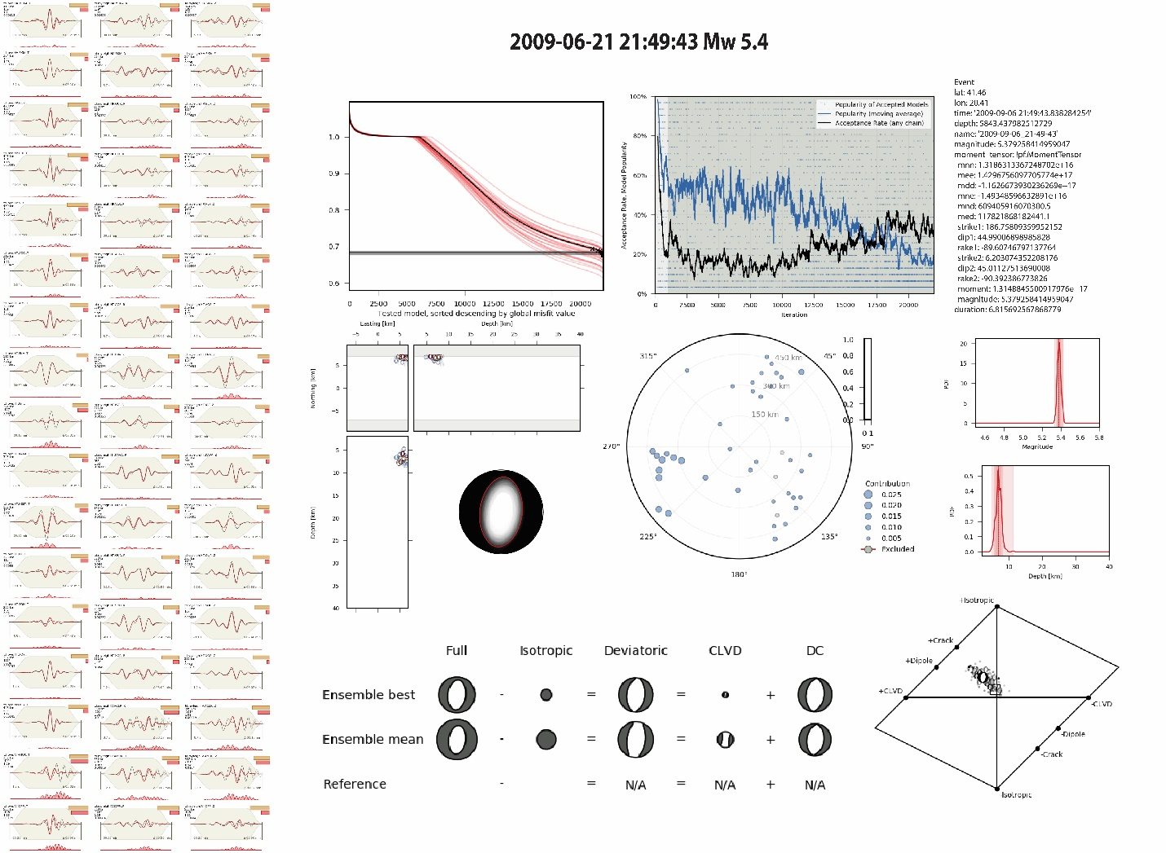
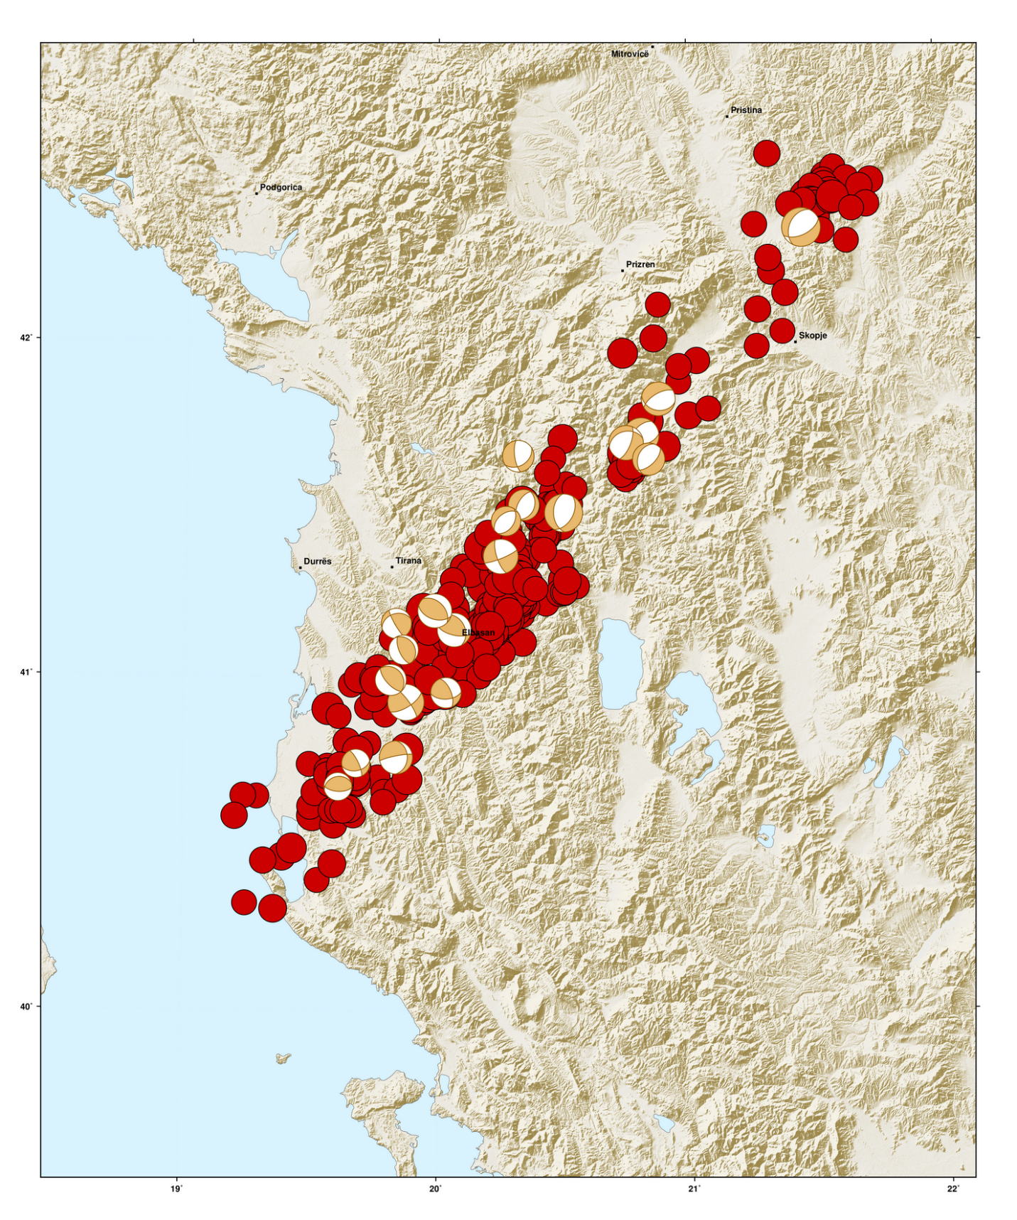
MT Solutions of Small to Moderate Earthquakes Along V-E-D Transversal Fault Zone
Olgert Gjuzi¹, Rrapo Ormeni¹, Fatih Truhan²
¹Seismology Department, Institute of Geosciences, Polytechnic University of Tirana
²Boğaziçi University, Kandilli Observatory, and Earthquake Research Institute, Regional Earthquake Tsunami Monitoring Center
Monitoring Center
P1.2-110
Introduction
The Vlora-Elbasan-Dibra (V-E-D) Transversal fault extends for about 130 km from the Adriatic coast to North Macedonia
Over 30000 events with ML >2 and 325 with ML> 3.5
Moment Tensor Inversion analysis of 22 events in 5 different segments
Data & Methods
Moment Tensor Inversion using GROND probabilistic earthquake source inversion
Pre-calculated Green’s function (GF) is based on the local velocity model
The forward modeling & Bootstraping method
Results
5 main segments with different focal mechanism characteristics
If you want to learn more about the results, come see my e-poster during the e-poster virtual session P1.2-110 on Tue 20/06/2023 or access it online on the SnT2023 Conference platform!
Disclaimer: The views expressed on this poster are those of the authors and do not necessarily reflect the views of IGEO nor the CTBTO

