Slide 1
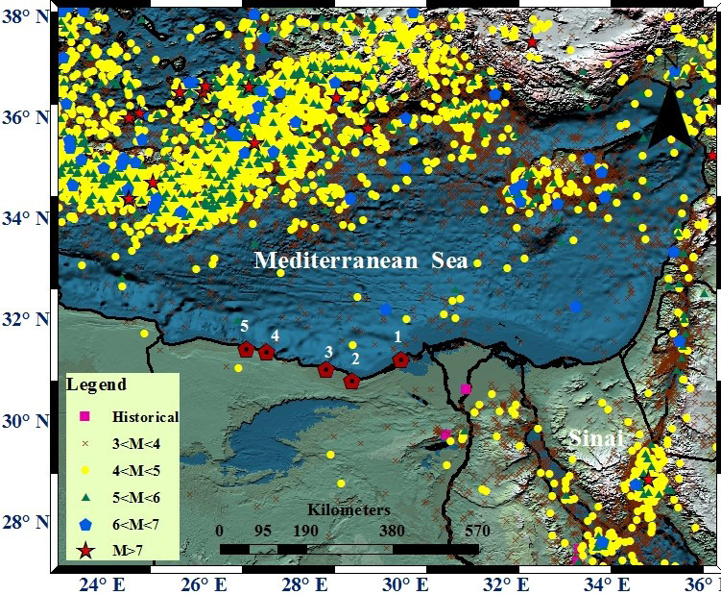
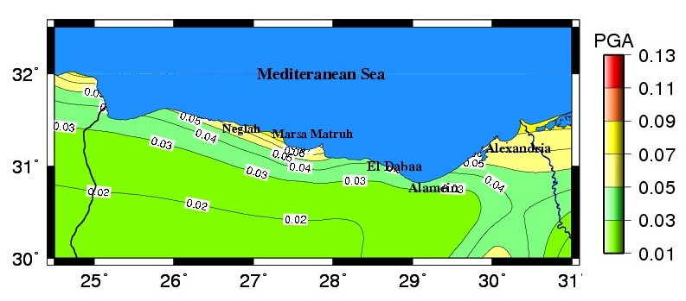
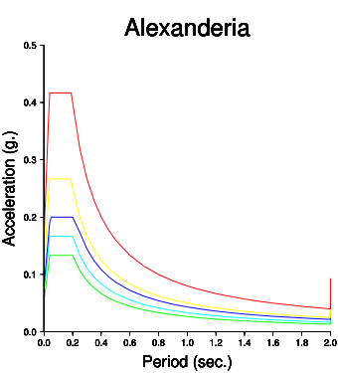
Design Response Spectra for Selected cities along the northwestern coast of Egypt
Hanan Gaber, Mahmoud El-Hadidy
National Research Institute of Astronomy and Geophysics, 11421 Helwan, Egypt
P1.2-145
The Design Response Spectra for Selected cities along the northwestern coast of Egypt
has 3 main objectives:
Probabilistic Seismic Hazard Analysis.
Hazard maps.
Design response spectrum of Northwestern coast cities , Egypt.
If you want to learn more about this, come see my e-poster during session P1.2-145 on 20 June or access it online on the SnT2023 Conference platform!

