Slide 1
Design Response Spectra for Selected cities along the northwestern coast of Egypt
Hanan Gaber, Mahmoud El-Hadidy
National Research Institute of Astronomy and Geophysics, 11421 Helwan, Egypt
The aim of the present work is to assess the Probabilistic Seismic Hazard Analysis at five cities across the northern coast of Egypt.
Determining the design response spectrum of five cities are: Alexandria,Alamein, Dabaa, Marsa Matrouh and Negelah.
Earthquake hazard analysis has been performed for the northern coast of Egypt using the (PSHA).
The catalogue has been collected from 2200 BC up to 2018 AD.
The design response spectrum are calculated considering all the soil types (ICC 2003).
The results show that, the PGA has low values at spectral periods ≥ 0.5 s, while the larger values (0.05– 0.3 g) have been calculated at spectral periods < 0.5 s, with return periods 475 and 2475 years .
The Western Desert is characterized by very low seismic activity.
Estimating the updated probabilistic seismic hazard maps and design response spectrum for the important cities located along the northern coast of Egypt, considering the recent seismic activity is become vital and essential, especially inconsistent with the Egypt vision 2030 for sustainable development.
Please do not use this space, a QR code will be automatically overlayed
P1.2-145

Slide 2
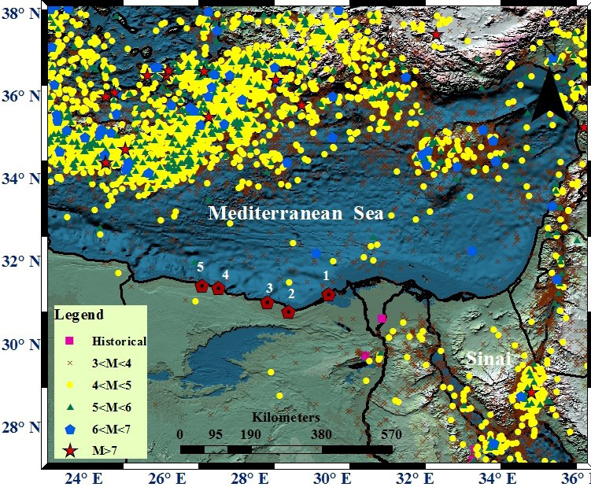
Introduction
The aim of the present work is to assess the Probabilistic Seismic Hazard Analysis (PSHA) at five selected cities (Figure 1) across the northern coast of Egypt, in addition to determining the design response spectrum, considering different soil conditions.
These five selected cities are: Alexandria, Alamein, Dabaa, Marsa Matrouh and Negelah. The five cities were selected, on the basis of the strategic and economic importance of these cities in the development plans and the major national projects, in accordance to the vision of Egypt 2030 for the sustainable development.
These cities have unique importance in Egypt due to their role in the future development of Egypt.
Please do not use this space, a QR code will be automatically overlayed
P1.2-145

Slide 3
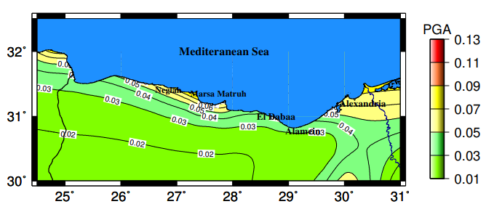
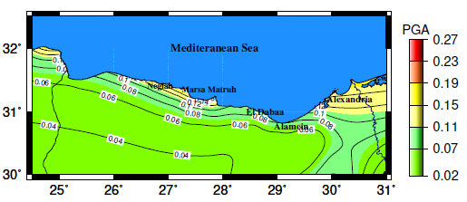
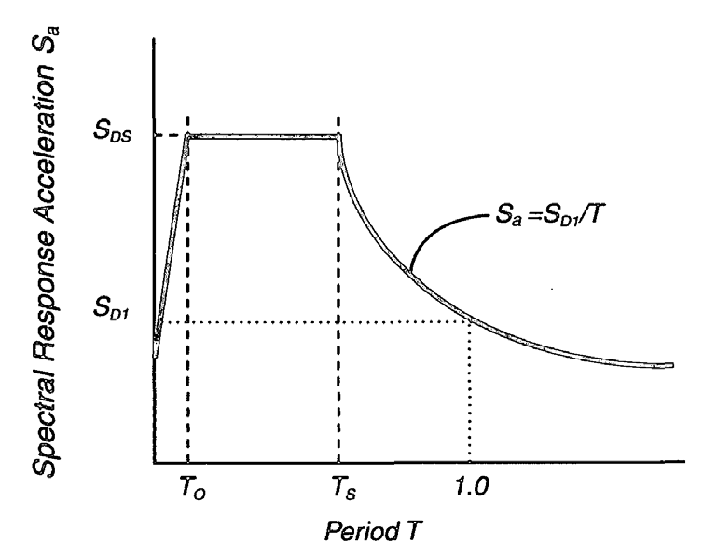
Objectives
1- Probabilistic Seismic Hazard Analysis
Earthquake hazard analysis has been performed for the northern coast of Egypt using the probabilistic seismic hazard approach (PSHA).
2- Hazard maps
Two seismotectonic models,the first one is Abou El-Enean (2010) and the second model is defined by Gaber et al.(2018).Different GMPEs are used to produce rock-site hazard for the PGA and 5% spectral acceleration at (0.2, 0.5, 1.0, and 2.0 s) for return period 475 and 2475 years, corresponding to 10% and 2% probability of exceedance in 50 years.
3- Design response spectrum of Northwestern coast cities , Egypt.
The design response spectrum are calculated considering all the soil types mentioned in the International Building Code 2003 (ICC 2003). The seismic hazard has been applied utilizing the well-known total probability theory, and formulated in the form of the rate of exceedance for a particular level of ground motion for a rock-site. Rock site conditions have Vs (30) larger than 760 m/s, Code (ICC, 2003).
PGA at 475
PGA at 2475
Please do not use this space, a QR code will be automatically overlayed
P1.2-145

Slide 4
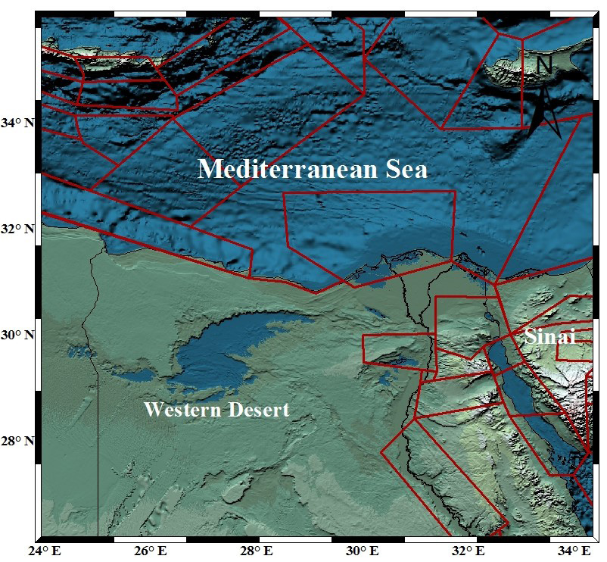
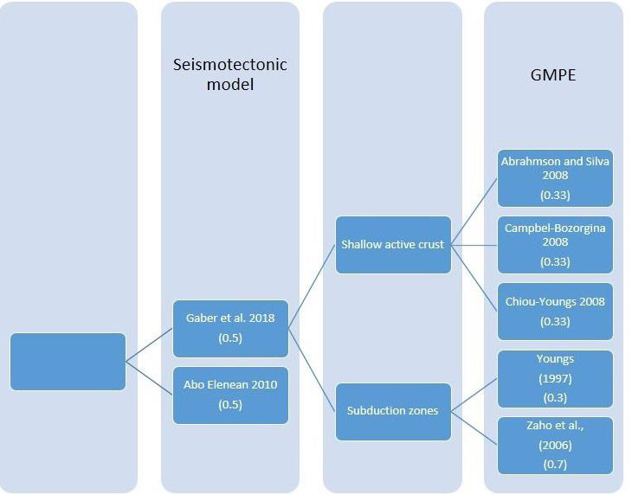
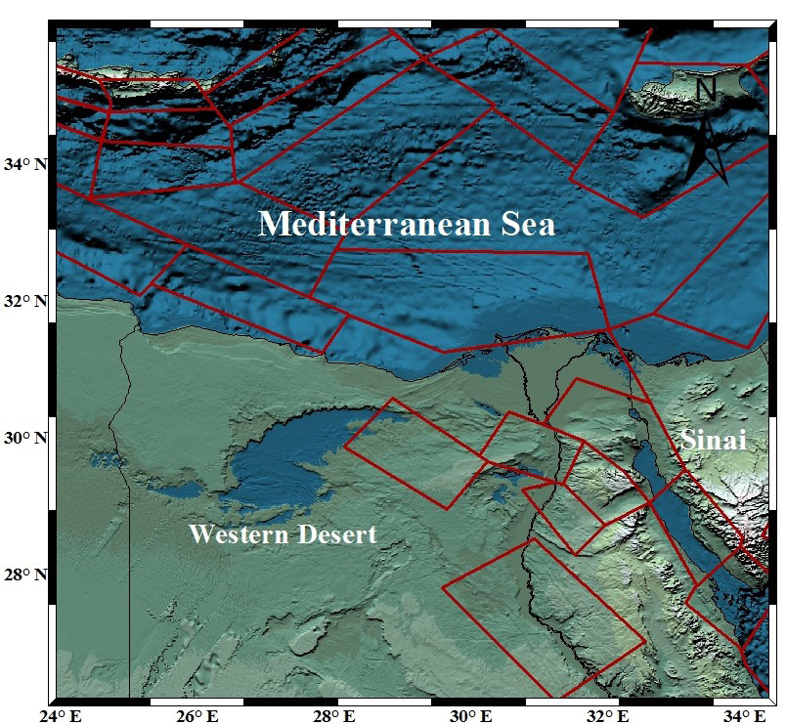
METHODOLOGY AND DATA
Earthquake hazard analysis has been performed for the northern coast of Egypt using (PSHA). we use a complete and homogenous earthquake catalogue, covering the time period up to 2018 AD and includes all the earthquakes with magnitude larger than 3 on any magnitude scale.
Two seismotectonic models are used. The first one is defined by Abou El-Enean (2010) and the second model is defined by Gaber et al. (2018).
Different GMPEs are implemented to produce rock-site hazard for the PGA and 5% spectral acceleration at (0.2, 0.5, 1.0, and 2.0 s) for return period 475 and 2475 years, corresponding to 10% and 2% probability of exceedance in 50 years.
The design response spectrum are calculated considering all the soil types mentioned in the International Building Code 2003 (ICC 2003).
Please do not use this space, a QR code will be automatically overlayed
P1.2-145

Slide 5
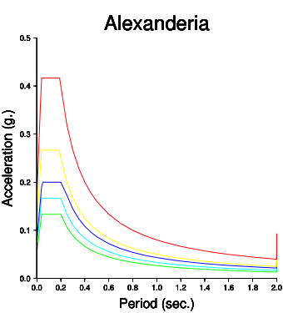
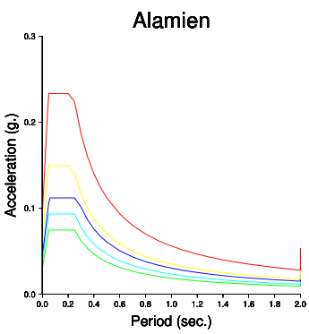
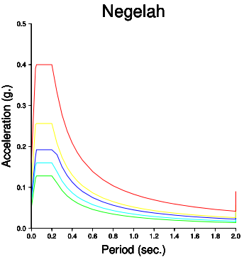
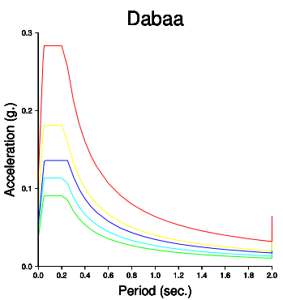
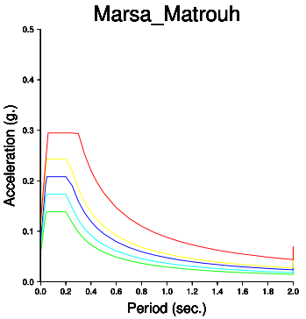
Results
The obtained results and hazard maps show that, the PGA has low values at spectral periods ≥ 0.5 s, while the larger values (0.05– 0.3 g) have been calculated at spectral periods < 0.5 s, with return periods 475 and 2475 years (e.g. Alexandria city). The proposed New Alamein city is supposed to be a commercial and scientific center in the Western Desert.
The Western Desert is characterized by very low seismic activity; however, recently, the stations of ENSN have recorded seismic activity along the South Alamein fault.
Please do not use this space, a QR code will be automatically overlayed
P1.2-145

Slide 6
Conclusion
Estimating the updated probabilistic seismic hazard maps and design response spectrum for the important cities located along the northern coast of Egypt, considering the recent seismic activity is become vital and essential, especially inconsistent with the Egypt vision 2030 for sustainable development.
In the current study, updated probabilistic seismic hazard maps for the different return periods for the PGA and different return periods are produced and used to estimate the design response spectra for the mentioned cities, considering different soil conditions.
A complete, updated and homogenous earthquake catalog, two seismotectonic models and four GMPEs are utilized to the produce the PSHA maps for the study area.
It is found that the seismic hazard maps are mostly affected by the North Alexandria, Ras El-Hekma, South Alamein and the Western Desert background seismic sources. It is very important to study the local site conditions at the locations of the mega-structures and important facilities.
Please do not use this space, a QR code will be automatically overlayed
P1.2-145

Slide 7
References
Abdallah, A. M., (1966). Stratigraphy and structures of a portion in the north Western Desert of Egypt, UAR, Geol. Surv. Egypt, Paper No. 45, p. 19.
Abdine, A. S., and Deibis, S., (1972). Lower Cretaceous Aptian Sediments and their oil prospects in the Northern Western Desert, Egypt, 8th Arab Petrol. Cong., Algiers, Paper No. 74 (B-3), p. 17.
Abou El-Enean, K. (1997). A study on the seismotectonics of Egypt in relation to the Mediterranean and Red Sea tectonics. Ph.D. Thesis, Ain Shams Univ., Egypt. 200.
Abou Elenean, K. (2007). Focal mechanism of small and moderate size earthquakes recorded by the Egyptian National Seismic Network (ENSN), Egypt. NRIAG Journal of Geophysics 6 (1), 117–151.
Abou El-Enean K., (2010). Seismotectonics studies of El-Dabaa and its surroundings. Unpublished Report.
Abrahamson, N. A., and Silva, W. J., (2008). Summary of the Abrahamson & Silva NGA groundmotion relations, Earthquake Spectra 24, 67–97.
Ambraseys, N. N., Melville, C. P., & Adams, R. D. (1994). The seismicity of Egypt, Arabia and the Red Sea, a historical review (pp. 1–137). King Abdul-Aziz City for Science and Technology, Cambridge University Press, Amsterdam.
Please do not use this space, a QR code will be automatically overlayed
P1.2-145

