Slide 1
Comparison of M_{b} (IDC) to M_{b} (ISC) for the East Africa region using the empirical regression equations.
GLADYS KAREGI KIANJI
University of Nairobi
The IRIS reviewed event bulletin collects data from several agencies including the IDC. This data has been collected with the following objectives
How many events are reported by both the IDC and other agencies
How do the estimated magnitudes compare
Are there similarities or differences and why
by other agencies and how many by IDC
The regression best-fit line yields a regression equation y=0.517x+ 2.1787 with R² 0.6208 for 972 events with a cut-off magnitude of 2.5. While the R² error is relatively high the result compare published regression equations.
The slight variations may be due to the IDC body wave calculation method. The equation bridges the data gap where no other magnitude type is provided and allows for the extension of the seismic catalogue by twenty-two (22) events not reported by any other network. Further, it helps increase our understanding of the seismicity of the region and contributes to more representative hazard mapping.
Data collected from IRIS Reviewed Bulletin for East Africa is used to generate empirical regression equations using orthogonal least square regression (OLSR).
Please do not use this space, a QR code will be automatically overlayed
P1.2-872

Slide 2
Introduction
.
More often than not different agencies report different magnitudes hence making it difficult to hormoginize catalogues and give a representative picture of the hazard levels
The IDC has been generating body wave magnitude (Mb) data and has contributed to the international data centers like IRIS etc
Regression equations bridge the gap and allow for representative conversion extension of catalogues.
Please do not use this space, a QR code will be automatically overlayed
P1.2-872

Slide 3
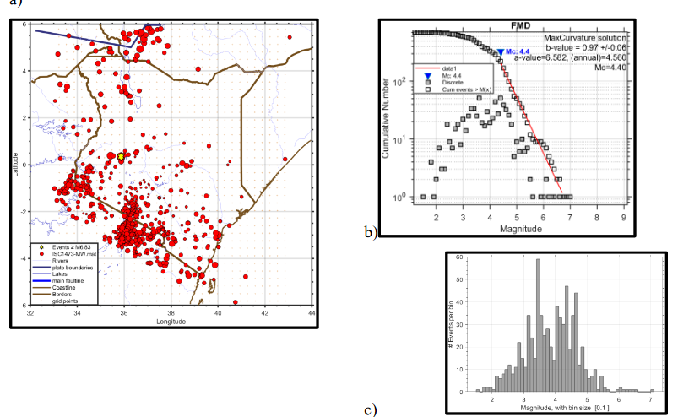
DISTRIBUTION OF THE EARTHQUAKES ()
Seismicity map of Kenya & adjoining areas. Data IRIS 972 (608 have magnitudes).
Please do not use this space, a QR code will be automatically overlayed
P1.2-872

Slide 4
Methods/data
Data
Methods (ORTHOGONAL REGRESSION EQUATION)
Least square methods (PLOT)
Ms (ISC) and Mb (IDC) data from IRIS (ISC) Reviewed event bulletin generating a total of 171 good events
CRITERIA for Good events
Reported by both catalogues
Also reported by specialized networks
Analyze using Orthogonal Least Square Method (OLS)
Use the generate equation to all ot generate a ther IDC Mb events (608) to convert to Mb (ISC)
From the IRIC data set generated 902 events but only 608 events had Mb IDC.
Please do not use this space, a QR code will be automatically overlayed
P1.2-872

Slide 5
Results
Mb=0.6655Ms ISC (+/-0.015902)+1.6897(+/-0.064459), R2=07643 (171 events)
M_{b} IDC vs M_{b} ISC y=0.517x+ 2.1787 with R² 0.6208 for 608 events with a cut-off mag. of 2.5.
Please do not use this space, a QR code will be automatically overlayed
P1.2-872

Slide 6
Conclusion
Further, it helps increase our understanding of the seismicity of the region and contributes to more representative hazard mapping.
While the R² error is relatively high the result compare published regression equations.
The slight variations may be due to the IDC body wave calculation method.
The equation bridges the data gap where no other magnitude type is provided and allows for the extension of the seismic catalogue to be extended by twenty-two (22) events not reported by any other network.
Please do not use this space, a QR code will be automatically overlayed
P1.2-872

Slide 7
References
THEORY
Kanamori, H., and Anderson, D. L., (1975). Theoretical basis of some Empirical Relations. InSeismology, Bulletin of the Seismological Society of America, 65:5, 1073109
APPLICATION
Kadirioğlu, F. T., & Kartal, R. F. (2016). The new empirical magnitude conversion relationsusing an improved earthquake catalogue for Turkey and its near vicinity (1900-2012). Turkish Journal of Earth Sciences, 25(4), 300-310.
DATA
http://www.isc.ac.uk/iscbulletin/search/catalogue/#reviewed
http://www.isc.ac.uk/cgi-bin/web-db-run?request=REVIEWED&out_format=CATCSV&searchshape=RECT&bot_lat=-10&top_lat=10&left_lon=32&right_lon=45&ctr_lat=&ctr_lon=&radius=&max_dist_units=deg&srn=&grn=&start_year=2000&start_month=1&start_day=01&start_time=00%3A00%3A00&end_year=2021&end_month=6&end_day=01&end_time=00%3A00%3A00&min_dep=0&max_dep=100&null_dep=on&min_mag=0&max_mag=7&req_mag_type=Any&req_mag_agcy=Any&include_links=on
Please do not use this space, a QR code will be automatically overlayed
P1.2-872

