Slide 1
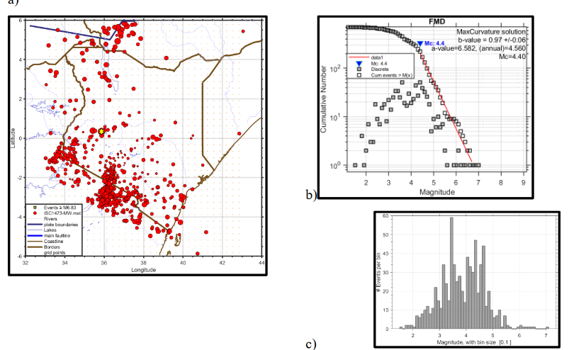
Comparison of M_{b} (IDC) to M_{b} (ISC) for the East Africa region using the empirical regression equations.
GLADYS KAREGI KIANJI
University of Nairobi
P5.3-666
INTRODUCTION
Data collected from IRIS Reviewed Bulletin for East Africa is used to generate empirical regression equations using orthogonal least square regression (OLSR).
The IRIS reviewed event bulletin collects data from several agencies including the IDC.
RESULTS AND CONCLUTIONS
OBJECTIVE
This data has been collected with the following objectives
How many events are reported by both the IDC and other agencies
How do the estimated magnitudes compare
DATA AND METHODS
Data from IRIS Reviewed Bulletin for East Africa is used to generate empirical regression equations using Orthogonal Least Square Regression (OLSR) method.
M_{b} IDC vs M_{b} ISC Mb(ISC)=0.517x+ 2.1787 with R² 0.6208 for 608 events with a cut-off mag. of 2.5.

