Slide 1
Rapid Magnitude Estimation Using Local Earthquake Waveform Data and The Application to Earthquake in Indonesia Including The 2010 Mentawai Tsunami Earthquake
Aziz WIDIARSO¹ , Akio KATSUMATA² ,Bunichiro SHIBAZAKI³
¹Meteorological, Climatological, and Geophysical Agency for Indonesia; ²University of Toyama, Japan ; ³Building Research Institute, Japan
BMKG is using M_{SUM} (Magnitude summary) for tsunami warning, while M_{SUM} tends to give underestimate and fluctuate magnitude for early phase
We collect 135 earthquakes data and calculate the empirical magnitude formula by using method proposed by Katsumata, 2013
M_{ID} (Magnitude formula for integrated displacement data) gives better estimation than M_{D} (Magnitude formula for displacement data)
Overall M_{ID} gives better estimation for common earthquakes and tsunami earthquake.
Please do not use this space, a QR code will be automatically overlayed
P1.2-350

Slide 2
MAGNITUDE FORMULA USED IN BMKG INDONESIA
BMKG is using Seiscomp3 for main seismic data acquisition
Seiscomp3 over many magnitude estimation:
Summary Magnitude (M_{SUM})
M_{SUM}
M_{Lv} (Richter, 1935)
M_{JMA} (Tsuboi, 1954)
m_{B} (Borman & Saul, 2008)
M_{W}(m_{B}) (Borman & Saul, 2008)
M_{WP} (Tsuboi, 1995)
M_{W}(M_{WP}) (Whitemore, 2002)
First Release (3 min)
Local station
(≧0⁰)
M_{SUM} is a weighted average of the individual magnitudes over by seiscomp3.
$w_{i}=a_{i}stationcount(M_{i})+b_{i}$ ,
$$M_{sum}=\frac{\sum{w_{i}M_{i}}}{\sum{w_{i}}}$$
≧5⁰
$w_{i}$ = Weighting factor
$M_{i}$ = Primary Magnitude (M_{Lv}, m_{b}, m_{B}, M_{WP}, M_{W}(m_{B}), M_{W}(M_{WP}))
$a_{i},b_{i}$ = coefficients
a_{i} : 0, M_{W}(m_{B}) 0.4, M_{W}(M_{WP}) 0.4
b_{i} : 1, M_{Lv} 2, M_{W}(m_{B}) -1, M_{W}(M_{WP}) -1
Please do not use this space, a QR code will be automatically overlayed
P1.2-350

Slide 3
TSUNAMI WARNING IN INDONESIA
Tsunami Warning in Indonesia
Indonesia relies on earthquake parameters to evaluate whether an earthquake can generate a tsunami or not.
BMKG uses M_{SUM} for tsunami warning in 3 minutes.
M_{Lv} and M_{JMA} have big influences in M_{SUM} for local station.
M_{Lv} and M_{JMA} tends to gives underestimated magnitude for major earthquake (Sitaram & Borah, 2007 ; Hirose et.al., 2011)
Rapid and reliable magnitude estimation for major earthquakes is necessary
Please do not use this space, a QR code will be automatically overlayed
P1.2-350

Slide 4
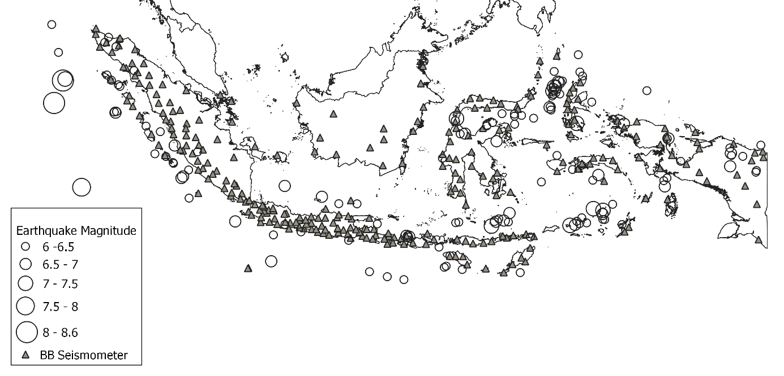
DATA & METHODS
Earthquakes M>6 (2012 – 2021)
Methods:
Instrumental response correction
Deconvolution filter in time domain
(Katsumata, 2021)
Numerical Integration and Low-cut filter
Low-cut Bessel filter (Katsumata, 1993)
Time window selection
Any wave phase (Katsumata, 2013)
Data Selection
Logaritmic Regression, Max > 2 SD
Constant Calculation
Weighted Least Square
M $={a log}_{10}A_{max}+b \log_{10}R+c$
267 Broadband Seismograph
135 Earthquake (2012-2021)
Eliminate 14 deep earthquake (>400 km)
Please do not use this space, a QR code will be automatically overlayed
P1.2-350

Slide 5
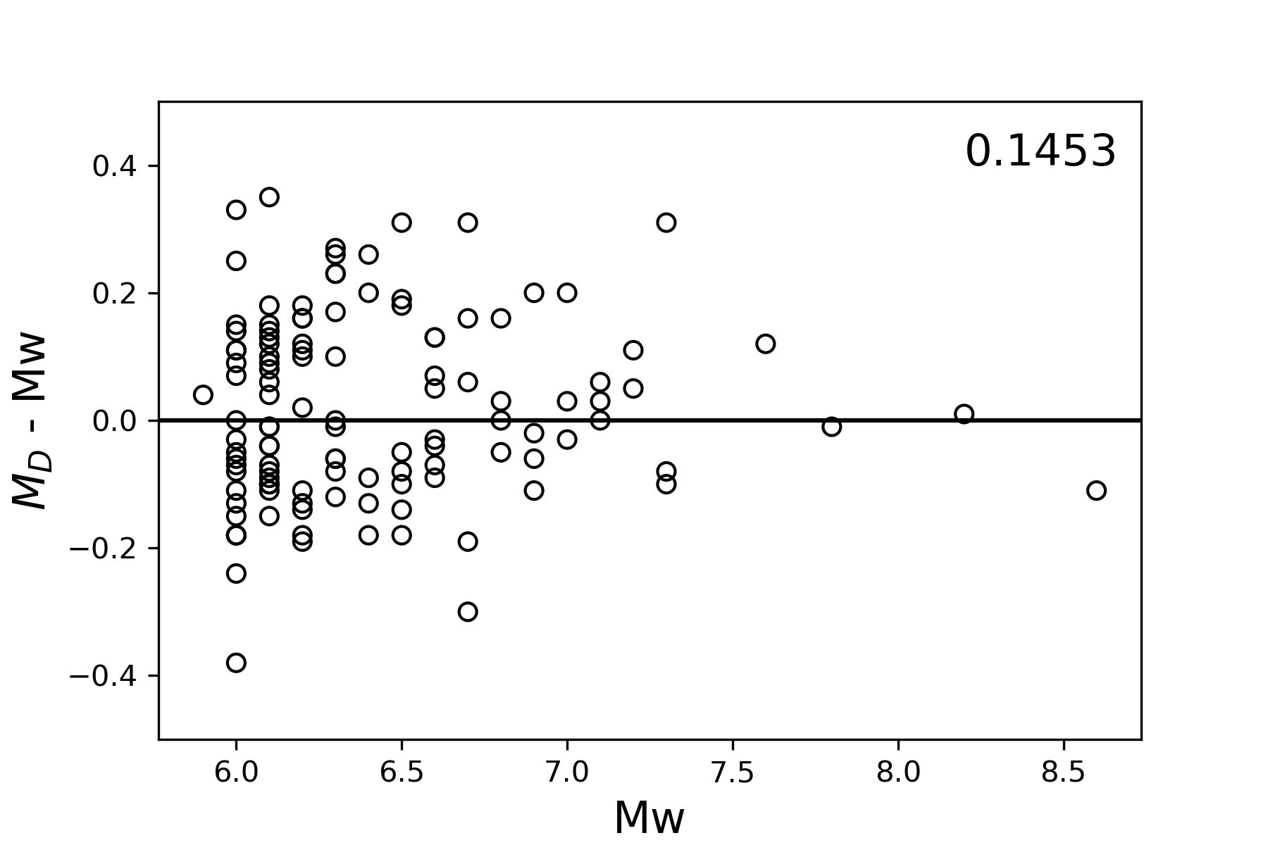
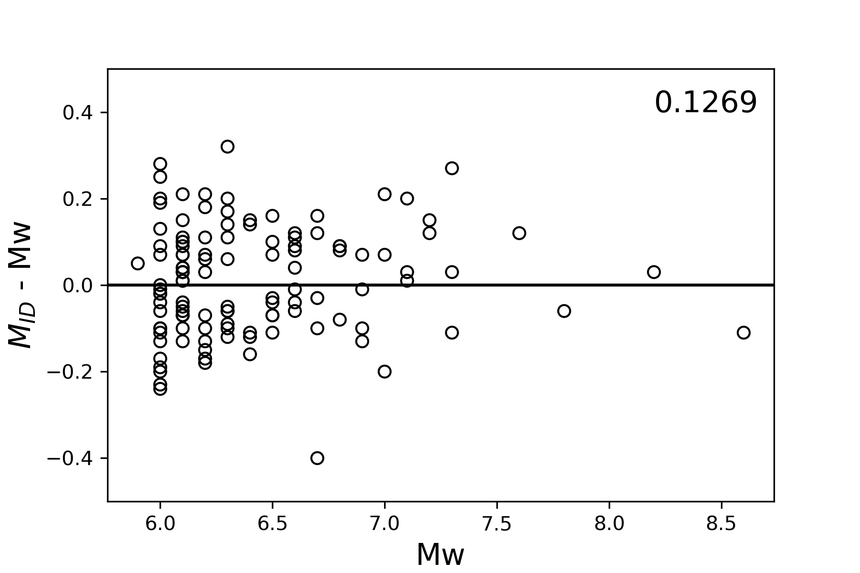
COMPARISON OF M_{D} AND M_{ID}
 | A | B | C
M_{D} | 0.898 | 1.308 | 5.835
M_{ID} | 0.789 | 1.167 | 5.359
Displacement (M_{D})
Integrated Displacement (M_{ID})
Please do not use this space, a QR code will be automatically overlayed
P1.2-350

Slide 6
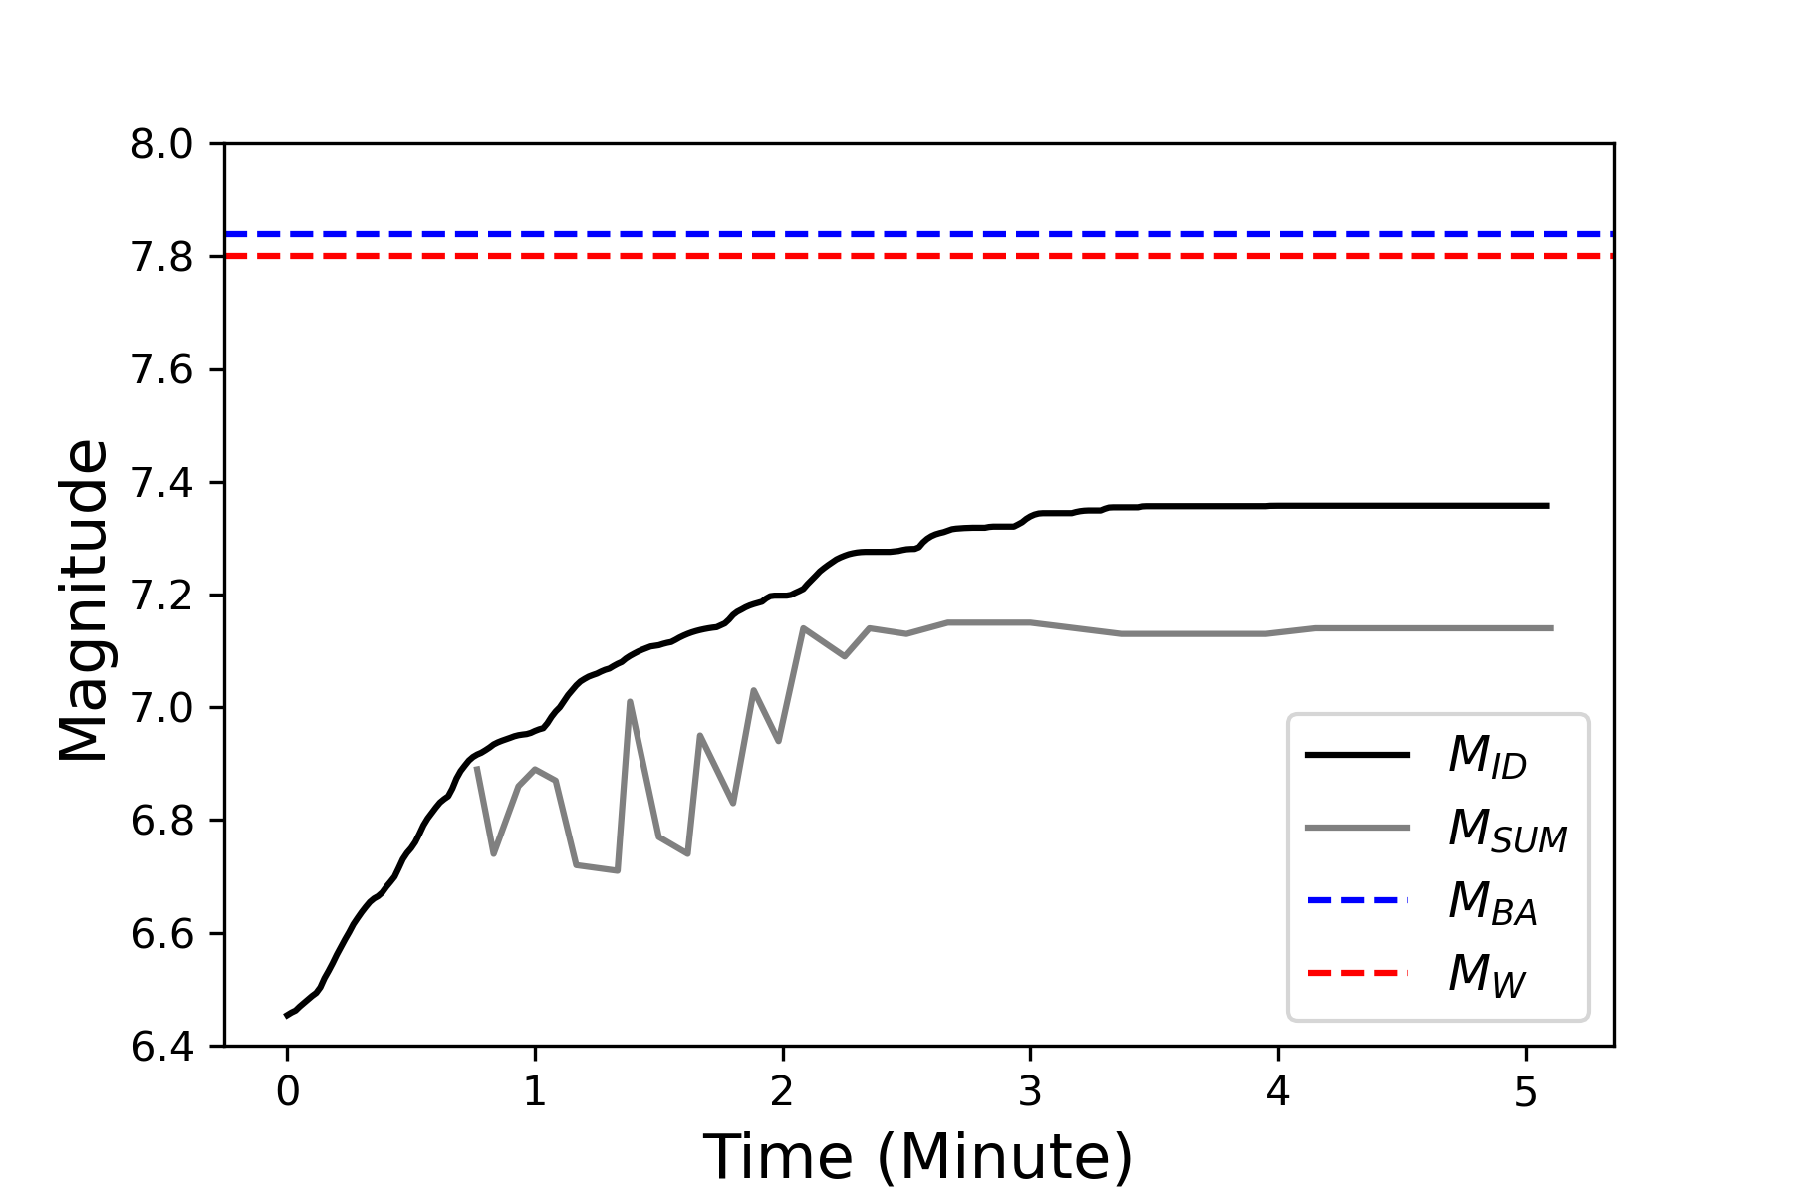
THE APPLICATION TO 2010 MENTAWAI TSUNAMI EARTHQUAKE
2010 Mentawai Tsunami EQ
M_{ID}
22 Broadband Seismograph
Convergent result after 3 minutes
Underestimated result by 0.4
Please do not use this space, a QR code will be automatically overlayed
P1.2-350

Slide 7
CONCLUSION
Integrated Displacement magnitude (M_{ID}) gives better magnitude estimation rather than Displacement magnitude (M_{D})
M_{ID} gives convergent result 3 minutes after 2010 Mentawai earthquake origin time
Please do not use this space, a QR code will be automatically overlayed
P1.2-350

