Slide 1
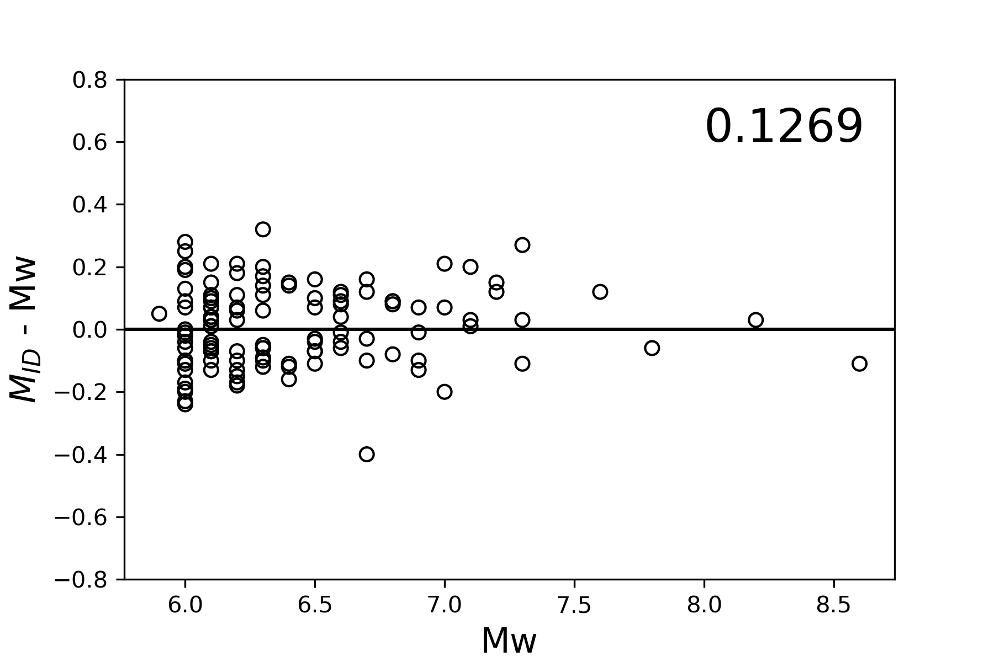
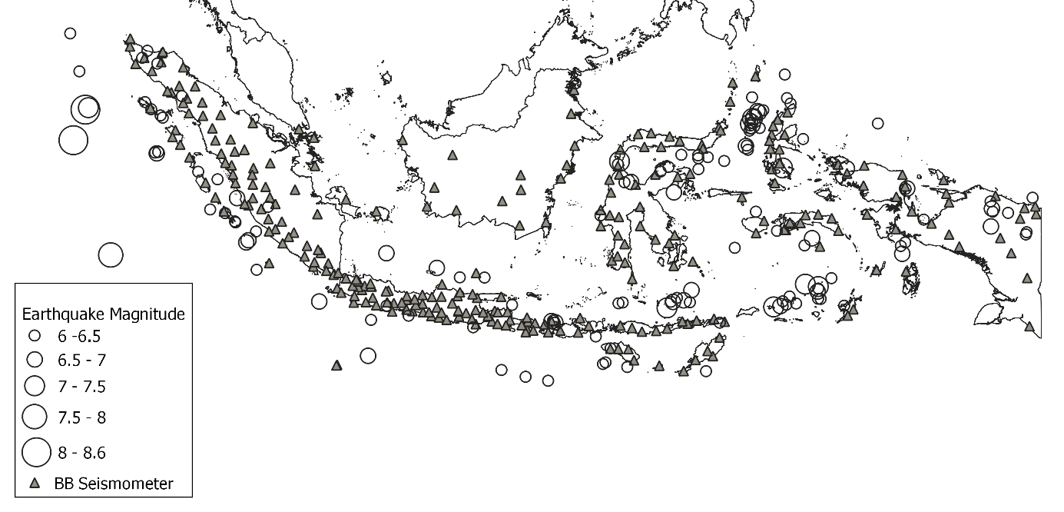
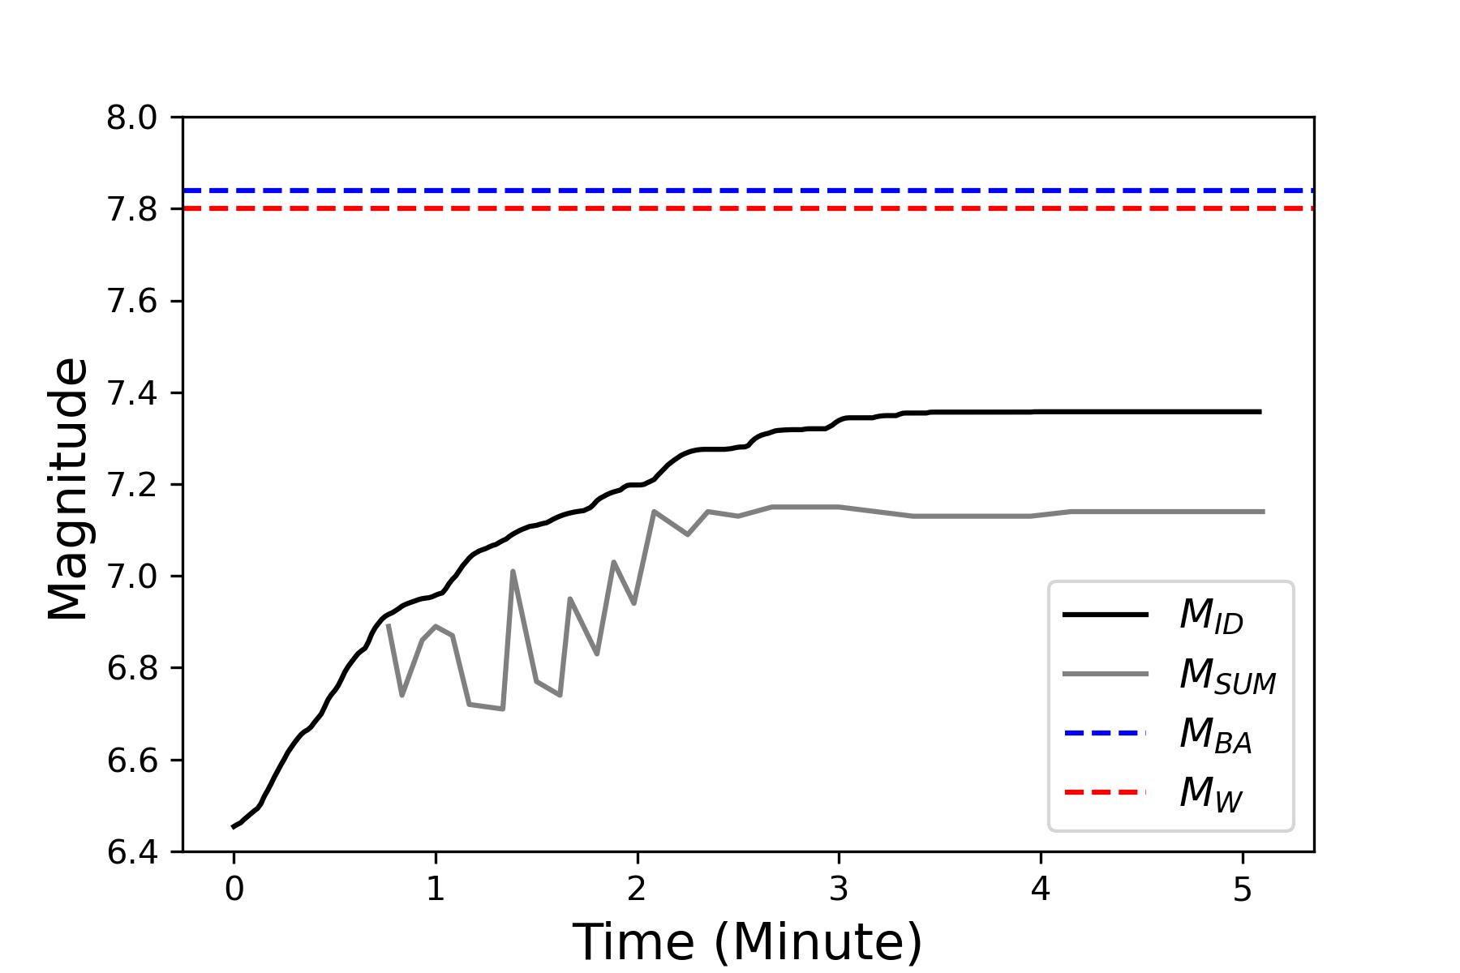
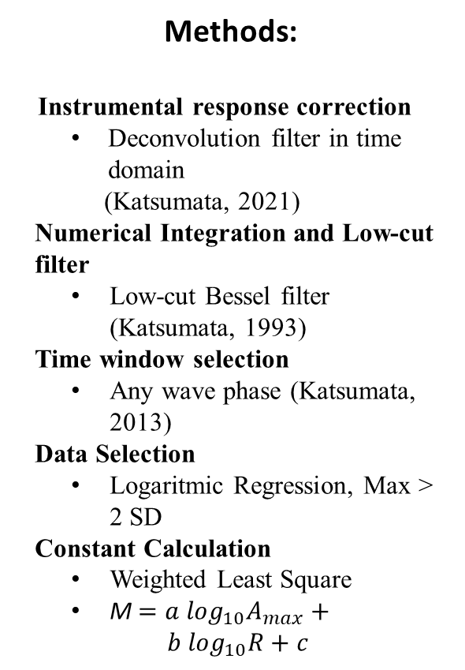
Rapid Magnitude Estimation Using Local Earthquake Waveform Data and The Application to Earthquake in Indonesia Including The 2010 Mentawai Tsunami Earthquake
Aziz WIDIARSO¹ , Akio KATSUMATA² ,Bunichiro SHIBAZAKI³
¹Meteorological, Climatological, and Geophysical Agency for Indonesia; ²University of Toyama, Japan ; ³Building Research Institute, Japan
P1.2-350
M_{ID} (Magnitude Integrated Displacement)
Earthquakes M>6 2012-2021 period
Methods:
Instrumental response correction
Deconvolution filter in time domain
(Katsumata, 2021)
Numerical Integration and Low-cut filter
Low-cut Bessel filter (Katsumata, 1993)
Time window selection
Any wave phase (Katsumata, 2013)
Data Selection
Logaritmic Regression, Max > 2 SD
Constant Calculation
Weighted Least Square
M $={a log}_{10}A_{max}+ b \log_{10}R+c$
2010 Mentawai Tsunami Earthquake
267 Broadband Seismograph
135 Earthquake (2012-2021)
Eliminate 14 deep earthquake (>400 km)

