Slide 1
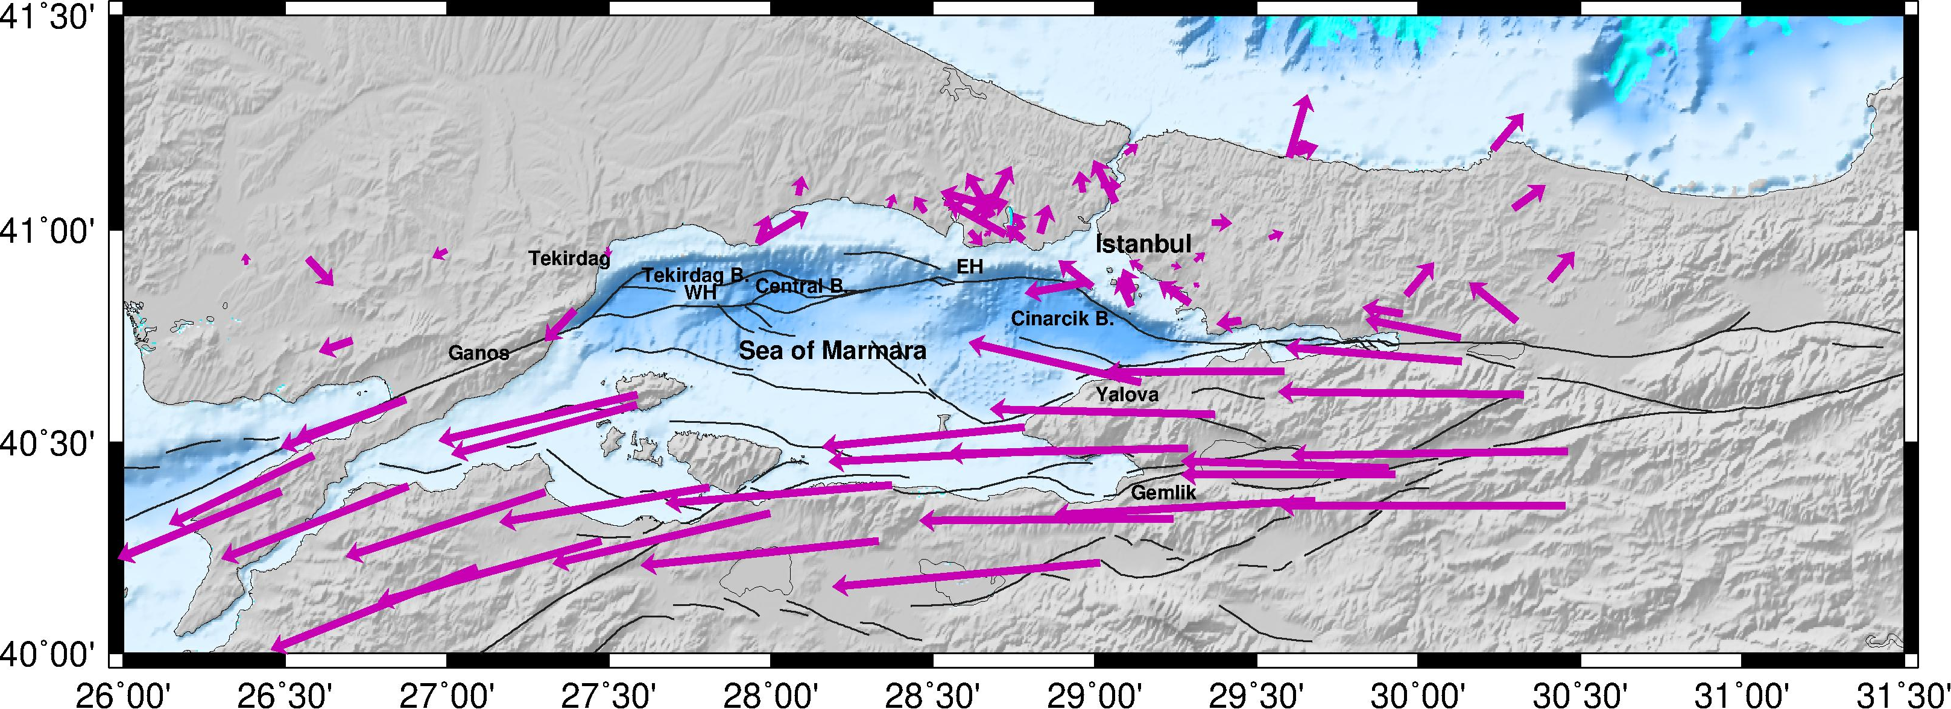
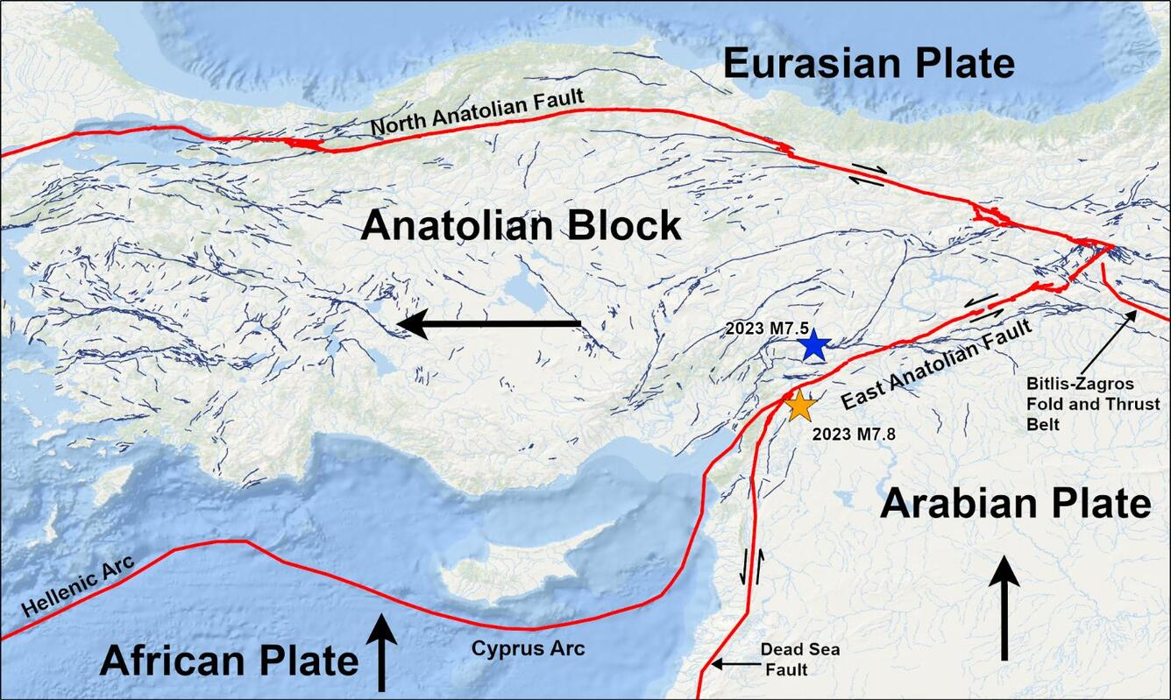
Inter-Seismic Strain Accumulation and Estimation of Stress Distribution
on the Main Marmara Fault
Yasemin KORKUSUZ ÖZTÜRK, Ali Özgün KONCA, Nurcan MERAL ÖZEL
Boğaziçi University, Kandilli Observatory and Earthquake Research Institute, Geophysics, Türkiye
P1.2-206
The main objective is
to derive heterogeneous stress loads
with high accuracy through manual calculations and quasi-static simulations.
Eventually we aim to simulate realistic dynamic earthquake rupture scenarios on the non-planar and heterogeneously stress loaded Main Marmara Fault using these estimated initial stress distributions.
One of the major issues in dynamic rupture simulations is to constrain the initial stress distribution along the fault zones.
In this study we obtain realistic heterogeneous initial stresses for the Sea of Marmara where a critical seismic gap of ~150 km exists.
We use two different methodologies for the same data sets in order to acquire initial stress distributions on the faults of the Main Marmara Fault.
Method-1 : Manual calculation of stress
Method-2 : Stress estimation from the effect of sliding blocks through quasi-static simulations
If you want to learn more about this, come see my e-poster during session 1.2. on 20th of June at 11:00 or access it online on the SnT2023 Conference platform!

