Slide 1
Seismicity and tectonics of the Caucasus region revisited
István Bondár¹, Tea Godoladze², Eric Cowgill³, Gurban Yetirmishli⁴, Stephen Myers⁵, Tuna Onur⁶, Irakli Gunia², Albert Buzaladze², Rengin Gök⁵, Andrea Chiang⁵
¹Institute for Geological and Geochemical Research, Research Centre for Astronomy and Earth Sciences (ELKH), Budapest, Hungary
²Ilia State University, Tbilisi, Georgia Institute of Seismology
³Earth & Planetary Sciences, University of California, Davis, USA
⁴Republic Seismic Survey Center of ANAS, Baku, Azerbaijan
⁵Lawrence Livermore National Laboratory, Livermore, CA, USA
⁶Onur Seemann Consulting, Inc., Victoria, British Columbia, Canada
Place your QR Code here after removing this text box!
P1.2-188

Slide 2
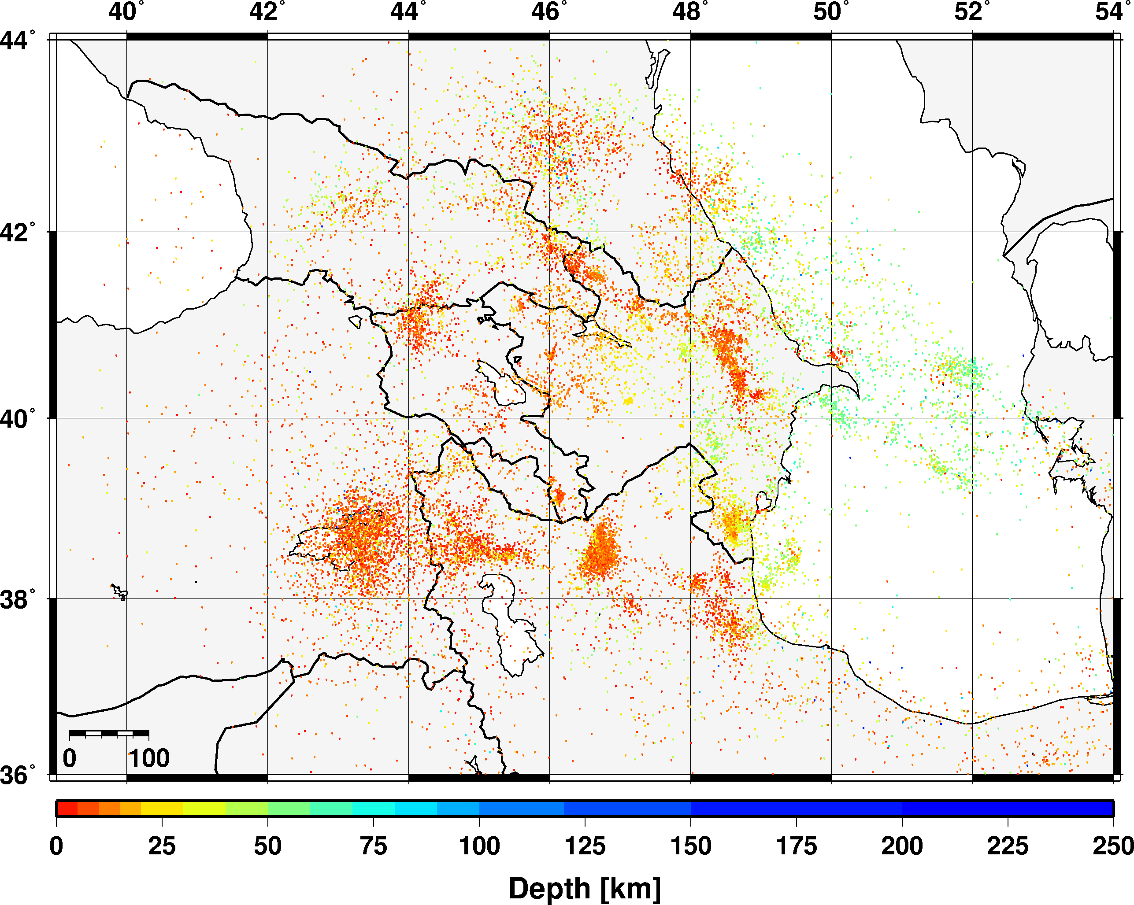
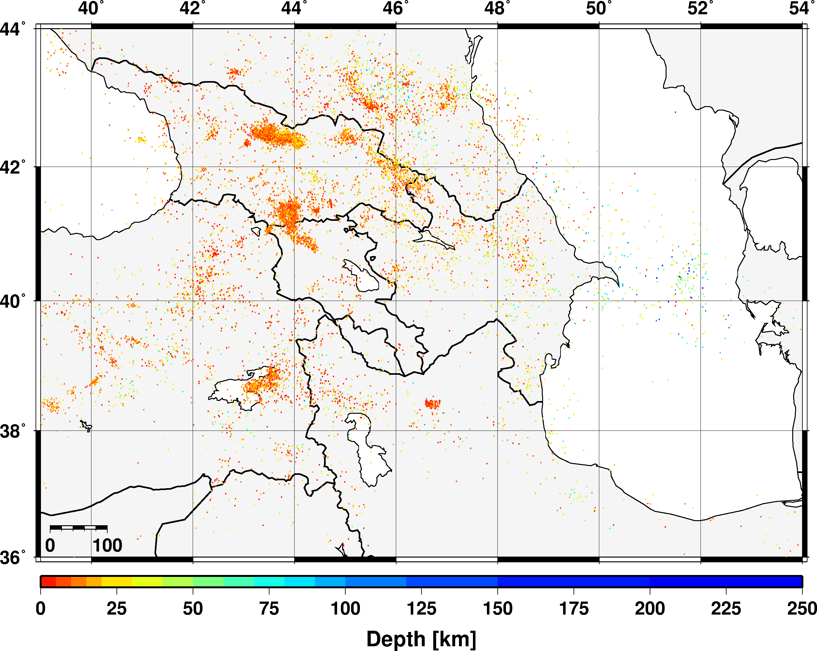
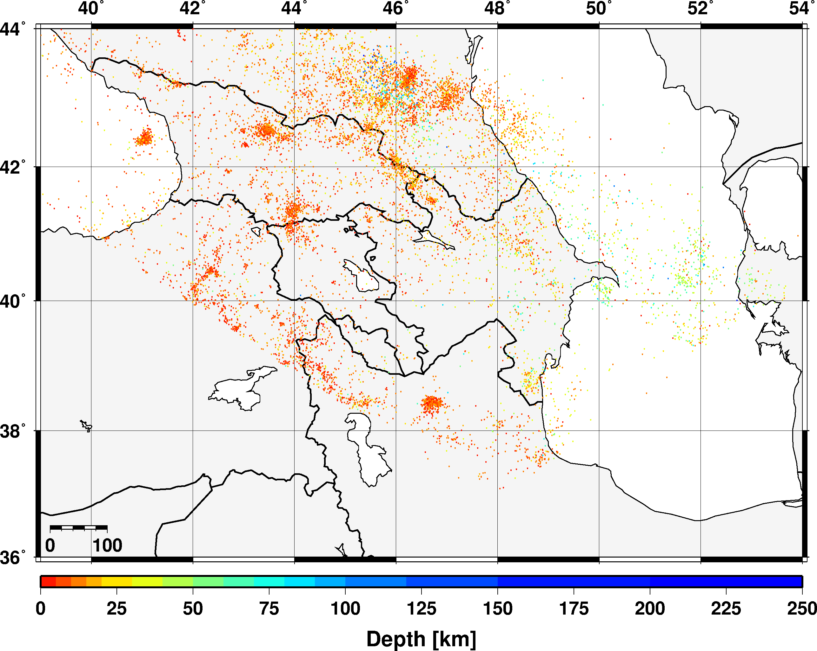
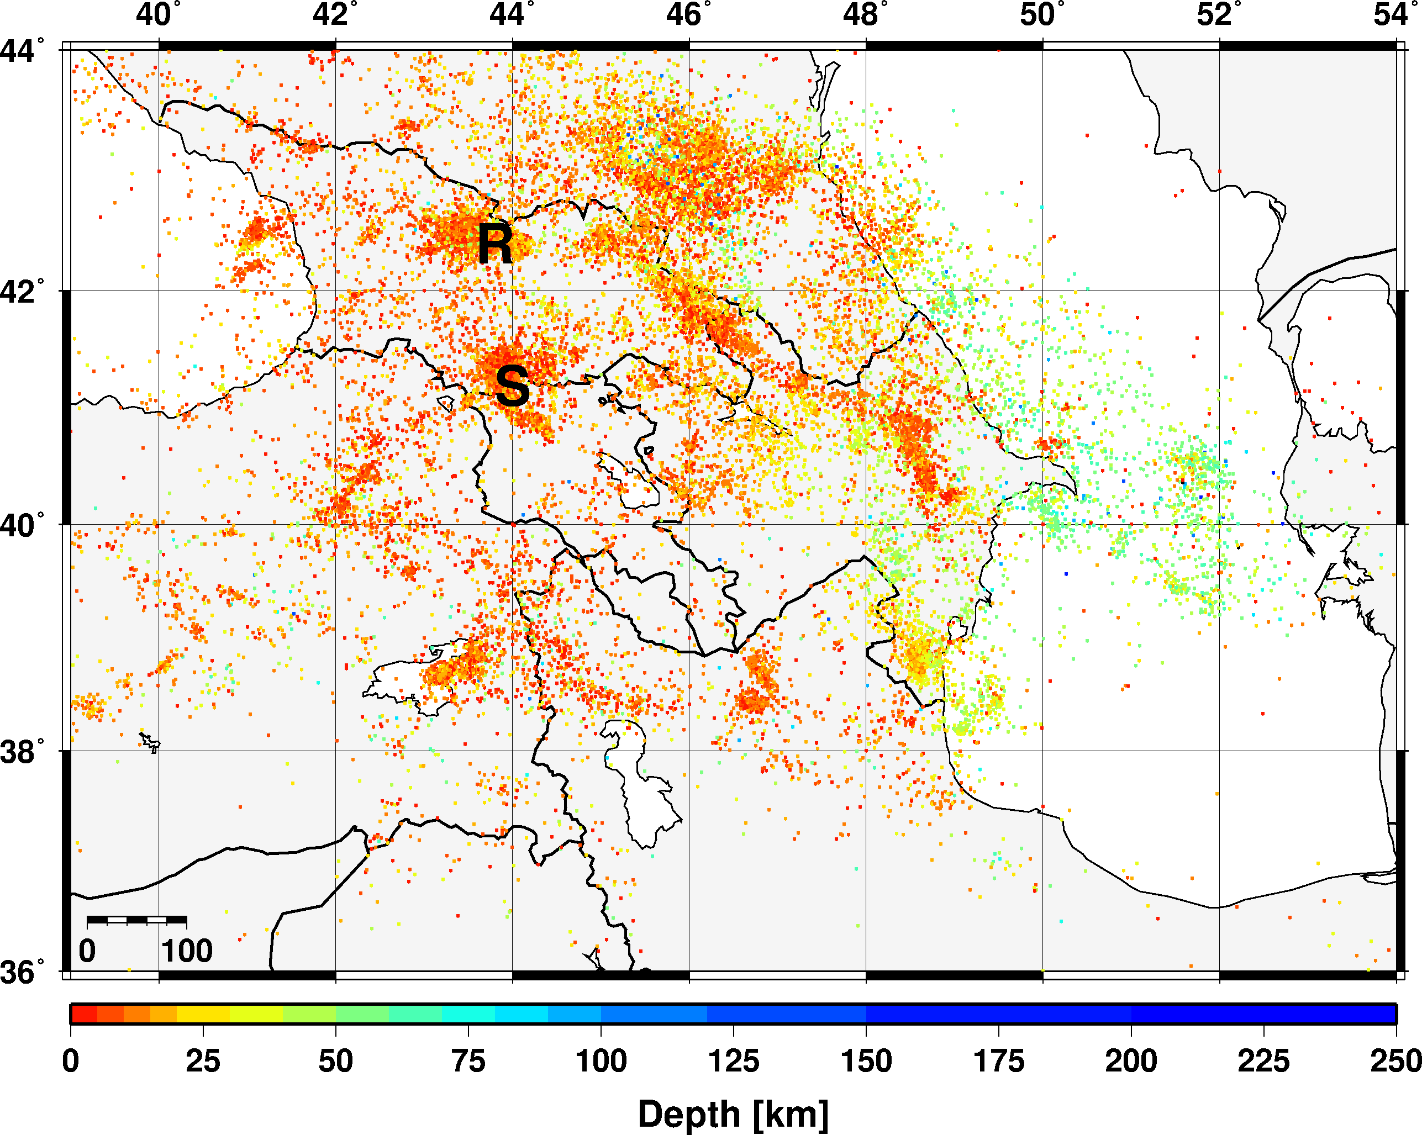
Introduction
Despite its role in Arabia-Eurasia convergence between the Black and Caspian Seas, the Caucasus region lacks a comprehensive earthquake catalog. To address the issue, the Lawrence Livermore National Laboratory and the Institute of Earth Sciences (IES) at Ilia State University generated a new, comprehensive seismic catalog for the Caucasus region by combining data in the IES bulletin with bulletins of the Republic Seismic Survey Center of Azerbaijan, monitoring centers in Turkey and Armenia, and the ISC covering the period 1951 to 2019.
We present the bulletin that contains some 20,000 relocated events. We first relocated each event using the single-event location algorithm iLoc and RSTT predictions and identified GT events. Then we relocated the entire seismicity of the Caucasus region with the multiple-event location algorithm Bayesloc, using the iLoc results as initial locations and the GT events as constraints.
We show that each relocation step leads to significant improvements, as indicated by tightening of event clusters. The improved view of the seismicity reveals a narrow band of crustal events along the southern flank of the Greater Caucasus we interpret as a megathrust and confirms both a region of deep seismicity beneath the northeastern Caucasus and a possible area of slab detachment in the central part of the range.
RSCC
IES
ISC
Place your QR Code here after removing this text box!
P1.2-188
Comprehensive Caucasus bulletin

Slide 3
Objectives
Compile a comprehensive seismic bulletin for the Caucasus region in cooperation with the NDCs in Georgia, Azerbaijan and Armenia by digitizing and adding data not yet reported to the ISC.
Relocate the events with iLoc using the three-dimensional RSTT velocity model travel time predictions.
Identify new ground truth events.
Using the iLoc results as initial locations and the ground truth events identified in the iLoc results as fix points, we apply Bayesloc, a multiple event location algorithm, to simultaneously relocate the entire seismicity of the Caucasus region.
The improved view of seismicity allows us to better understand the seismicity and refine the tectonic interpretation of the Caucasus region.
Place your QR Code here after removing this text box!
P1.2-188

Slide 4
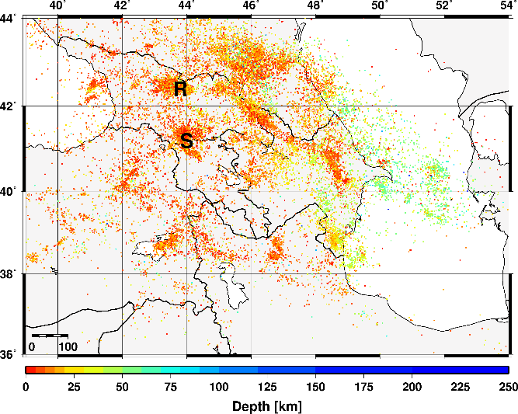
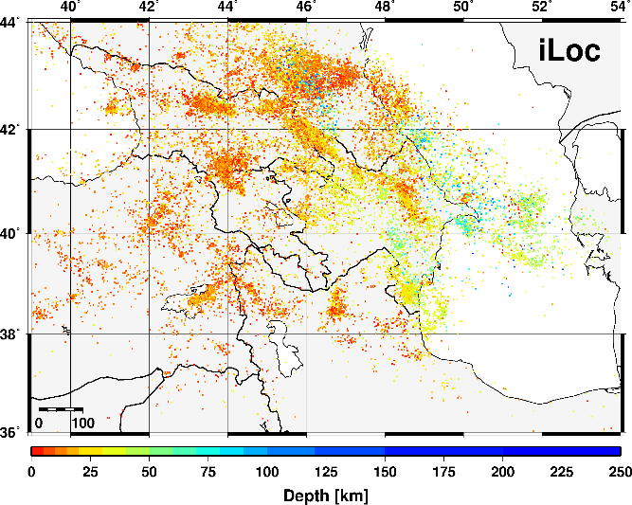
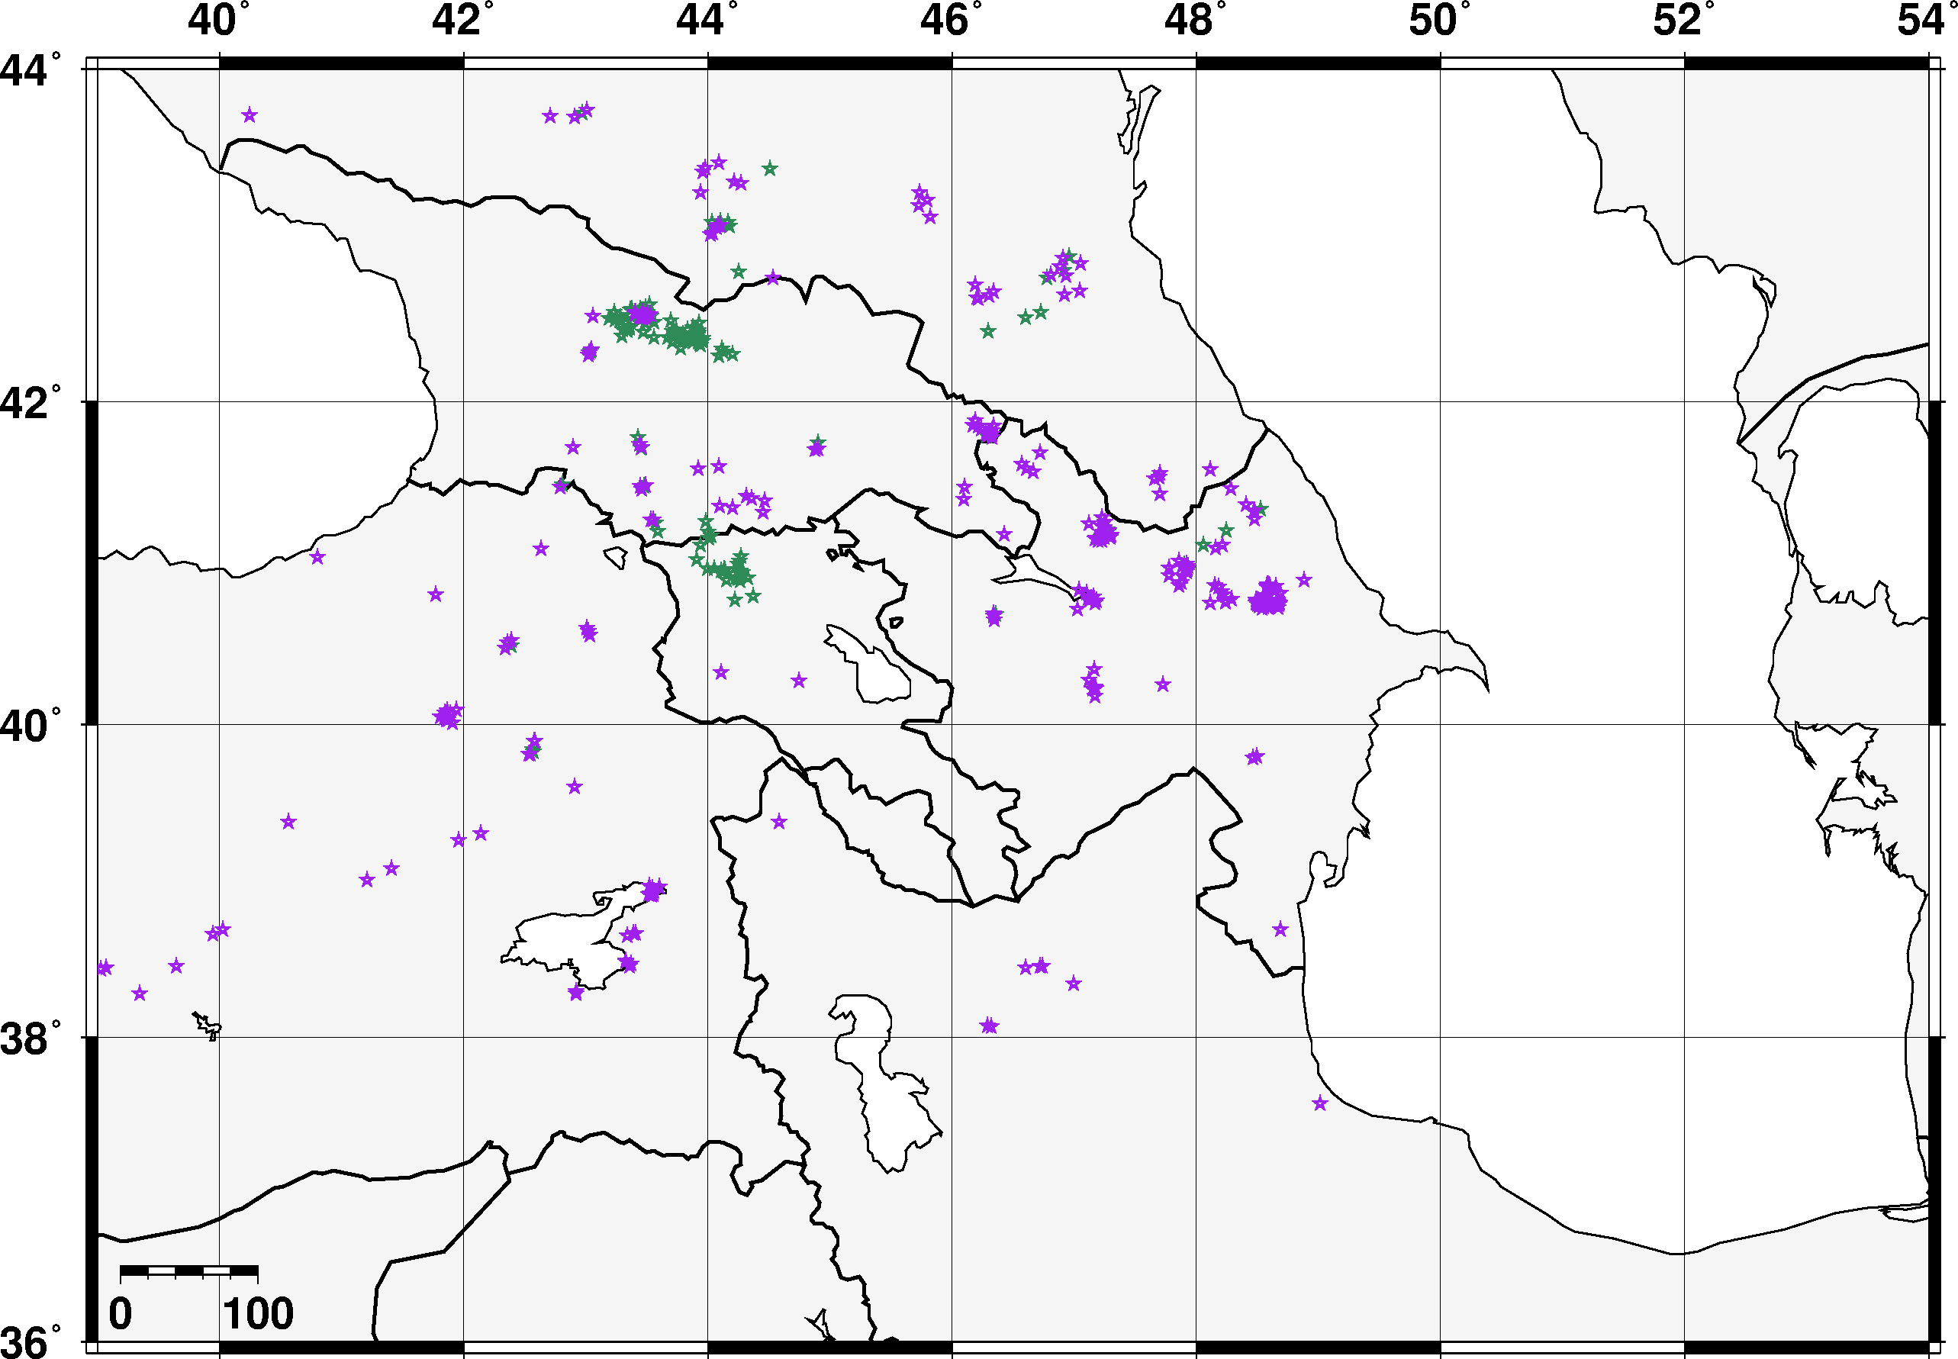
Methods/data
iLoc
The reviewed iLoc locations tighten the seismicity. RSTT travel time predictions outperform 1D model predictions, result in better depth estimates and clustering of events.
The iLoc locations allowed us to increase the number of ground truth events from 136 to 410.
Place your QR Code here after removing this text box!
P1.2-188
Existing (green) and new (magenta) GT events

Slide 5
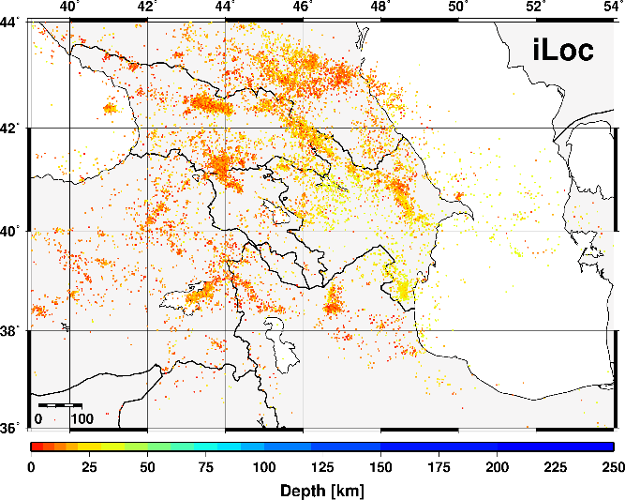
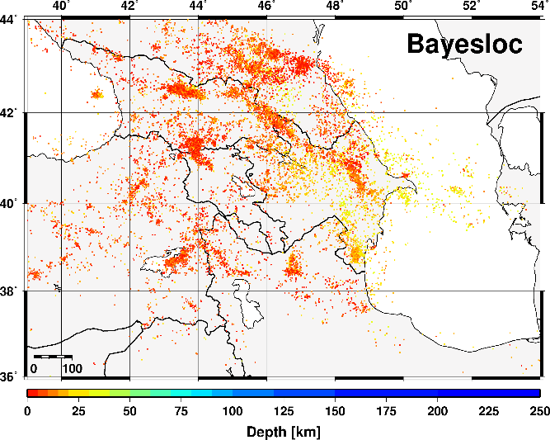
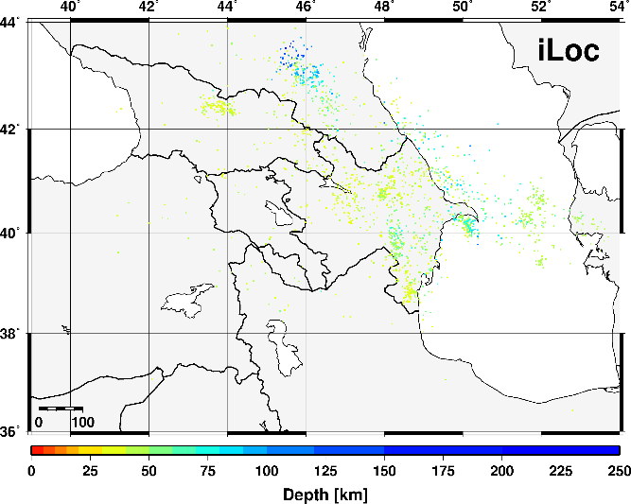
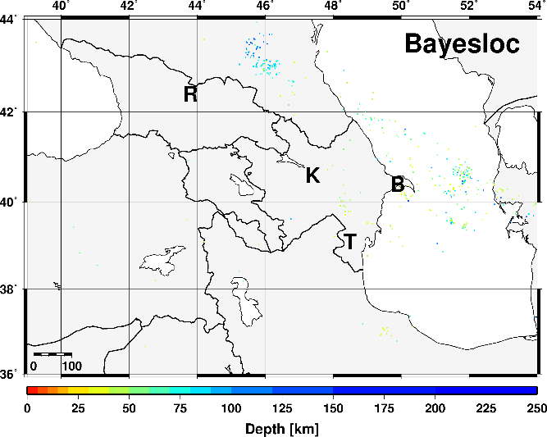
Results
Shallow (< 35 km) seismicity
Bayesloc tightens the seismicity and makes events shallower (e.g Racha, Kura Basin and Baku) while retaining the deep seismicity in the Northern Caucasus and the Caspian Sea.
Because we used the GT events as tight priors, Bayesloc produces not just relative but absolute locations.
Bayesloc
Place your QR Code here after removing this text box!
P1.2-188
Deep (> 35 km) seismicity

Slide 6
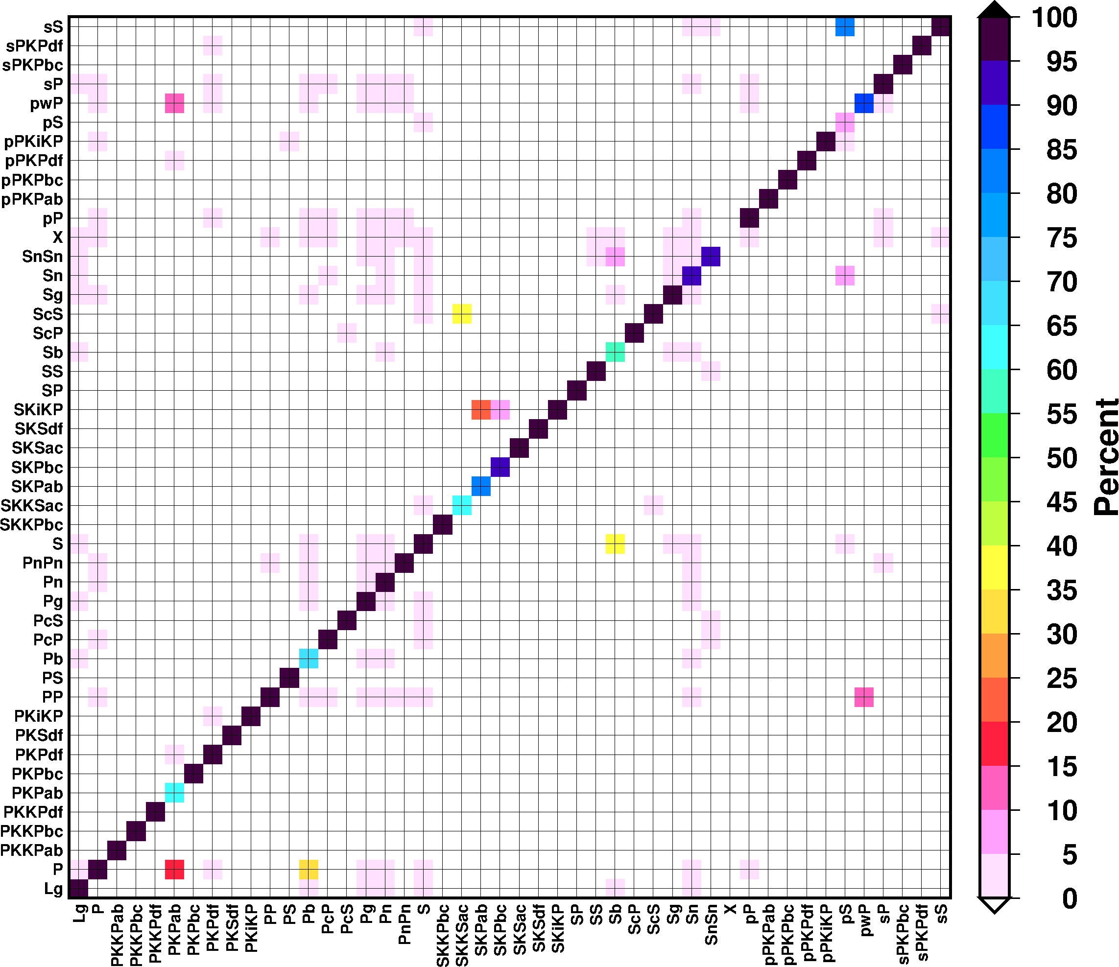
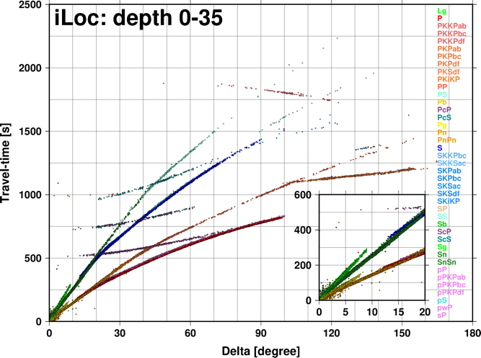
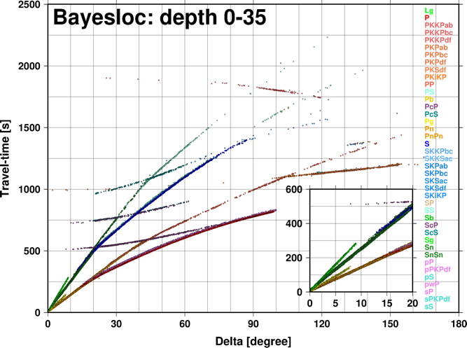
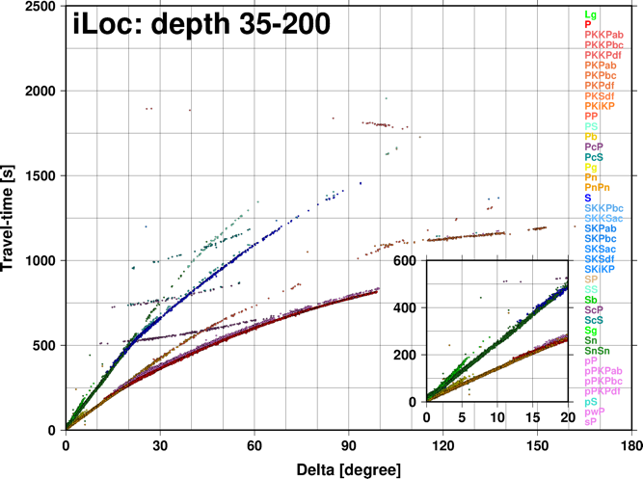
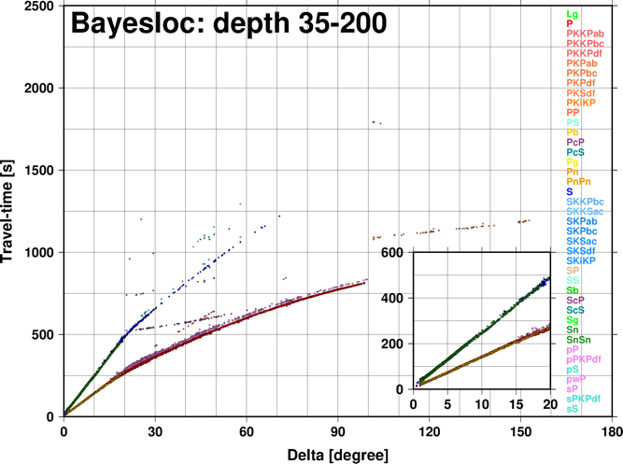
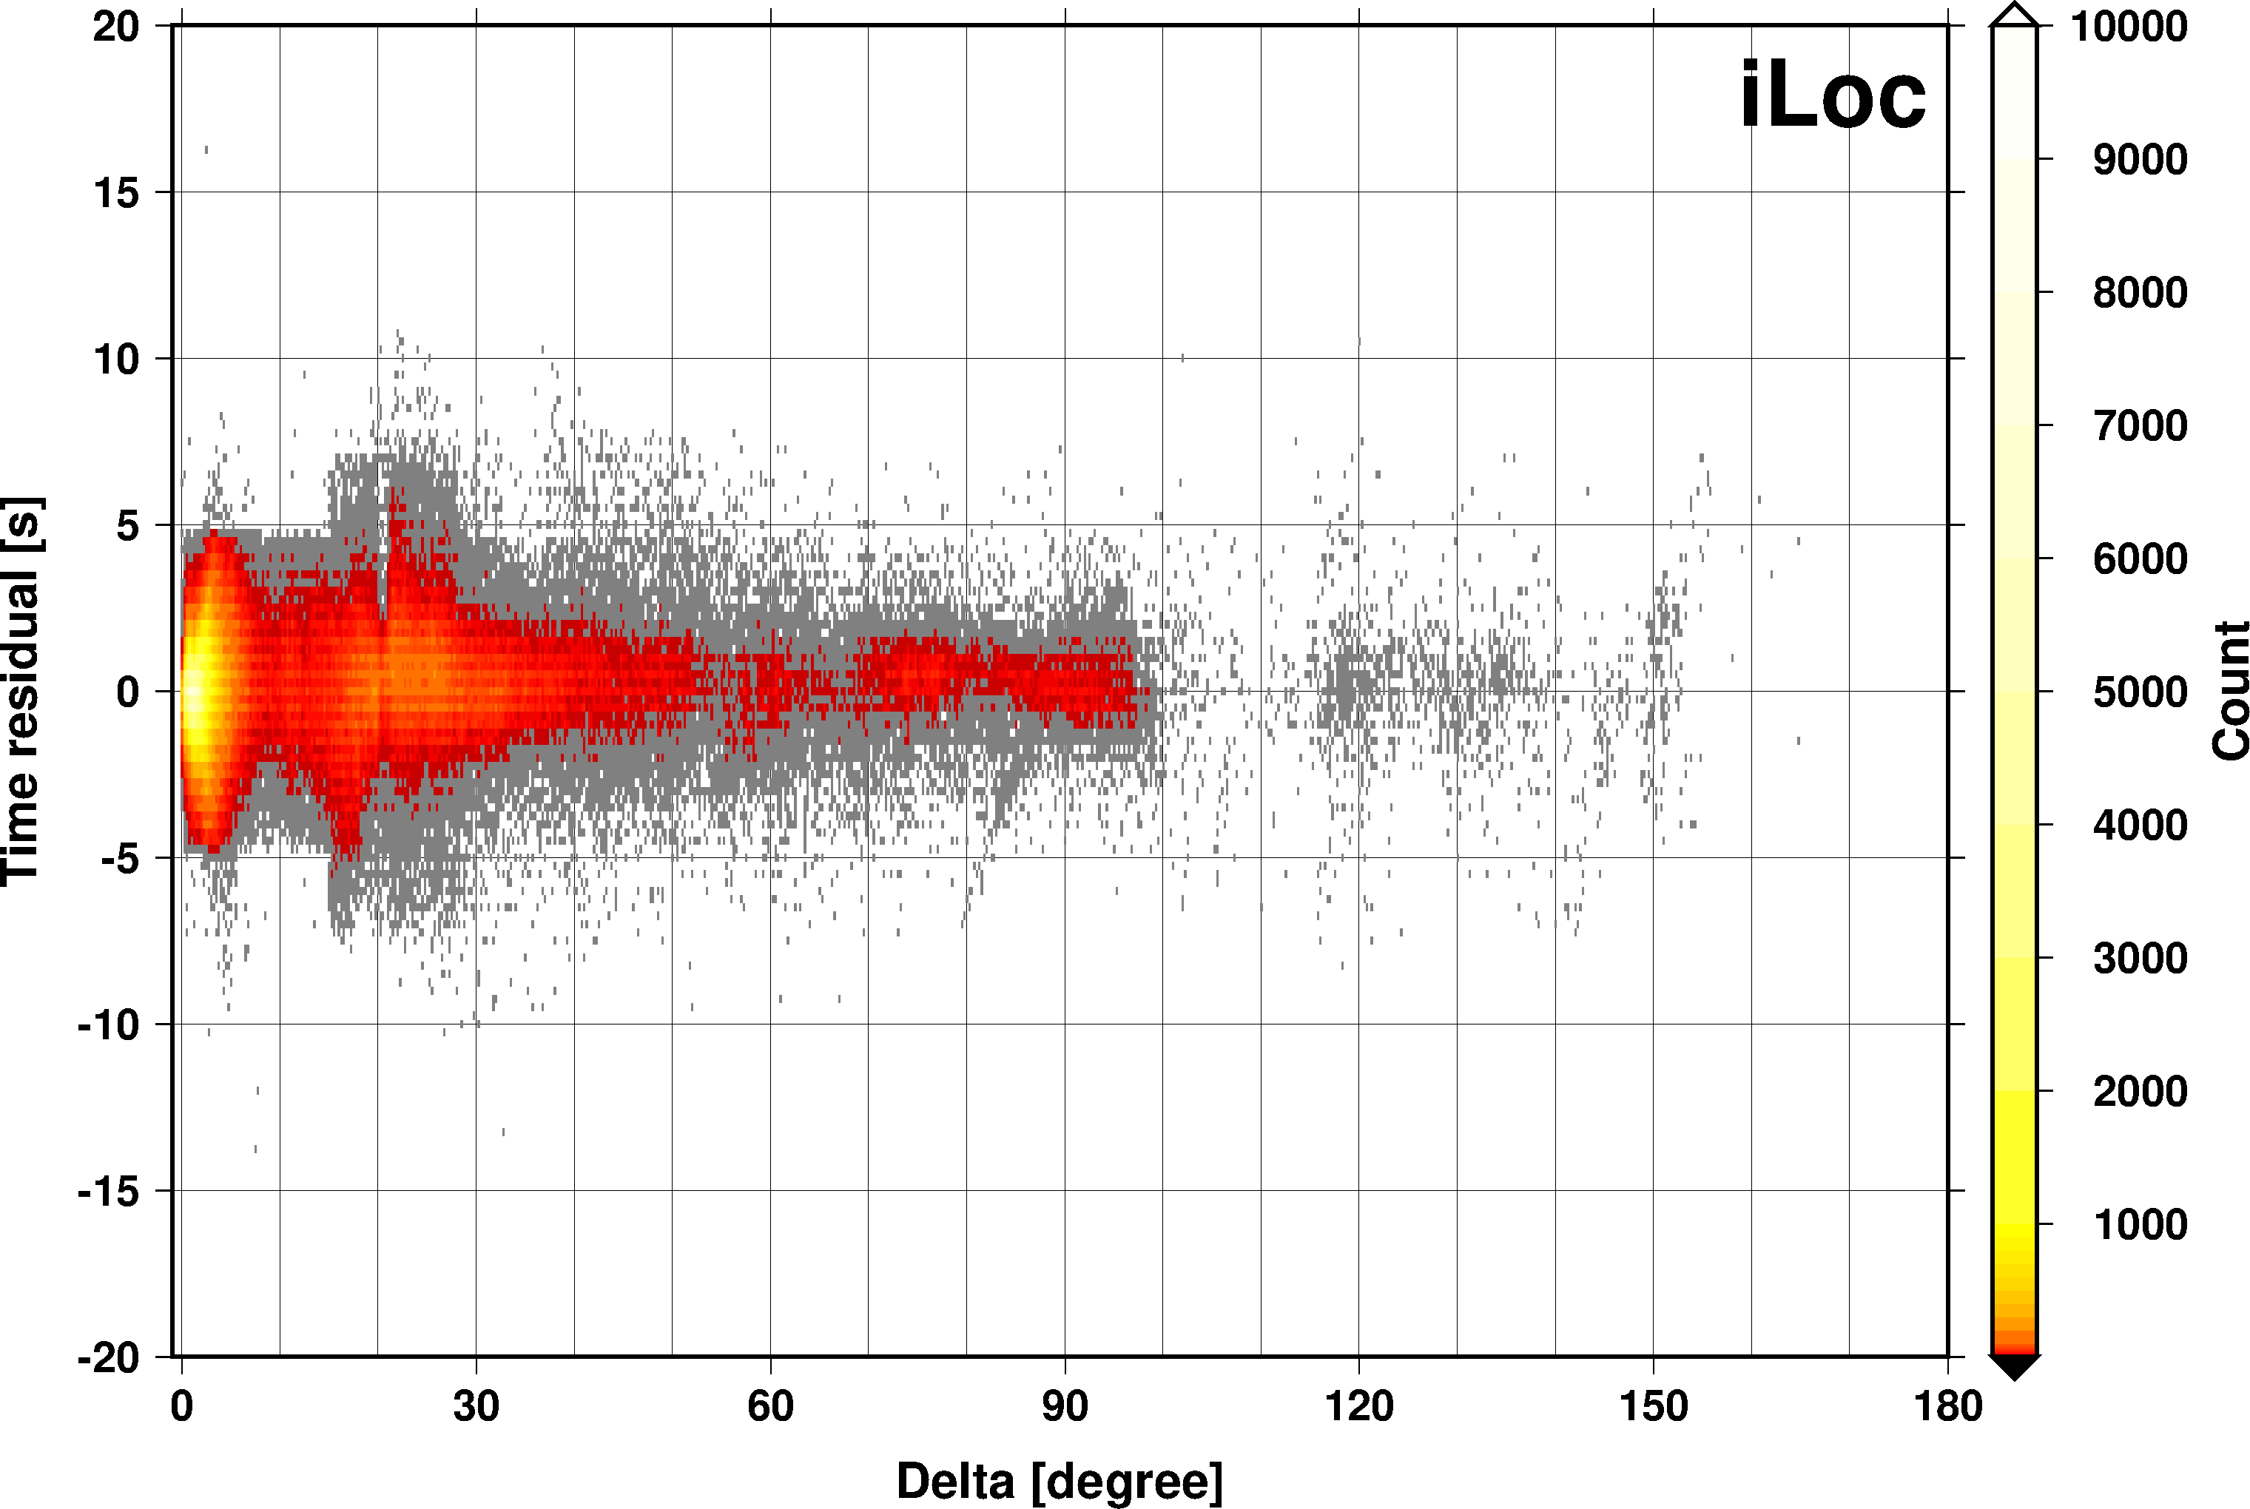
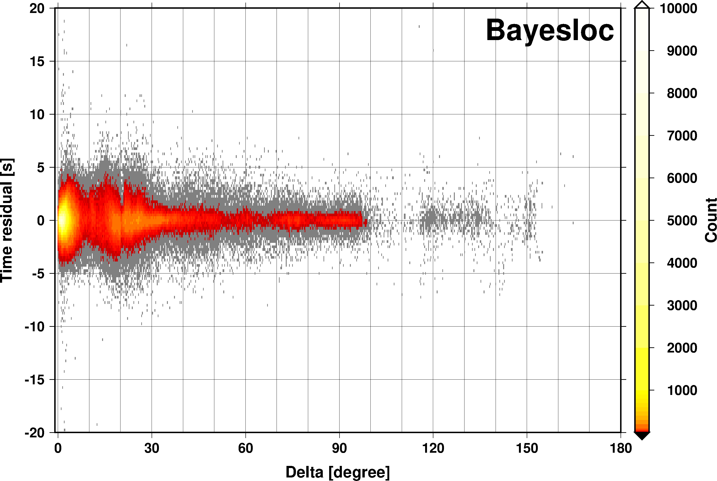
Results
Bayesloc
iLoc
Place your QR Code here after removing this text box!
Bayesloc finds better phase identifications for crustal (Pg, Lg) and mantle (Pn, Sn) phases, thus cleaning up the travel time curves at local and regional distances. Bayesloc also provides smaller time residuals.
P1.2-188

Slide 7
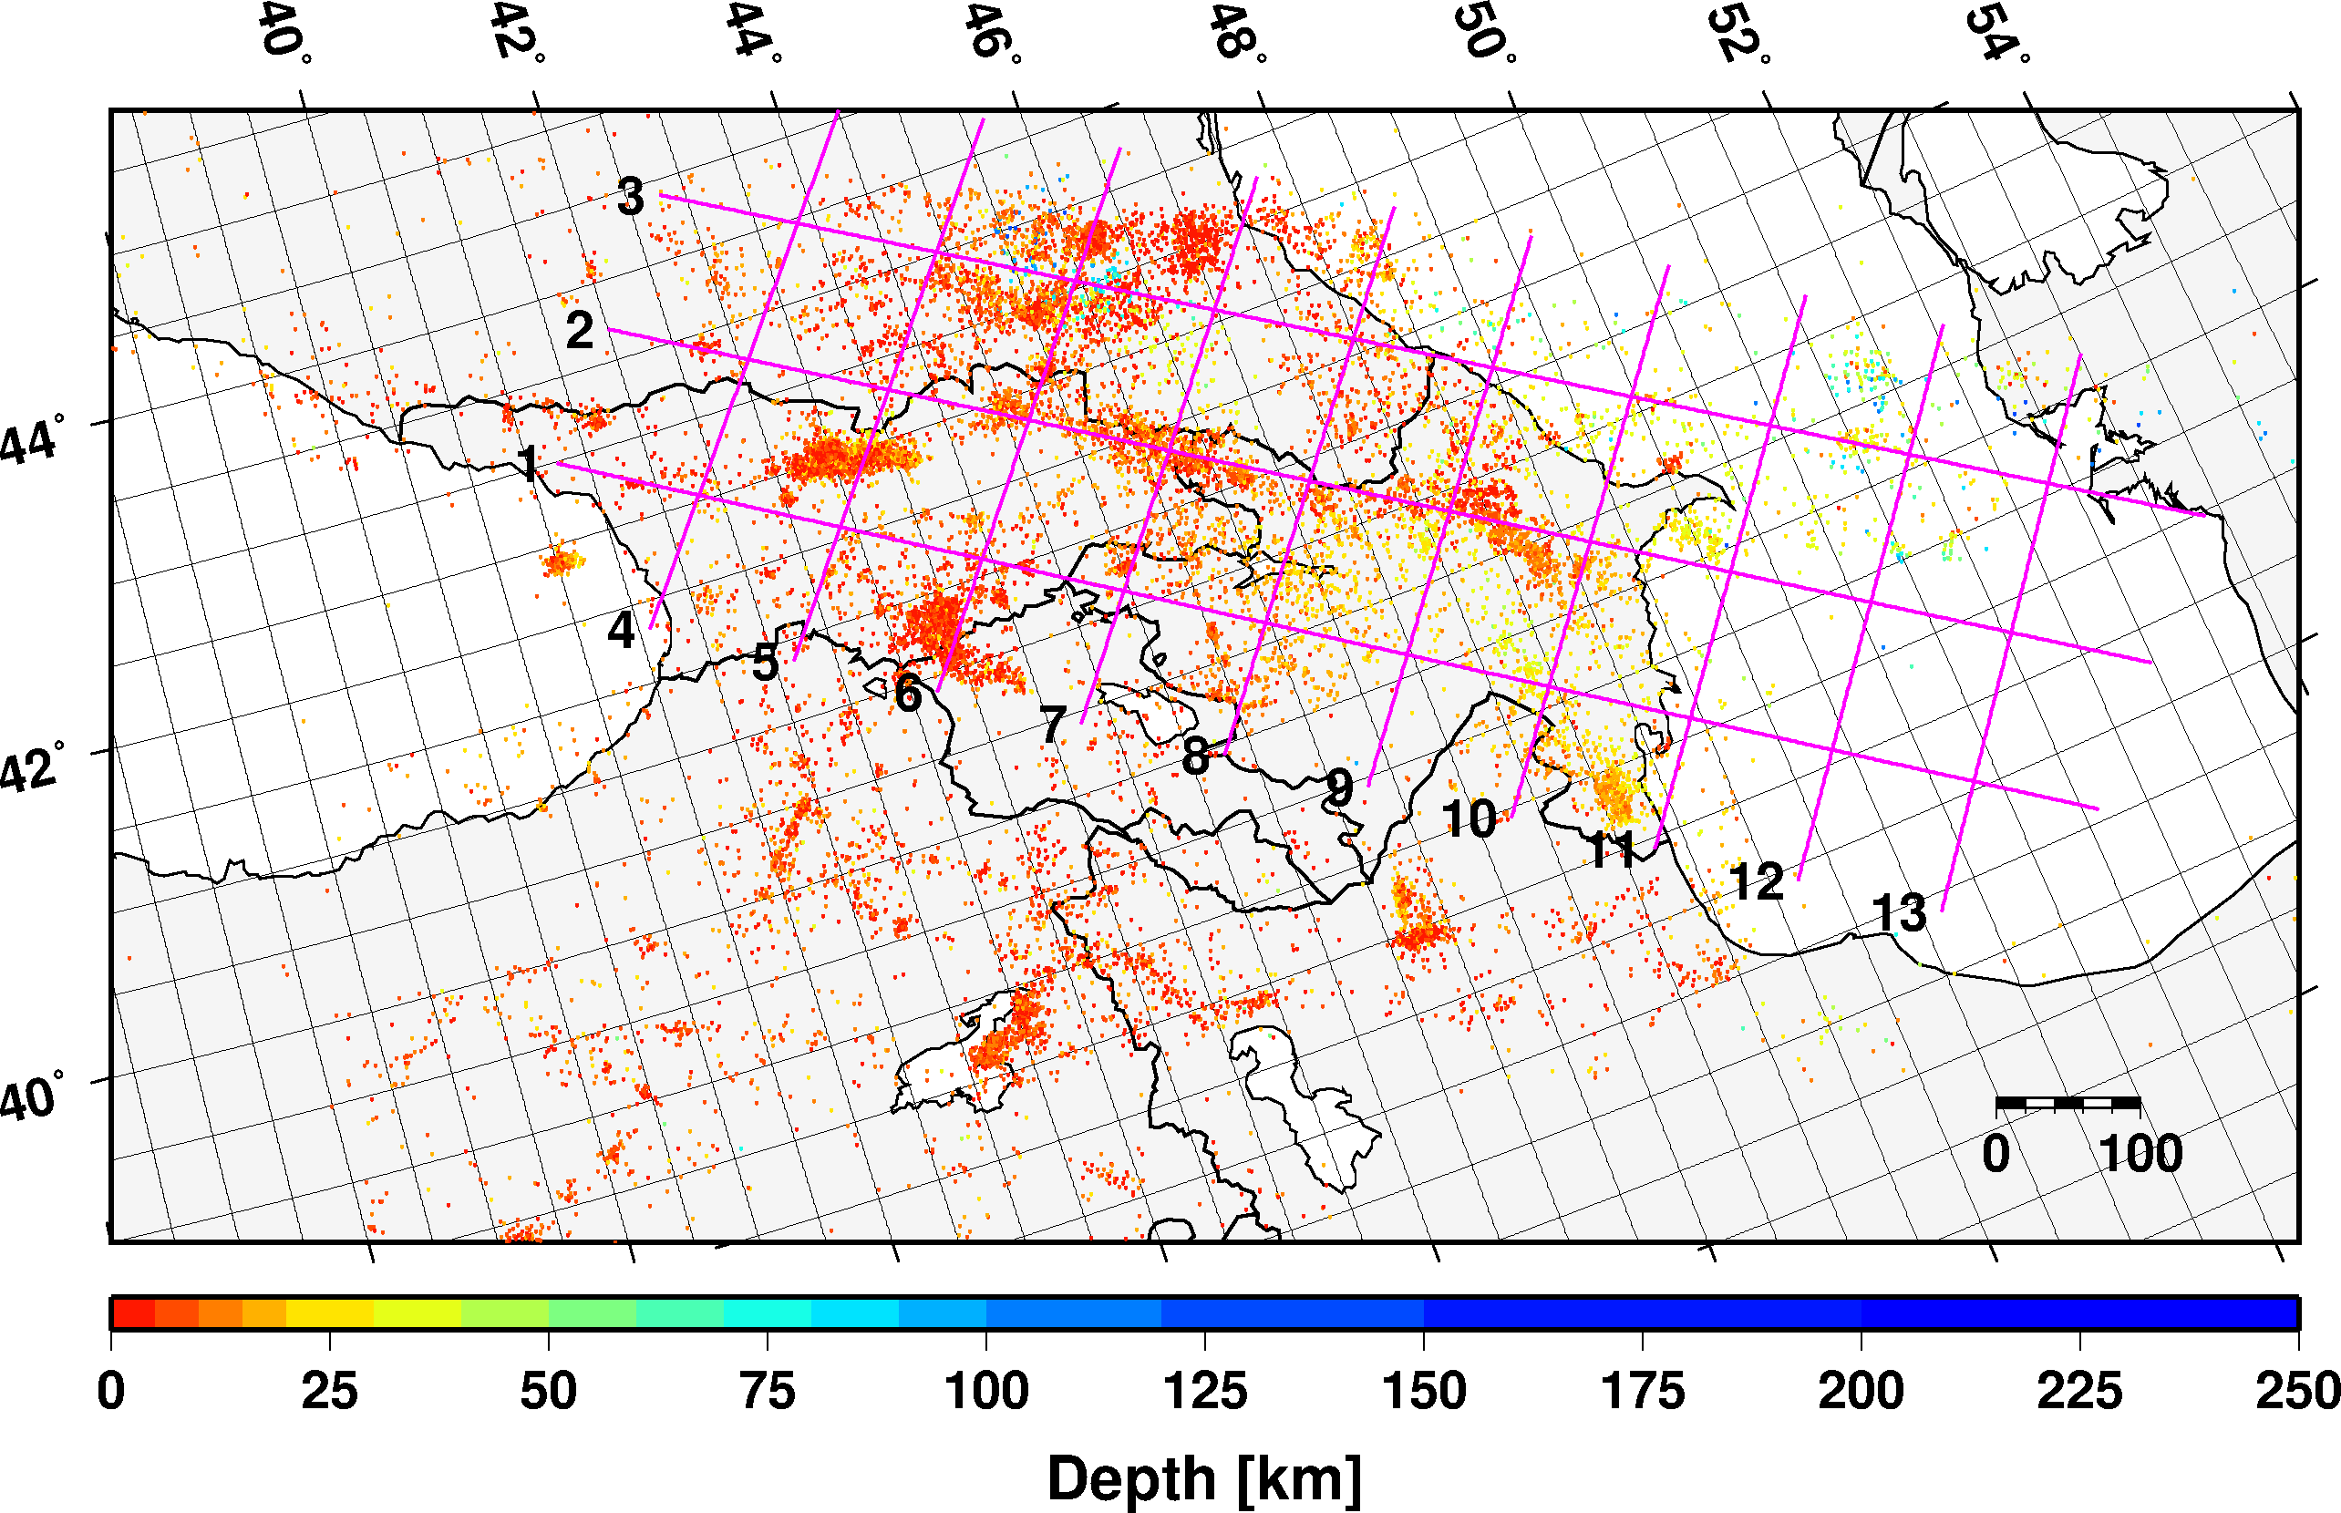
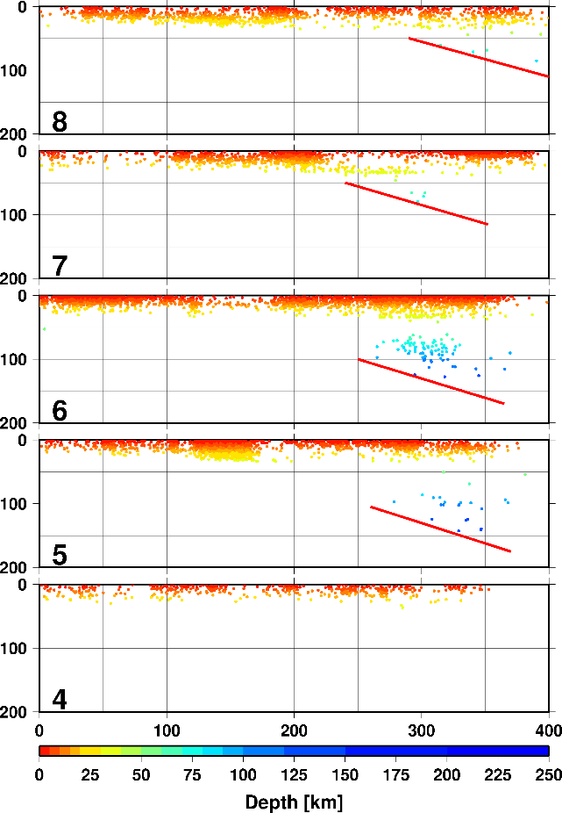
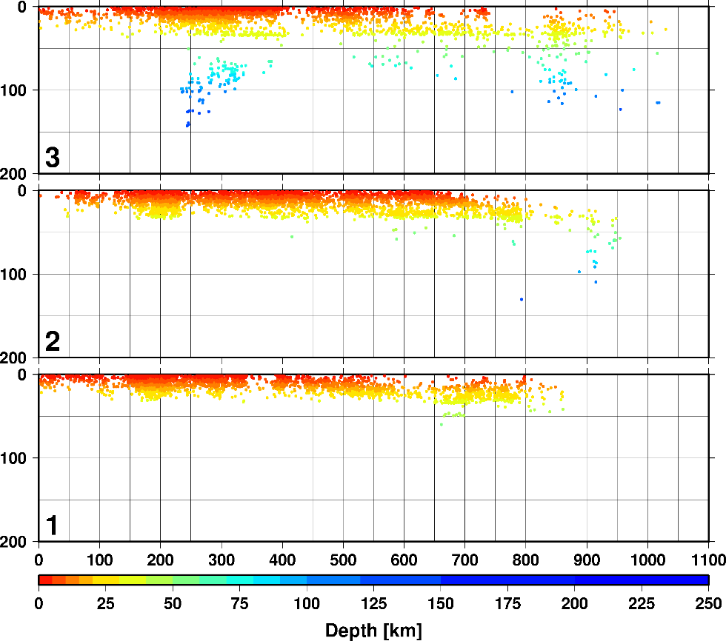
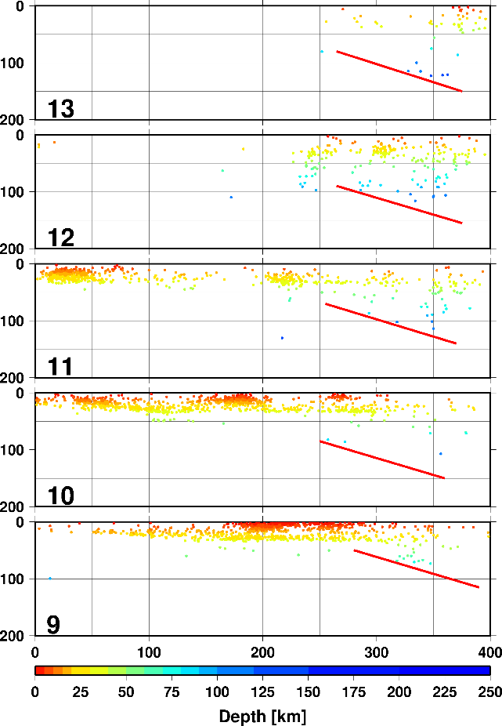
Conclusions
The successive relocations with iLoc and Bayesloc clarified the location and geometry of major active structures accommodating ongoing convergence between the Arabian and Eurasian continents between the Black and Caspian Seas.
The results confirm the widespread seismicity in the mantle beneath the northern flank of the Greater Caucasus and central Caspian. The lithospheric-scale cross sections along the length of the Greater Caucasus show the progressive northward appearance of mantle earthquakes, from almost no deep events in the south to numerous mantle events in the north.
A discrete band of crustal seismicity appears beneath the southern flank of the Greater Caucasus which we attribute to deformation along and above a north-dipping, crustal-scale ramp in a master basal thrust beneath the Greater Caucasus.
Place your QR Code here after removing this text box!
P1.2-188

Slide 8
References
Begnaud, M.L., D.N. Anderson, S.C. Myers, B. Young, J.R. Hipp, W.S. Phillips, Correction to: Updates to the Regional Seismic Travel Time (RSTT) Model: 2. Path-dependent travel-time uncertainty, Pure Appl. Geophys., 178, 2499-2525, https://doi.org/10.1007/s00024-021-02696-0, 2021.
Begnaud, M.L., D.N. Anderson, S.C. Myers, B. Young, J.R. Hipp, W.S. Phillips, Updates to the Regional Seismic Travel Time (RSTT) Model: 2. Path-dependent travel-time uncertainty, Pure Appl. Geophys., 178, 313-339, https://doi.org/10.1007/s00024-021-02657-7, 2021.
Bondár, I., and D. Storchak, Improved location procedures at the International Seismological Centre, Geophys. J. Int., 186, 1220-1244, https://doi.org/10.1111/j.1365-246X.2011.05107.x, 2011.
Bondár, I., Tea Godoladze, Eric Cowgill, Gurban Yetirmishli, Stephen C. Myers, Irakli Gunia, Albert Buzaladze, Barbara Czecze, Tuna Onur, Rengin Gök, Andrea Chiang, Relocation of the seismicity of the Caucasus region, submitted to Seism. Res. Let.
Godoladze, T., T. Onur, R. Gok, I. Bondár, M. Dzmanashvili, I. Gunia, G. Boichenko, A. Buzaladze, L. Ratiani, T. Rostomashvili, Z. Javakhishvili, G. Etirmishli, 2023, Earthquake Catalogue of the Caucasus of Analogue Seismic Network Era, submitted to Seism. Res. Let.
Myers, S. C., M. L. Begnaud, S. Ballard, M. E. Pasyanos,W. S. Phillips, A. L. Ramirez, M. S. Antolik, K. D. Hutchenson, J. J. Dwyer, C. A. Rowe, and G. S. Wagner, A crust and upper-mantle model for Eurasia and North Africa for Pn travel-time calculation, Bull. Seismol. Soc. Am., 100, 640–656, 2010.
Myers, S.C., G. Johannesson and W. Hanley, A Bayesian hierarchical method for multiple-event seismic location, Geophys. J. Int., 171, 1049-1063, https://doi.org/10.1111/j.1365-246X.2007.03555.x, 2007.
Myers, S.C., G. Johannesson, and W. Hanley, Incorporation of probabilistic seismic phase labels into a Bayesian multiple-event seismic locator, Geophys. J. Int., 177, 193–204. https://doi.org/10.1111/j.1365-246X.2008.04070.x, 2009.
Place your QR Code here after removing this text box!
P1.2-188

