Slide 1
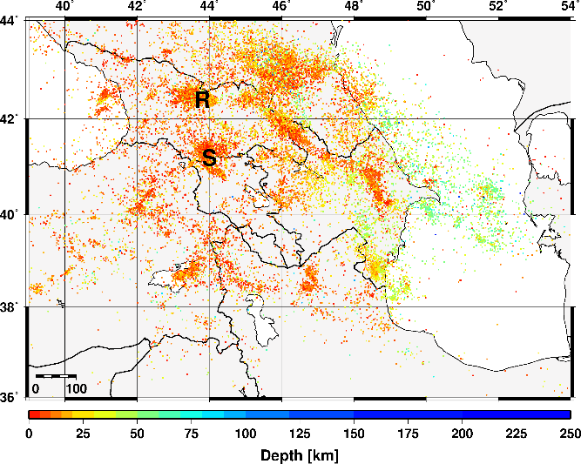
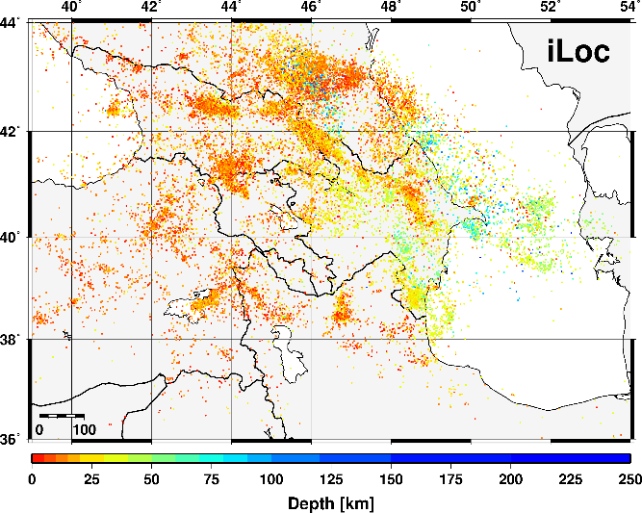
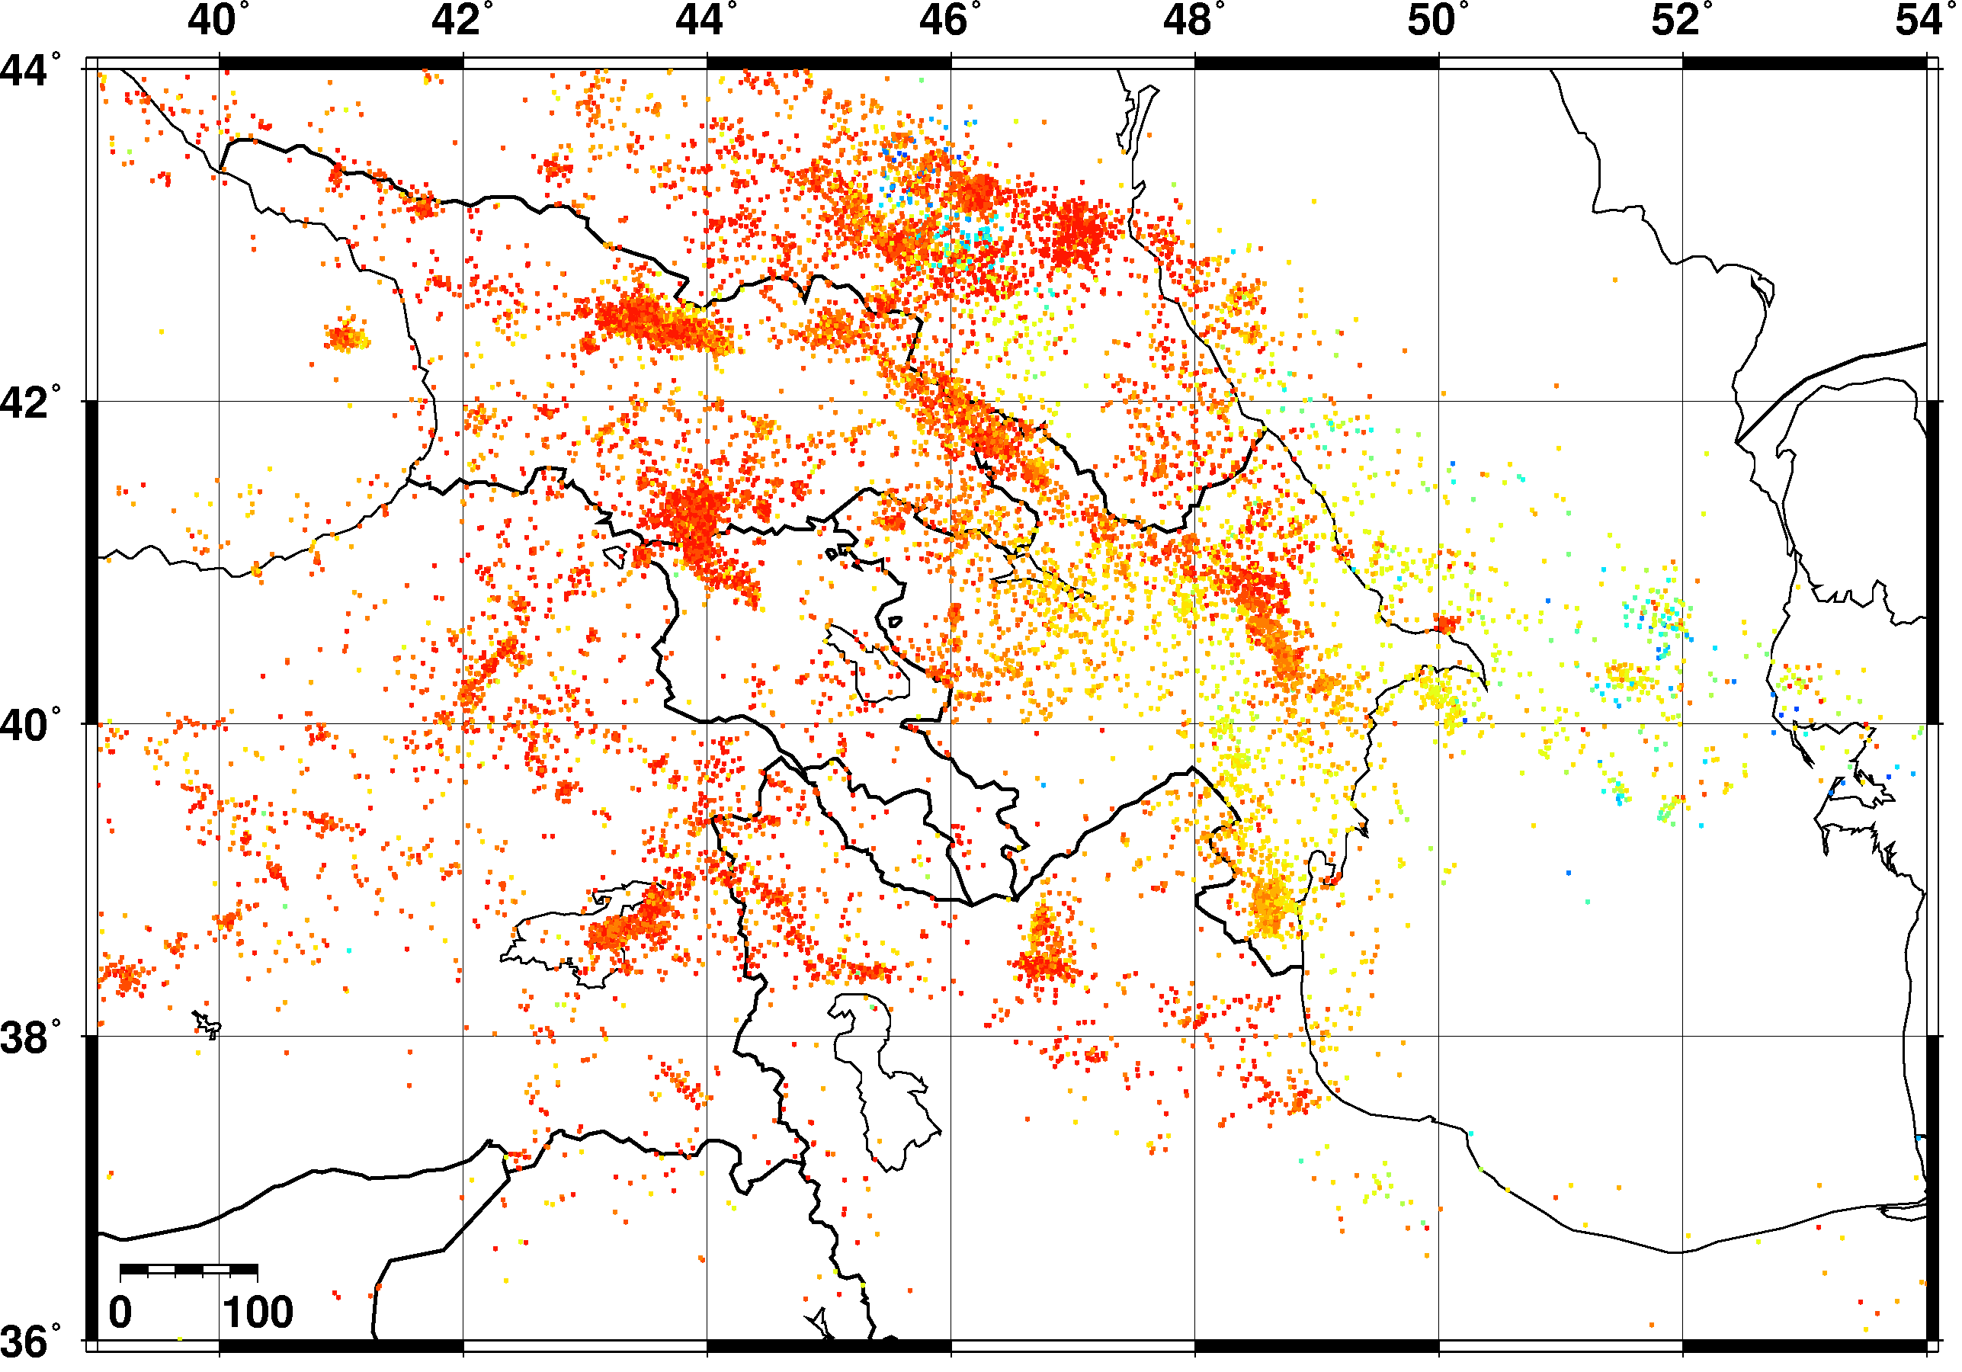
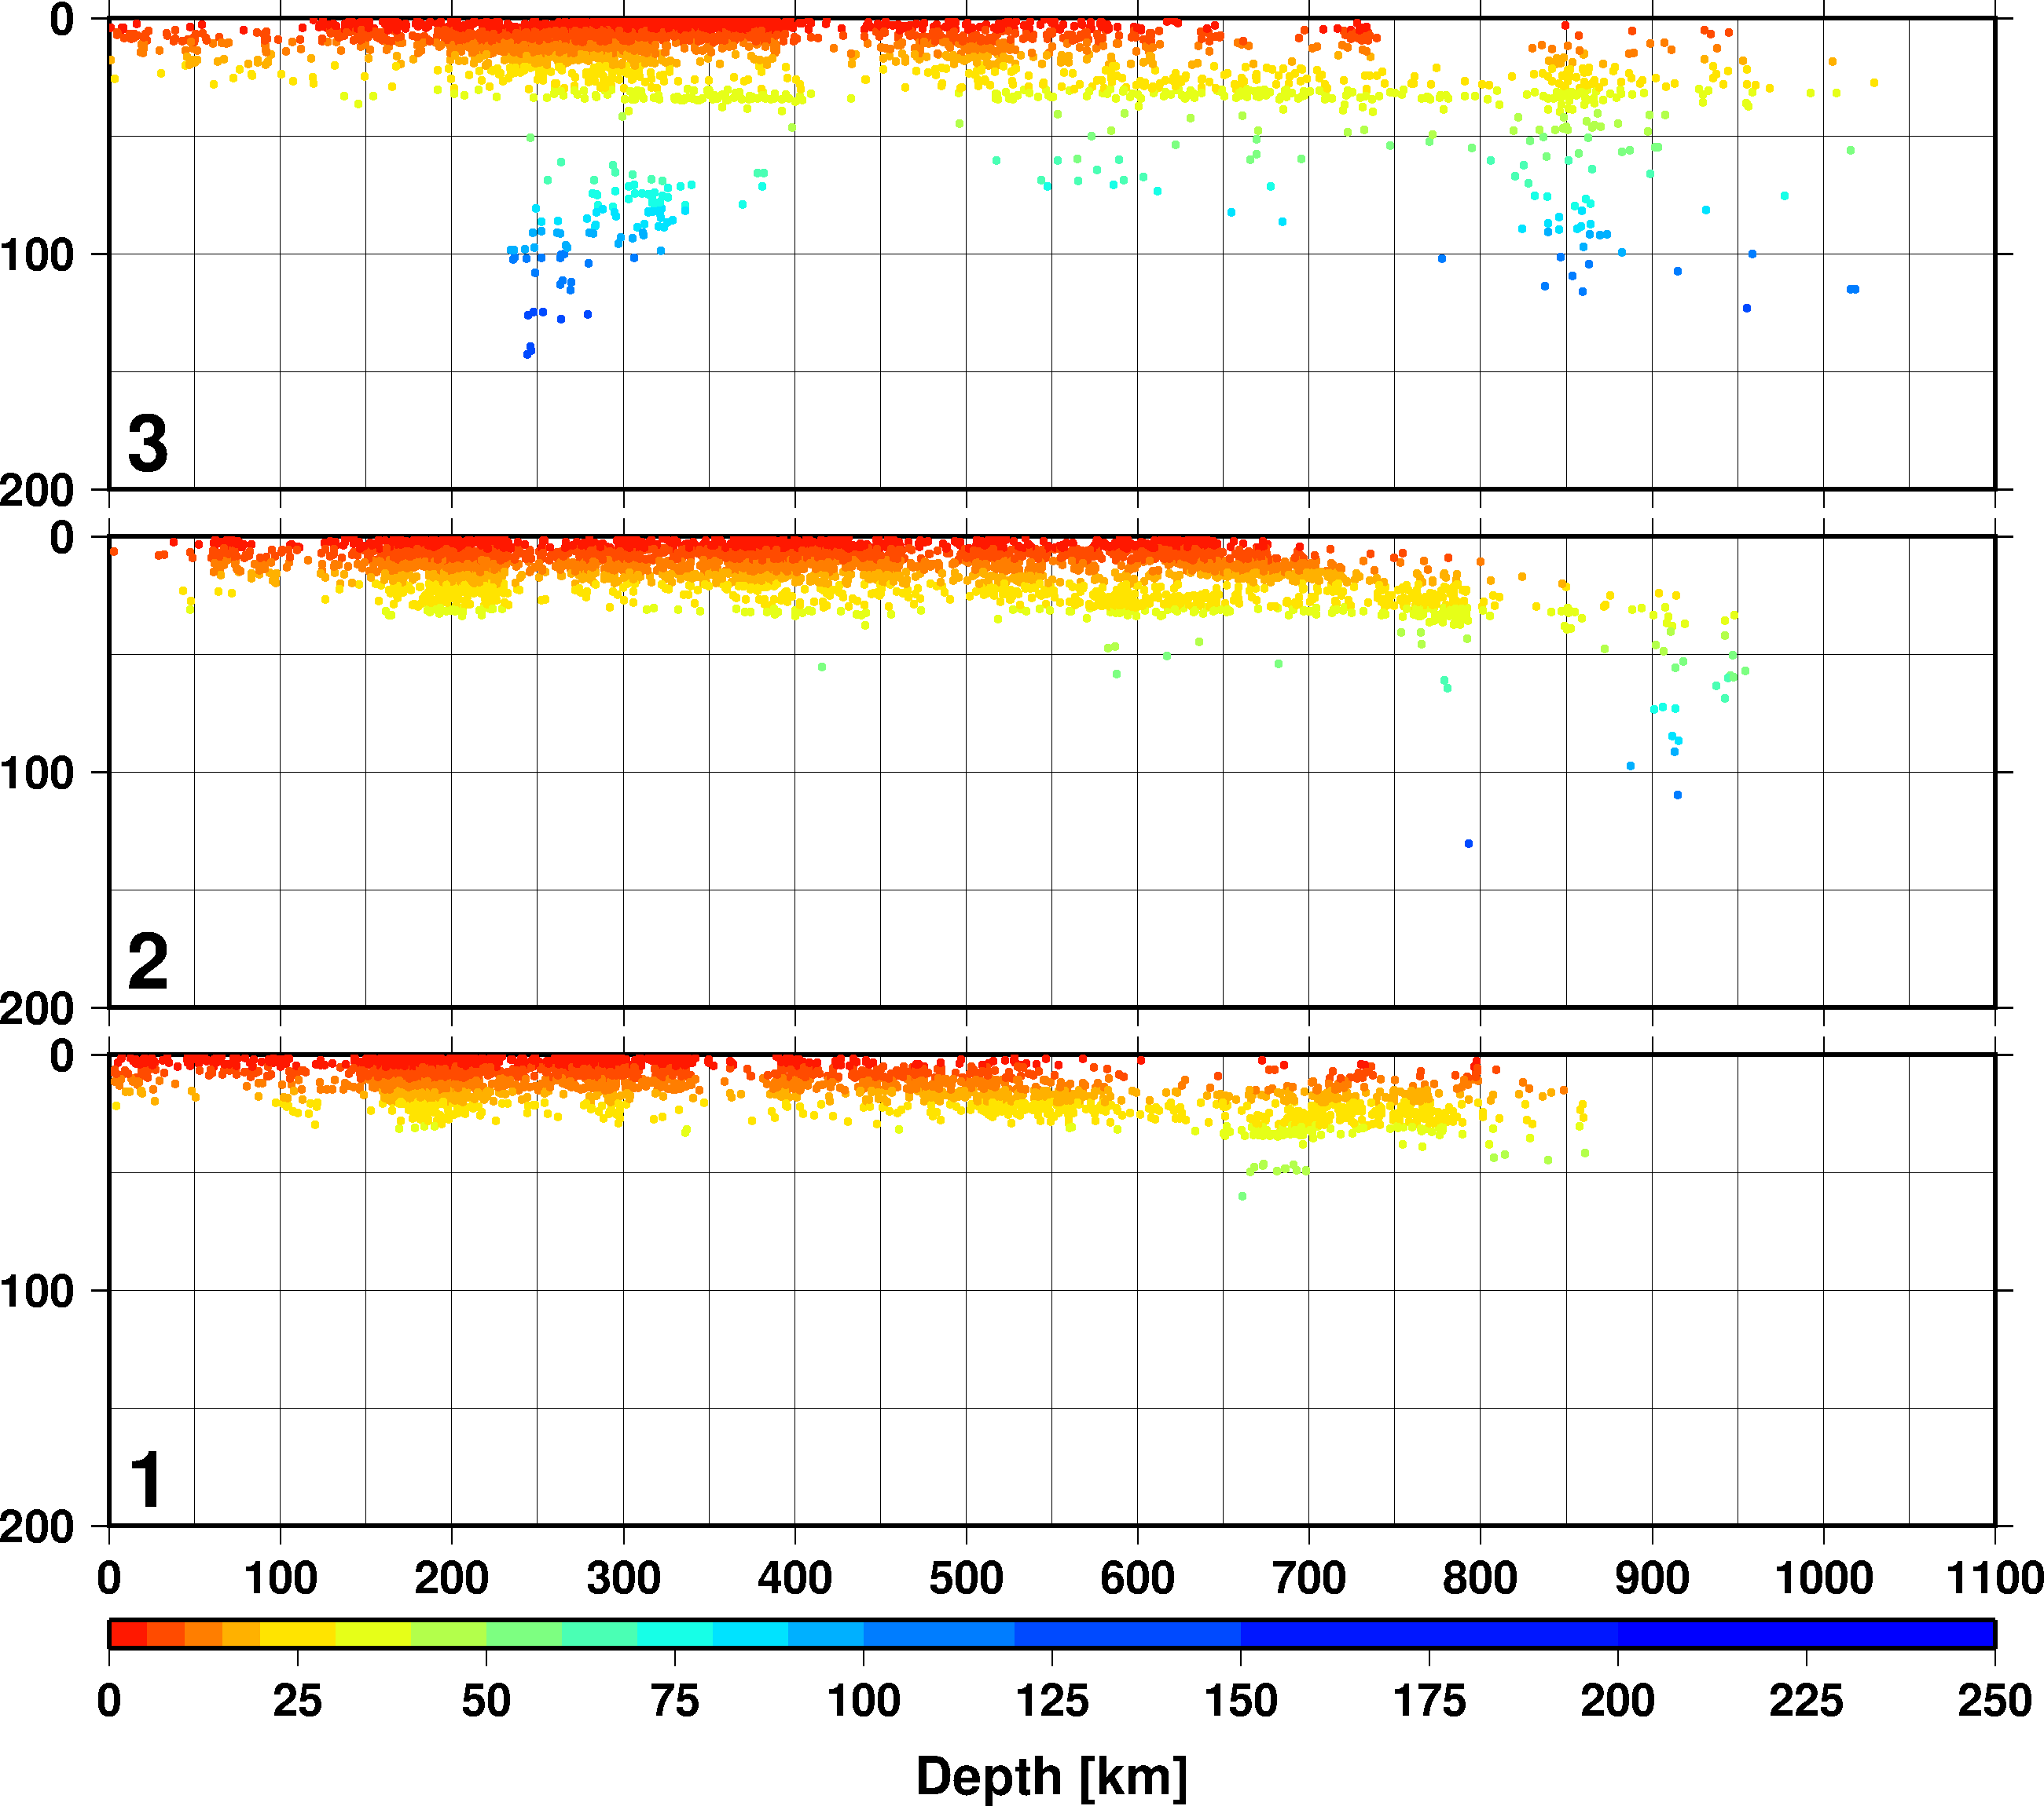
Seismicity and tectonics of the Caucasus region revisited
István Bondár, Tea Godoladze, Eric Cowgill, Gurban Yetirmishli, Stephen Myers, Tuna Onur, Irakli Gunia, Albert Buzaladze, Rengin Gök, Andrea Chiang
P1.2-188
Bayesloc
LLNL and Ilia State University compiled a comprehensive bulletin for the Caucasus region complemented with bulletins from Azerbaijan, Armenia, Turkey and the ISC bulletin.
We relocated the comprehensive bulletin of some 20,000 events with iLoc using the global upper mantle RSTT model travel time predictions and identified ground truth events.
Using the GT events as anchors and the iLoc locations we simultaneously relocated the bulletin with Bayesloc.
The result clarified the locations and geometry of major active structures.

