Slide 1
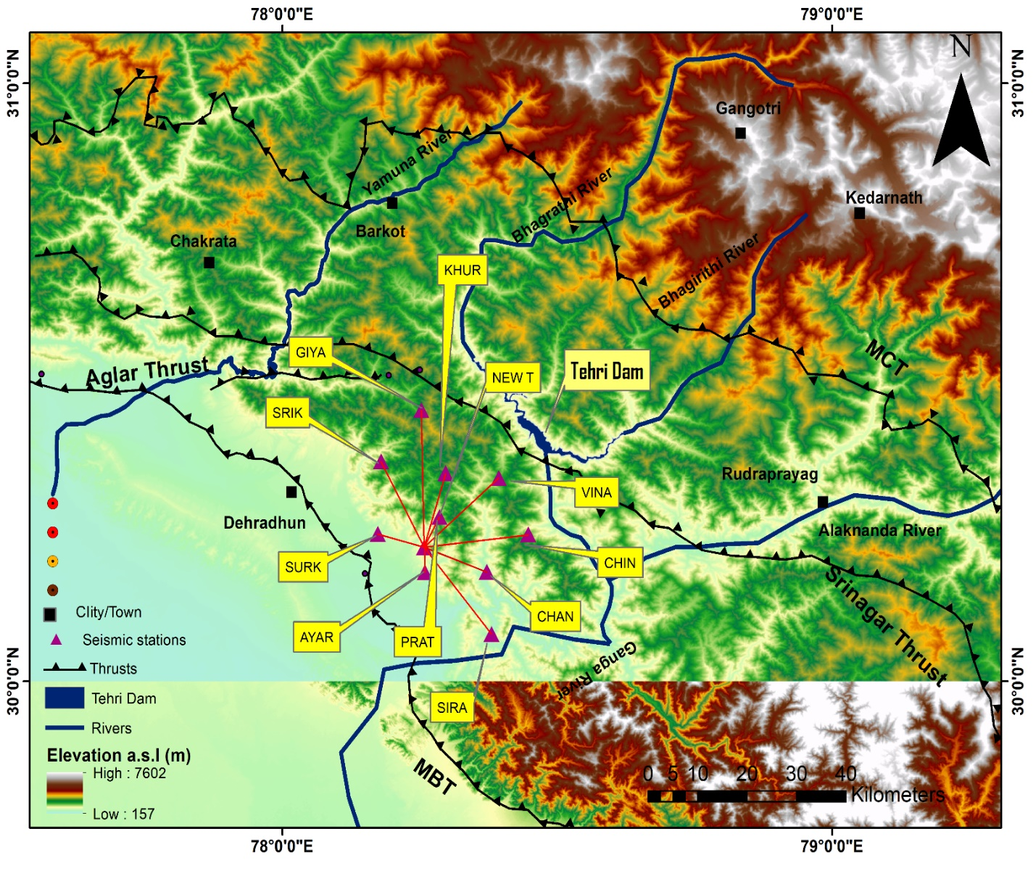
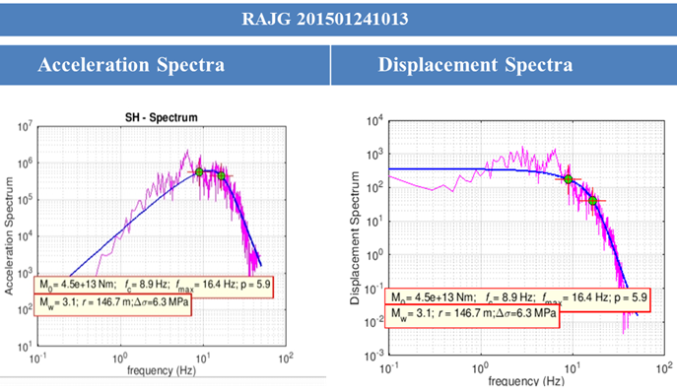
Study on Source Parameters of Local Earthquakes in Tehri Dam Site and Hinterlands in the Himalayas
Daya shanker and Abhishek Pathak
Indian Institute of Technology Roorkee, Department of Earthquake Engineering
P1.2-064
The objective of this study is to estimate hypocentre parameters and source parameters of local events recorded using 12-stations data at the seismological laboratory of IIT Roorkee.
Considering circular Brune-type source model, source parameters such as seismic moment, corner frequency, source radius and stress drop were estimated

