Slide 1

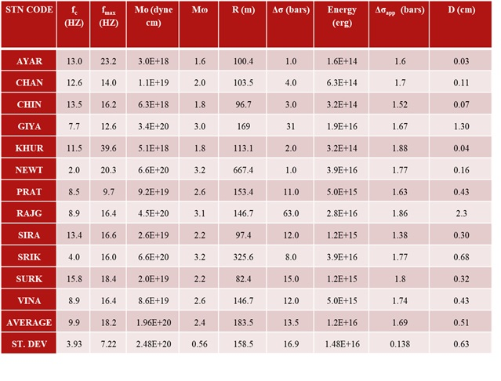
Study on Source Parameters of Local Earthquakes in Tehri Dam Site and Hinterlands in the Himalayas
Daya shanker and Abhishek Pathak
Indian Institute of Technology Roorkee, Department of Earthquake Engineering
Prof. Daya Shanker is presently an Associate Professor of Engineering Seismology & Seismotectonics working as faculty since 1996 in the Department of Earthquake Engineering, Indian Institute of Technology Roorkee, India. He has produce 05 PhD and 23 M. Tech Thesis, 47 foreign visits, 180 publications.
The phase data of 3 local earthquakes (1.3<Mw<3.2) are recorded by both accelerograph and seismograph by 12-stations of Seismological Network at Tehri Dam region set up and process at IIT Roorkee.
Results of Source parameters estimated from 12 Seismic stations for Local Earthqauke event recorded on 24 January, 2015
1. The source radius of the events ranges from 65.1 m to 667.4 m and source size increases as seismic moment ofearthquake increases.
Brune stress drop range from 1 bar to 63 bars.
This study suggests that there shall be no major earthquake near Tehri. Also it seems that Tehri dam is safe.
Place your QR Code here after removing this text box!
P1.2-064

Slide 2
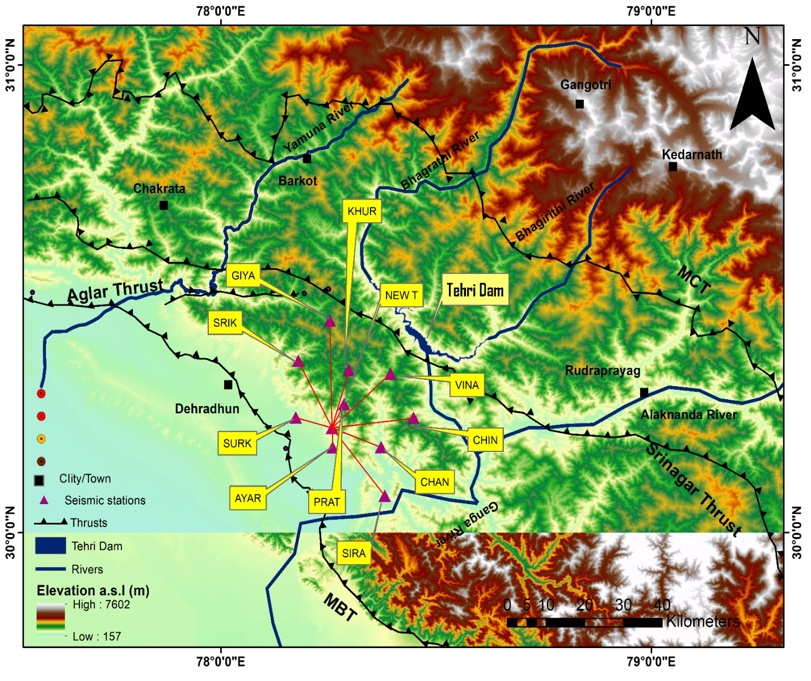
Introduction
The Tehri dam site is located in the Cetral Seismic Gap (CSG) region of Himalaya and constructed across Bhagirathi River. The region around Tehri dam site is identified by the occurrence of moderate to large earthquake activity.
The reservoir has an area of 44 km² to Bhagirathi and a length of 25 km to Bhilangana Valley.
The Tehri Dam is about 5 km in the south direction of the North Al-Molar Thrust (NAT).
NAT appears to have moved around 500 meters by tipping NE-SW on Dewal Tear, which is a transverse fault situated in the Bhilangana River Valley. The phase data of 3 local earthquakes (1.3<M_{w}<3.2) are recorded by both accelerograph and seismograph by 12-stations of Seismological Network at Tehri Dam region set up and process at IIT Roorkee.
Place your QR Code here after removing this text box!
Map showing study area, location of 12-recording stations
P1.2-064

Slide 3
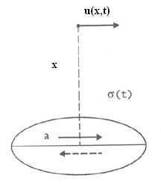
Objectives
The objective of this study is to estimate hypocentre parameters and source parameters of local events recorded at the seismological laboratory of IIT Roorkee Using 12-stations data. A study on seismic activity at Tehri Dam was carried out in two different seismic movements
First, there is a pseudo-ground acceleration (Mw = 7) of the earthquake (PGA = 0·23g) used in the Dam design (Thatte 1992).
The second is the earthquake of non existent magnitude (Mw = 8.5) and a physiological earthquake acceleration (PGA = 0.45g).
The noise parameters have also been used that can calculate the seismic phase and the arrival time of the pulse width in the P and S waves, respectively, in the time and frequency domains. By considering circular Brune-type source model, source parameters such as seismic moment, corner frequency, source radius and stress drop were estimated. In this model the earthquake dislocation is modeled as a shear stress pulse applied instantaneously to the interior of a dislocation surface . According to Brune, ground motion parameters are a function of effective stress.
The function is expressed as
𝜎(𝑥,𝑡)=𝜎𝐻(𝑡−𝑥/𝛽)
Place your QR Code here after removing this text box!
P1.2-064

Slide 4
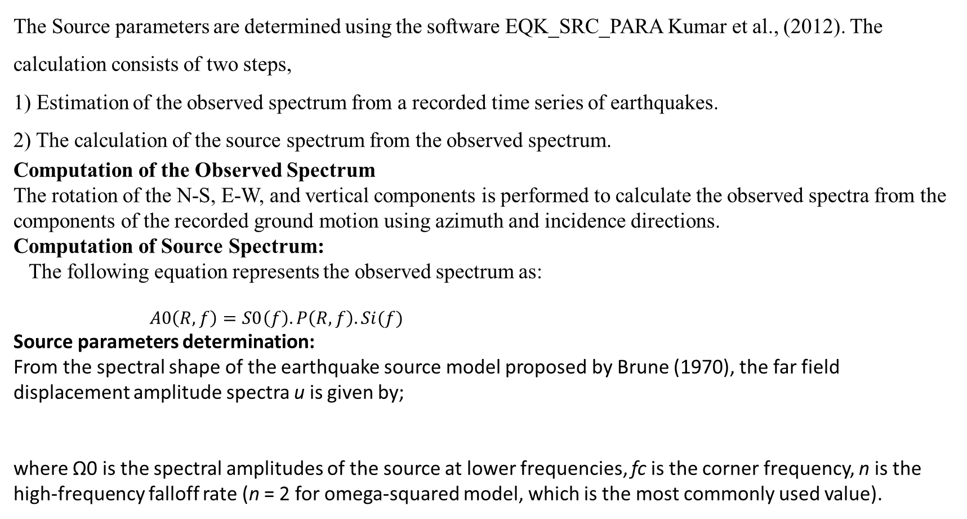
Methodology Adopted for Data Analysis
The Source parameters are determined using the software EQK_SRC_PARA Kumar et al., (2012). The calculation consists of two steps,
1) Estimation of the observed spectrum from a recorded time series of earthquakes.
2) The calculation of the source spectrum from the observed spectrum.
Computation of the Observed Spectrum
The rotation of the N-S, E-W, and vertical components is performed to calculate the observed spectra from the components of the recorded ground motion using azimuth and incidence directions.
Computation of Source Spectrum:
The following equation represents the observed spectrum as:
$A0\left(R,f\right)=S0\left(f\right).P\left(R,f\right).Si(f)$
Source parameters determination:
From the spectral shape of the earthquake source model proposed by Brune (1970), the far field displacement amplitude spectra u is given by;
where Ω0 is the spectral amplitudes of the source at lower frequencies, fc is the corner frequency, n is the high-frequency falloff rate (n = 2 for omega-squared model, which is the most commonly used value).
Place your QR Code here after removing this text box!
P1.2-064

Slide 5
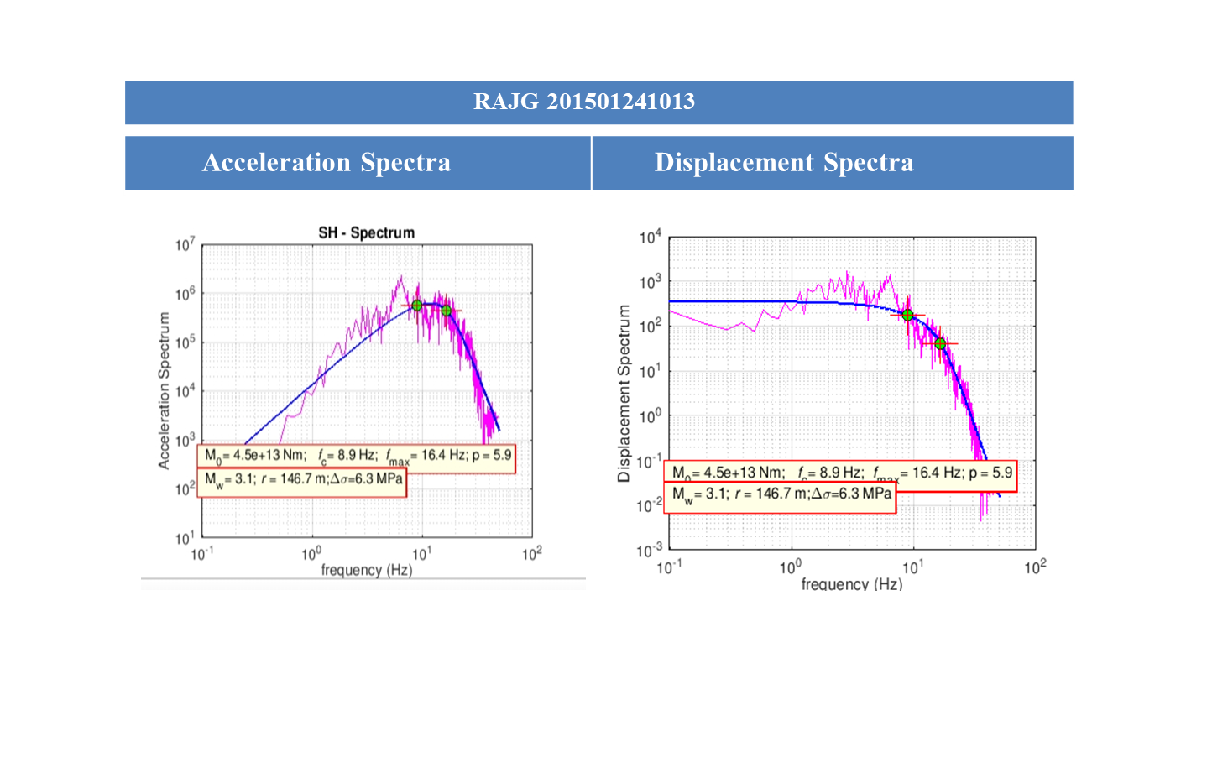
Results and Discussion
For the circular fault model, the seismic moment (Brune, 1970), corner frequency (fc) (Andrews, 1986), and stress drop (Δσ) (Eshelby, 1957; Madariaga, 1976) can be calculated using the source spectra, obtained from the inversion, by the following equations:
where ρ is the density, v is the seismic velocity (either P wave or S wave according to the wave type used), 𝑅𝜃𝜑 is the radiation pattern, A0 is the flat level of acceleration spectra in the higher frequency band and β is the shear wave velocity near the source.
Place your QR Code here after removing this text box!
P1.2-064

Slide 6
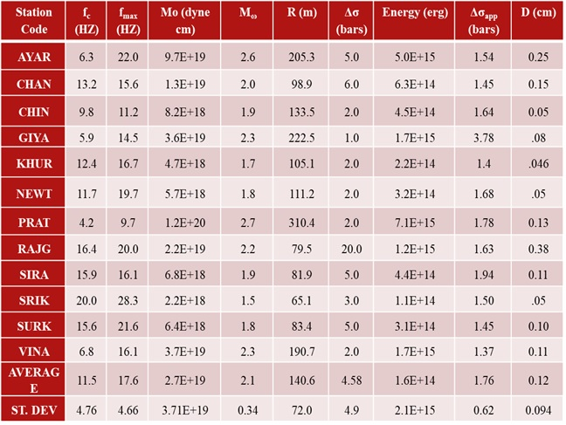
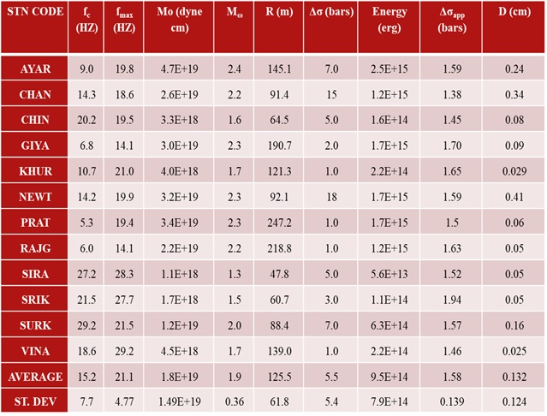
Conclusions
Source parameters estimated
For January
01,
11
And
25, 2015
From the study on estimation of source parameter of local earthquake events in Tehri Dam region , we can conclude following points:
1 Seismic moment ranges from 2.2×10¹⁸ dyne-cm to 6.6×10²⁰ dyne-cm. For these seismic moments values the values for corner frequency 𝑓_{𝑐} and f_{max} vary from 4 Hz to 20 Hz and 16 Hz to 28.3 Hz respectively.
2 The source radius of the above events ranges from 65.1 m to 667.4 m and source size increases as seismic moment of earthquake increases.
Place your QR Code here after removing this text box!
P1.2-064

Slide 7
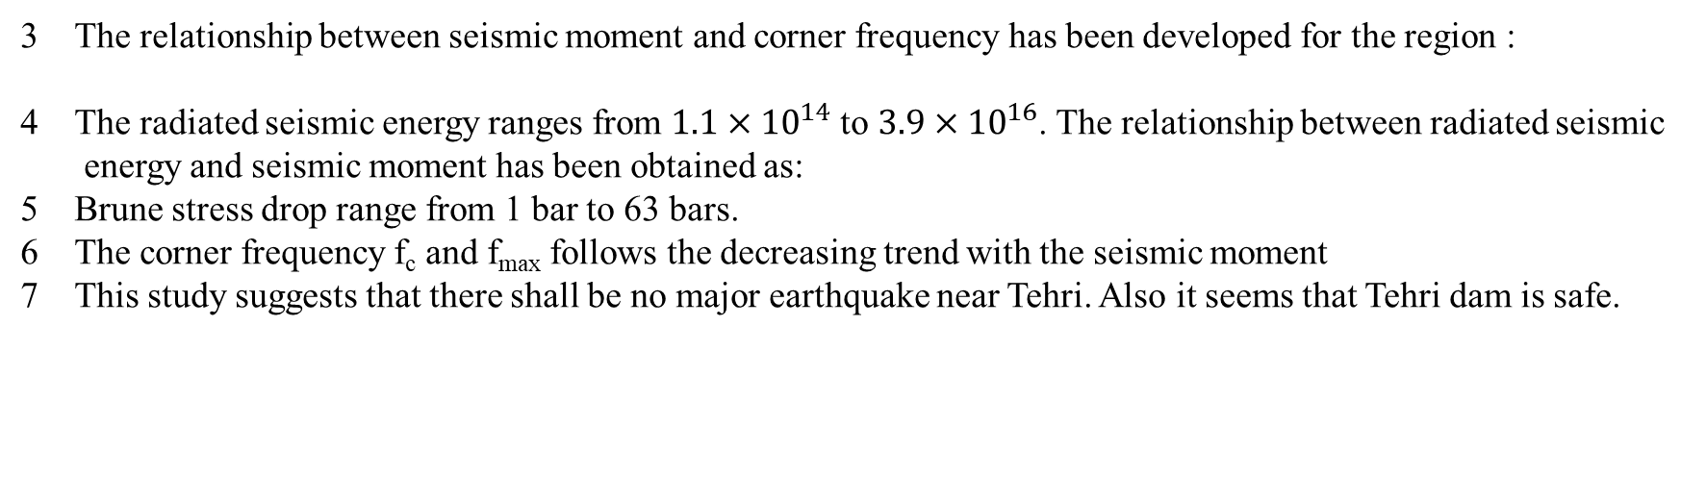
References
The relationship between seismic moment and corner frequency has been developed for the region :
The radiated seismic energy ranges from $1.1×{10}^{14}$ to $3.9×{10}^{16}$. The relationship between radiated seismic
energy and seismic moment has been obtained as:
Brune stress drop range from 1 bar to 63 bars.
The corner frequency f_{c} and f_{max} follows the decreasing trend with the seismic moment
This study suggests that there shall be no major earthquake near Tehri. Also it seems that Tehri dam is safe.
References
Andrews, D. T., Objective determination of source parameters and similarity of earthquakes of different size. In Earthquake Source Mechanics (Das, S., Boatwright, J., and Scholz, C. H., eds.) American Geophysical Union Monograph 37 (AGU, Washington, DC 1986) pp. 259–267.
Brune, J. N. (1970). Tectonic stress and the spectra of seismic shear waves from earthquakes. Journal of geophysical research, 75(26), 4997-5009.
Eshelby, J.D. (1957). The determination of the elastic field of an ellipsoidal inclusion and related problems. Proceedings of the Royal Society of London A 241, 376–396.
Kumar, A., Kumar, A., Kumar, A., Gupta, S. C., Jindal, A. K., & Mittal, H. (2012, September). Source Parameters of Uttarkashi Earthquake of 21st Sept. In 15th world conference on earthquake engineering, Lisbon, Portugal (pp. 24-28)
Madariaga, R. (1976), Dynamics of an Expanding Circular Fault, Bull. Seismol. Soc. Am. 66, 639–666.
Thatte C D 1992 Earthquakes, Dam design and Tehri project. J. Ind. Geot. 22(1): 1–41
Place your QR Code here after removing this text box!
P1.2-064

