Slide 1
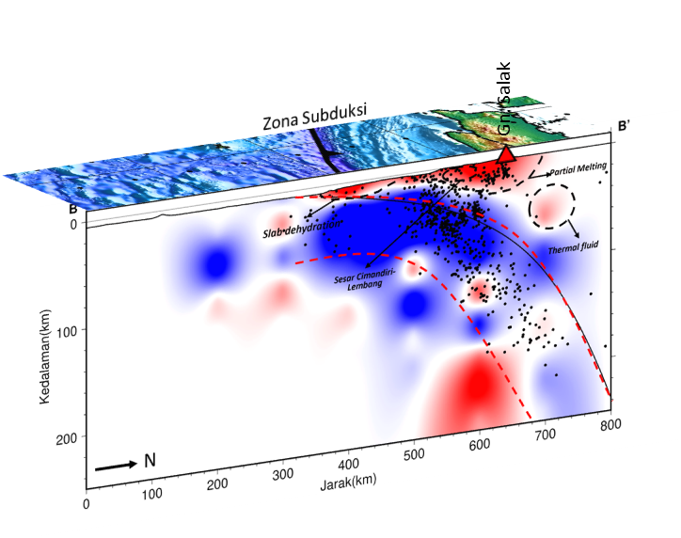
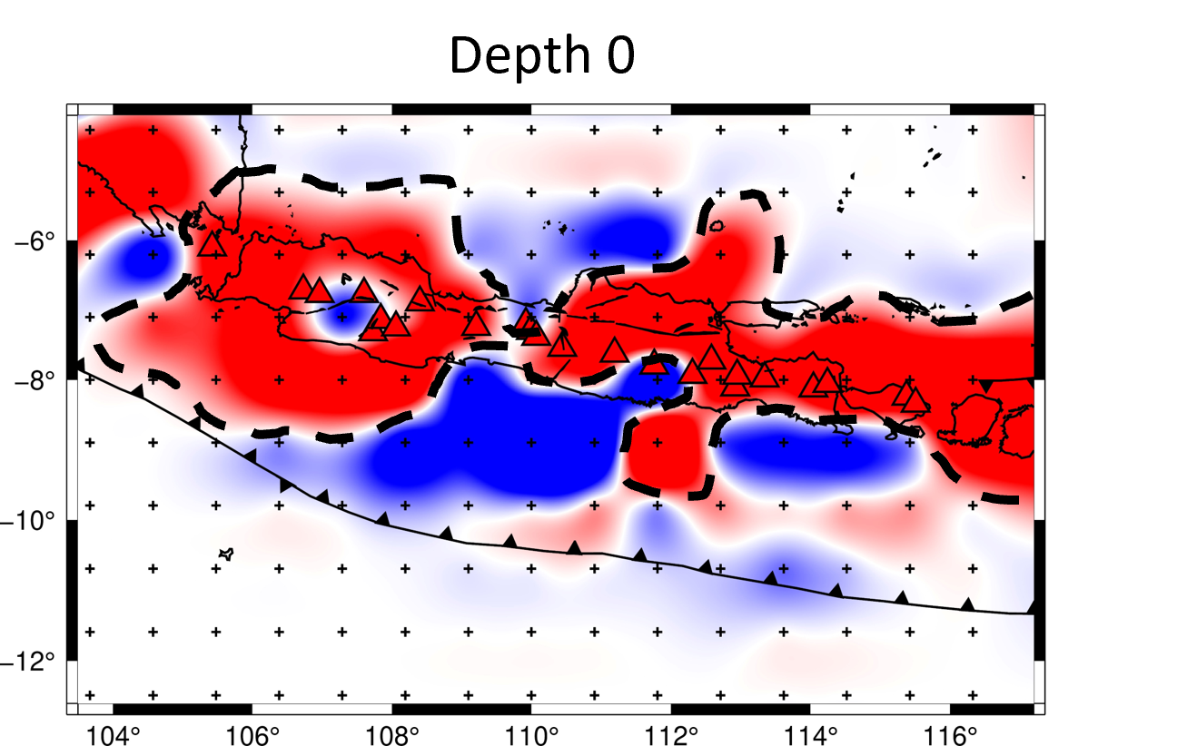
Seismic Velocity Structure of P-Wave Beneath The Jawa Region, Indonesia Using Simultaneous Seismic Tomography Method: A Preliminary Result
Mufti Putra Maulana, Mohamad Ramdhan, Wandono
BMKG, BRIN, STMKG
P1.2-433
Seismic tomographic imaging is a relevant technique to be applied about the dynamic evolution of the earth.
The study has a several main objectives:
Knowing the structure of the subsurface structure of Java Island based on the tomographic inversion results of the P phases of seismic waves.
Updating information on the seismic wave velocity structure for further research.
There are horizontal and vertical results interpretation
If you want to learn more about this, come see my e-poster during session 1.2 on this date or access it online on the SnT2023 Conference platform!

