Slide 1
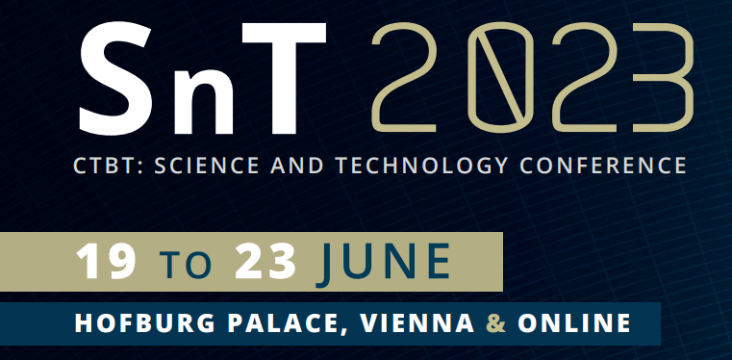
Estimating the Recurrence Periods of Earthquake in Sabah
Using the CTBTO International Monitoring System Data
Muhammed Zulfakar Zolkaffly
Malaysian Nuclear Agency
P1.2-436
Beyond its core purpose of detecting nuclear explosions, the CTBT’s IMS produces a treasure trove of data that can be put to wider civil and scientific use.
This includes to help expanding our knowledge of the Earth and the natural world.
In this study, we focus at quantifying the recurrence periods and probabilities of occurrence of earthquakes in Sabah region using the IMS seismic data, where the findings could be useful to further understanding the seismicity of the region.
In this regard, I welcome all of you to see my e-poster during session P1.2-2 on Tuesday, 20 June 2023, or access it online on the SnT2023 Conference platform!

