Slide 1
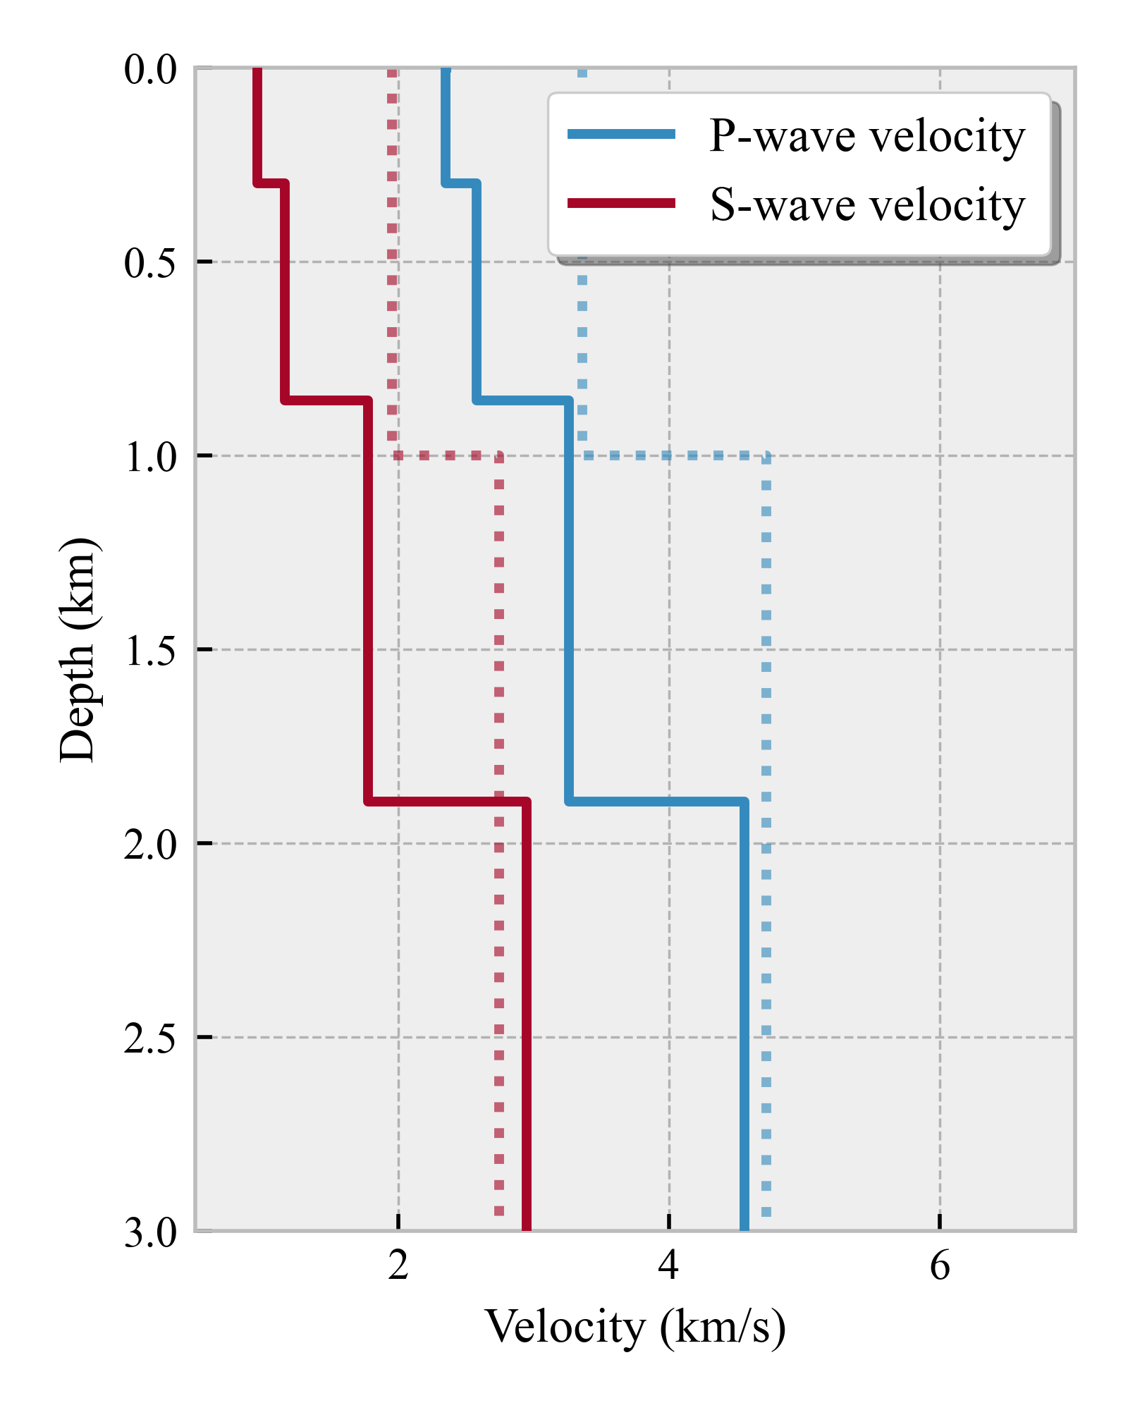
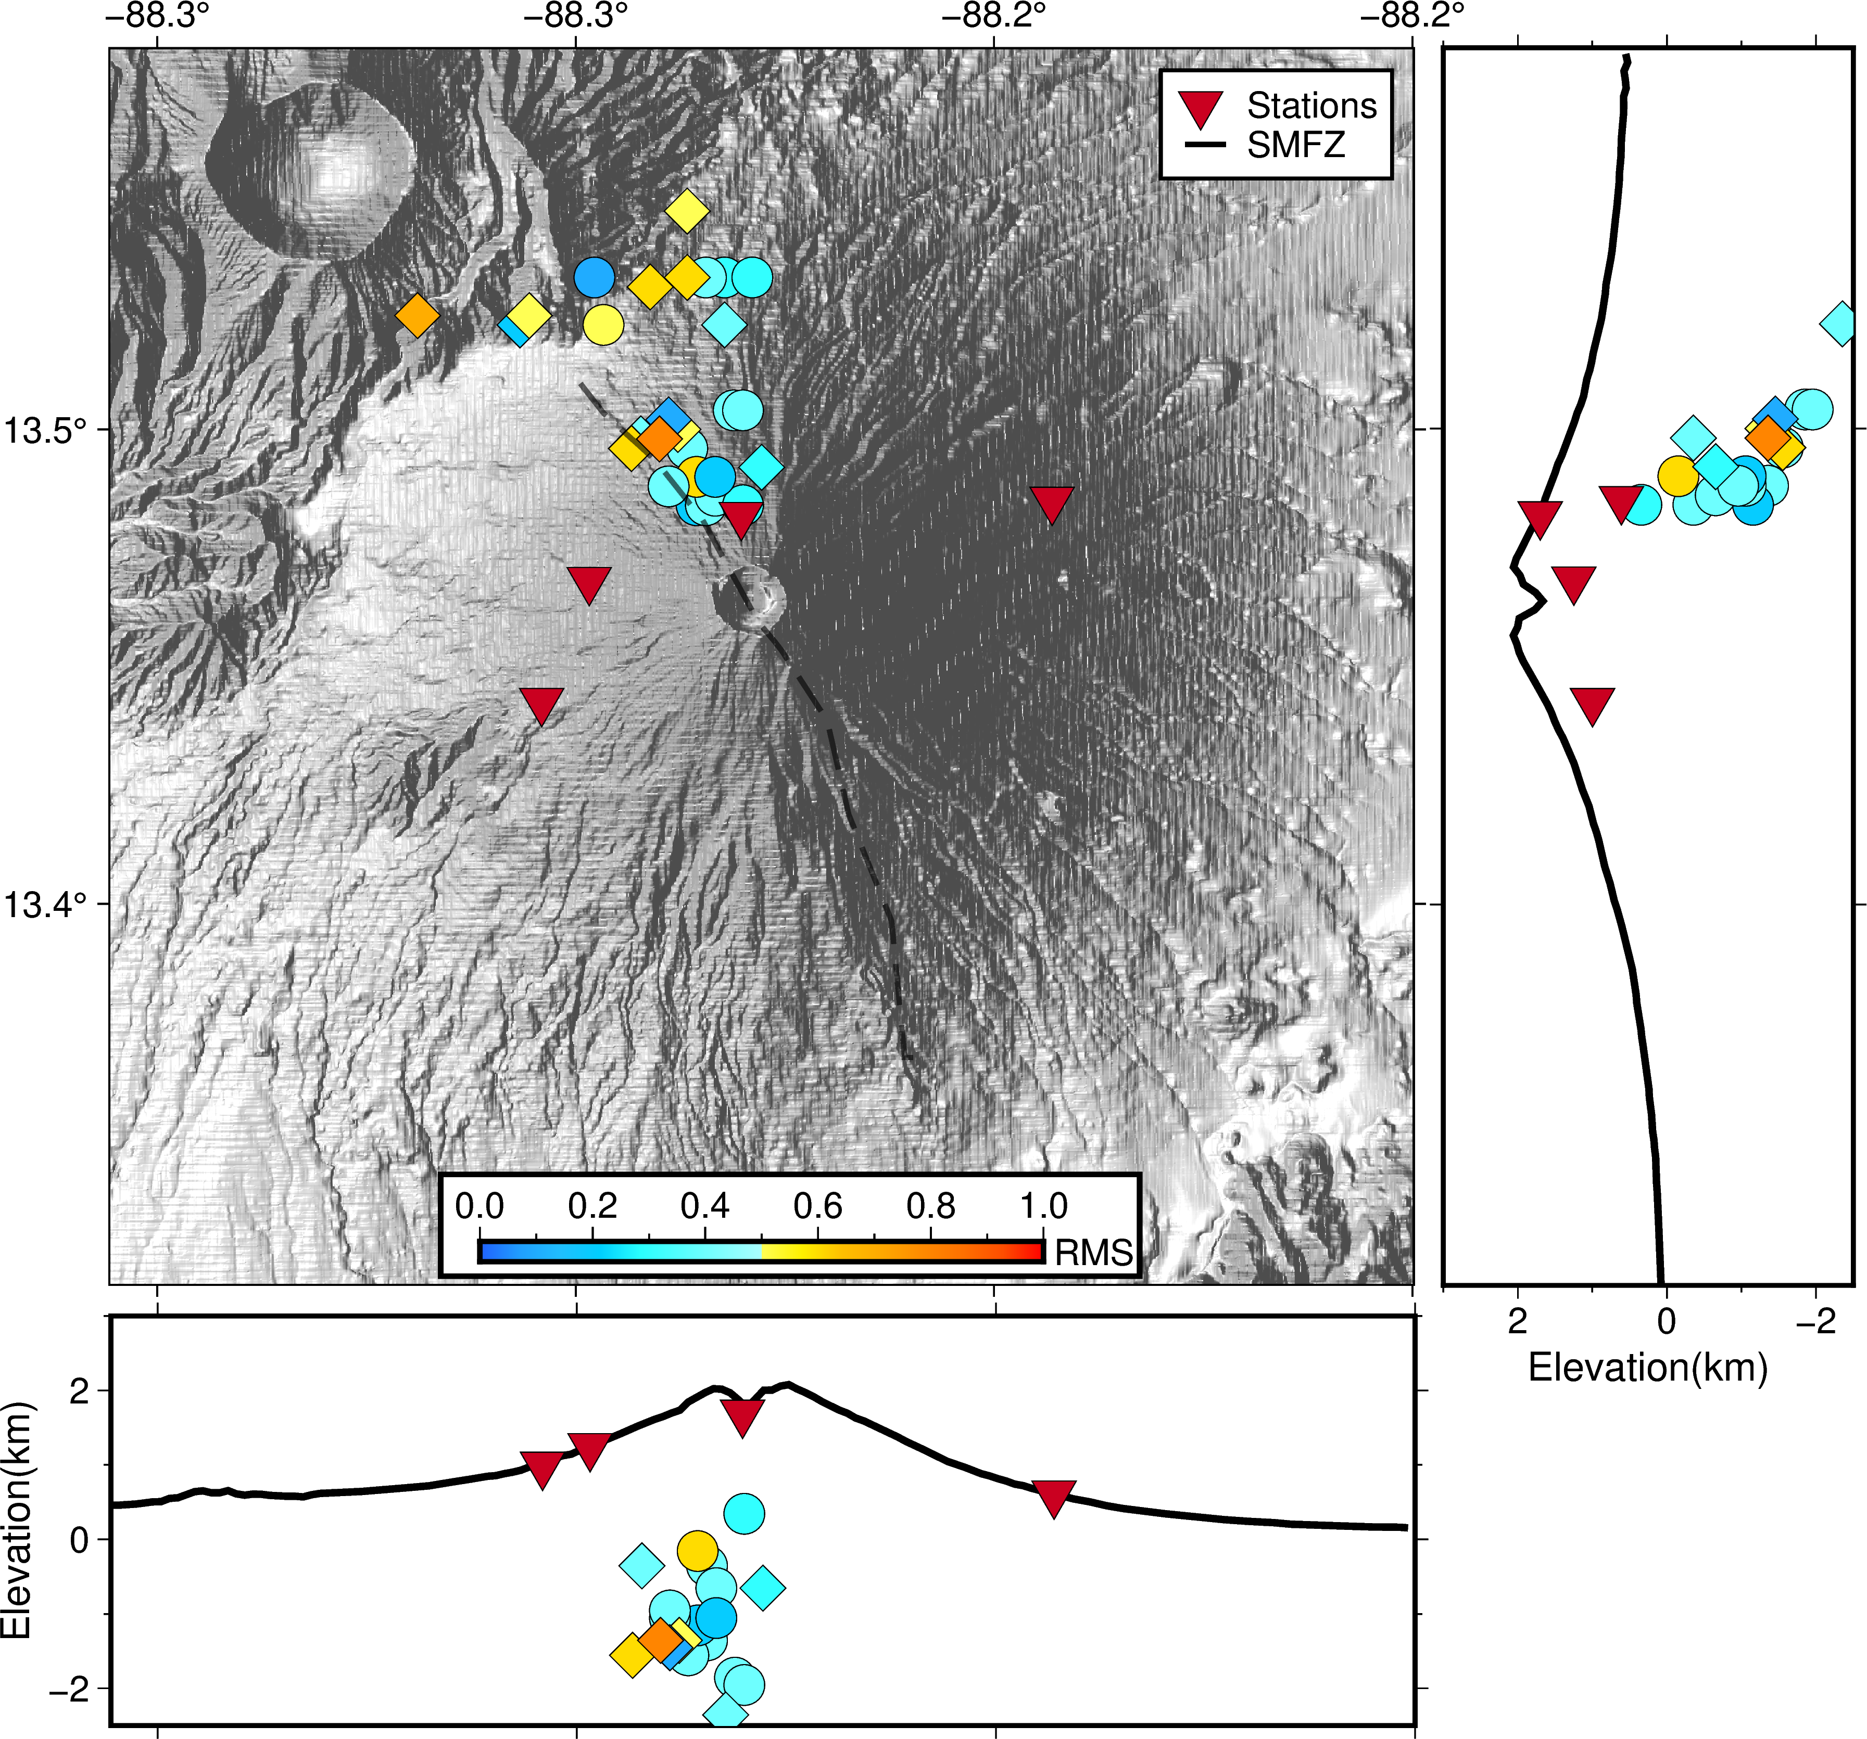
S-wave velocity structure beneath San Miguel volcano, El Salvador, estimated from seismic ambient noise
Kevyn Pineda
Ministry of Environment and Natural Resources, El Salvador
P2.4-123
Transforming noise into signal to understand San Miguel volcano.
We analyzed ambient noise data (>0.2 Hz) using the spatial autocorrelation (SPAC) method and seismic interferometry technique. The combined use of the two methods offered ways to gain information about the subsurface seismic velocity structure from the same dataset.
Our results made it possible to perform a joint inversion of phase and group velocities to obtain the S-wave velocity (Vs) structure of the volcano.
If you want to learn more about this, come see my e-poster during session 1.2

