Slide 1
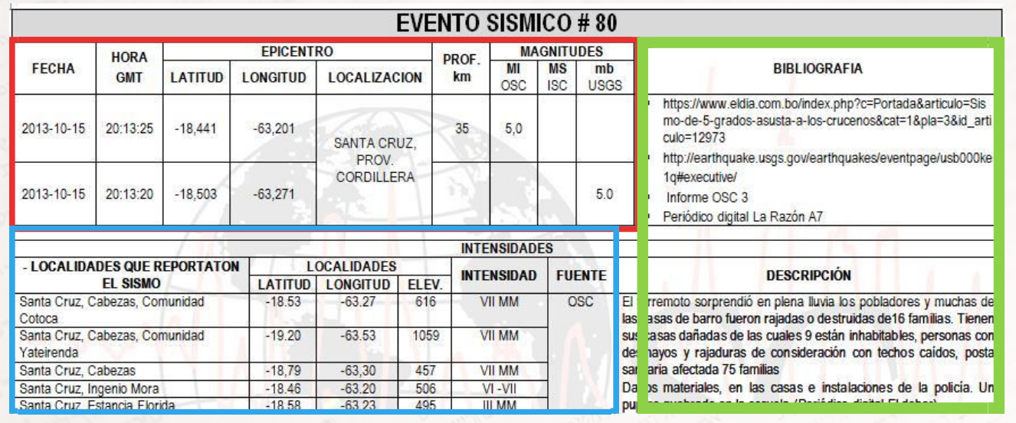
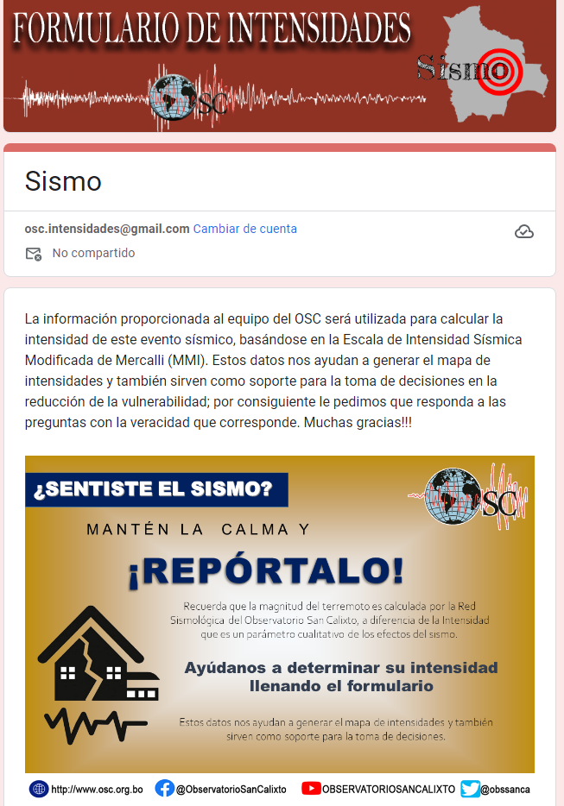
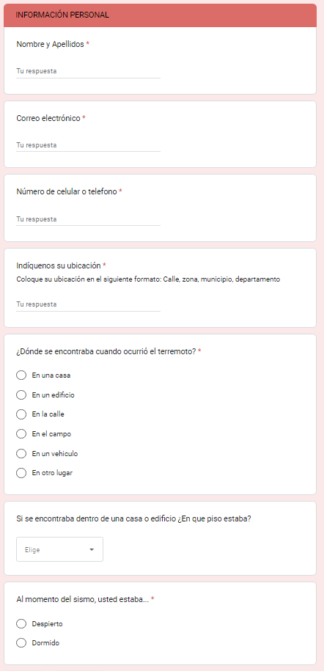
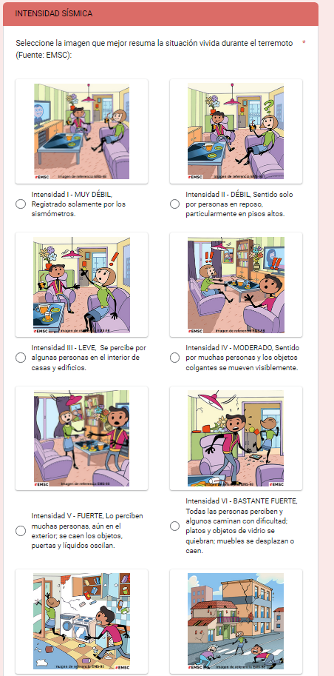
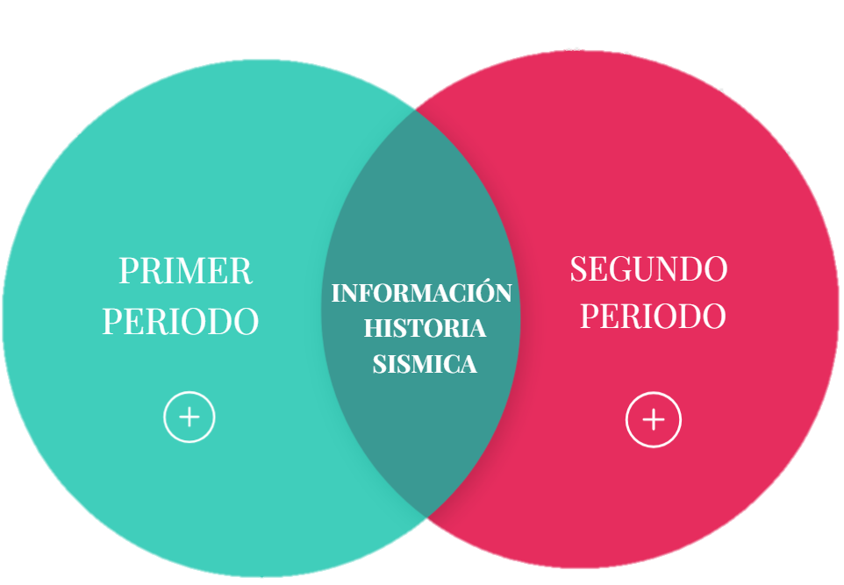
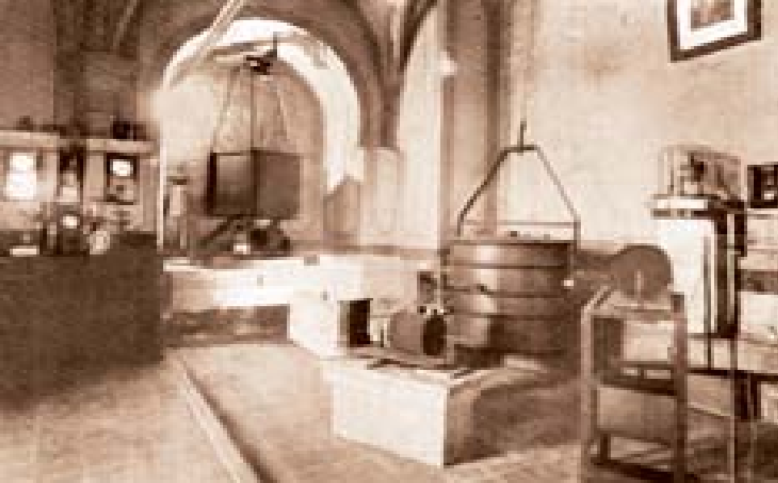
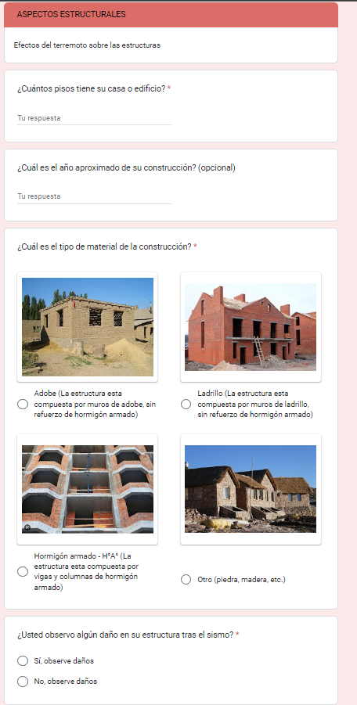
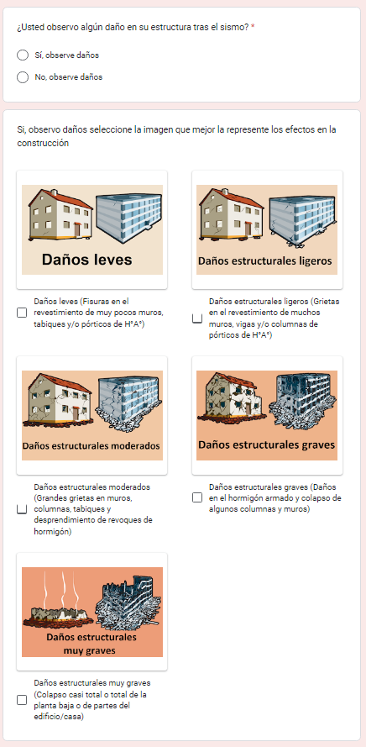
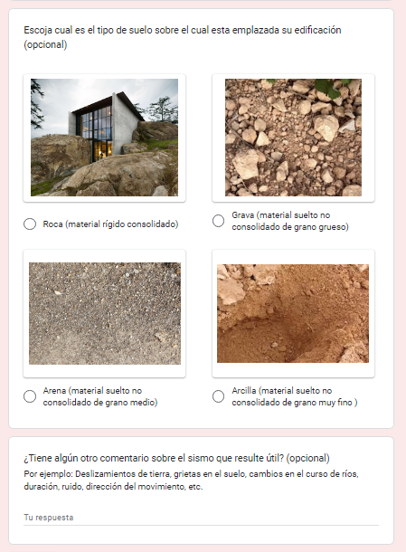
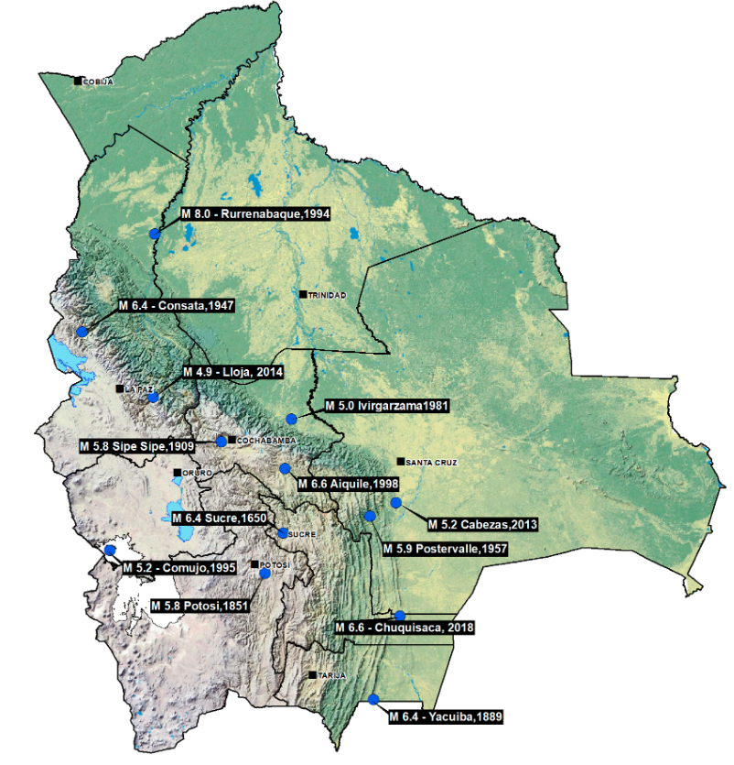
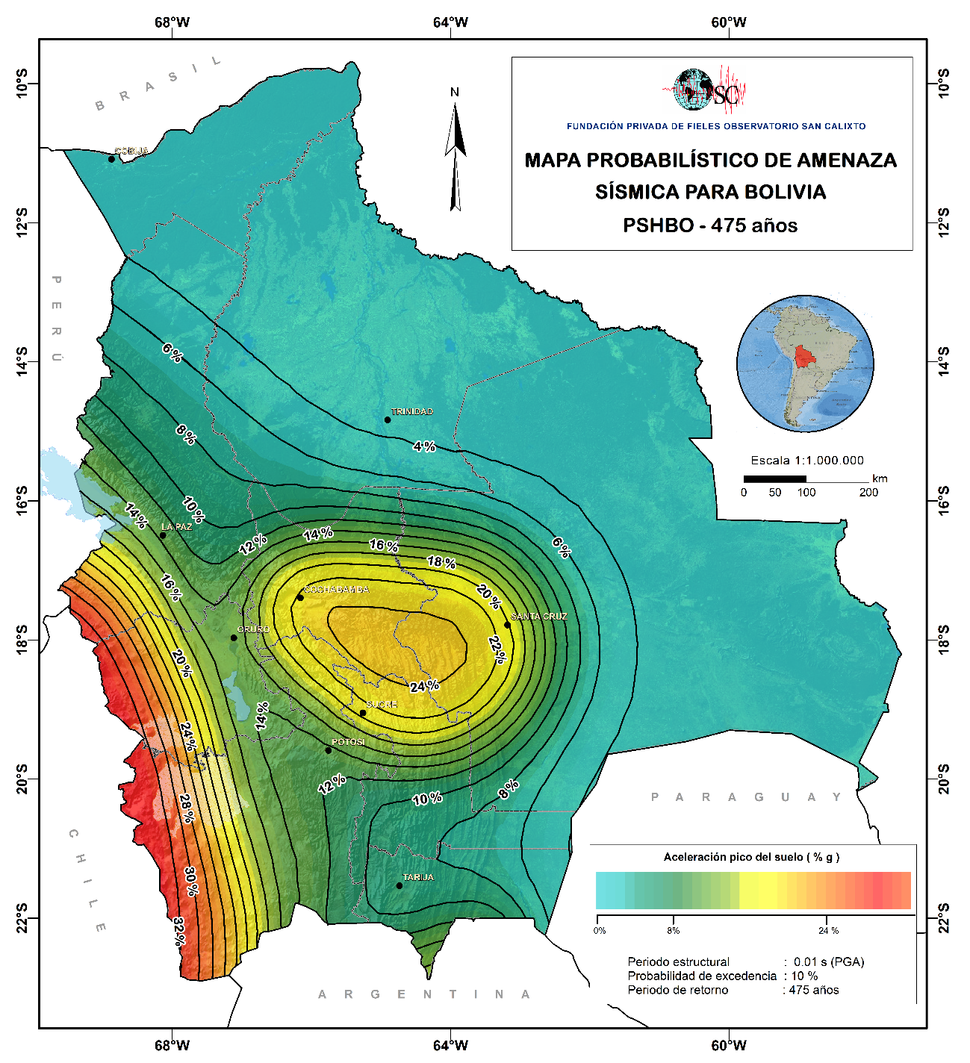
Toward Macro Seismic Intensities Computation for Bolivian Earthquakes
Nieto M., Fernandez G.
Observatorio San Calixto
P1.2-462
P1.2-462
[
ABSTRACT
METHODS
RESULTS
Macro seismic intensities are a key factor to support the seismic hypocenter location, moreover, this kind of information contributes to sample the Mercalli Modified Intensities (MMI) felt in each city, which can vary along the earthquake ray path. In our country the MMI has been collected since the OSC-NDC foundation, however, over the last 20 years this task was discontinued due to the lack of a collection protocol. To resolve this issue, since 2018, we re-did an intensity form so people would fill it in. As a result, we produced visually appealing questions and provided check box options. As the Covid-19 pandemic started and forced institutions to migrate to digital and teleworking procedures, we implemented a digital form to fill in through tested information technologies, such as, WhatsAPP and Google Forms. MMI computation output’s goes to a database from where the expert can draw intensities curves and evaluate the effect along a city. The latest results proved that the new digital form works efficiently and enhances the maps along the region that felt the earthquake
PROBLEM:
In 1985, the last integrated catalog of seismic intensities for Bolivia was published as a result of the SISRA Project; however, there was no continuity in the SISRA methodology, which led to the fact that the intensity data are found in Excel tables lacking important descriptions.
The structure of the OSC intensity catalog is based on the format used by the SISRA project, divided into two sections: the first provides information related to the Hypocentral parameters of the earthquake, the second provides the intensities for the different locations for which information is available.
It also includes the "bibliography" field (sources of primary and secondary information) and the "description" field contains comments on the effects or damage caused by the earthquake on buildings, objects, land and the impact on people.
OBJECTIVE
Update the catalog of seismic intensities of Bolivia, based on the format used by the SISRA project, for cortical earthquakes that occurred between 1985 - 2022.
INTRODUCTION
METHODOLOGY
Seismic information from Bolivia is divided into two periods (Descotes and Cabré, 1973; Vega, 1996):The first is historical, which begins with the relates and reports of documents from Colonial times. The second instrumental period began in 1913 with the installation of the first mechanical seismometer in the city of La Paz.
IMPLEMENTATION OF ICT TOOLS, AS AN ENGINE FOR INTENSITY DATA COLLECTION
JUSTIFICATION:
Since 1985 to date there have been several significant earthquakes in Bolivian territory that constitute valuable information to increase the knowledge of the seismic hazard of Bolivia. However, the database has been simplified to brief descriptions of the main seismic effects or to simple lists that lack important parameters and even reference sources. For this reason, it is necessary to propose a methodology and format to update the OSC intensity catalog, thus systematizing the intensity data without the risk of losing information
OVERVIEW

