Slide 1
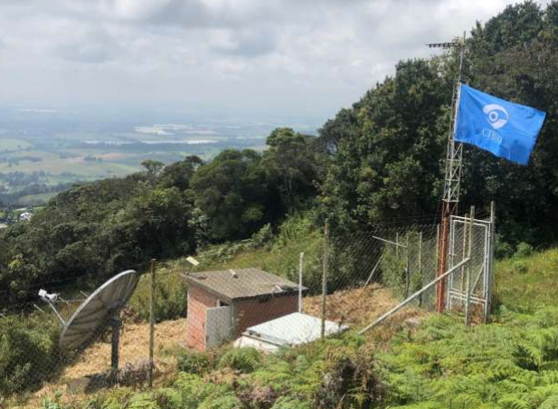
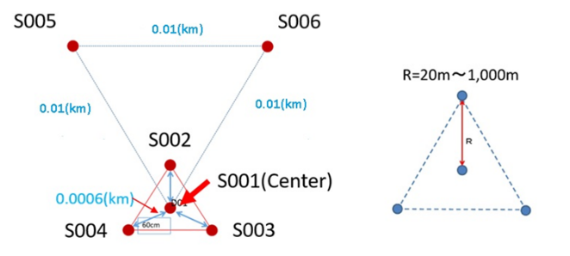
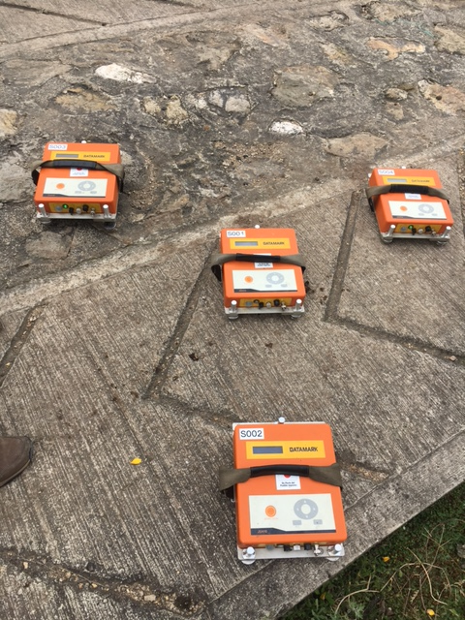
Local Site Characteristics Around the PS14-ROSC Seismic Station
Patricia Pedraza, Helber García and Luisa Castillo
Servicio Geológico Colombiano
P1.2-772
The primary seismic station PS14 is located near the town of Rosal in the central part of the Eastern Cordillera of Colombia.
Passive seismic techniques using microtremors are a very useful and popular tool to investigate the soil properties, due to its low cost and accessibility.
In this study, we performed miniature microtremor arrays in order to characterize the local site effects of the primary seismic station PS14.

