Slide 1
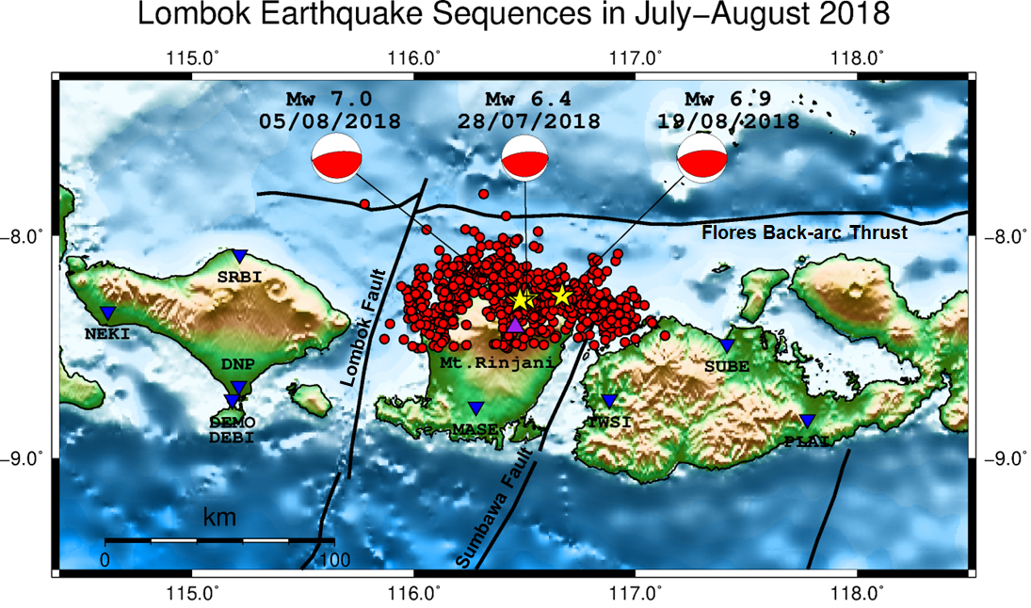
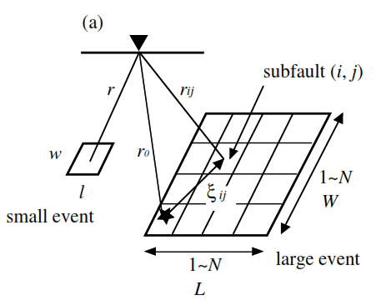
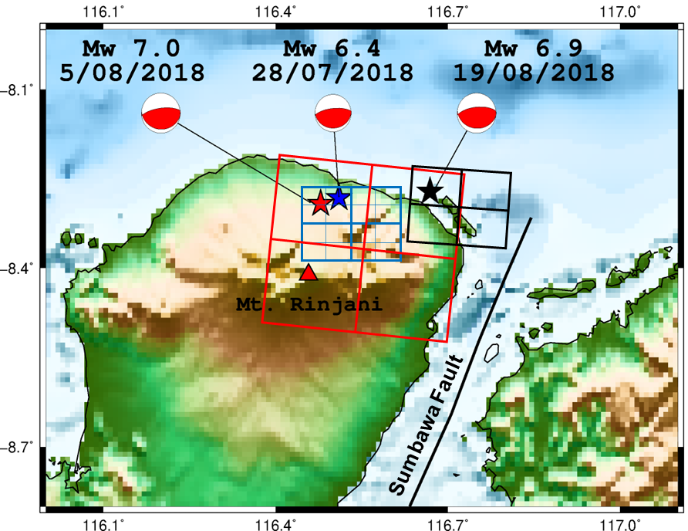
Seismic Source Modeling for the 2018 Lombok Earthquake Sequence Estimated from the Empirical Green’s Function Method
Aldilla Damayanti Purnama Ratri, et al
Indonesia Agency for Meteorology, Climatology, and Geophysics (BMKG)
P1.2-217
ABSTRACT
In 2018, a series of earthquakes in Lombok, Indonesia, causing a lot of casualties and property damage. In this study, we conducted source modeling for these earthquakes by simulating the target event with strong motion data of the smaller event in the surrounding area using empirical Green’s function method. We obtained the best-fit of the strong motion generation area (SMGA) size and rupture starting point from the grid search to conduct source modeling. The relative SMGA location indicated the rupture direction extends radially toward the bottom right-hand direction. Furthermore, there is a relationship among the foreshock, the mainshock, and the largest aftershock that may have triggered each other and have similar source characteristics with rupture directions.
Conducting source modeling using empirical Green’s function Method (EGFM) can be used to capture the rupture and aftershock direction.
INTRODUCTION
METHODS
RESULTS
Distribution of Seismicity in Lombok from July to August 2018
Distribution of Seismicity in Lombok from July to August 2018
Empirical Green’s Function Method (Miyake et al, 2003)
Combination of three source models for the 2018 Lombok earthquake sequence
CONCLUSIONS
Empirical Green’s Function Method (EGFM) has been successfully applied to conduct simulations and source modeling for the Lombok earthquake sequence in 2018.
This source modeling can capture the rupture and aftershock direction which is important for seismic hazard assessment

