Slide 1
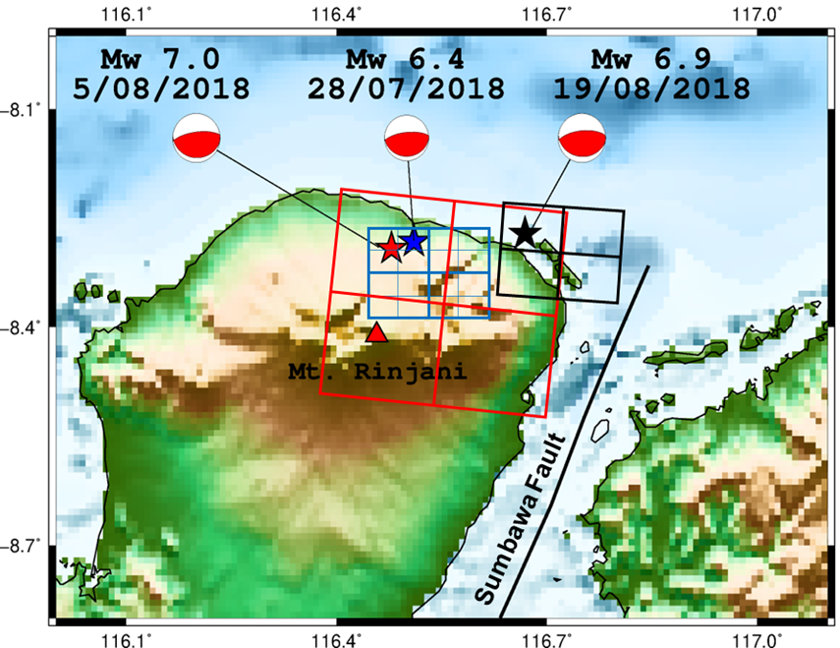
Seismic Source Modeling for the 2018 Lombok Earthquake Sequence Estimated from the Empirical Green’s Function Method
Aldilla Damayanti Purnama Ratri¹, Hiroe Miyake², Saeko Kita³, Takumi Hayashida³, Angga Wijaya¹, Akram Mujahid¹
¹Indonesia Agency for Meteorology, Climatology, and Geophysics (BMKG)
²Earthquake Research Institute (ERI), University of Tokyo
³International Institute of Seismology and Earthquake Engineering (IISEE)
1.Lombok is prone area of
earthquakes
2.Focus on Lombok
Earthquake sequences in
2018 (Mw 6.4 ; Mw 7.0 ;
Mw 6.9)
3.Conduct ground motion
simulations and source
modeling for these
earthquake sequence
4.Capture the rupture and
aftershock directions
Method : Empirical Green’s Function → Using smaller Earthquake with similar hypocenter and focal mechanism with target earthquake
Data : Earthquake data (BMKG and Global CMT) ; Strong motion data (BMKG)
Empirical Green’s Function Method (EGFM) has been successfully applied to conduct simulations and source modeling for the Lombok earthquake sequence in 2018.
This source modeling can capture the rupture and aftershock direction which is important for seismic hazard assessment
Combination of three seismic source models for the 2018 Lombok earthquake sequence
Please do not use this space, a QR code will be automatically overlayed
P1.2-217

Slide 2
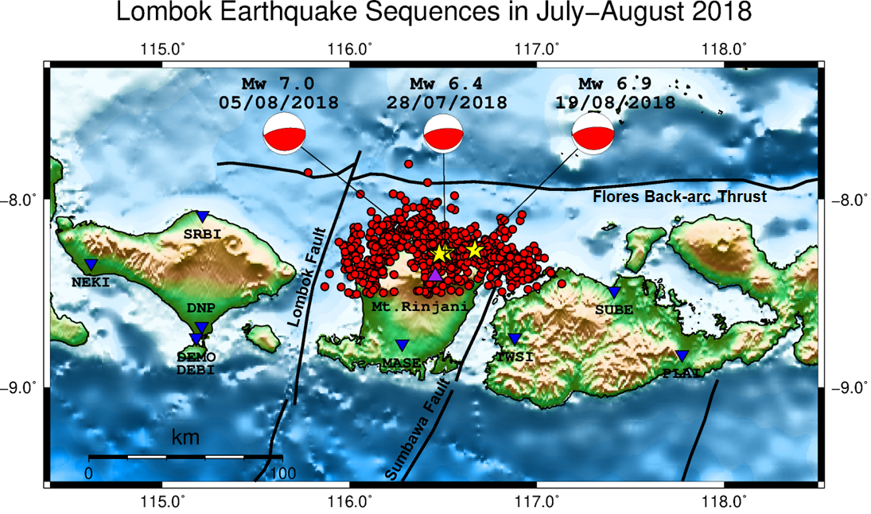
INTRODUCTION
Lombok is a prone area of earthquakes.
Focus on Lombok earthquake sequences in 2018 (Mw 6.4 ; Mw 7.0 ; Mw 6.9)
Please do not use this space, a QR code will be automatically overlayed
P1.2-217

Slide 3
OBJECTIVES
Conduct ground motion simulations and source modeling for these earthquake sequence.
Capture the rupture and aftershock directions.
Please do not use this space, a QR code will be automatically overlayed
P1.2-217

Slide 4
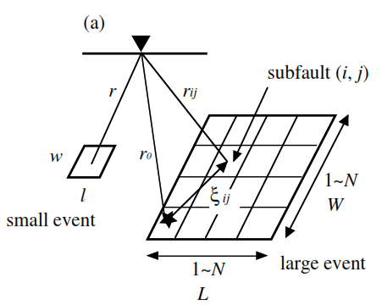
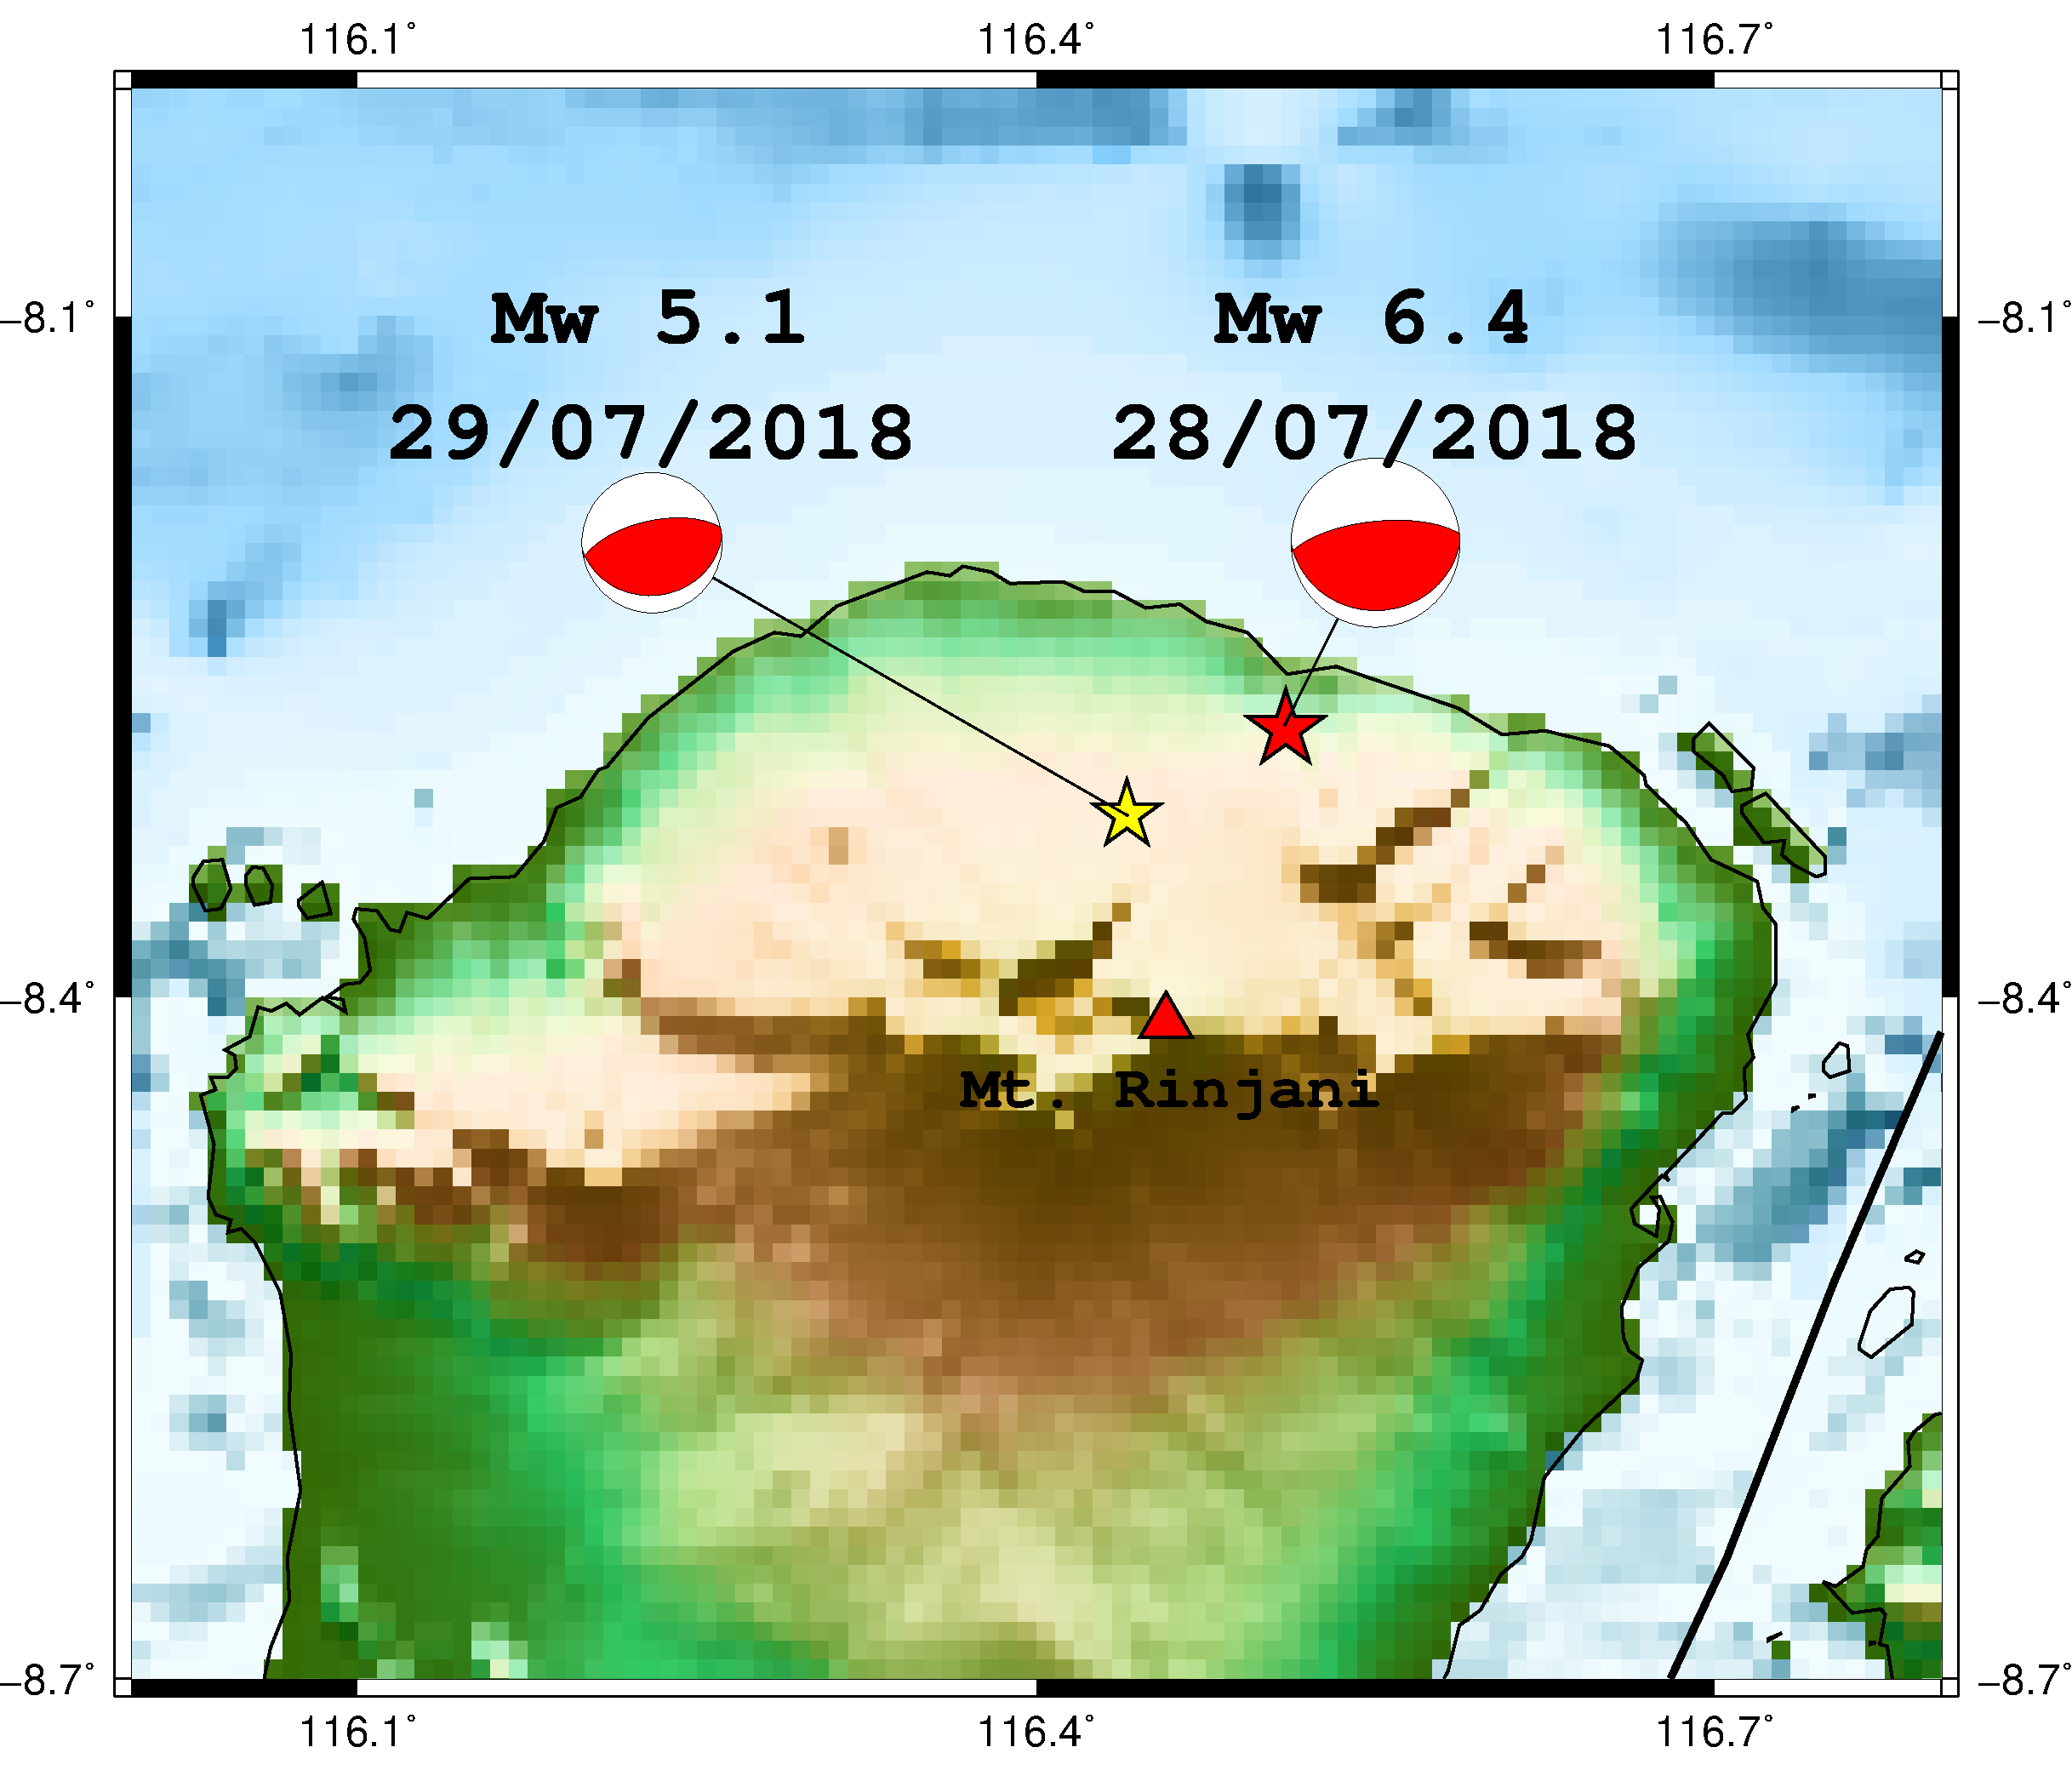
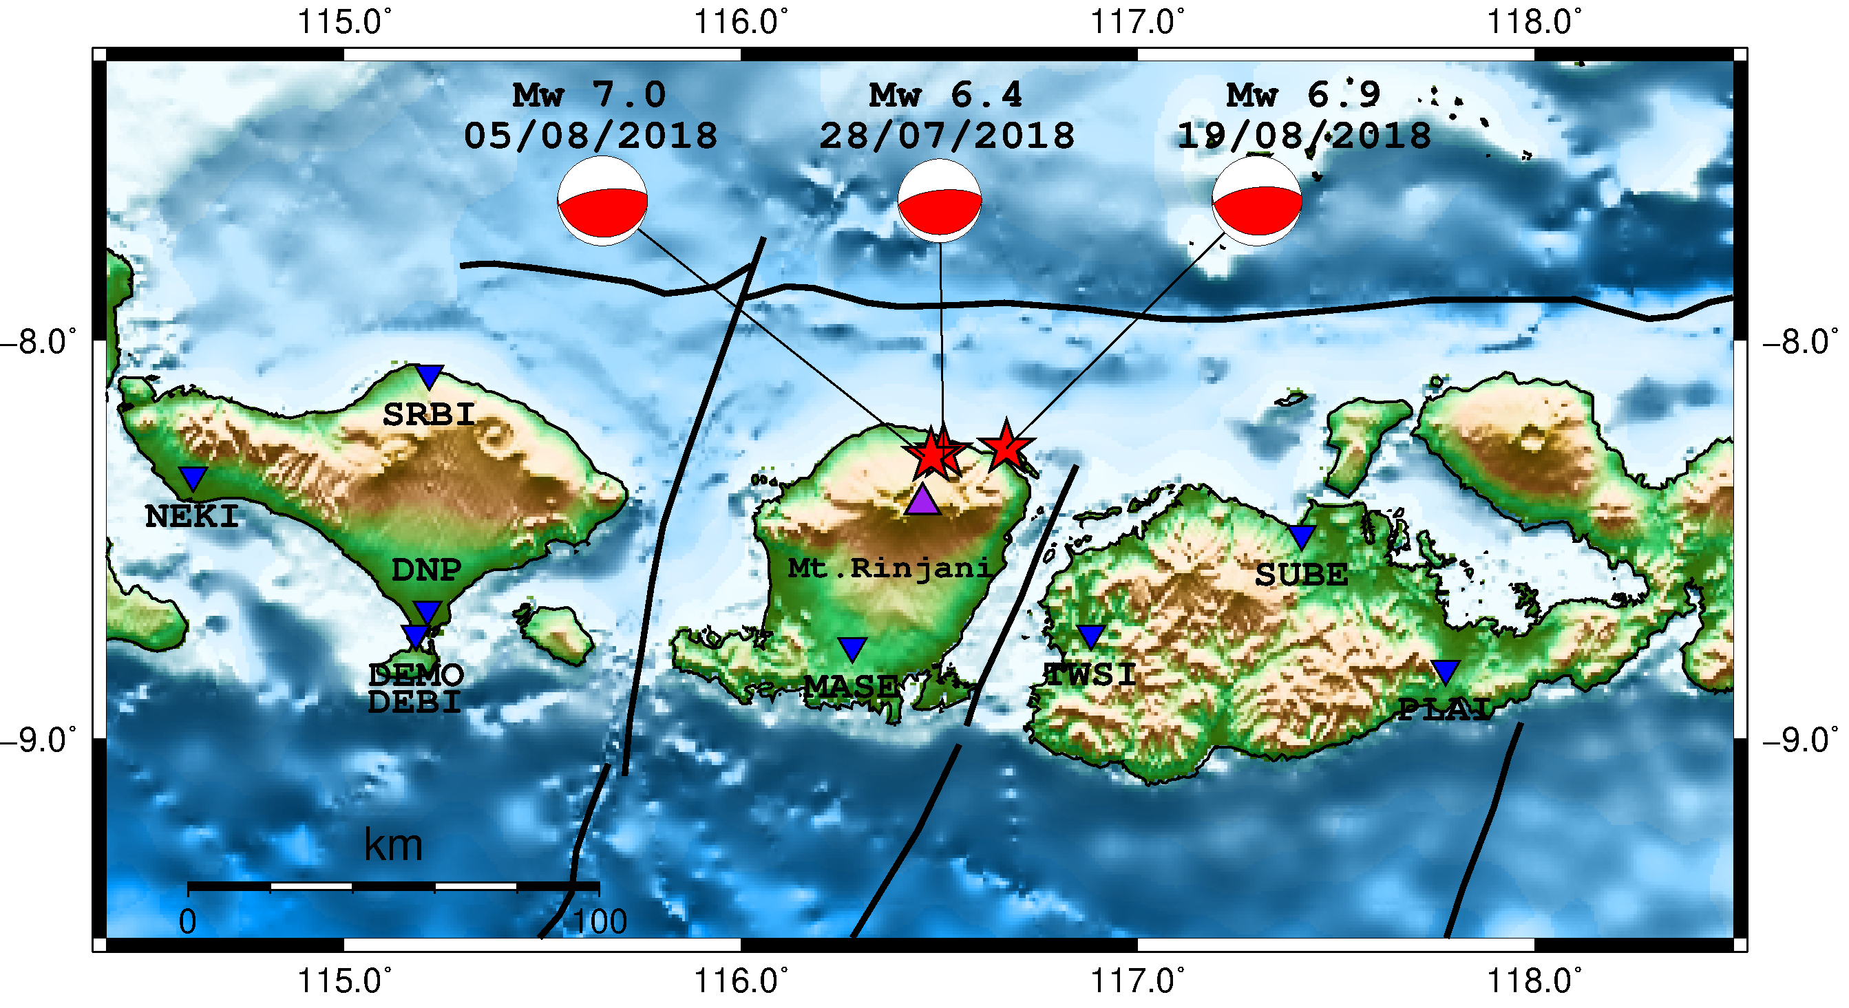
METHODS / DATA
Earthquake Data (BMKG and Global CMT)
Empirical Green’s Function Method (Miyake et al., 2003)
Foreshock (Mw 6.4)
Mainshock (Mw 7.0)
Largest aftershock (Mw 6.9)
EGF EVENT
HYPOCENTER
FOCAL MECHANISM
Please do not use this space, a QR code will be automatically overlayed
TARGET EVENT
P1.2-217
Distribution of strong motion station

Slide 5
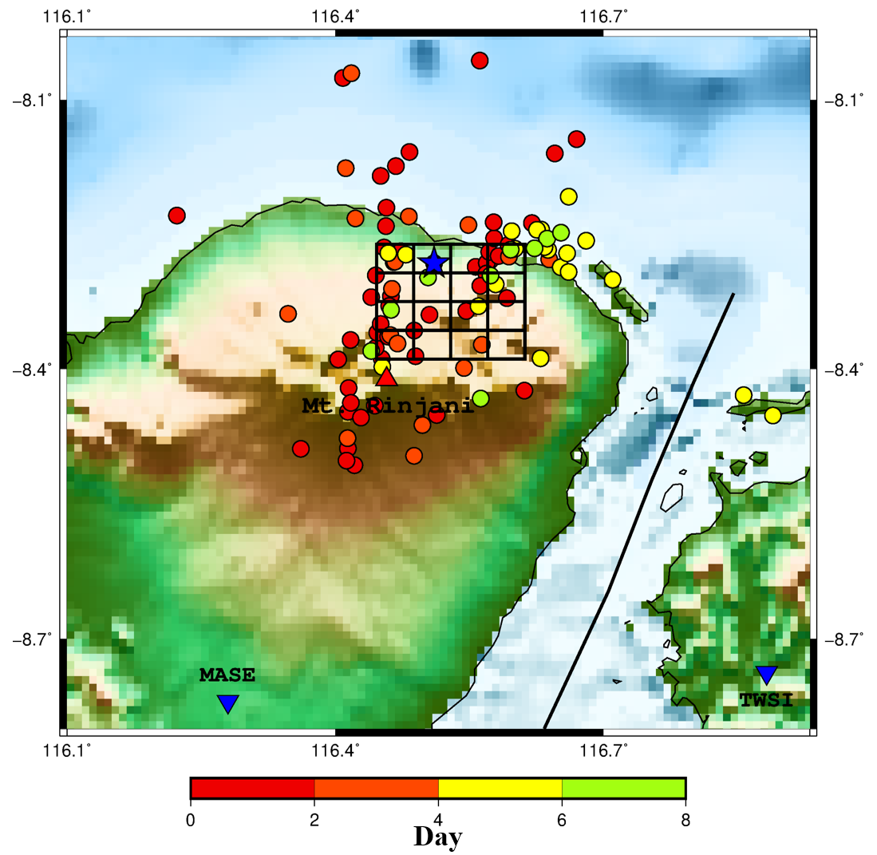
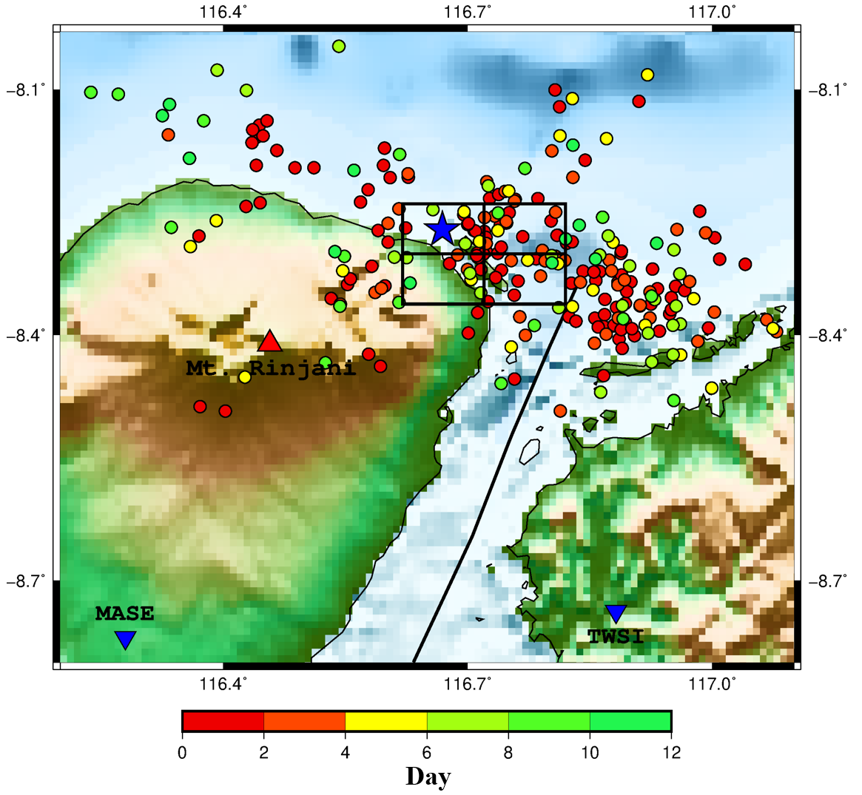
RESULTS
Source models for the 2018 Lombok Earthquake sequence
Day
Foreshock (Mw 6.4)
Mainshock (Mw 7.0)
Combination of three source models for the 2018 Lombok earthquake sequence
Please do not use this space, a QR code will be automatically overlayed
P1.2-217
Largest aftershock (Mw 6.9)

Slide 6
CONCLUSIONS
Empirical Green’s Function Method (EGFM) has been successfully applied to conduct simulations and source modeling for the Lombok earthquake sequence in 2018.
This source modeling can capture the rupture and aftershock direction which is important for seismic hazard assessment.
Please do not use this space, a QR code will be automatically overlayed
P1.2-217

Slide 7
References
Miyake, H., Iwata, T., & Irikura, K., 2003, Source characterization for broadband ground-motion simulation: Kinematic heterogeneous source model and strong motion generation area, Bulletin of the Seismological Society of America, 93(6), 2531-2545.
Please do not use this space, a QR code will be automatically overlayed
P1.2-217

