Slide 1
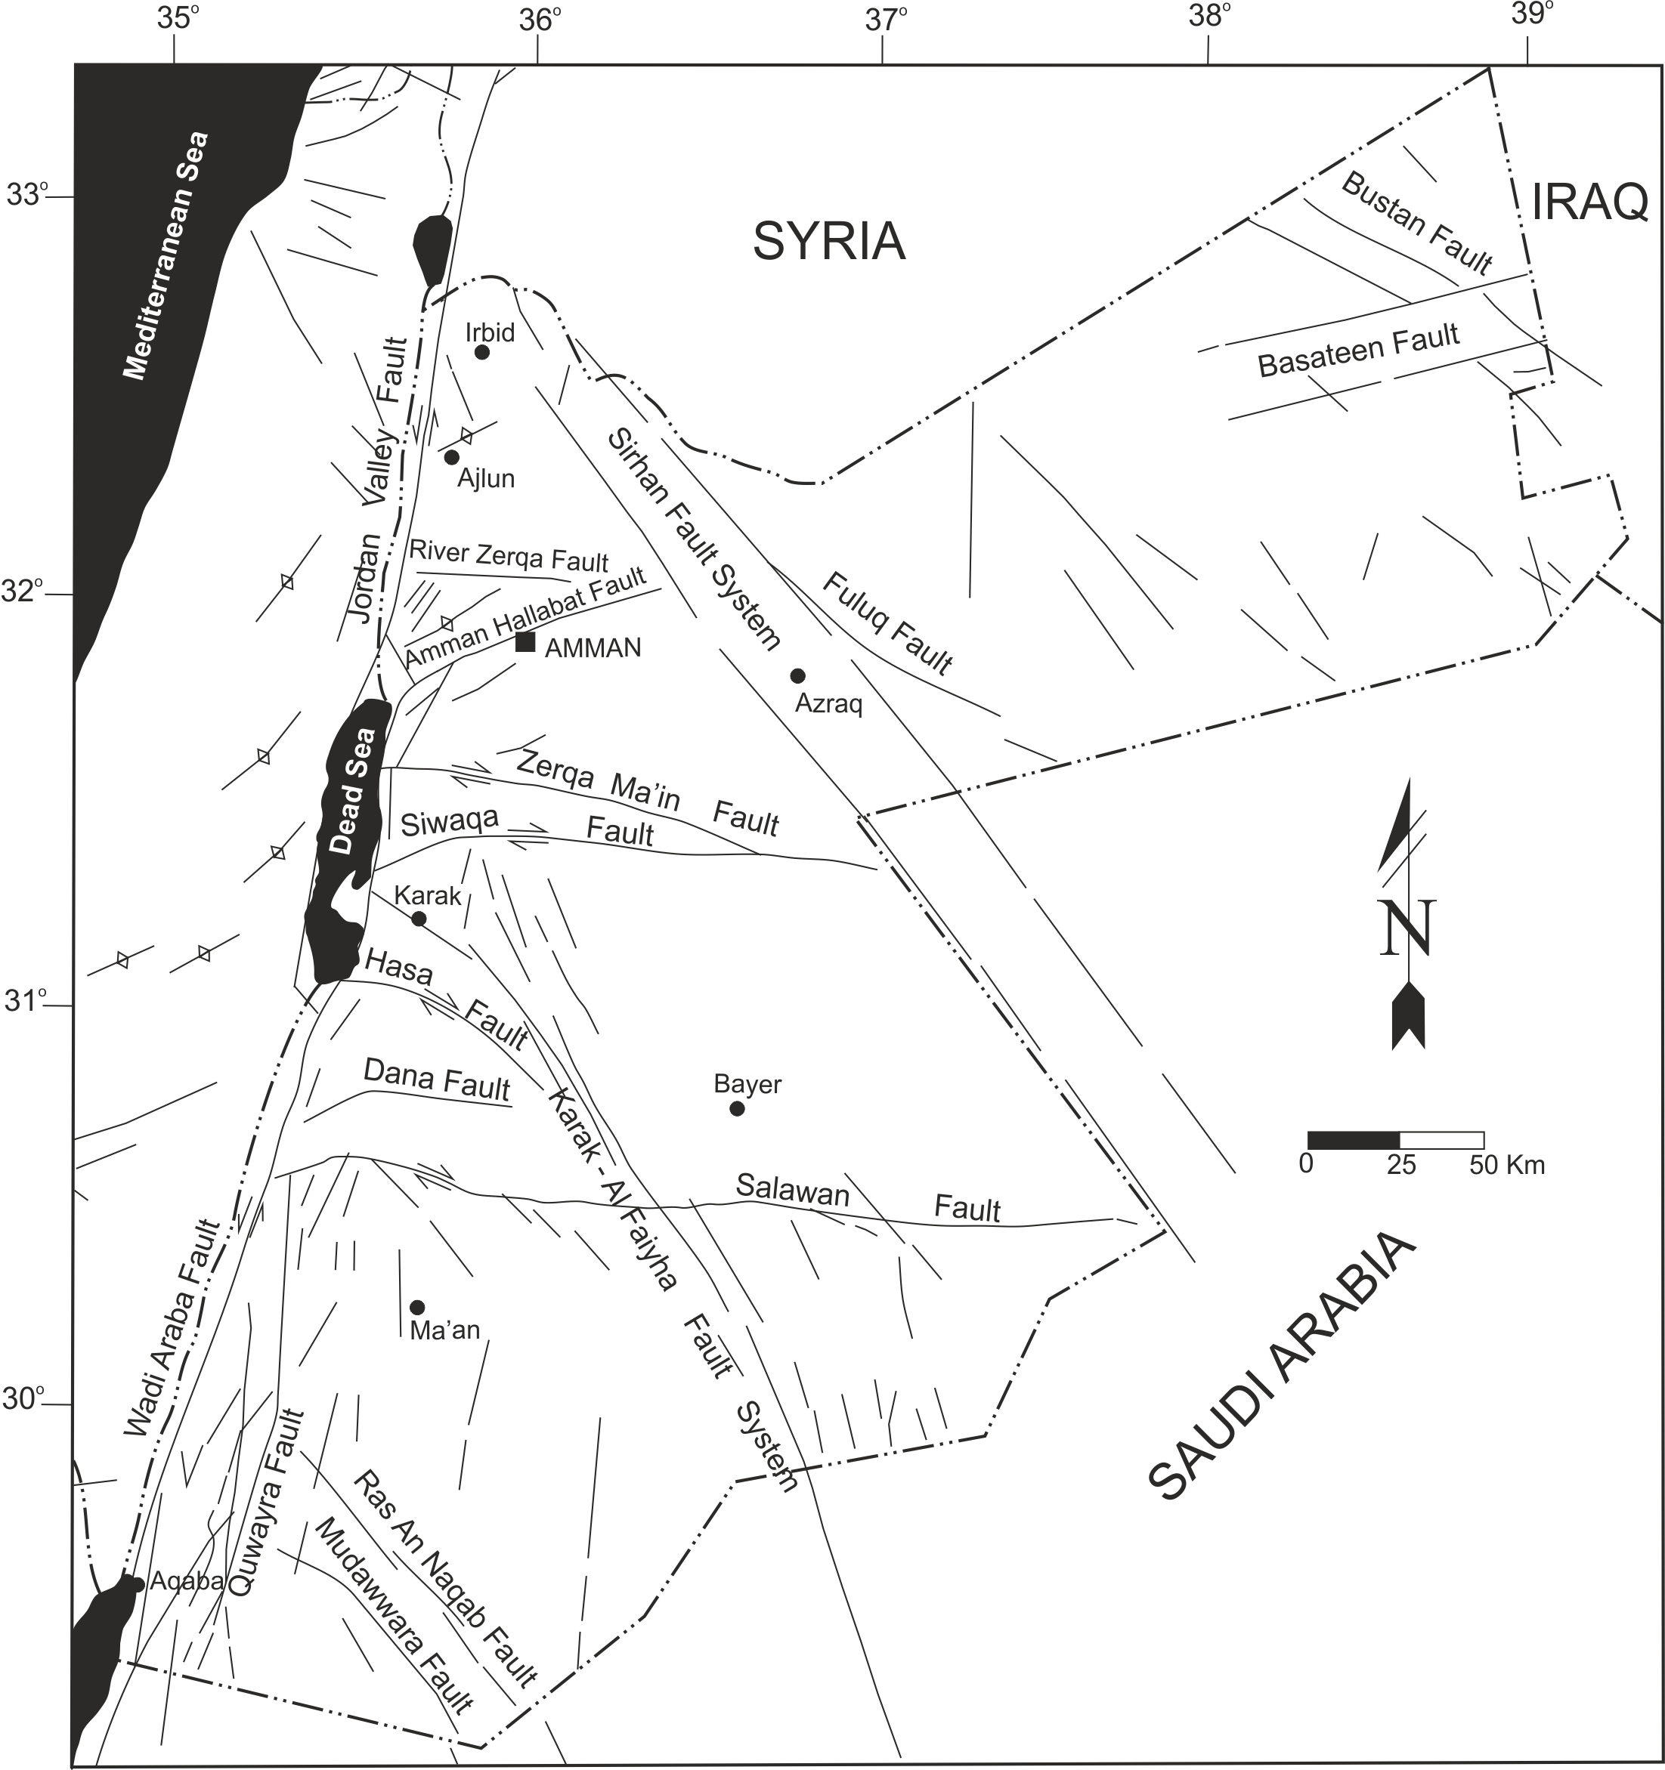
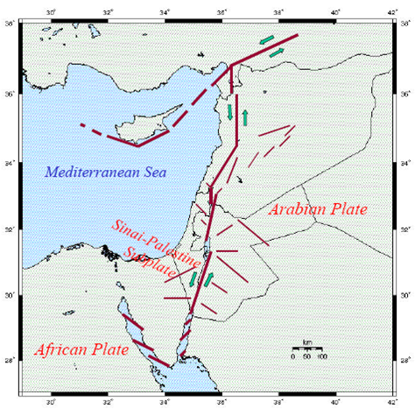
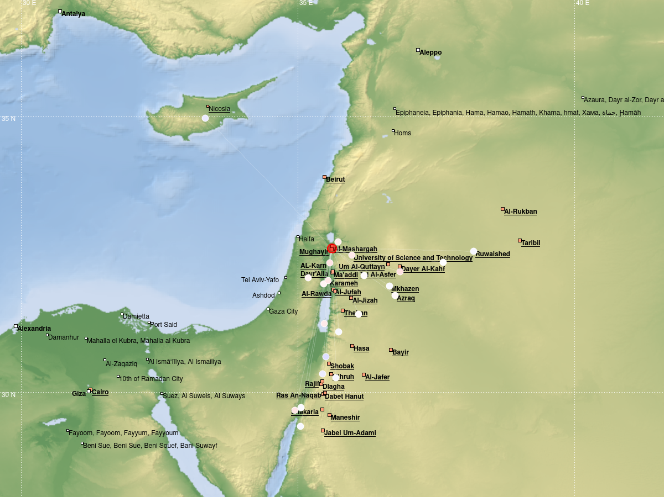
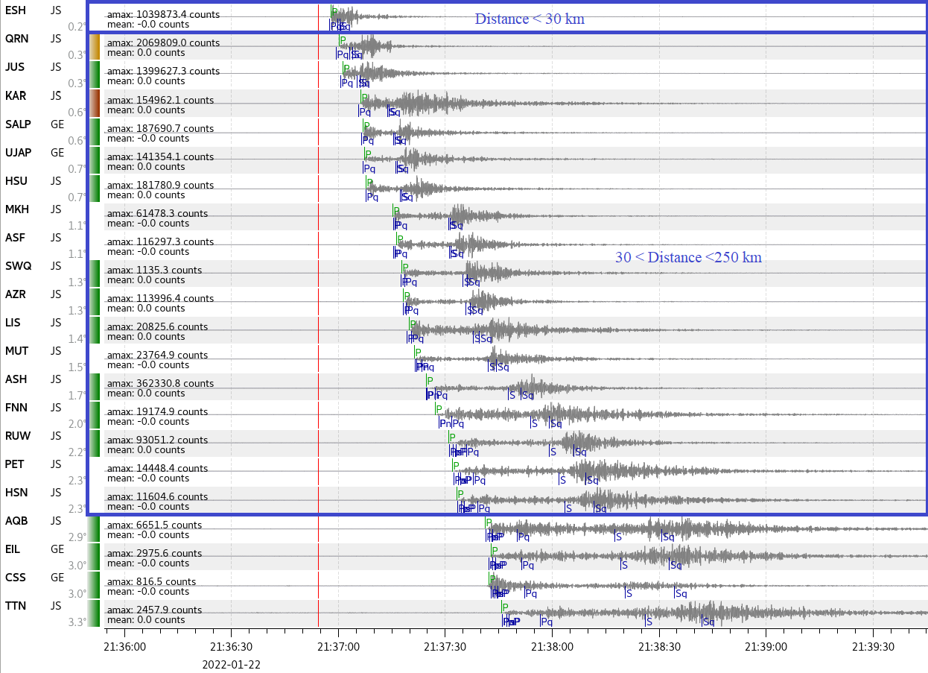
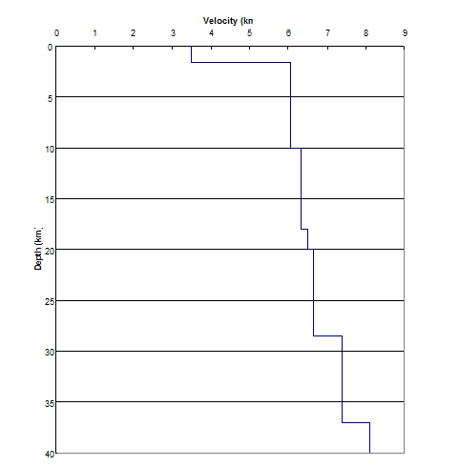
Improving Location Accuracy for Seismic (GT5) Events in Jordan
Murad Alhomaimat
Jordanian Seismological Observatory/Jordan National Data Center
Affiliation / Organization / Company / Institute [if any / Font: Arial Size: 14]
Px.x-xxx
Introduction
Seismic activity along the Dead Sea Transform Fault (DSTF) in Jordan
Installation of seismic networks for data collection
Role of the Jordan Seismological Network in recording ground vibrations
Objectives
Overview of seismic activity in Jordan
Importance of local seismic data and IMS data for validating velocity models
Significance of GT events in validating models and enhancing monitoring capabilities
Enhancing local velocity models using available data
Methodology and Data
Utilizing Jordan Seismological Network and available data sources and local Velocity Model to improving location accuracy.
If you want to learn more about this, come see my e-poster during e-poster virtual session 1 on Tue 20/06/2023 at 19:00 or access it online on the SnT2023 Conference platform!

