Slide 1
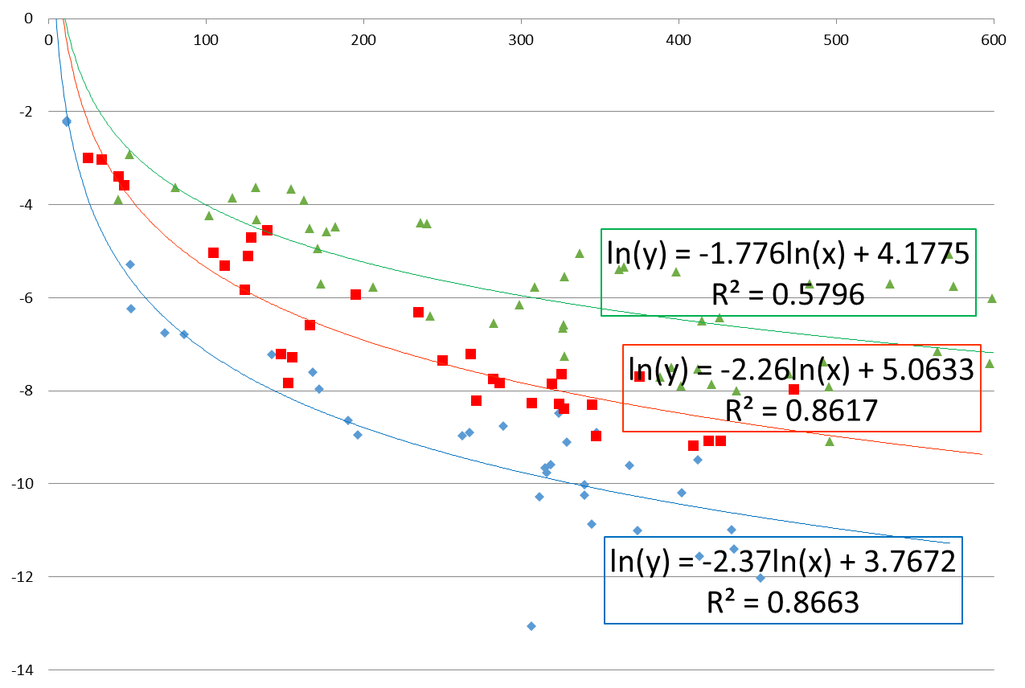
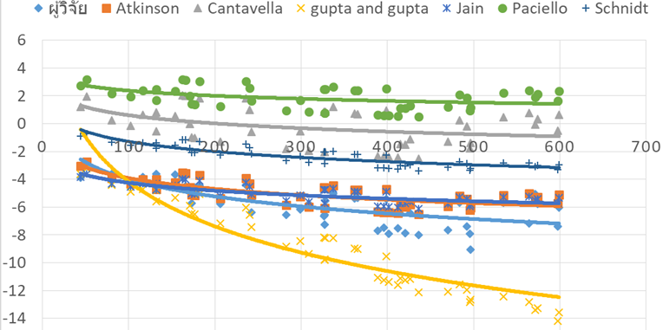
Ground motion prediction equation (GMPEs) in Thailand
Sophon Chaila
Earthquake observation division, Thai meteorological department
P1.2-289
We obtained a total of 465 PGA datasets and able to determine the highest R-squared for PGA and distance. We can divide GMPEs into three formulas according to the magnitude of an earthquake: less than 4.0, between 4.0 to 4.9, and greater than 5.0
The GMPEs equation for Thailand obtained for earthquakes magnitude less than 4.0 was found to be related to the Gupta and Gupta(2004) formula. For earthquakes of magnitude greater than 4.0 GMPEs are close to the Atkinson(2015) equation.
The result of R-squared of the peak ground acceleration vs distance for earthquake magnitude less than 4.0, 4.0-4.9 and >5.0 is 86.63%, 86.17, 57.96, respectively.
By comparing the six GMPE equations from other countries, Jain et al. (2000)’s equation was found to be consistent with the three equations we studied.

