Slide 1
Seismotectonics of the 2018 Abuja Earthquakes and Probabilistic Seismic Hazard Assessment in Nigeria
Umar Afegbua Kadiri
Centre for Geodesy and Geodynamics, National Space Research and Development Agency, Toro, Nigeria
Series of unusual earthquakes occurred in Abuja, Nigeria, in 2018 which raised serious concerns on the hitherto belief about the aseismic nature of the Nigeria. Study was undertaken to ascertain the causes and impacts of the events.
The study involved the collection of geological, geophysical (aeromagnetic, electrical conductivity, and gravity), space-based technique (GPS), infrasound, and seismological data within Mpape, Abuja and environs. Earthquake catalogue spanning 1933-2021 was used to perform PSHA for Nigeria.
Findings showed the causes of recent seismicity at Mpape were tectonics, as evidence of a fault was established at Mpape. A seismotectonic map of Mpape and at large Nigeria, was produced from the study.
A seismotectonic map of Mpape and Nigeria at large was produced from the study.
For the first time, earthquake hazard parameters and a hazard map have been established for Nigeria
Please do not use this space, a QR code will be automatically overlayed
P1.2-062

Slide 2
Introduction
The series of unusual earthquakes occurred in Abuja, Nigeria, in 2018 which raised serious concerns on the hitherto belief about the aseismic nature of the Country. Contrary to hitherto presumptions, low-magnitude earthquakes are now occurring in Nigeria and has become potential hazard to the nation that is building critical infrastructure to meet the surging population.
The events occurred on 5th-7th September, 1st November, and 18th of December, 2018. The 5-7 September 2018 whose magnitudes ranged from 2.5 to 3.0 and II-V on the modified Mercalli scale, were located at Mpape, a suburb of Abuja, about 3km to Nigeria’s presidential villa and other important critical structures like dams, nuclear research reactors etc.
A sequence of foreshocks were observed from 5-6th of September, 2018; the main earthquake and aftershocks occurred on 7th, 2018.
Impacts from the earthquakes were felt at Jahi, Asokoro, Maitama, Gwarimpa and Wuse, Katampe and Mpape area. There were however, no observed damages and properties or loss of lives as a result of the events.
P1.2-062
Please do not use this space, a QR code will be automatically overlayed

Slide 3
Objectives
Conduct detailed seismotectonic study of the area (using integrated techniques) in order to properly delineate the fault systems in the area
Ascertain the causes of the seismic activities and evaluate impacts on facilities
Perform Probabilistic Seismic Hazard Assessment (PSHA) across Nigeria and its immediate environs.
P1.2-062
Please do not use this space, a QR code will be automatically overlayed

Slide 4
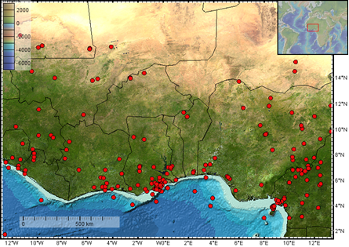
Methods/Data
The study involved the collection of geological, geophysical (aeromagnetic, electrical conductivity, and gravity), space-based technique (GPS), infrasound, and seismological data within Mpape, Abuja and environs.
Data were acquired from field surveys, local networks and international agencies. Earthquake catalogue spanned the period of 1933 to 2021
Perform Probabilistic Seismic Hazard Assessment (PSHA) across Nigeria and its immediate environs. The conventional procedures for the conduct of PSHA was followed including the harmonization different magnitude scales to Moment magnitude (Mw).
As earthquake catalogue for Nigeria is incomplete, an approach that incorporates both incomplete historical and complete parts of instrumental catalogue at different levels of magnitude completion was used in this study.
Seismicity map of West Africa showing seismicity of Nigeria
P1.2-062
Please do not use this space, a QR code will be automatically overlayed

Slide 5
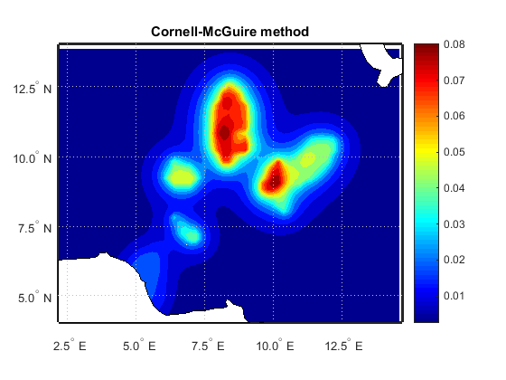
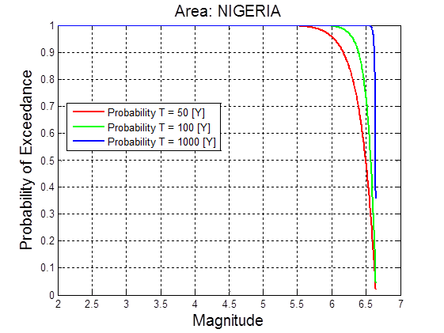
Results
Findings showed the causes of recent seismicity at Mpape were tectonics, as evidence of a fault was established at Mpape.
The b-value, activity rate and regional possible maximum magnitude were 0.69±0.07, 1.684±0.462 and 6.7±0.34.
Annual activity rates of earthquake magnitudes 2.0-3.0 are high, while the likelihood of earthquakes of magnitudes 5.0-6.0 occurring annually, 50 years, 100 years, and 1000 years were 0.7%, 75.81%, 99.70%, and 100%, respectively.
Return period of magnitude 6.0 earthquake is 143 years.
The PGAs for a 10% chance of exceeding in 50 years range between 0.01-0.08g.
Results are useful for planning and as baseline parameters for establishing seismic building codes in Nigeria.
P1.2-062
Please do not use this space, a QR code will be automatically overlayed
PGA (g) for 10% probability of exceedance in 50 years in Nigeria

Slide 6
Conclusion
CTBT’s resources assist scientists to undertake scientific research and cooperation in support of national needs. For the first time, the resources were used to realize in-depth analysis of likely causes of increased seismicity in Nigeria and implications on critical facilities.
A seismotectonic map of Mpape and at large Nigeria, was produced from the study.
For the first time, earthquake hazard parameters and a hazard map have been established for Nigeria
P1.2-062
Please do not use this space, a QR code will be automatically overlayed
seismotectonic map of Nigeria showing faults, earthquake epicenters etc.

Slide 7
References
Afegbua, K.U., Yakubu T. A., Akpan, U.O., Duncan, D., Usifoh, S.E., 2011. Towards an integrated seismic hazard monitoring in Nigeria using geodetic and geophysical techniques. International journal of the physical sciences. 6(28), 6385-6393.
Kijko, A., 2011. “Introduction to Probabilistic Seismic Hazard Analysis”. (Extended version of contribution by A. Kijko, Encyclopedia of Solid Earth Geophysics, Harsh Gupta (Ed.), Springer, 2011). 3-12.
Kijko, A., and Smit, A., 2012. Extension of the Aki-Utsu b-Value Estimator for Incomplete Catalogs. Bulletin of the Seismological Society of America. 102(3), 1283–1287. doi: 10.1785/0120110226.
Mavonga, T., Durrheim, R.J., 2009. Probability Seismic Hazard Assessment for the Democratic Republic of Congo and Surrounding Areas. Geological Society of South Africa. South African Journal of Geology. 112,329-342 doi:10.2113/gssajg.
McGuire, R. K., 1995. Probabilistic Seismic Hazard Analysis and Design Earthquakes. Closing the Loop. Bull. Seism. Soc. Am., 85. 1275–1284.
Meghraoui, M., Amphonsah, P., Ayadi, A., Ayele, A., Ateba, B., Bensuleman, A., Delvaux, D., El Gabry, M., Fermandes, R.M., Midzi, V., Roos, M., Timoulali, Y., 2016. The Seismotectonic map of Africa. Episodes. 39(1), Doi: 18814/epiiugs/2016/v391/89232.
P1.2-062
Please do not use this space, a QR code will be automatically overlayed

