Slide 1
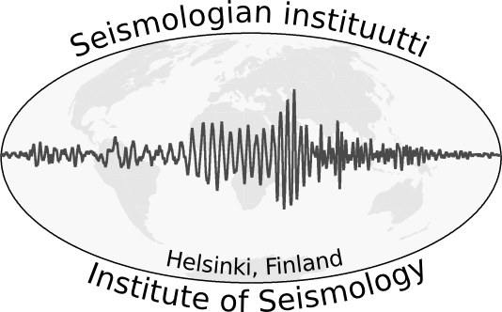
Reimaging the Fennoscandian Microseismicity
Tommi Vuorinen, Kati Oinonen, Jennifer Hällsten, Tuija Luhta
Institute of Seismology, University of Helsinki
The conventional picture of the seismicity in Finland, and the rest of Fennoscandia, has been that earthquakes are mostly “individual” events.
We seek to challenge this notion here.
We use a cross-correlation based template matching detector developed to monitor induced seismicity from an Enhanced Geothermal System (EGS), and run it using selected Finnish earthquakes.
The detector is able to find events orders of magnitude smaller than the template event.
If they have occurred.
The prelliminary results are promising, but the differences in target areas means that more research is necessary to find the optimal parameters.
Please do not use this space, a QR code will be automatically overlayed
P1.2-832

Slide 2
Introduction
The conventional picture of the seismicity in Finland, and the rest of Fennoscandia, has been that earthquakes are mostly individual or doublet events without fore or aftershocks. This notion of apparent singularity is based on an analysis workflow designed for regional events visible on multiple stations over a relatively sparse seismic network. On the other hand, it is known that in Wyborg rapakivi batholith, located in south-east Finland, earthquakes have been known to exhibit a more swarm type behaviour, with up to hundreds of smaller events following a (regionally) larger – a M2.0–3.0 – event.
In order to study the induced seismicity of an EGS plant in Otaniemi, we developed a template matching based event detector tool suite. Beyond the Otaniemi EGS, The tool was already tested on several earthquakes in Virolahti, located on the rapakivi batolith in SE Finland, where the tool was able to find dozens of additional events. Here we apply the detector suite to selected Finnish earthquakes in order to map the Fennoscandian microseismicity related to bigger events.
Please do not use this space, a QR code will be automatically overlayed
Example of a foreshock detection for a M2.3 event in Joensuu
P1.2-832

Slide 3
Objectives, the selected earthquakes and few words about parameters
Our goal is to provide a proof of concept that the detector works, and to begin painting a more comprehensive picture of the microseismicity related to the larger Fennoscandian events. This more detailed view of the microseismicity can provide additional insight into seismic hazard related to e.g. nuclear power, geothermal energy and other projects where seismic hazard analysis might be considered. In more practical terms, we also need to look into what kind of parameters are optimal for the purpose. In Otaniemi, the seismic network of hundred stations was located within a few tens of kilometers of the site. On the other hand, regionally we are talking about few stations within a few hundred kilometers! So, the scope of application is considerably different.
The template events were selected based on criteria that allow us to evaluate the performance of the detector tool suite in variable conditions.
Bothnian bay M 4.2 on 2016-03-19 21:55 at 65.066N 22.525E, depth of 21.6 km
Selected because it has known aftershocks and because it is located near a denser OBF seismic station network.
Liminka M 3.3 on 2017-12-07 22:32 at 64.785N 25.370E, depth of 37.6 km
Another event within the denser OBF-network. This time with a much larger depth.
Joensuu M2.3 on 2022-12-13 20:11 at 62.788 N 30.231 E, depth of 1.5 km
Event that happened in a location with very few known historical events and only 2 stations under 150 km from the event!
Please do not use this space, a QR code will be automatically overlayed
P1.2-832

Slide 4
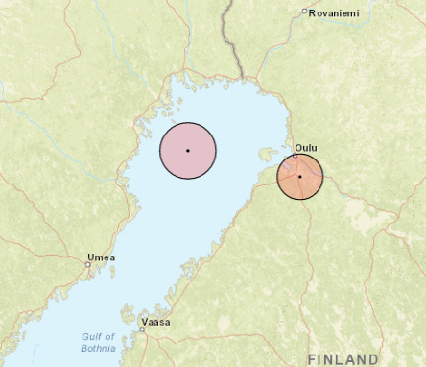
Data and results from the OBF-network events
The OBF network was a 10-station seismic network that was constructed to monitor a planned nuclear power plant in Pyhäjoki, Finland. This gives us a relatively dense network, with multiple stations under 150 km, of uniform devices all recording at 250 Hz. The Bothnian
Bay seaside is also relatively active seismically.
Bothnian Bay M 4.2, 2016-03-19 21:55
3 previously known aftershocks before midnight, and several the following day
The detector was able to find 6 + 3 events before midnight
3 candidate events need more confirmation
Magnitudes range from 0.15 to 0.4
Further investigation in progress
Liminka M 3.3, 2017-12-07 22:32
No known fore- or aftershocks
The detector did not find immediately confirmable events
Several candidates, largest has amplitude estimated M -0.4
The large depth – 35+ km – makes the event quite unique
Stat
Map of the template events. The larger circle is the M4.2 event, and the smaller is the M3.3 event
Please do not use this space, a QR code will be automatically overlayed
P1.2-832

Slide 5
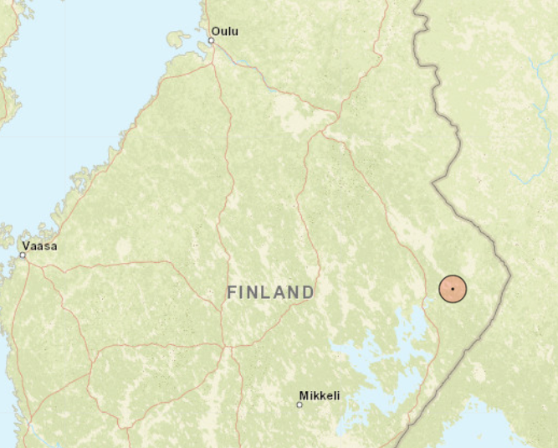
Results from Joensuu
Joensuu earthquake, the M2.3 on 2022-12-13 20:11, happened in the Eastern Finland in a location where there have been very few known events. Coincidentally, the only other EQ within 50 kilometers since 2000 happened in June 2020, a M1.4 around 25 kilometers south-east.
The Joensuu earthquake turned out to be interesting. The detector was able to find both a foreshock and an aftershock. The foreshock event (see slide 2) occurred 10 hours before the mainshock. The aftershock, pictured below, happened 14 hours after the mainshock and 24 hours after the foreshock. Both the foreshock & aftershock have an estimated M of ~0.3.
Map of the Joensuu M2.3 event.
Please do not use this space, a QR code will be automatically overlayed
P1.2-832

Slide 6
Conclusions & what next?
The examples here show that the detector suite can be used to find more events using templates from Fennoscandian earthquakes. This supports the findings from Virolahti. The results also show the complexities of applying a methodology developed to a dense near-field network to a completely different settings.
Finding the best detector parametrization is difficult, and most likely needs to be considered case-by-case. Here we have used similar set of parameters (n.b. in total, there are ~100 configurable settings) for all events: 10 to 20 Hz bandpass filtering, 26 second template window with 1 second lead from P-arrival and lax correlation requirements. The choice of frequency band is especially interesting: Lower frequency band → Higher correlation, better quality events. Higher frequency band, on the other hand, might enable us to detect weaker events. There are trade-offs either way!
The tool will be eventually integrated into daily analysis, but before that, we are planning on having a project focusing on the OBF-network area to both map the seismicity in the area better, but also to develop the detector further and to give more insight on the effect of different parameters.
Please do not use this space, a QR code will be automatically overlayed
P1.2-832

Slide 7
References
These are some of the sources that were used across the e-poster
Chamberlain, et al., 2018. EQcorrscan: Repeating and near-repeating earthquake detection and analysis in Python. Seismological Research Letters, 89(1), pp.173-181.
Luhta, et al., 2022, December. Rapakivi Seismicity–Shallow Swarm-type Intraplate Earthquakes in Southern Finland on the Seismically Quiescent Fennoscandian Shield. In AGU Fall Meeting Abstracts (Vol. 2022, pp. T25D-0159).
Veikkolainen, et al., 2021. The Finnish national seismic network: Toward fully automated analysis of low-magnitude seismic events. Seismological Research Letters, 92(3), pp.1581-1591.
Vuorinen, et. al., 2023. Detecting and mapping the induced seismicity of a planned EGS in Helsinki/Espoo, Finland (No. EGU23-15982). Copernicus Meetings.
Please do not use this space, a QR code will be automatically overlayed
P1.2-832

