Slide 1
Seismic Hazard Studies in Sub-Saharan Africa Using Integrated Techniques
Umar Afegbua Kadiri
Centre for Geodesy and Geodynamics, National Space Research and Development Agency, Toro, Nigeria
Performance of Seismic hazard assessments (SHA) in large parts of the Sub-Saharan Africa is challenging due to incomplete earthquake catalogues, sparse seismic networks or complete absence of seismic stations, etc. raising concerns on needed information for planning and disaster risk management.
Mixed earthquake (Historical and Instrumental) catalogues were updated and spanning 1615-2022. Traditional procedures in Probabilistic Seismic Hazard Assessment were adopted to calculate earthquake recurrence parameters and hazard for the study areas so far covered with a 10% probability of exceeding in 50 years.
Computed Gutenberg-Richter b-value, activity rates, and regional maximum possible magnitudes ranged from 0.69 to 1.0, 1.6 to 2.1, and 5.2 to 7.2 respectively. Peak ground accelerations ranged from 0.02g to 0.2g for a 10% chance of exceedance in 50 years. Results are expected to make significant contribution to planning in the vast region.
The seismic hazard predicted by GMMs for stable continental areas is higher than those predicted by GMMs for shallow crustal seismicity for most parts of the region. Results from this study are expected to contribute a great revolution to seismic hazard assessments study in Sub-Saharan Africa. It has potential for the promotion of healthy collaboration with larger scientific communities.
Please do not use this space, a QR code will be automatically overlayed
P1.2-061

Slide 2
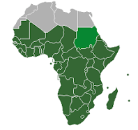
Geographical map of sub-Saharan Africa
Geographical map of sub-Saharan Africa
Geographical map of sub-Saharan Africa
Geographical map of sub-Saharan Africa
Sub-Saharan Africa
Geographical map of sub-Saharan Africa
Sub-Saharan Africa
Introduction: Seismic Hazard Studies in the Sub-Saharan Africa
Sub-Saharan Africa refers to the area and regions of the African continent that are located south of the Sahara. Central Africa, East Africa, Southern Africa, and West Africa are among them. Geographically, in addition to African countries and territories that are entirely located in that region, the term may also refer to polities that only have a portion of their territory in that region.
Major cities in this region include: Abidjan, Accra, Addis Ababa, Cape Town, Dar es Salaam, Durban, Harare, Johannesburg, Juba, Kampala, Kinshasa, Lagos, Luanda, Lusaka, Mogadishu, Nairobi, Pretoria, Windhoek.
Performance of Seismic hazard assessments (SHA) in large parts of this region have been challenging due to incomplete earthquake catalogues, sparse seismic networks or complete absence of seismic stations, etc. raising concerns on needed information for planning and disaster risk management.
As a result of seismic activities associated with East African Rift System, a number of SHA have been conducted here. Other parts of the Sub-Saharan African region mainly covered in this work include Western Africa, Southern African, etc.
.
P1.2-061
Geographical map of sub-Saharan Africa
Please do not use this space, a QR code will be automatically overlayed

Slide 3
Objectives
Creation of distinct seismic source zones for Sub-Saharan Region
Performance of PSHA for the whole region using mixed earthquake catalogues
Production of hazard maps at different periods for the region to aid planning
Improvement on knowledge of the region’s seismicity
To bridge the research gap using modern (integrated) techniques in SHA.
P1.2-061
Please do not use this space, a QR code will be automatically overlayed

Slide 4
Methods/Data
Updated catalogue from local networks within the region, CTBTO's National Data Centres, International Seismological Centre and publications spanning 1615-2022 with threshold and maximum moment magnitudes (Mw) of 4.0 and 6.8 formed the dataset.
The catalogue was declustered and harmonized to Mw. Available geological data was used to delineate area source zones and computation of earthquake recurrence parameters. We adopted the method described by Scordilis (2006) to convert M_{S} and mb into M_{W}
Depending on the area, three or four ground motion prediction equations for tectonically similar regions to Sub-Saharan Africa were implemented using logic tree formalism in the calculation, with all equations weighted equally.
We used the OpenQuake software (Marco et al., 2016) to calculate the hazard for the study areas so far covered with a 10% probability of exceeding in 50 years.
The earthquake recurrence parameters were calculated using the maximum-likelihood approach, which was implemented in the AUE MATLAB program developed by Kijko and Smit (2012).
P1.2-061
Please do not use this space, a QR code will be automatically overlayed

Slide 5
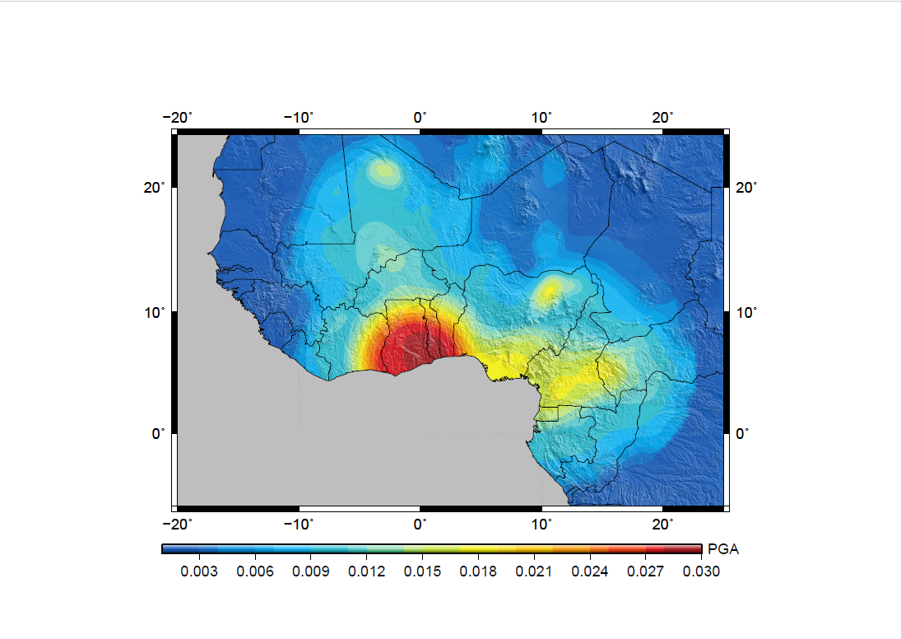
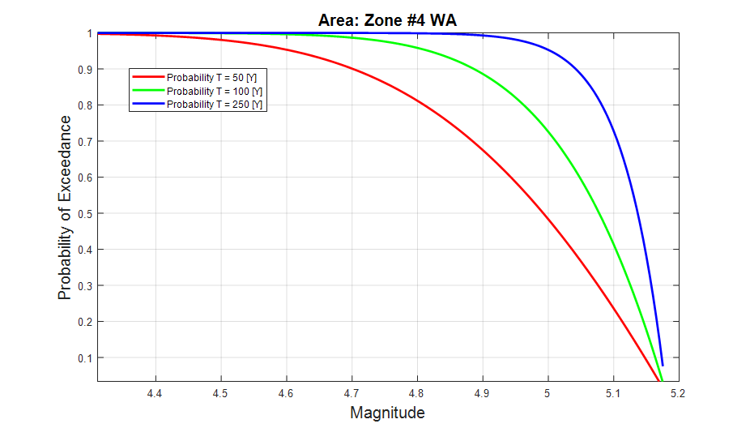
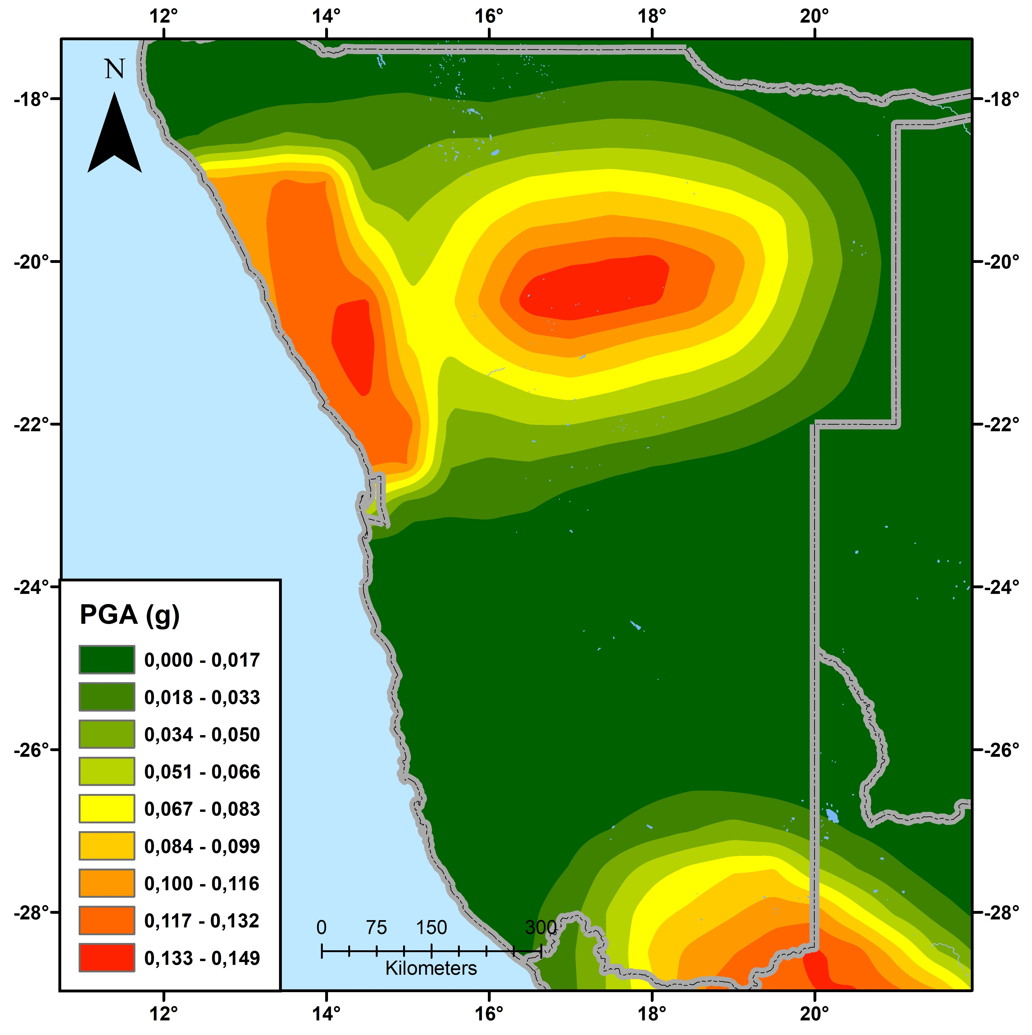
The earthquake recurrence parameters were calculated using the maximum-likelihood approach, which was implemented in the AUE MATLAB program developed by Kijko and Smit (2012).
Results
Computed Gutenberg-Richter b-value, activity rates, and regional maximum possible magnitudes ranged from 0.69 to 1.0, 1.6 to 2.1, and 5.2 to 7.2 respectively, within the 1-1000 year period considered. Peak ground accelerations ranged from 0.02g to 0.2g for a 10% chance of exceedance in 50 years and seismic hazard maps for 0.1s, 0.2.s, 0.3s, 0.5s, and 0.15s periods were produced. Results are expected to make significant contribution to planning in the vast region.
P1.2-061
The probability of at least once exceeding the specified magnitude within the time periods of 50, 100 and 1000 years
PGA (g) for 10% probability of exceedance in 50 years in West Africa under the assumption of the area (a) lying on stable continental areas
Expected PGA (g) for a 10% chance of exceeding at least once every 50 years for the Namibia and neighbours in Southern Africa.
Please do not use this space, a QR code will be automatically overlayed

Slide 6
Conclusion
The seismic hazard predicted by GMMs for stable continental areas is higher than those predicted by GMMs for shallow crustal seismicity for the region. Hence, it was confirmed from our results that, WA which part of Sub-Saharan Africa is characterized by stable continental crust. Here, the highest hazard levels were observed in parts of Ghana, Togo, Guinea-Bissau, Guinea and the region of Cameroun Volcanic Line (CVL) ranging between 0.02g and 0.03g.
Peak ground accelerations obtained for a 10% chance of exceeding in 50 years ranged from 0.017g to 0.149g in parts of Southern Africa.
SHAs conducted in parts of the Sub-Saharan African are expected to contribute a great revolution to seismic hazard assessments study for the first time in Sub-Saharan Africa, in knowledge, idea and data exchange. It has potential for the promotion of healthy collaboration with larger scientific communities.
P1.2-061
Please do not use this space, a QR code will be automatically overlayed

Slide 7
References
1. Kadiri, A.U., Sitali, M., Midzi, V. (2023). Probabilistic Seismic Hazard Assessment in Namibia. Journal of African Earth Sciences. 202 (2023) 104933. https://doi.org/10.1016/j.jafrearsci.2023.104933
2. Kadiri A.U. and Kijko A. (2021). Seismicity and seismic hazard assessment in West Africa. Journal of African Earth Sciences 183, 104305. Pp. 1-16. https://doi.org/10.1016/j.jafrearsci.2021.104305
3. Kadiri Afegbua Umar & Paulina Ekua Amponsah (2021). Computation of area characteristic seismicity parameters in Ghana, Nigeria, and immediate neighbors. Arabian Journal of Geosciences. 14:1213. https://doi.org/10.1007/s12517-021-07558-6
4. Marco, P, Vitor S, Graeme W, Anirudh R, Michele S.,2016. OpenQuake 2016 Ver. 6.1: program for computing seismic hazard. GEM Foundation, Pavia
5. Kijko, A. and Smit, A.,2012, Extension of the Aki-Utsu b-Value Estimator for Incomplete Catalogs. Bulletin of the Seismological Society of America. 102(3): 1283–1287, doi: 10.1785/0120110226
6. Scordilis, E. M., 2006. Empirical global relations converting MS and mb to moment magnitude:J. Seismol,10,225–236, DOI 10.1007/s10950‐006‐9012‐4 C.
P1.2-061
Please do not use this space, a QR code will be automatically overlayed

