Slide 1
Crust-uppermost mantle structure beneath the Caribbean region from seismic ambient noise tomography.
Bladimir Moreno¹, Abdelkrim Aoudia², Daniel Manu-Marfo², Radia Kherchouche³ and Surya Pachhai⁴
The Caribbean plate shows a widespread crustal thickness between oceanic and continental crust, although most of the Caribbean Sea is dominated by a thick oceanic or extended continental crust with a Moho depth between 11 and 25 km.
The complete work can be found in the following journal issue: Bulletin of the Seismological Society of America (2023) 113 (3): 1064–1076. https://doi.org/10.1785/0120220062
bladimir@cenais.cu
The Caribbean plate is a very complex area with subduction zones, oceanic basins, rifts, rises and a predominantly thick oceanic crust.
The group and phase dispersions curves were obtained by computing the Rayleigh wave Green function between each pair of stations by cross-correlating ambient noise signals.
¹Centro Nacional de Investigaciones Sismológicas (CENAIS). Cuba.
²The Abdus Salam International Center for Theoretical Physics (ICTP).Trieste, Italy.
³Centre de Recherche en Astronomie, Astrophysique et Géophysique. Algerie.
⁴Department of Geology and Geophysics, The University of Utah. USA.
P1.2-346

Slide 2
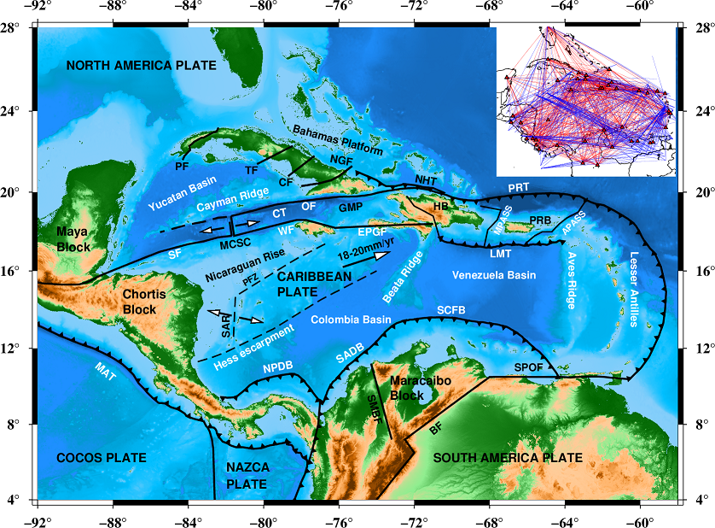
Introduction
The Caribbean plate is a very complex area with subduction zones, oceanic basins, rifts, rises and a predominantly thick oceanic crust. Here, the group and phase dispersion curves derived from seismic ambient noise cross-correlation were joined with the group velocity dispersion curves obtained from earthquakes data. That allowed to reduce by a factor of two the surfaces wave’s tomography resolution of previous studies. Using both group and phase dispersion curves, a 3D shear wave velocity model of the crust and upper mantle to depths of 150 km was obtained for the Caribbean region.
Tectonic setting of the Caribbean region. NGF: Nipe-Guacanayabo Fault, NHT: North Hispaniola Trench, PRT: Puerto Rico Trench, GMP: Gonave Microplate, HB: Hispaniola Block, MCSC: Mid Cayman Spreading Center, LMT: Los Muertos Trench, SCFB: South Caribbean Fold Belt, SADB: South America Deformed Belt, NPDB: Northern Panama Deformed Belt, MAT: Middle America Trench, SMBF: Santa Marta-Bucaramanga Fault, BF: Bocono Fault, SPOF: San Sebastian-El Pilar-Oca Fault System, SAR: San Andres Rift, OF: Oriente Fault, CT: Cayman Trough, WF: Walton Fault, EPGF: Enriquillo Plantain Garden Fault, SF: Swan Fault, MPASS: Mona Passage, APASS: Anegada Passage, CF: Camaguey Fault, TF: Trocha Fault, PF: Pinar Fault, PFZ: Pedro Fault Zone. Upper right map shows rays paths cover of the area (red for earthquake data).
P1.2-346

Slide 3
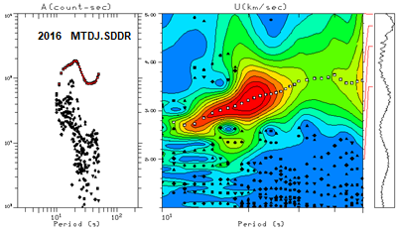
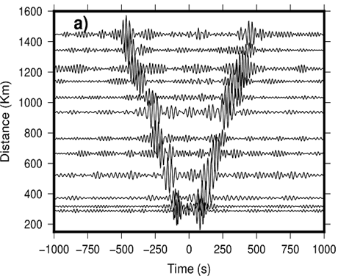
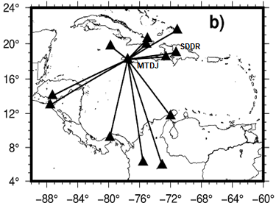
Methods and Data
The continuous waveforms data of several years were obtained from the Incorporated Research Institutions for Seismology (IRIS). https://www.iris.edu. The group and phase dispersions curves were obtained by computing the Rayleigh wave Green function between each pair of stations by cross-correlating ambient noise signals (Bensen et al., 2007). From 534 high quality Green functions with signal to noise ratio SNR > 7 were measured fundamental mode group and phase velocities by frequency-time analysis (Hermann and Ammon, 2002) between periods of 10 to 70 sec. We applied the method of Ditmar and Yanovskaya (1987), based on a generalization to 2D of the 1D approach of Backus and Gilbert (1968) for the 2-D surface wave tomography. The data of 357 group velocity dispersion curves was also incorporated. The area was divided in 750 cells of 1x1 degrees, given a lateral resolution of 300 km. The estimation of 3-D shear wave velocities from the dispersion data was done with a fully non-linear Bayesian approach (Pachhai et al., 2014).
P1.2-346
Dispersion curves measurements using DO-MFT utility (Herrmann, 2013).
The selected fundamental mode is identified by white points.
Record sections (band-pass filter from 20s to 30s) of cross correlations obtained from up to two years of continuous data for station pairs shown in (b).
Ray-paths from station MTDJ to some stations crossing different tectonic areas.

Slide 4
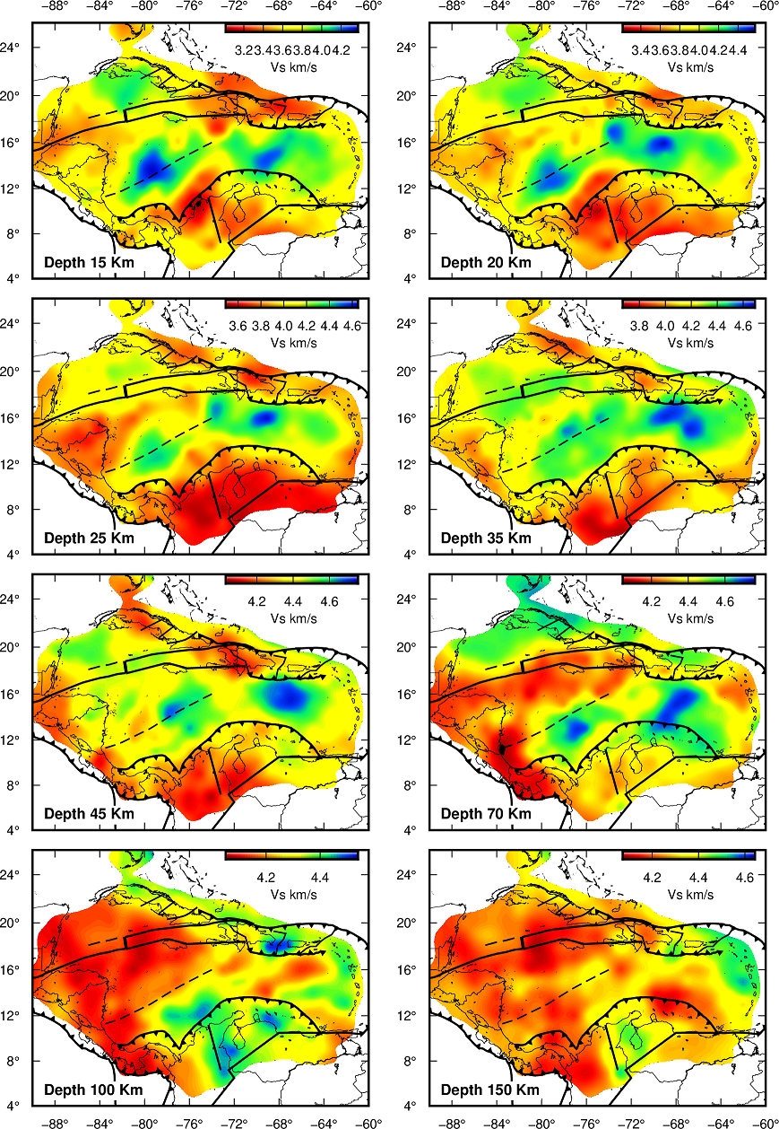
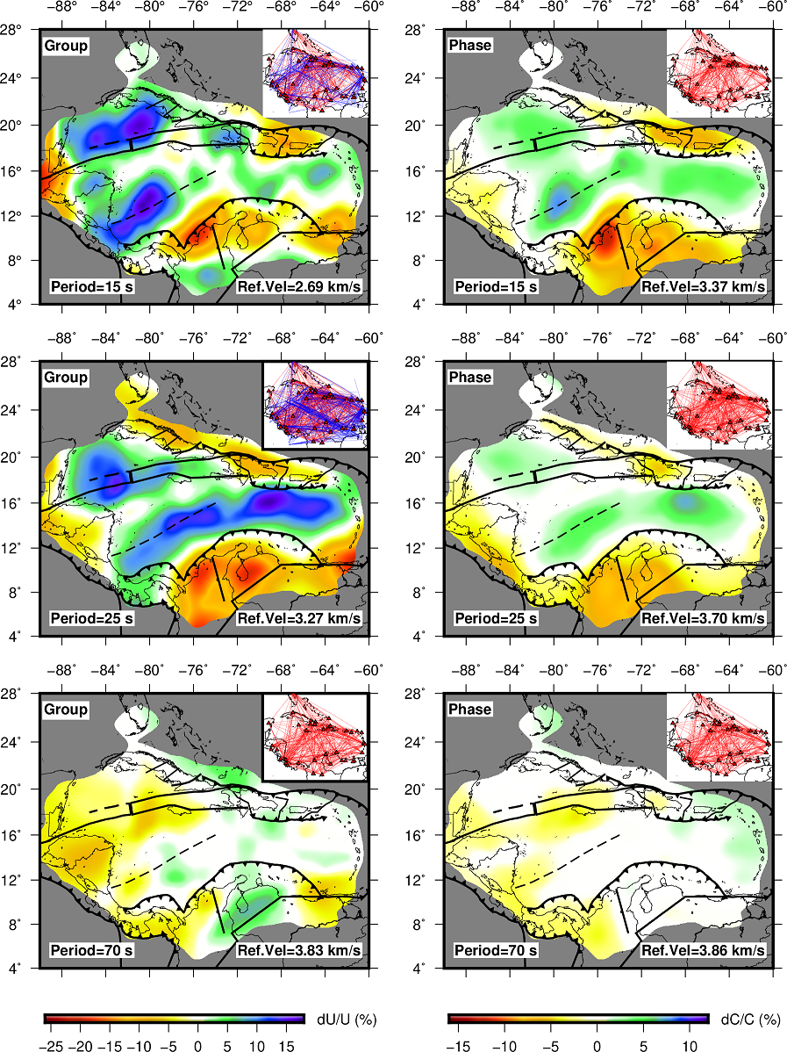
Results
Rayleigh wave group velocity maps (left panel) and phase velocity maps (right panel) at 15, 25 and 70 s periods.
Velocities are plotted as deviations from the average velocity (Ref. Vel) at each period.
Shear-wave velocity structure in map view at different depths. The color bars within each panel give the range of shear-wave velocities.
P1.2-346

Slide 5
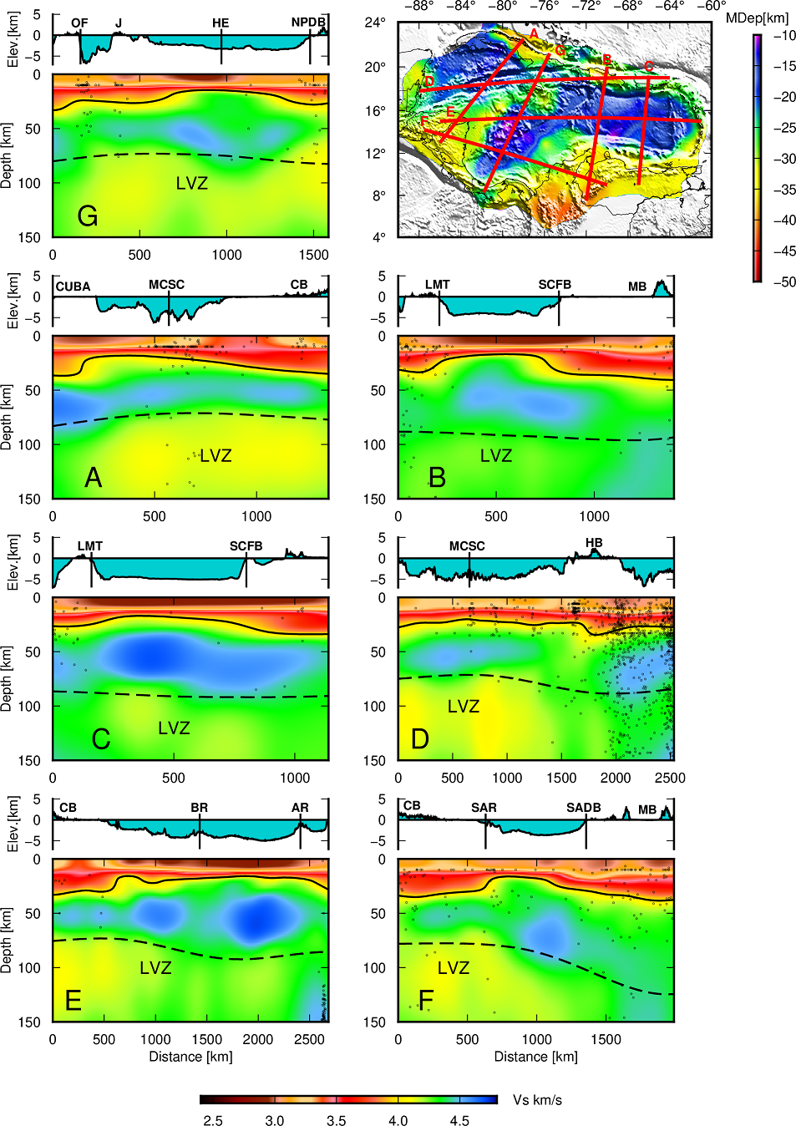
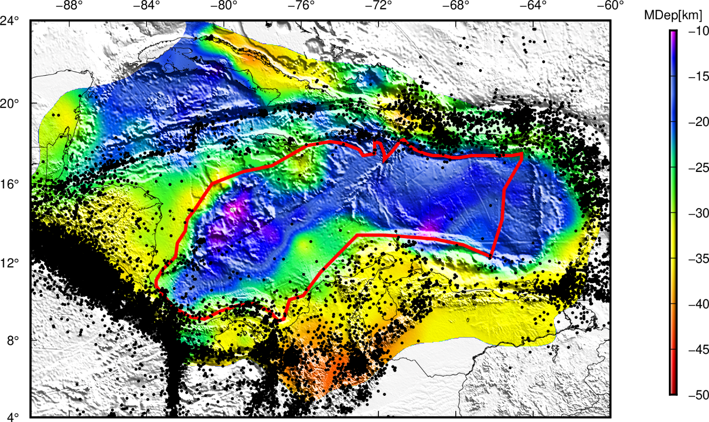
Results
Shear-wave velocity structure along seven different profiles, oriented N-S and W-E shown in the top right panel. The labels of each profile identify the starting point of the cross-sections. Black dots indicate epicenters from earthquakes with magnitude > 4 from 1970 to 2018. Solid lines indicate the Moho interface and dashed lines indicate the Lithosphere - Asthenosphere boundary. The map on the upper right corner shows the proposed Moho interface for the study area. OF: Oriente Fault, J: Jamaica, HE: Hess Escarpment, NPDB: Northern Panama Deformed Beld, MCSC: Mid Cayman Spreading Center, CB: Chortis Block, LMT: Los Muertos Trench, SCFB: South Caribbean Fold Belt, MB: Maracaibo Block, HB: Hispaniola Block, BR: Beata Ridge, AR: Aves Ridge, SAR: San Andres Rift, SADB: South America Deformed Belt. The thick red line encloses the Caribbean Plateau defined by Mauffret et al., (2001).
P1.2-346

Slide 6
Conclusions
The Caribbean plate is dominated by a thick oceanic or extended continental crust with a Moho depth between 11-25 km.
The tomographic study confirms the presence of a seafloor spreading center on the San Andres Rift (SAR), with the thinnest moho interface in the Colombia basin between 11-13 km.
Low velocity zones pattern in the upper most mantle supports the existence of an asthenospheric flow actively dragging eastwards the Caribbean plate (Chen et al., 2021).
The Lithosphere-Asthenosphere boundary is suggested to be between 50 km and 140 km.
P1.2-346

Slide 7
References
Backus, G. E., Gilbert, F., 1968. The Resolving power of Gross Earth Data. Geophys. J. of the Royal Astronomical Society, 16, 169–205. https://doi.org/10.1111/j.1365-246X.1968.tb00216.x
Bensen, G.D., Ritzwoller, M.H., Barmin, M.P., Levshin A.L., Lin F., Moschetti M.P., Shapiro, N.M., Yang, Y., 2007. Processing seismic ambient noise data to obtain reliable broad-band surface wave dispersion measurements. Geophys. J. Int., 169, 1239–1260. https://doi.org/10.1111/j.1365-246X.2007.03374.x.
Chen, Y.W., Colli, L., Bird, D.E., Wu, J. & Zhu, H., 2021. Caribbean plate tilted and actively dragged eastwards by low-viscosity asthenospheric flow. Nat. Commun., 12, 1603. https://doi.org/10.1038/s41467-021-21723-1.
Ditmar, P.G., Yanovskaya, T.B., 1987. A generalization of the Backus-Gilbert method for estimation of lateral variations of surface wave velocity. Phys. Solid Earth, Izvestia Acad. Sci. U.S.S.R. 23(6), 470–477.
Herrmann R.B., Ammon, C.J., 2002. Computer programs in seismology: Surface waves, receiver functions and crustal structure (Version 3.30), Saint Louis University, Earthquake Center. http://www.eas.slu.edu/eqc/eqccps.html.
Herrmann, R. B., 2013. Computer Programs in Seismology: An Evolving Tool for Instruction and Research. Seismological Research Letters, 84(6), 1081–1088. https://doi.org/10.1785/0220110096
Mauffret A, Leroy, S., Vila, J.M., Hallot, E., Mercier de Lepinay, B., Duncan, R.A., 2001. Prolonged magmatic and tectonic development of the Caribbean igneous province revealed by a diving submersible survey. Mar. Geophys. Res., 22,17–45. https://doi.org/10.1023/A:1004873905885
Pachhai, S., Tkalčić, H., Dettmer, J., 2014. Bayesian inference for ultralow velocity zones in the Earth’s lowermost mantle: Complex ULVZ beneath the east of the Philippines. J. Geophys. Res. Solid Earth 119, 8346–8365. https://doi.org/10.1002/2014JB011067
P1.2-346

