Slide 1
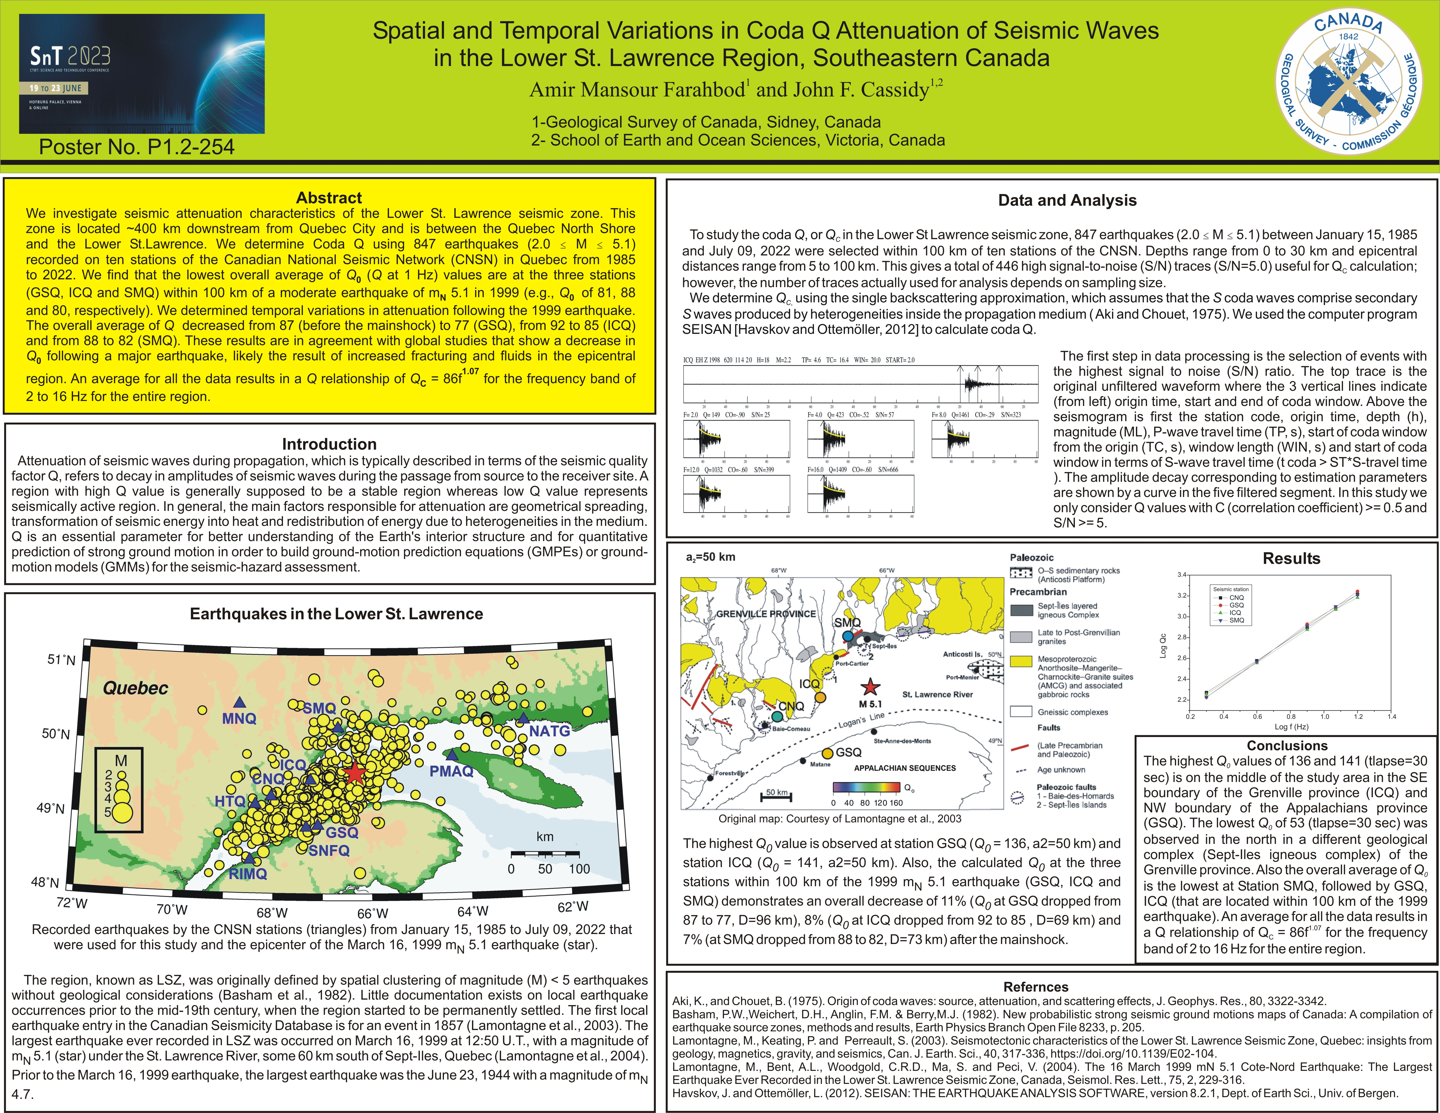
Spatial and Temporal Variations in Coda Q Attenuation of Seismic Waves in the Lower St. Lawrence Region, Southeastern Canada
A.M. Farahbod & J.F. Cassidy
Geological Survey of Canada
P1.2-125
Our presentation provides an overall knowledge about coda Q in a region in southeastern Canada which is one of the most useful parameters for the study of earth structure and seismic hazard assessments.
If you want to learn more about this, come see my e-poster during session P1.2-2 on Tuesday, 20 June or access it online on the SnT2023 Conference platform!

