Slide 1
Spatial and Temporal variations in Coda Q Attenuation of seismic waves in the Lower St. Lawrence region, southeastern Canada
[A.M. Farahbod & J.F. Cassidy]
Geological Survey of Canada
We investigate seismic attenuation characteristics of the Lower St. Lawrence seismic zone. This zone is located ~400 km downstream from Quebec City and is between the Quebec North Shore and the Lower St. Lawrence.
We determine Coda Q (single backscattering method) using 847 earthquakes (2.0 ≤ M ≤ 5.1) recorded on ten stations of the Canadian National Seismic Network (CNSN) in Quebec from 1985 to 2022.
The highest Q₀ value is observed at station GSQ (Q₀ = 136, a₂=50 km) and station ICQ (Q₀ = 141, a₂=50 km). An average for all the data results in a Q relationship of Q_{C} = 86f^{1.07} for the frequency band of 2 to 16 Hz for the entire region.
We find that the lowest overall average of Q₀ (Q at 1 Hz) values are at the three stations within 100 km of a moderate earthquake of m_{N} 5.1 in 1999 . Also we observe decrease in Q on average after the large earthquake.
Please do not use this space, a QR code will be automatically overlayed
P1.2-125

Slide 2
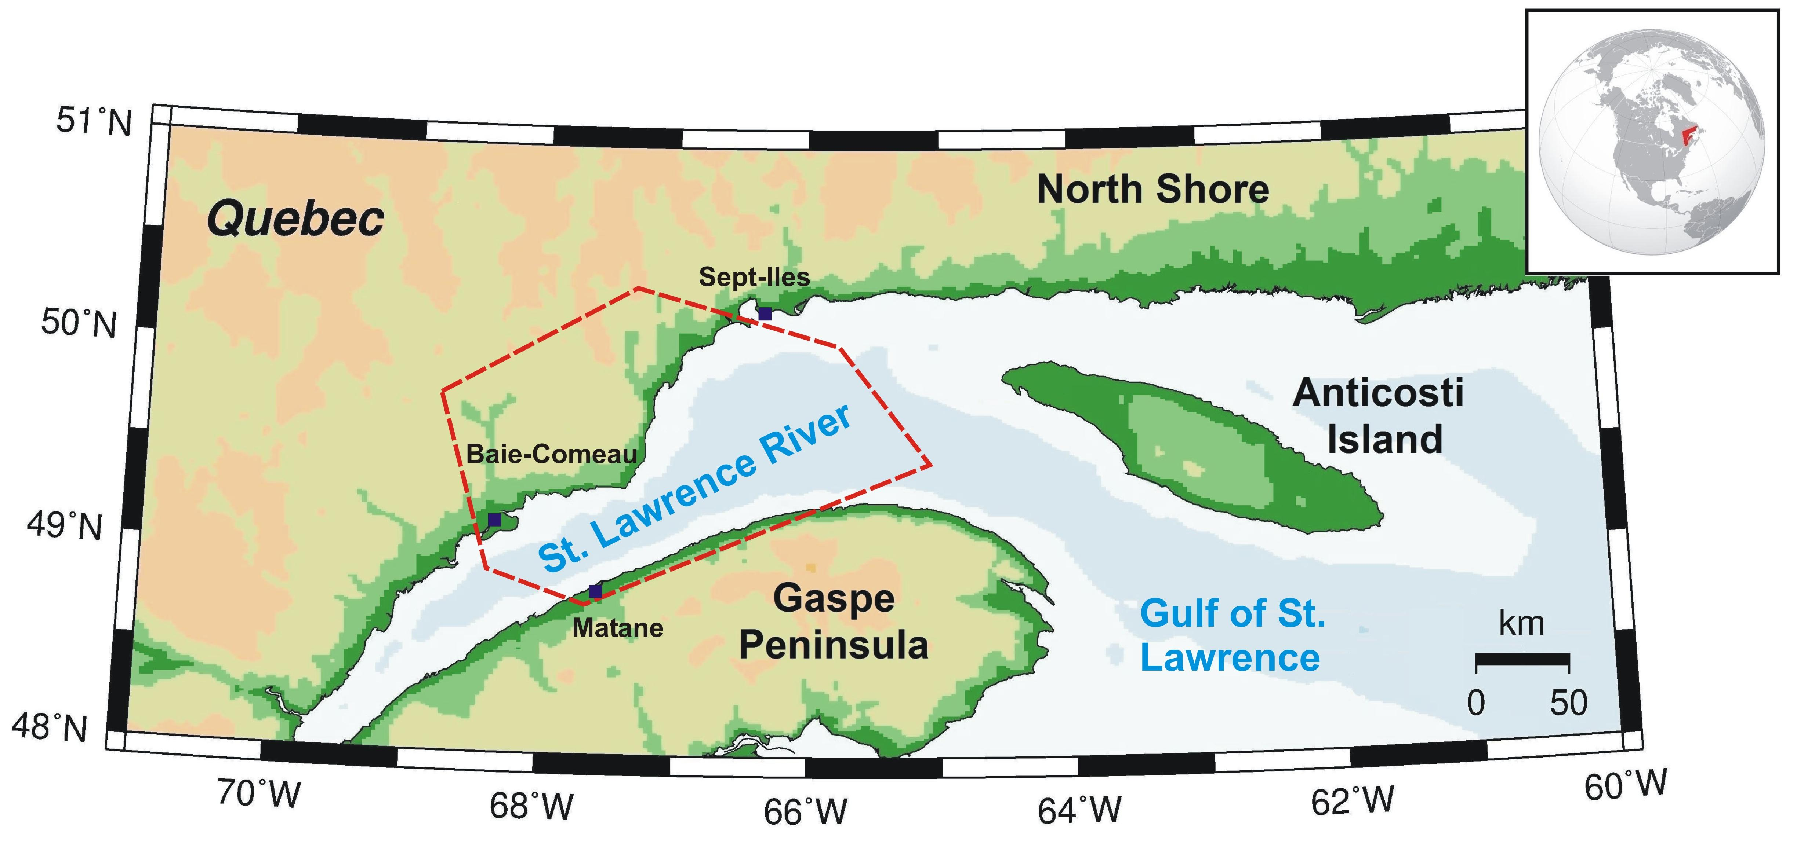
Lower St. Lawrence Seismic Zone
Please do not use this space, a QR code will be automatically overlayed
Boundaries of the Lower St. Lawrence Seismic Zone defined by the towns of Baie-Comeau, Sept-Iles, and Matane on the south shore (Basham et al., 1982).
P1.2-125

Slide 3
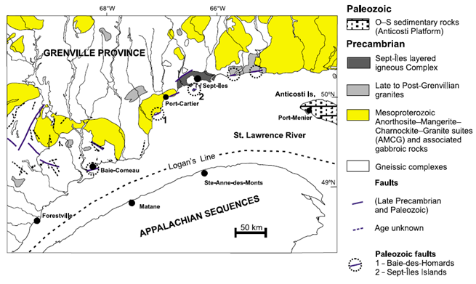
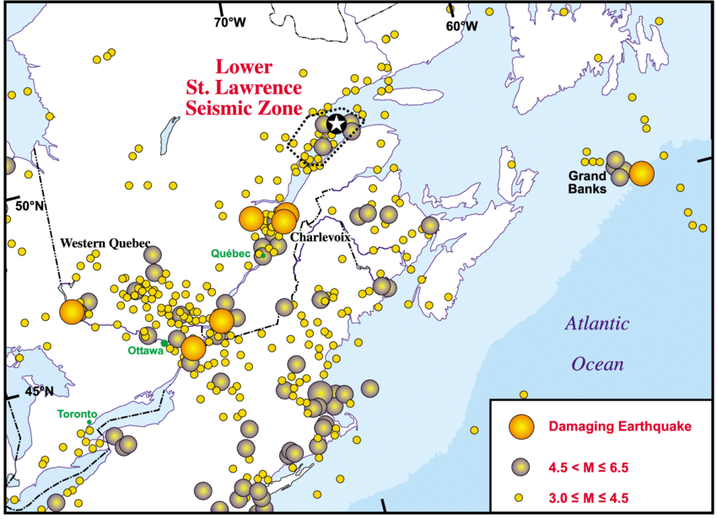
Seismic attenuation and the geotectonic of the region
The attenuation and frequency dependency for different paths and the correlation of the results with the geotectonic of the region will be presented (maps: Courtesy of Lamontagne et al., 2003)
Please do not use this space, a QR code will be automatically overlayed
P1.2-125

Slide 4
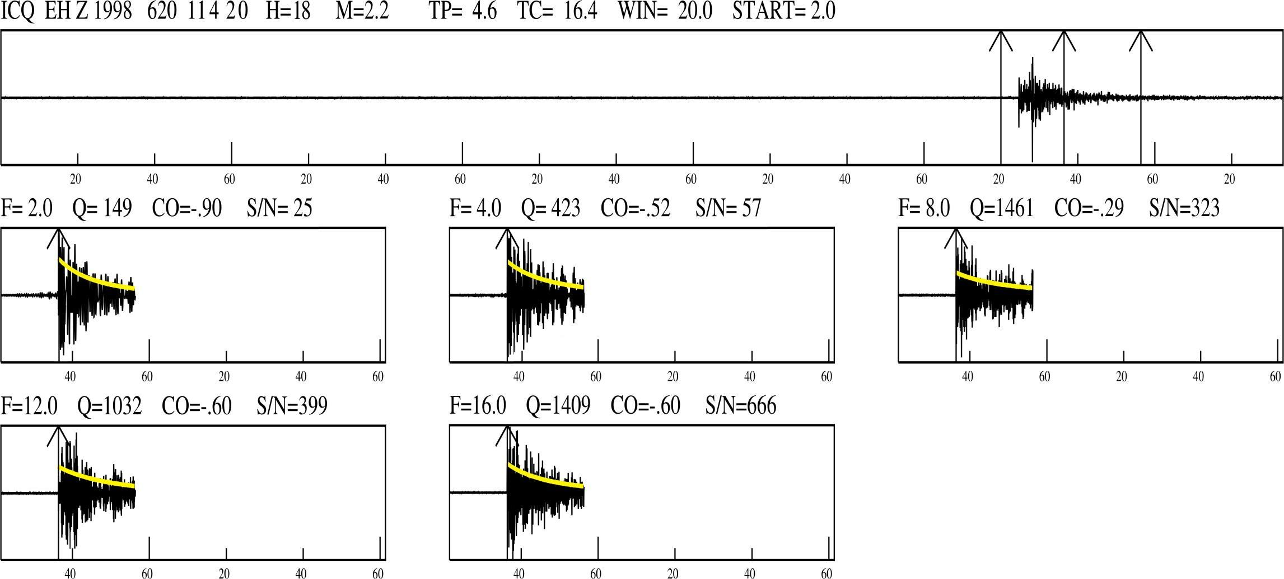
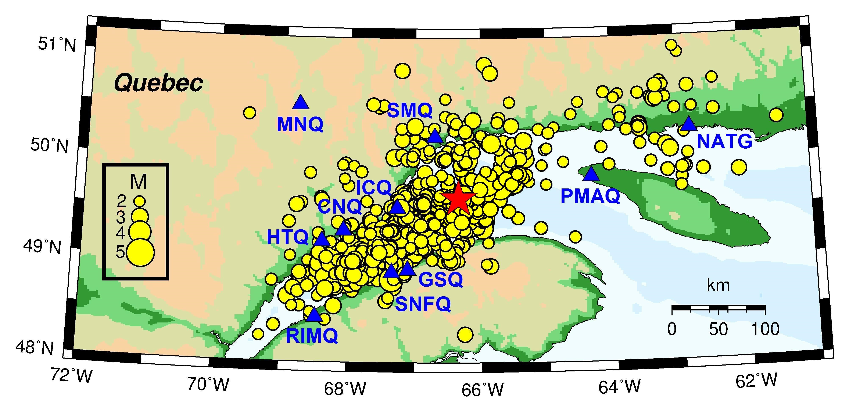
Methodology / data
In this study we determine the coda Q factor using the single backscattering approximation, which explains the decay of earthquake coda under the assumption of weak isotropic scattering from homogeneously distributed heterogeneities [Aki & Chouet, 1975].
For calculating Q_{C} we used seismic waveform data from 10 CNSN sites in southeast Quebec from January 15, 1985 to July 09, 2022 (star: epicenter of the March 16, 1999 m_{N} 5.1 earthquake). We used the computer program SEISAN [Havskov and Ottemöller, 2012] to calculate coda Q.
Please do not use this space, a QR code will be automatically overlayed
P1.2-125

Slide 5
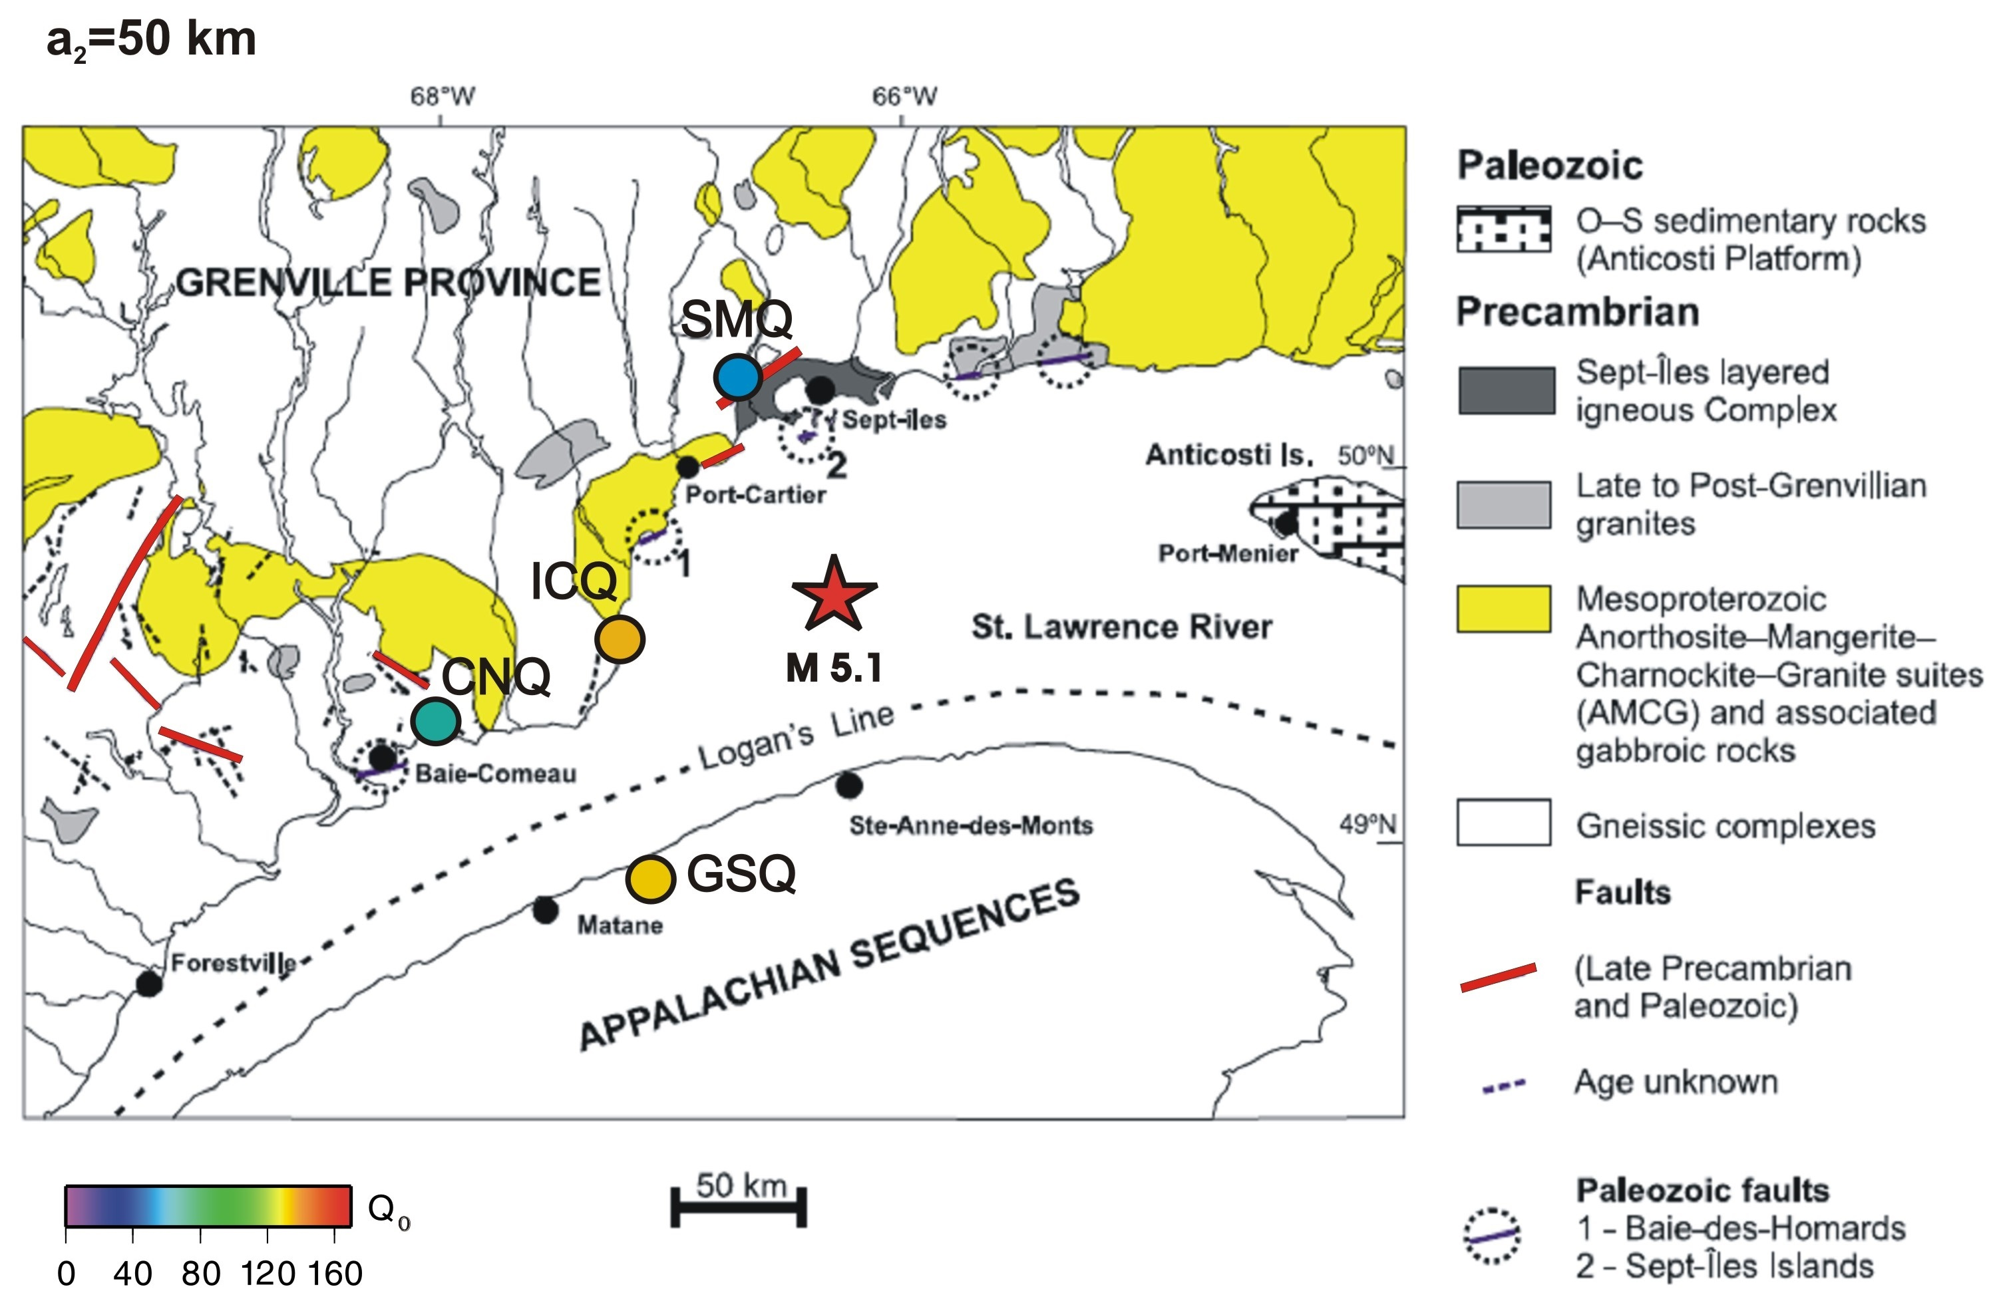
Results
The sampling volume is one-half of a three-dimensional ellipsoid, where a₂ is its semi-minor axis.
The highest Q₀ value is observed at station GSQ (Q₀ = 136, a₂=50 km) and station ICQ (Q₀ = 141, a₂=50 km). Also, the calculated Q₀ at the three stations within 100 km of the 1999 m_{N} 5.1 earthquake (GSQ, ICQ and SMQ) demonstrates an overall decrease of 11% (GSQ, D=96 km), 8% (ICQ, D=69 km) and 7% (SMQ, D=73 km) after the mainshock. An average for all the data results in a Q relationship of Q_{C} = 86f^{1.07} for the frequency band of 2 to 16 Hz for the entire region.
Please do not use this space, a QR code will be automatically overlayed
(Original map: courtesy of Lamontagne et al., 2003)
P1.2-125

Slide 6
Conclusion
We investigated coda-wave attenuation from the southeast Quebec in the Lower St. Lawrence Seismic Zone using the single scattering approximation on records from short period and broadband stations of the regional Canadian National Seismic Network. Coda windows were selected to start at t_{C} = 2t_{S} and were filtered at center frequencies of 2, 4, 8, 12 and 16 Hz. The highest Q₀ values of 136 and 141 (t_{lapse}=30 sec, station GSQ and station ICQ; respectively) is on the middle of the study area in the SE boundary of the Grenville province (ICQ) and NW boundary of the Appalachians province (GSQ). The lowest Q₀ of 53 (t_{lapse}=30 sec, station SMQ) was observed in the north in a different geological complex (Sept-Iles igneous complex) of the Grenville province. Also the overall average of Q₀ is the lowest at Station SMQ, followed by GSQ, ICQ (that are located within 100 km of the 1999 m_{N} 5.1 earthquake) and then station CNQ. In general, lower calculated Q₀ values for station SMQ in the north are mainly attributed to the proximity to the main fault systems. Fracturing, crack opening, and saturation increase of pore fluid cause attenuation and make S-Wave Q lower in a fault zone (Lees and Lindley, 1994). The effect of the type and age of the rock is less visible in our results, most probably due to local complexities. Other factors such as a large earthquake in the vicinity of the recording station (Jin and Aki, 1988) seems to have limited impact on Q value in this study due to the relatively large source-receiver distance (D ≥ 69 km) and limited size of the earthquake (m_{N} 5.1). We consider the effect of this factor (as calculated for stations SMQ, ICQ and GSQ) between 7 to 11 percent on average in this study.
Please do not use this space, a QR code will be automatically overlayed
P1.2-125

Slide 7
References
Aki, K. and Chouet, B. (1975). Origin of coda waves: source, attenuation, and scattering effects, J. Geophys. Res., 80, 3322-3342.
Basham, P.W.,Weichert, D.H., Anglin, F.M. & Berry,M.J. (1982). New probabilistic strong seismic ground motions maps of Canada: A compilation of earthquake source zones, methods and results, Earth Physics Branch Open File 82–33, p. 205.
Farahbod, A.M. & Cassidy, J.F. (2022a). An overview of seismic attenuation in the northern Appalachians seismic zone, New Brunswick and Nova Scotia, Geological Survey of Canada, Open File 8875, 41 p., https://doi.org/10.4095/329702.
Farahbod, A.M. & Cassidy, J.F. (2022b). An overview of seismic attenuation in the Eastern Canadian Arctic and the Hudson Bay complex, Manitoba, Newfoundland and Labrador, Nunavut, Ontario and Quebec; Geological Survey of Canada, Open File 8908, 47 p., https://doi.org/10.4095/330396.
Havskov, J. and Ottemöller, L. (2012). SEISAN: THE EARTHQUAKE ANALYSIS SOFTWARE, version 8.2.1, Dept. of Earth Sci., Univ. of Bergen.
Jin, A. and Aki, K. (1988). Spatial and temporal correlation between coda Q and seismicity in China. Bul. Seismol. Soc. Am., 78, 741-769.
Lamontagne, M., Keating, P. and Perreault, S. (2003). Seismotectonic characteristics of the Lower St. Lawrence Seismic Zone, Quebec: insights from geology, magnetics, gravity, and seismics, Can. J. Earth. Sci., 40, 317-336, https://doi.org/10.1139/E02-104.
Lees, J. M., Lindley, G. T. (1994). Three-dimensional Attenuation Tomography at Loma Prieta: Inversion of t* for Q, J. Geophys. Res., 99, 6843-6863.
Please do not use this space, a QR code will be automatically overlayed
P1.2-125

