Slide 1
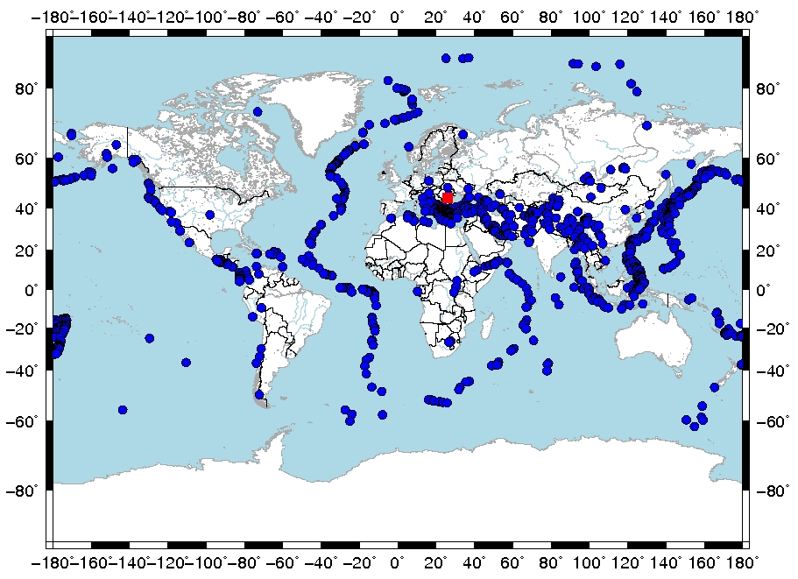
The contribution of the auxiliary seismic station MLR in IDC products and comparison of the IDC REBs with the NDC Romania bulletins
A. Chircea, D. Ghica, M. Popa, R. Dinescu
: 14]
P1.2-447
This study has two main purposes:
Using statistical methods to analyze and highlight the contribution of the MLR station in the IDC products for local and regional earthquakes as well as in the ISC bulletins on a global scale (a);
Compare the reviewed seismic bulletins produced by ROM-NDC with the reviewed seismic bulletins (REBs) produced by IDC and analyze them in terms of epicentral locations, calculated magnitudes, epicentral depths and associated phases (b).
b)
a)

