Slide 1

The contribution of the auxiliary seismic station MLR in IDC products and comparison of the IDC REBs with the NDC Romania bulletins
A. Chircea^{1,2}, D. Ghica¹, M. Popa^{1,4}, R. Dinescu^{1,3}
1. National Institute for Earth Physics, Magurele, Romania
2. University of Bucharest, Faculty of Physics, Magurele, Romania
3. University of Bucharest, Faculty of Geology and Geophysics, Bucharest, Romania
4. Academy of Romanian Scientists, Romania
The study presents the results of the monitoring evaluation of the local and regional seismic activity during 2021 using the Romanian Seismic Network (RSN) and International Monitoring System of CTBTO and the global use of the MLR seismic station
Analysing the contribution of the MLR station for events occurred on a local and global scale for 2021 and conducting a comparative analysis of the reviewed seismic bulletins (REBs) produced at IDC and NDC-RO.
MLR station contributed to the location of 2960 local, regional and teleseismic events.
Comparing the events with magnitude ML over 3.5, occurred on the territory of Romania and adjacent areas, an important percentage of such events are missed in IDC REBs (over 50%).
Due to the good azimuthal distribution of RSN stations relative to the sources of the analysed events, the location errors are much smaller in the NDC-RO bulletins
Please do not use this space, a QR code will be automatically overlayed
P1.2-447

Slide 2
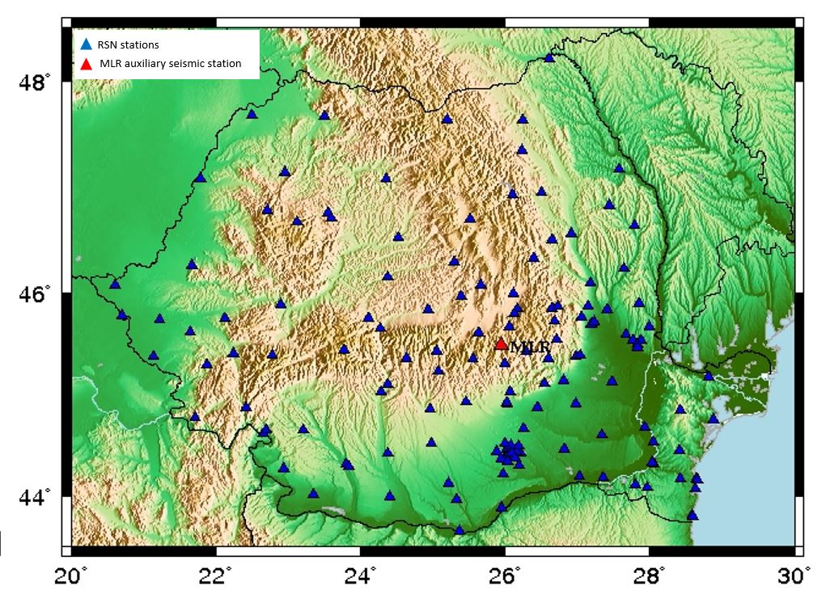
Introduction: ROMANIA IN SUPPORT OF THE CTBT VERIFICATION REGIME
In support of the verification regime of the CTBT, National Institute for Earth Physics (NIEP):
hosts the National Data Centre of Romania (NDC-RO),
operates and maintain the auxiliary seismological station Cheia-Muntele Rosu (MLR) as part of International Monitoring System (IMS)
At NDC-RO, data recorded with dense Romanian Seismic Network (RSN) are continuously processed and analyzed for real-time event detection, phase
identification and source location estimation; daily reviewed seismic bulletins and list of phases (associated and unassociated) are generated
P1.2-447
Please do not use this space, a QR code will be automatically overlayed

Slide 3
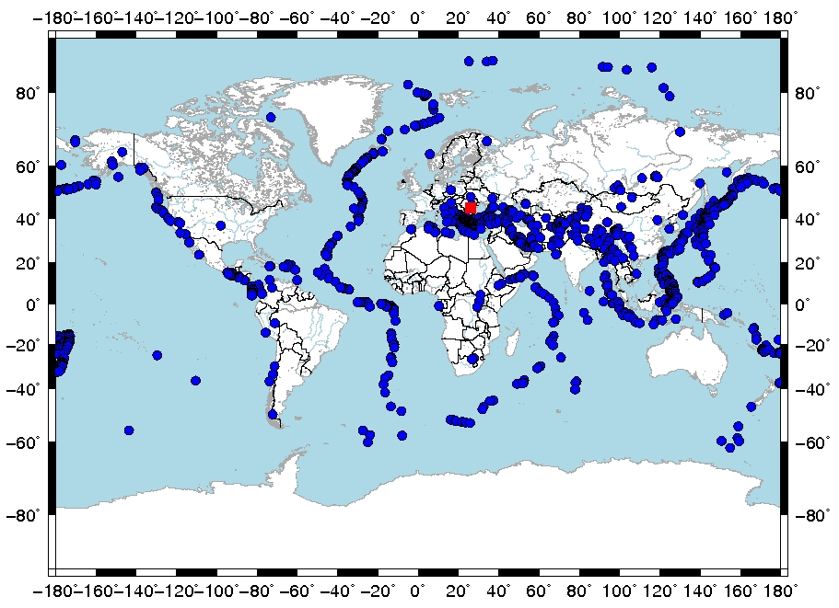
Objectives
This study main purposes:
highlight the use of the MLR station in the IDC products for local and regional earthquakes as well as in the ISC bulletins on a global scale
compare the reviewed seismic bulletins produced by NDC-RO with the reviewed seismic bulletins (REBs) produced by IDC
P1.2-447
Please do not use this space, a QR code will be automatically overlayed

Slide 4
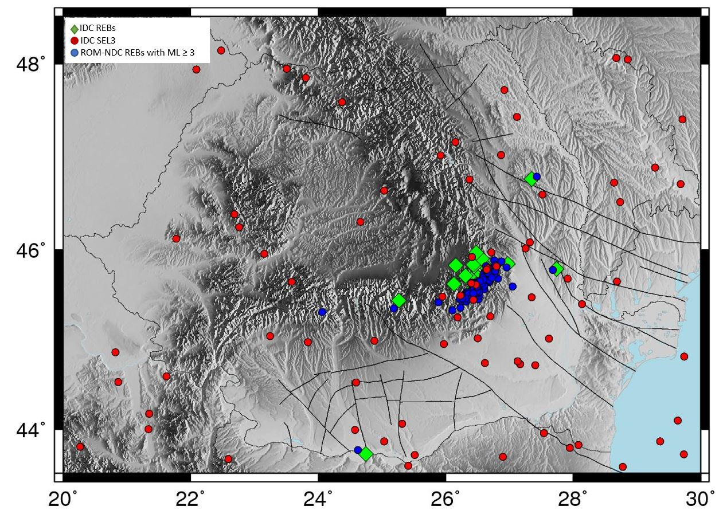
Methods and Data
For the comparative study regarding `Romanian events`, we analyzed 19 IDC Reviewed Event Bulletins (REBs), 76 IDC Standard Event List (SEL3) and 111 events with ML ≥ 3 NDC REBs
P1.2-447
Please do not use this space, a QR code will be automatically overlayed
Statistical methods were applied in order to emphasis the use of auxiliary station Muntele Rosu- MLR in processing local events and also for both regional and teleseismic events.

Slide 5
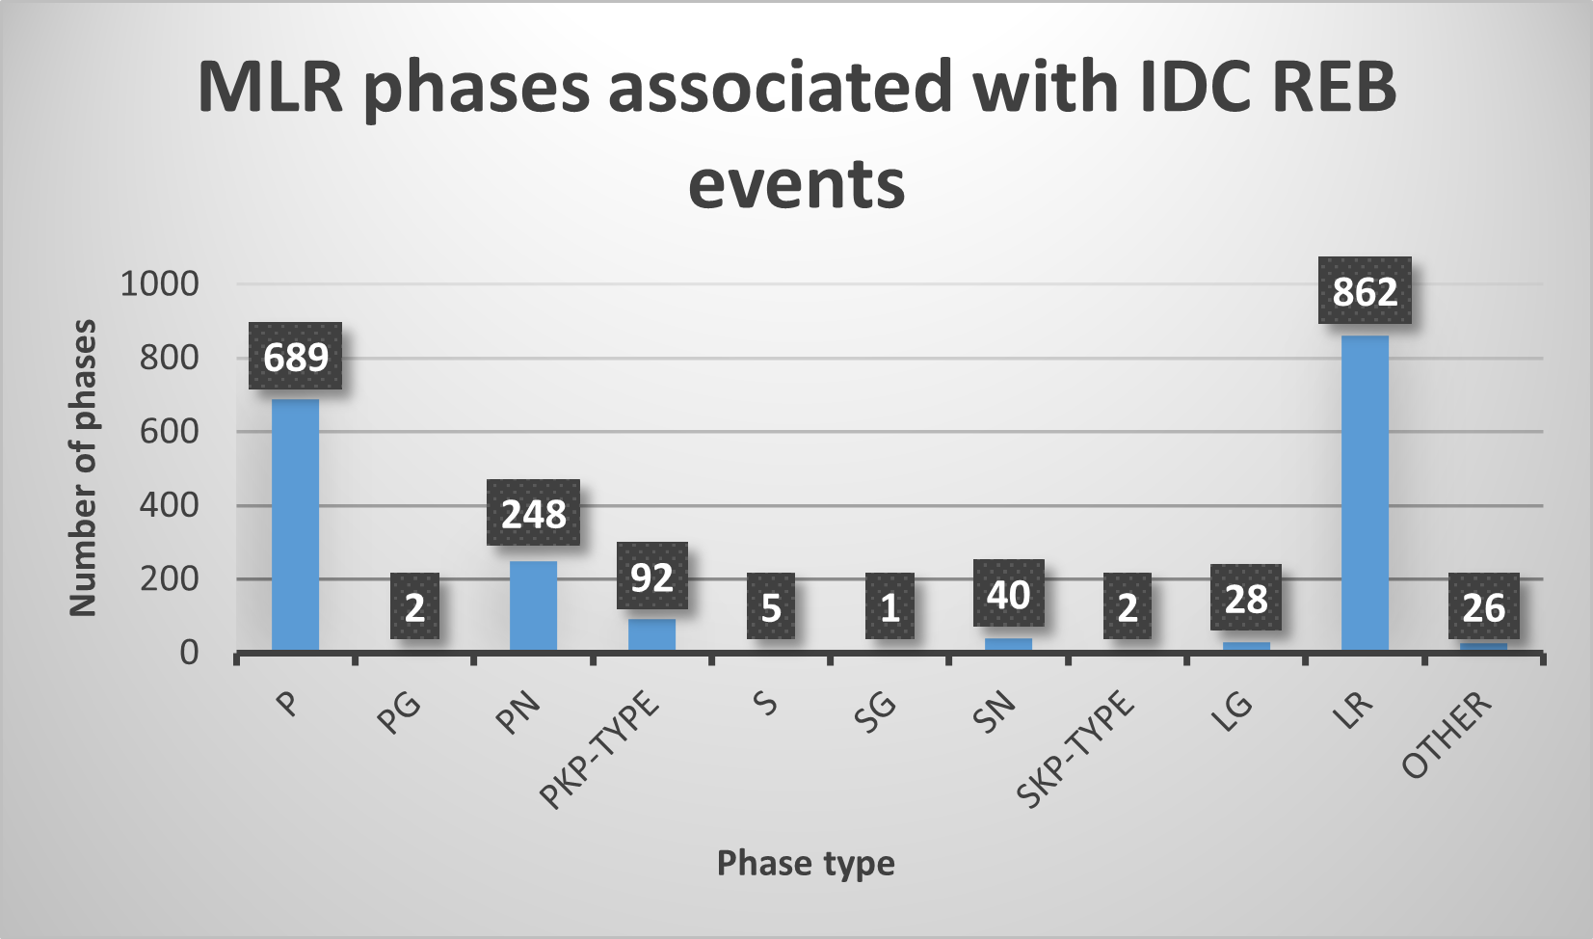
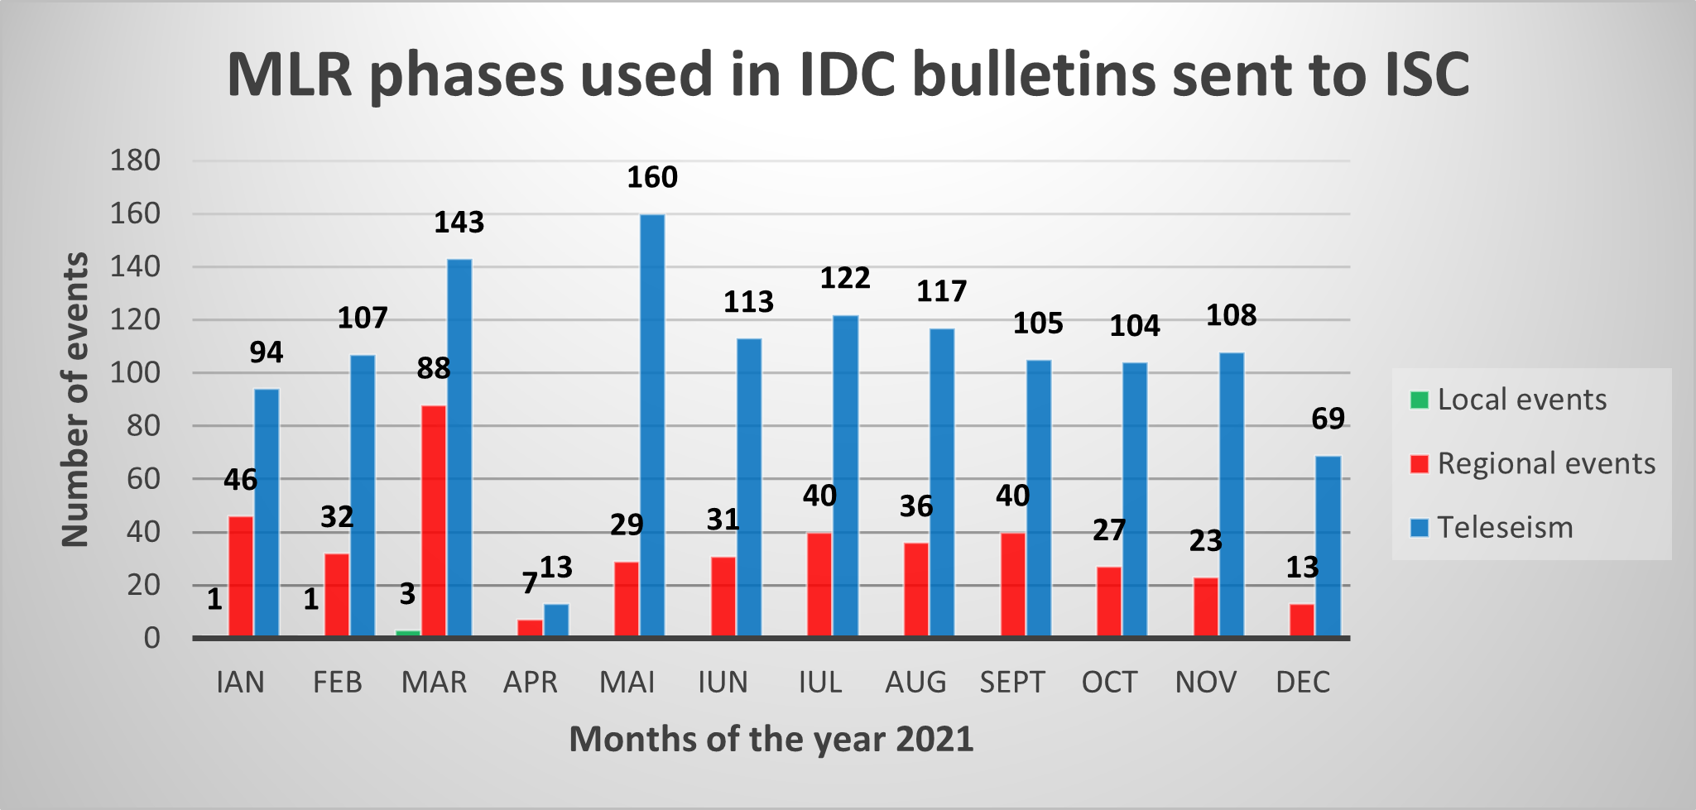
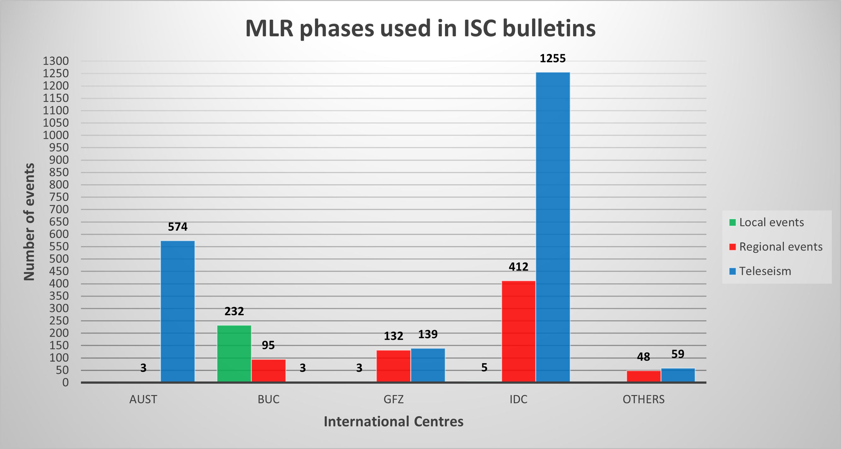
Results
1995 different phases measured on MLR recorded waveforms were associated to REB events in 2021 on a global scale
IDC used MLR phases in 1672 events bulletins sent to ISC in 2021. 5 of them were local events, 412 regional events and 1255 teleseisms.
P1.2-447
Please do not use this space, a QR code will be automatically overlayed
MLR phases were defined in 2960 events locations reported to ISC by International Centres, almost 56% of them being reported by IDC

Slide 6
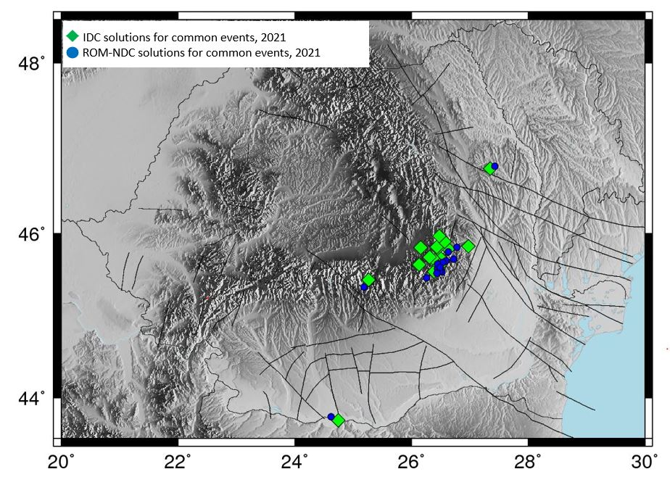
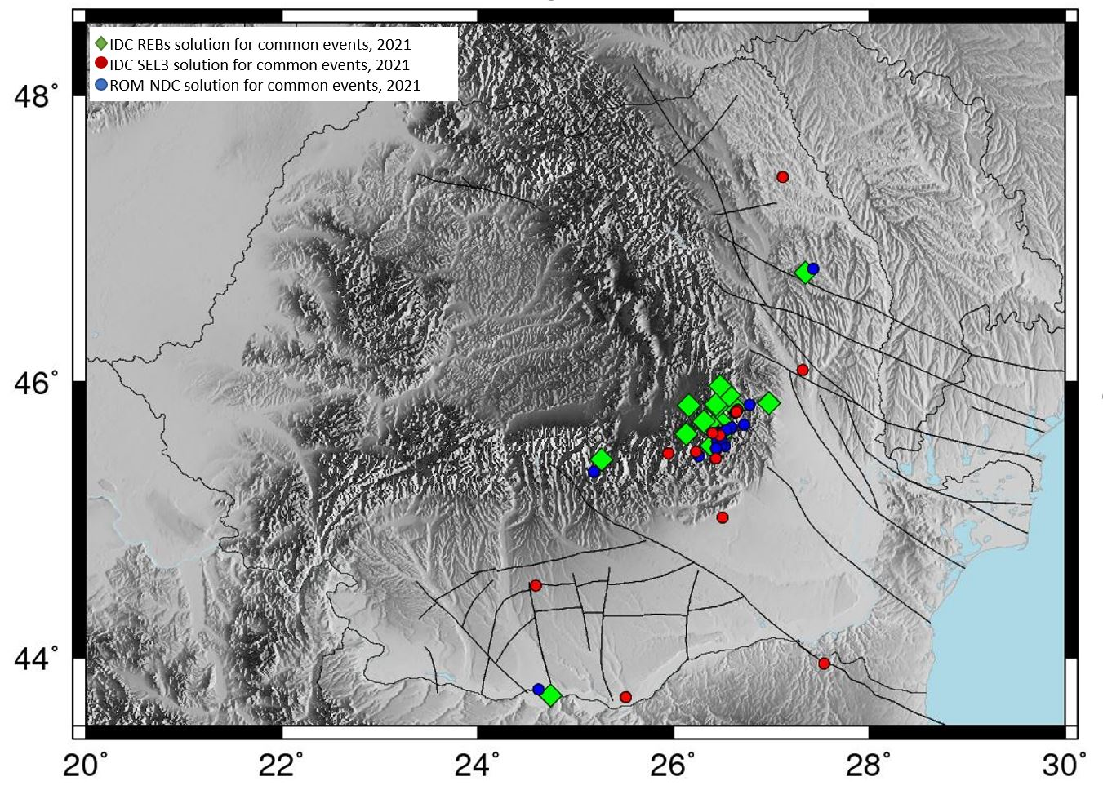
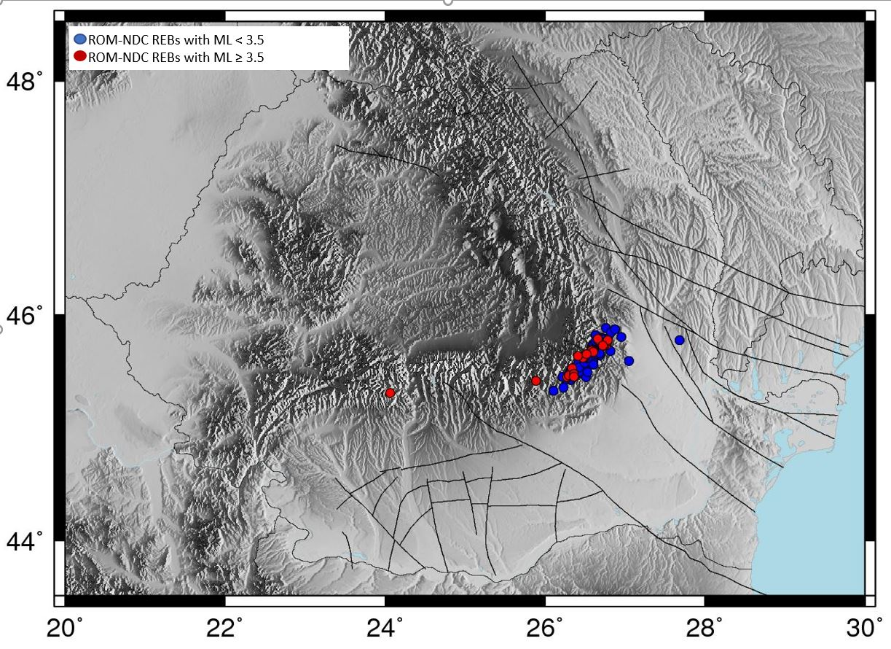
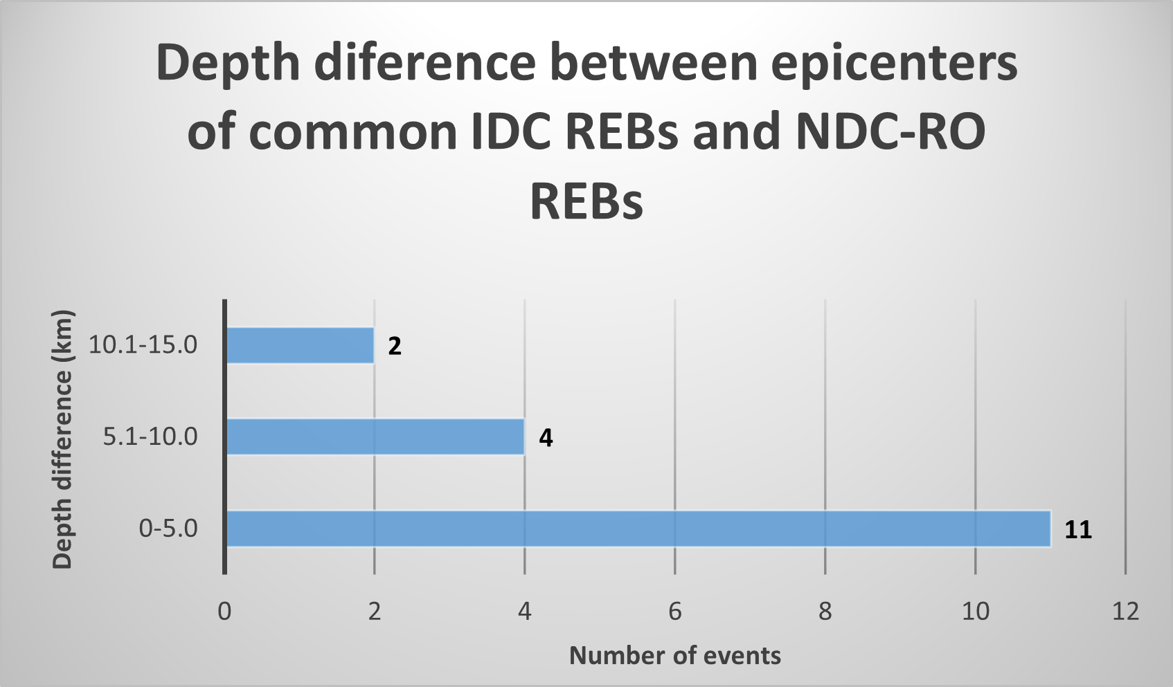
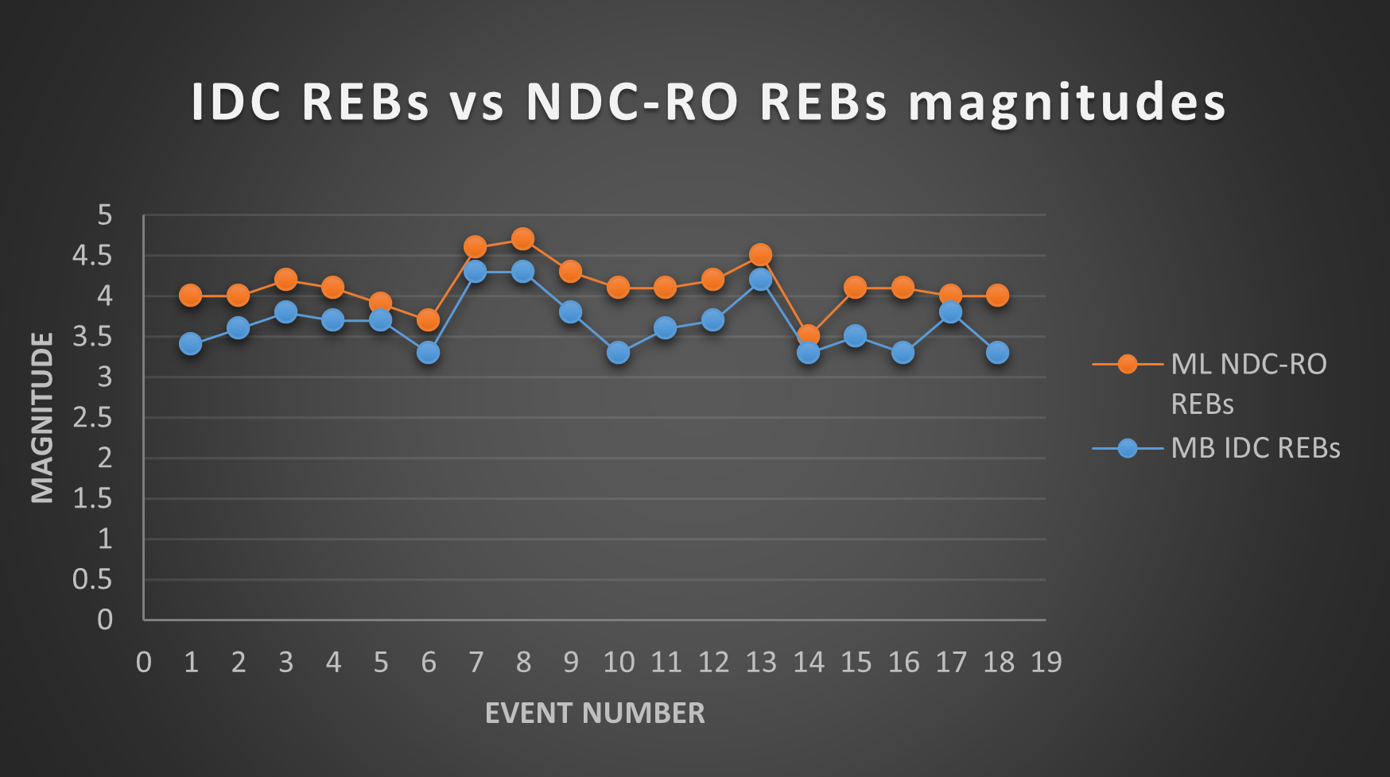
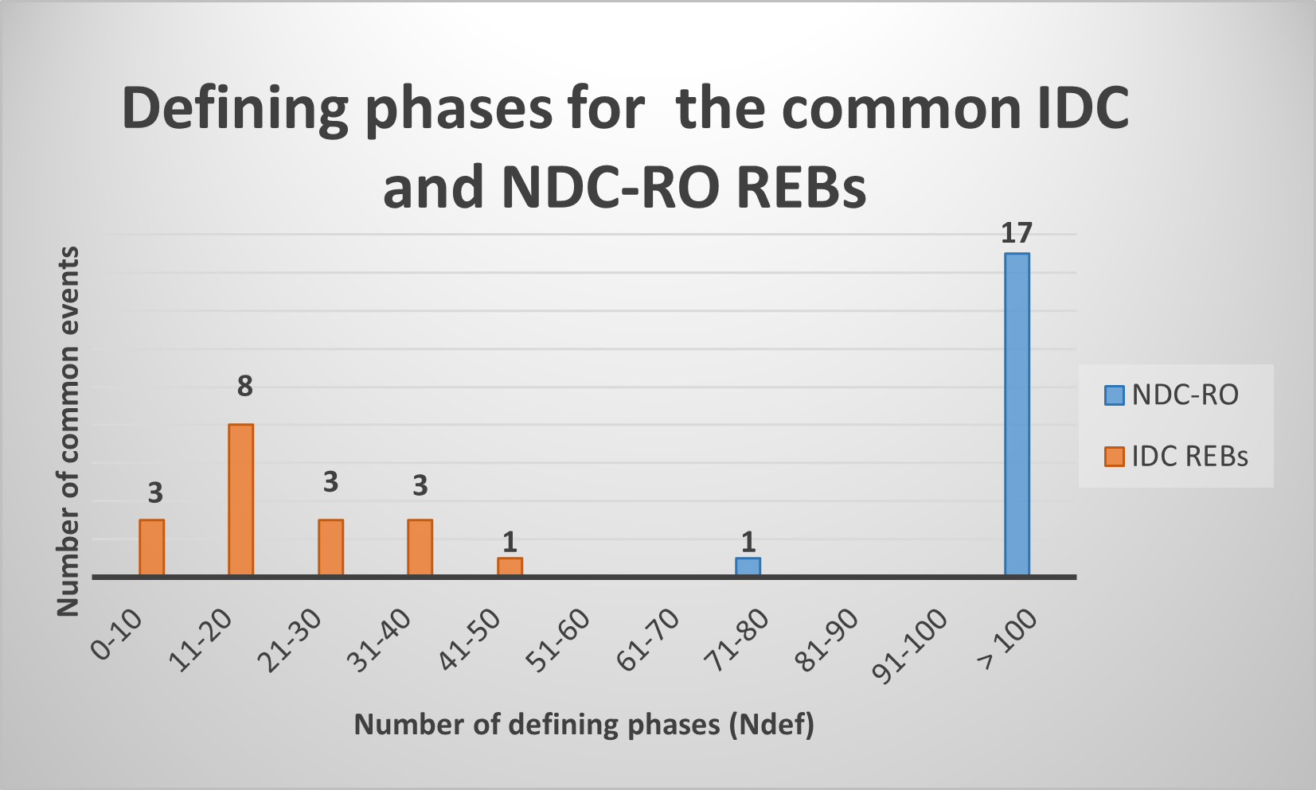
Results
18 common solutions were identified in IDC REBs and NDC-RO REBs for the `Romanian events`
13 common solutions were identified in IDC REBs, SEL3s and NDC-RO REBs for the `Romanian events`
93 Romanian events with ML ≥ 3 are located only in NDC-RO REBs
21 events with ML ≥ 3.5 may have been missed by IDC REBs
P1.2-447
Please do not use this space, a QR code will be automatically overlayed
For all ISC REBs, was calculate a magnitude MB between 3.3 and 4.3
For 83% of NDC-RO REBs, magnitude ML is above 4.0
The distance between epicentres of the ISC and NDC-RO REBs common solutions ranges between 0 and 15 km
94% of NDC-RO REBs used more than 100 phases, while 94% of IDC REBs used less than 40 phases for events location

Slide 7
Conclusion
A comparison between the locations of events occurred on the Romanian territory produced by the NDC-RO and IDC, and also a statistical analysis according to MLR seismic station use, was conducted.
During the year 2021, data recorded by the MLR seismic station were used to locate local events, as well as over 2000 regional and teleseismic event, with high accuracy and satisfying parameters;
Due to the high coverage of RSN stations, locations calculated at NDC-RO are very well constrained, 94% of the NDC-RO REBs having more than 100 defining phases, providing ground truth solutions for many events located in Romania's region, considering the position of the stations around the epicentral areas;
18 common events were identified in NDC-RO and IDC REBs, in good agreement between the two types of solutions (origin time, epicentral location and depth estimation);
For the common events (18), 61% from the common events have the depth difference between epicentres below 5 km;
P1.2-447
Please do not use this space, a QR code will be automatically overlayed

Slide 8
References
Ghica D., Popa M., Rogozea M., - Romanian NDC contribution to local and regional seismic monitoring in support of CTBT Verification Regime – NDC Workshop 2016
Popa M., Oancea V., Rizescu M., Bazacliu O., Popescu E., - Comparative study of locations produced by PIDC and ROM_NDC for seismic events in Romania
Popa M., Chircea A., Dinescu R., Neagoe C.,Grecu B. and Borleanu F. Romanian Earthquake Catalogue (ROMPLUS). Mendeley Data, V2, Doi: 10.17632/tdfb4fgghy.2 (2022)
International Seismological Centre (20XX), On-line Bulletin, https://doi.org/10.31905/D808B830
P1.2-447
Acknowledgment
We would like to express our gratitude to CTBTO for their generous funding support that made our participation at the SnT conference possible.
The present study was partially funded by the NUCLEU Project PN 19080101, supported by the Ministry of Research, Innovation and Digitalization.
The NDC-RO data processed in this paper are recorded by Romanian Seismic Network (https://doi.org/10.7914/SN/RO) and earthquake locations were taken from the ROMPLUS catalogue (https://data.mendeley.com/datasets/tdfb4fgghy).
Maps were created using GMT software (NDC-in-a-Box package), kindly provided by PTS of CTBTO.
Please do not use this space, a QR code will be automatically overlayed

