Slide 1
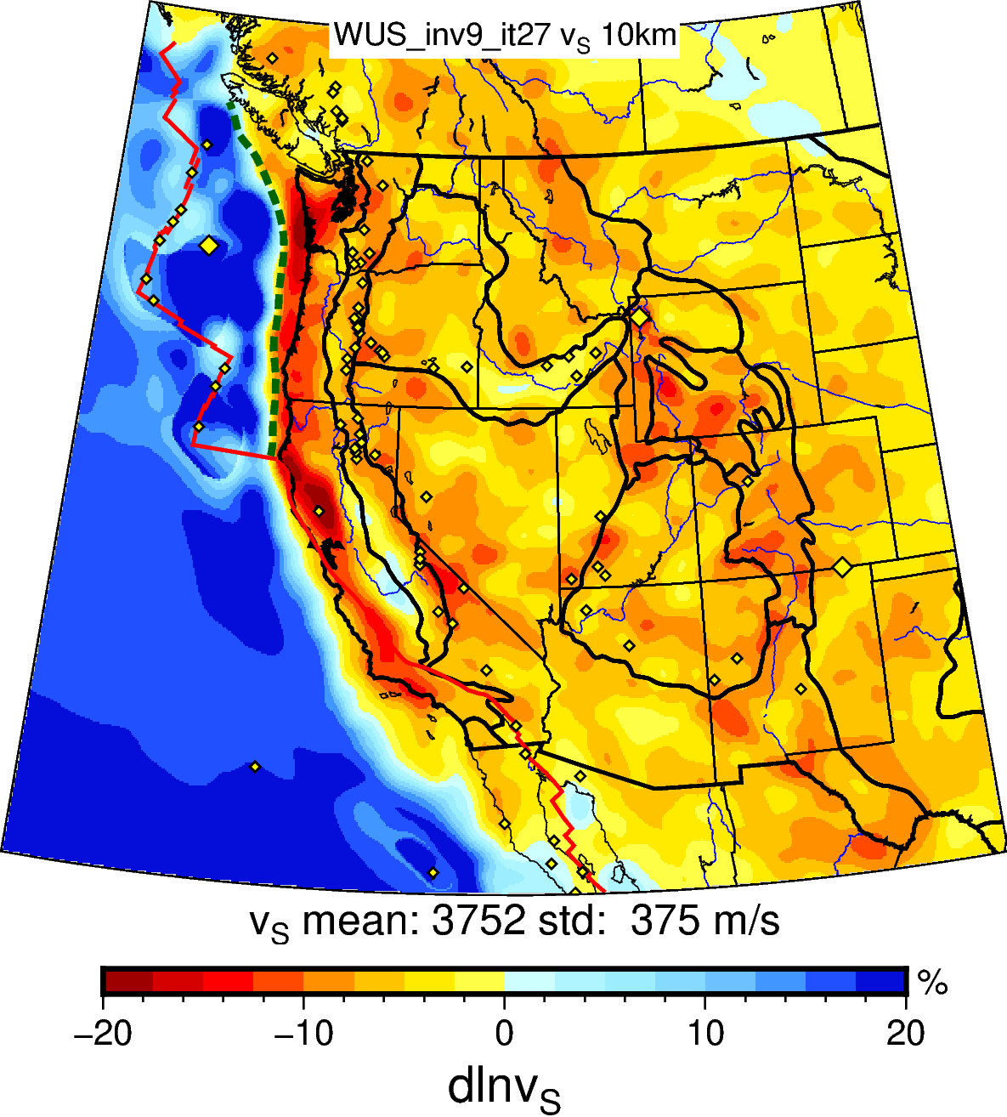
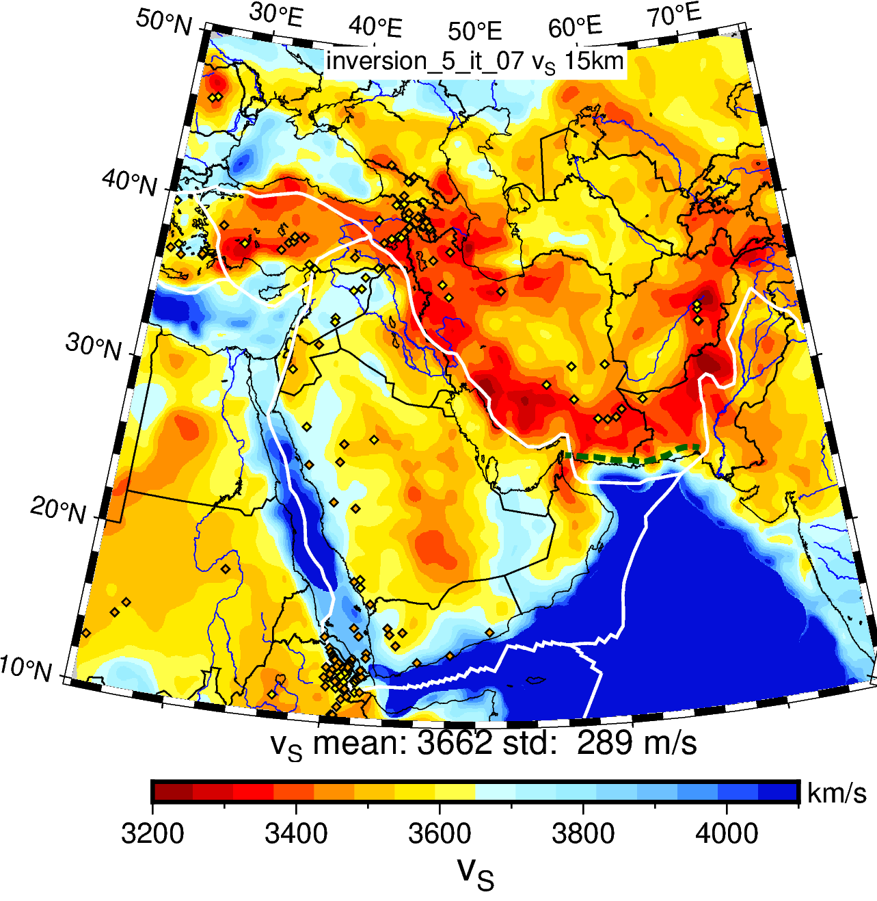
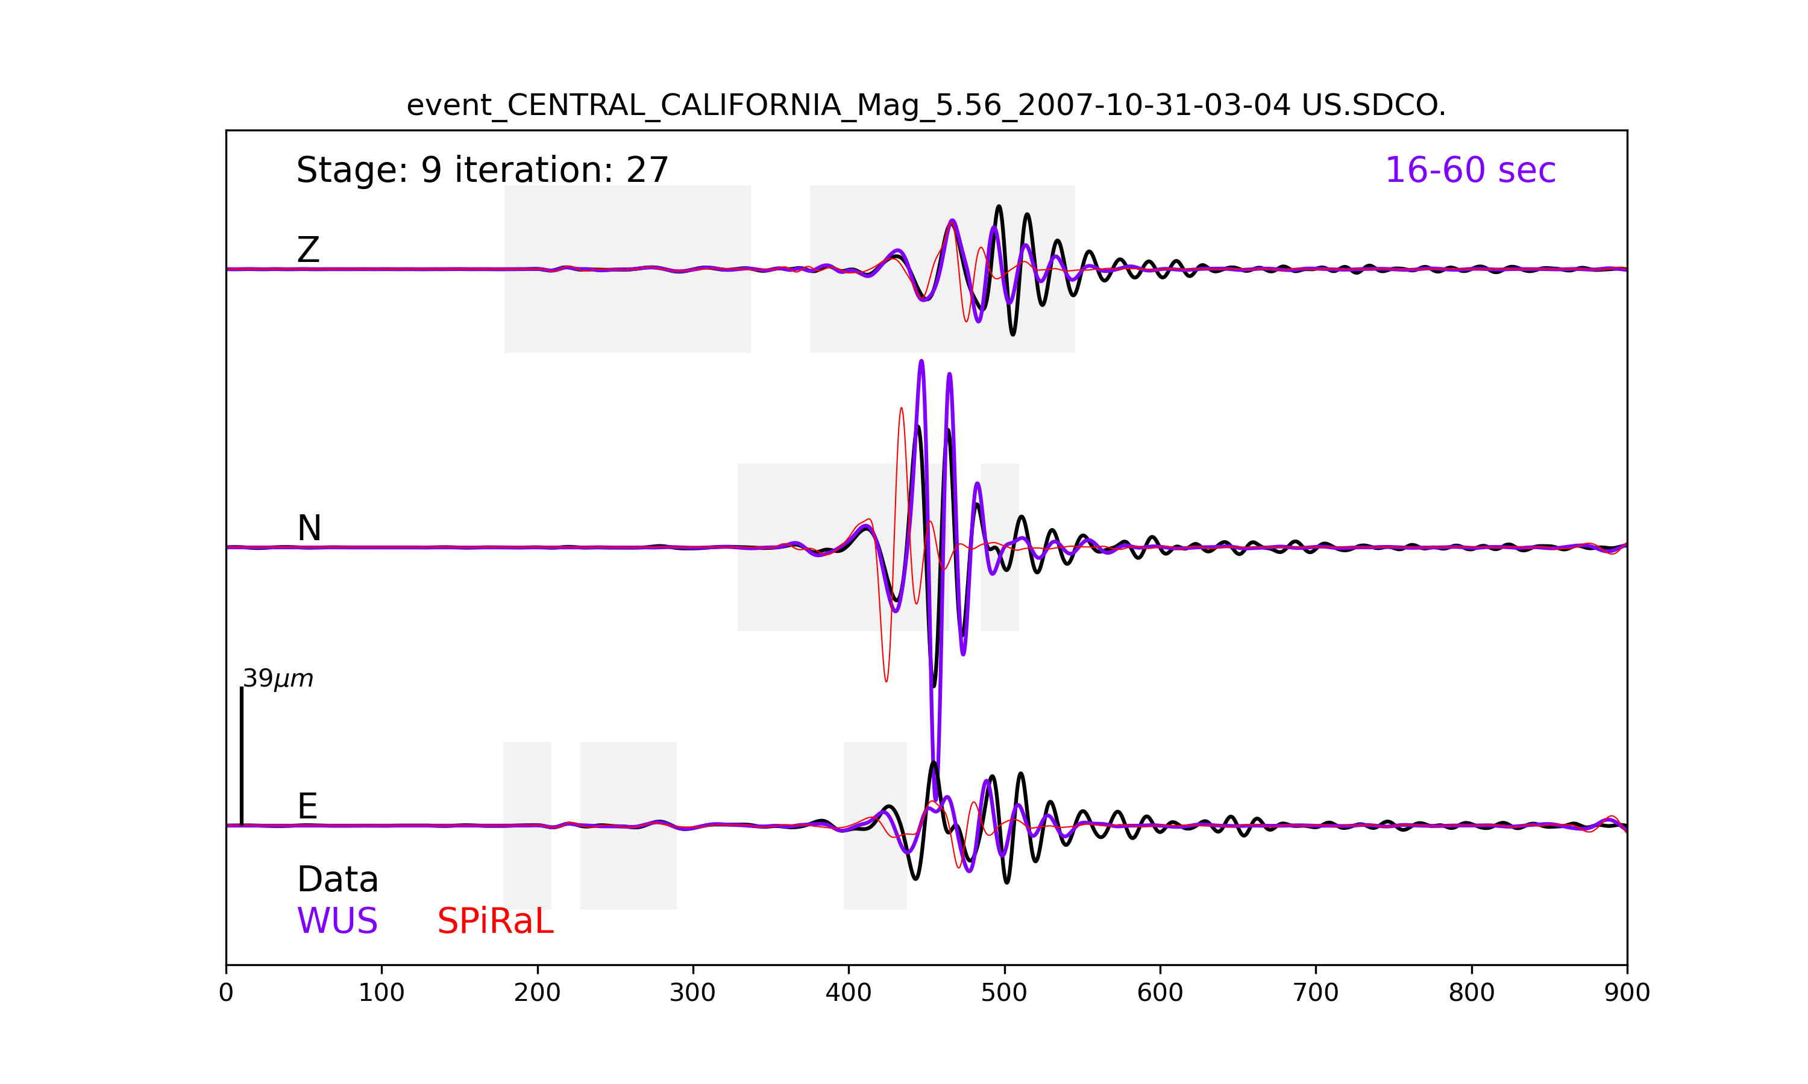
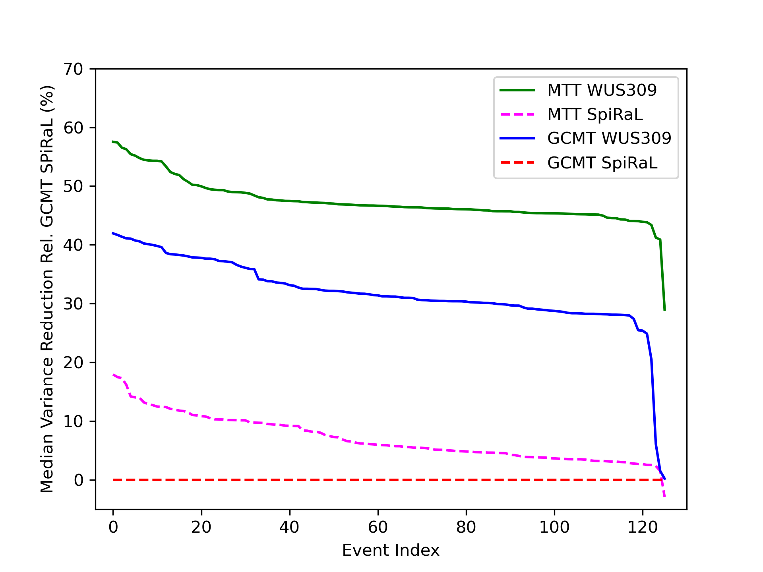
Adjoint Waveform Tomography Models for Improved Moment Tensor Inversions with Three-Dimensional Greens Functions and Sparse Regional Networks
Arthur Rodgers, Andrea Chiang, Nathan Simmons
Lawrence Livermore National Laboratory, Livermore, CA USA
P1.2-363
Western United States (WUS)
Middle East and Southwest Asia (MESWA)
3D models were created using Adjoint Waveform Tomography for two regions:
Western United States (WUS, 16-120 s)
Middle East and Southwest Asia (30-100 s)
Models improve waveform fits and can be used for moment tensor inversion.
Results for the WUS show greater reduction of waveform misfit for seismic Earth model improvements than for source MT updates
Importantly, models achieve improved fits for distant stations and shorter periods
This demonstrates the value of 3D models obtained with Adjoint Waveform Tomography for improving fits with a sparse regional network.
Improved regional waveform fits
Data = observed waveforms
WUS = final AWT model
SPiRaL = starting model
Event-averaged complete waveform misfit relative to GCMT and SPiRaL starting model
Moment tensors inversion with regional waveform and 3D AWT models
mttime WUS309 (47%)
GCMT WUS309 (32%)
mttime SPiRaL (7%)
GCMT SPiRaL
This work was performed under the auspices of the U.S. Department of Energy by Lawrence Livermore National Laboratory under Contract DE-AC52-07NA27344. LLNL-PRES-849195

