Slide 1
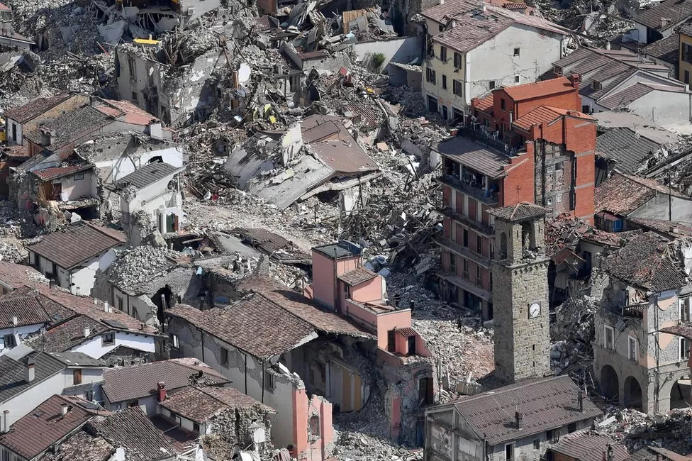
Near-surface non-linear material behaviour due to coupling of atmospheric pressure and solid Earth
Richard Kramer¹, Yang Lu¹ and Götz Bokelmann¹
Department of Meteorology and Geophysics, University of Vienna
P1.2-300
monitoring of subsurface properties could be helpful to understand earthquake processes more completely
environmental effects (temperature changes, tidal effects, …) overlap with tectonic signatures
Amatrice, central Italy (© AP Photo)
studying changes in the subsurface with high temporal resolution will help to understand these environmental effects
from Kramer et al., (2023)
If you want to discuss more about this, come to my e-poster during session P1.2-2 on Wednesday 9-10 or access it online on the SnT2023 Conference platform!

