Slide 1
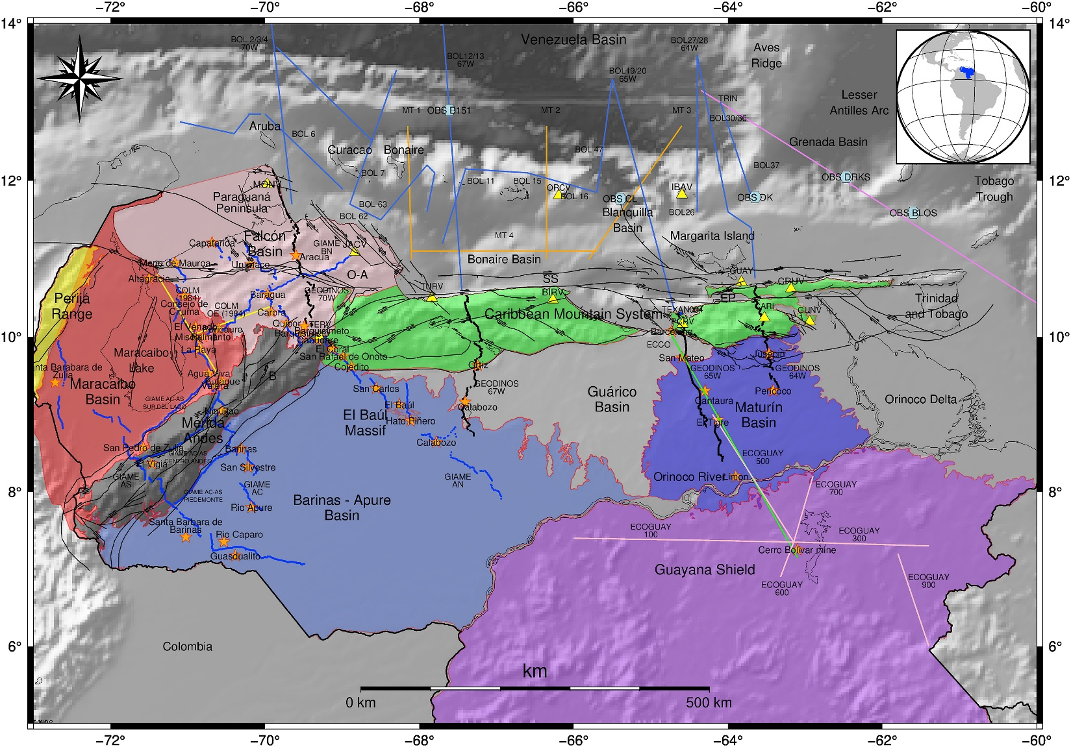
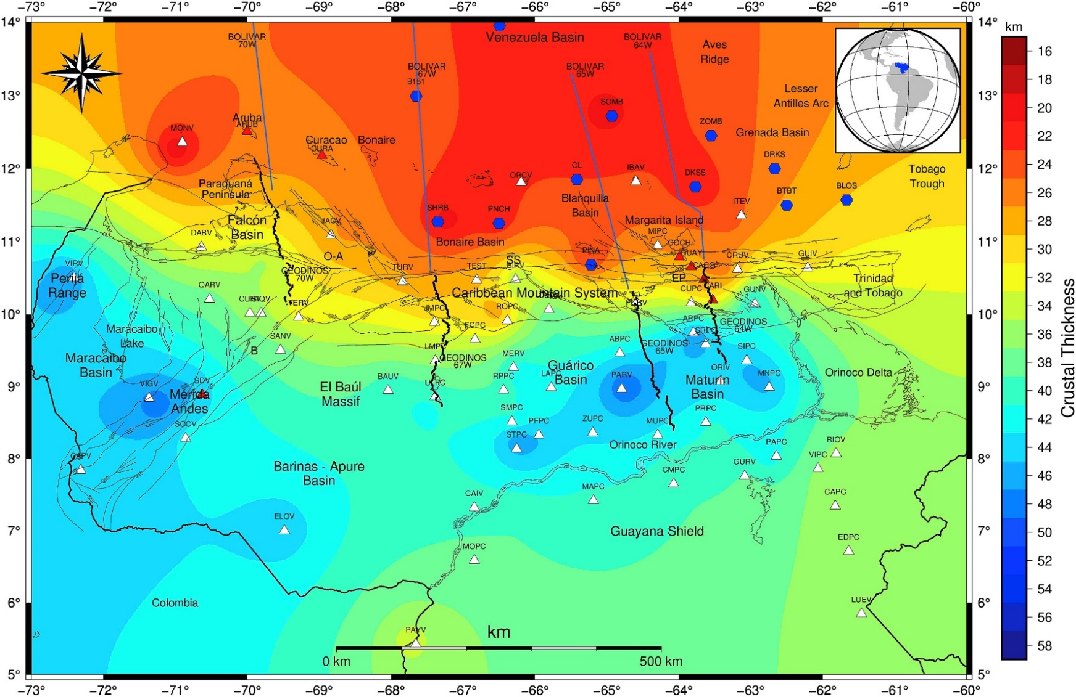
Data Assesment and Regional Seismic Travel Time (RSTT) modelling in Venezuela and the Caribbean Sea
Keyla Ramirez
FUNVISIS, Venezuelan Foundation for Seismological Research
P1.2-2
ABSTRACT:
To achieve reliable earthquake relocalization, it has been gathered geophysical data to assess these data sets. Therefore, the data would serve as input for RSTT (Regional Seismic Travel Time) global model’s workflow to the end of achieving accurate Regional Seismic Travel Times in Venezuela and its Caribbean Sea geographical limits. The datasets are extensive therefore, this data compilation which included earthquakes, mine blasts and seismic data shots from various projects that have taken place in the last decades, would serve as a significant improvement in the RSTT model and the IMS data for relocalization propose in this area. Most of these datasets have served in the past for geological characterization and basin analysis within the oil exploration industry, geohazard assessment, and local velocity model building for a better understanding of Seismic risk. However, proper data integration would be a significant improvement, given the previous
efforts made in data integration to achieve consistent Moho depths that best describe the lateral variations and heterogeneities within the Venezuelan Crust, which would benefit seismic phases picking for the NDC and IMS data.
RESULTS:
Wide Angel Seismic Profiles data compilation since 1984 until 2015
Projects:
COLM
ECOGUAY
MAR Y TIERRA
GEODINOS
BOLIVAR
GIAME
Figure 2: SCHMITZ & RAMIREZ ET AL. (2021). Blast and wide angle data distribution
METHODOLOGY:
Gathering of relevant geophysical – seismological data
Gathering on mine blasts
Assessment of data Azimuth
Assessment of local data with in RSTT model
Velocity modeling contrast
Data integration and Assessment
Figure 1 : Crust 1 Data resolution for Venezuela and the Caribbean Region
Figure 3: SCHMITZ & RAMIREZ ET AL. (2021). Wide-angle data integration, OBS receiver Functions data sets

