Slide 1

Estimation of the Mantle Transition Zone Seismic Discontinuities Beneath Northwestern South America from P Wave Receiver Function Analysis
Carlos Alberto Vargas – Jorge Enrique Cubillos
Department of Geosciences, Universidad Nacional de Colombia at Bogota
The studies on the geometry of the seismic discontinuities in the mantle at 410 km and 660 km depth offer fundamental insights to understand the geodynamics, infer the presence of mantle plumes, and predict a region's volcanic and tectonic behavior.
We used information from 1854 teleseismic events with 4.7≤Mw≤8.1, epicenter solutions located between 30° and 130°, and recorded in 98 seismological stations deployed in Colombia. We estimated 66.277 RF and finally chose to be analyzed 15.049 HQ RF.
The region that recorded the lowest thickness of the mantle's transition zone was under the Nazca plate, below the Malpelo Ridge. This tectonic feature could have its origin at the base of the upper mantle, causing an increase in temperature in the region and explaining its divergent behavior and cortical thinning.
There is a considerable variation in the geometry of both discontinuities, possibly due to significant anomalies in temperature, water content, or seismic velocities.
Please do not use this space, a QR code will be automatically overlayed
P1.2-016

Slide 2
Introduction: Mantle discontinuities and MTZ Thickness
Lawrence and Shearer (2006)
Distance ( ° )
Lawrence and Shearer (2006)
Is MZT linked with first-order tectonic features?
Please do not use this space, a QR code will be automatically overlayed
P1.2-016

Slide 3
Objectives
Evaluate the lateral variability in the geometry of the mantle discontinuities at 410 km and 660 km depth in the NW South America by using teleseismic information and Receiver Function analysis.
Evaluate the tectonic implications of the geometry setting of these mantle discontinuities.
Please do not use this space, a QR code will be automatically overlayed
P1.2-016

Slide 4
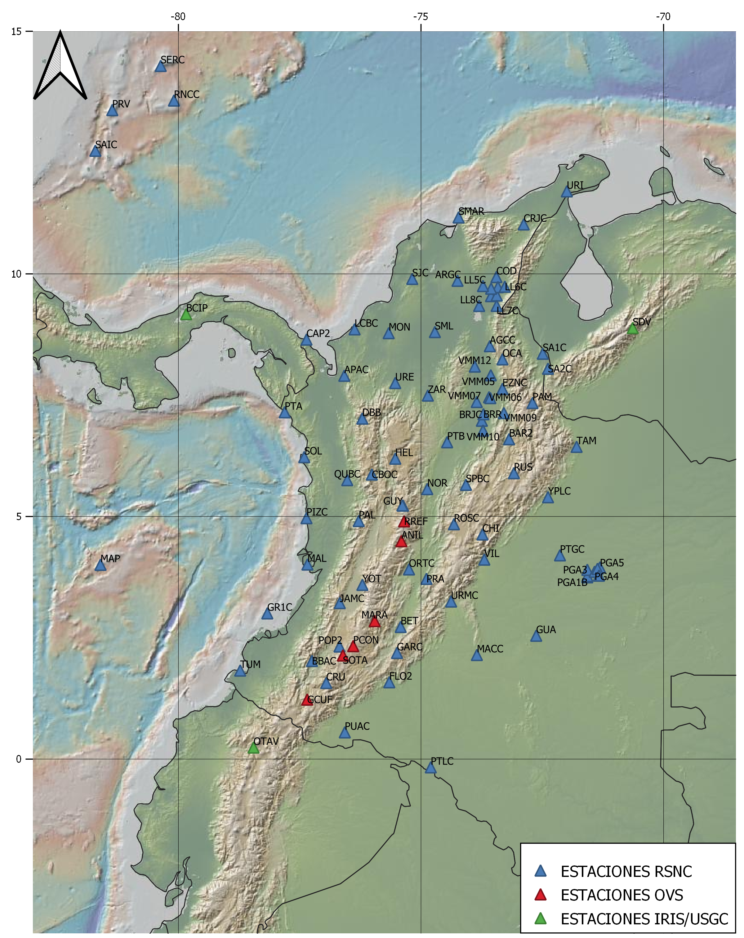
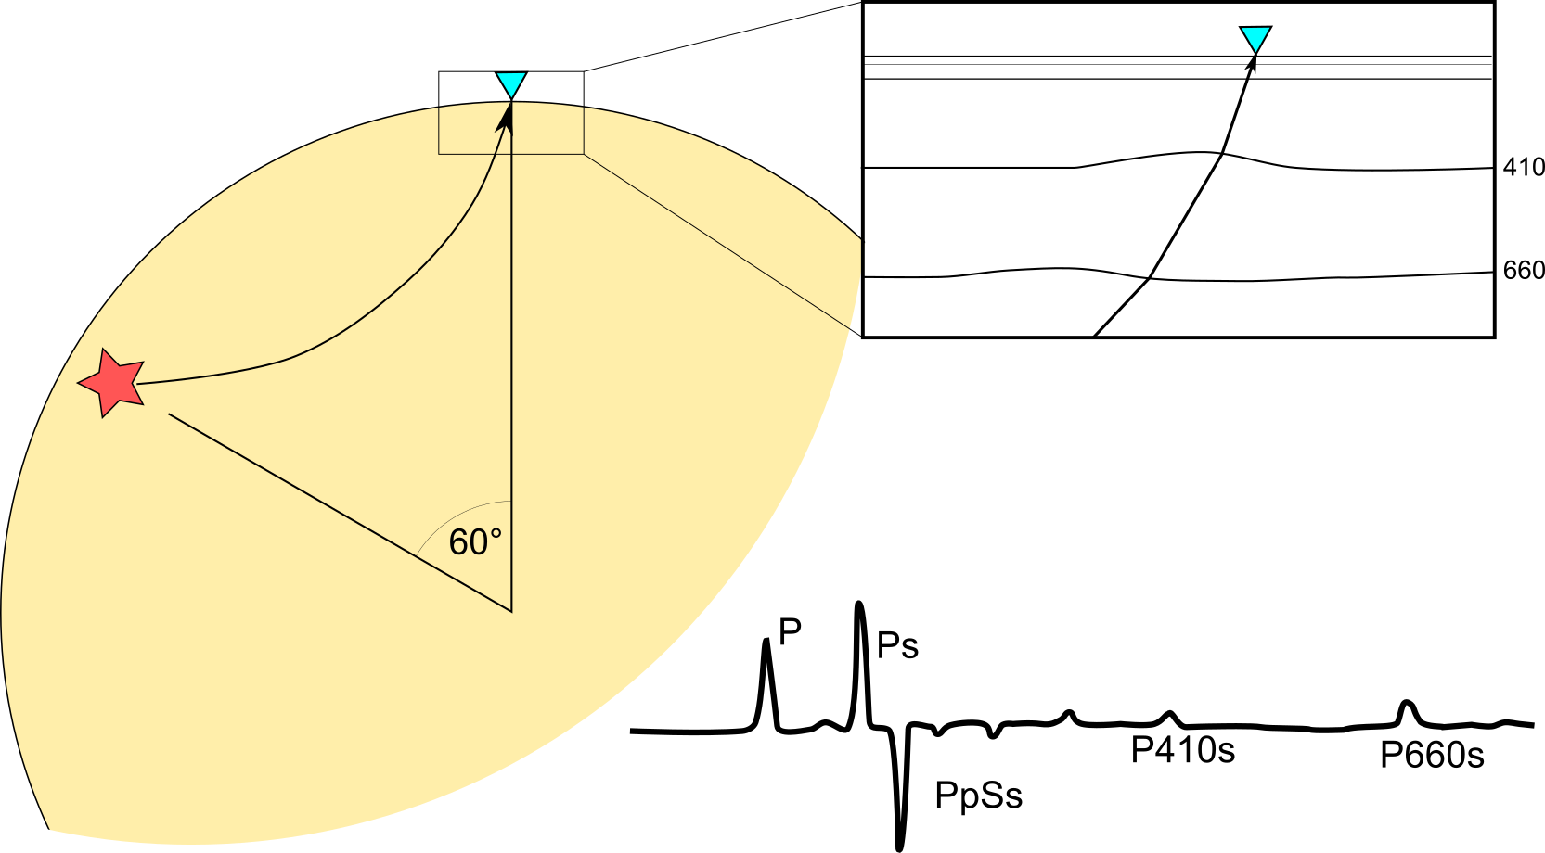
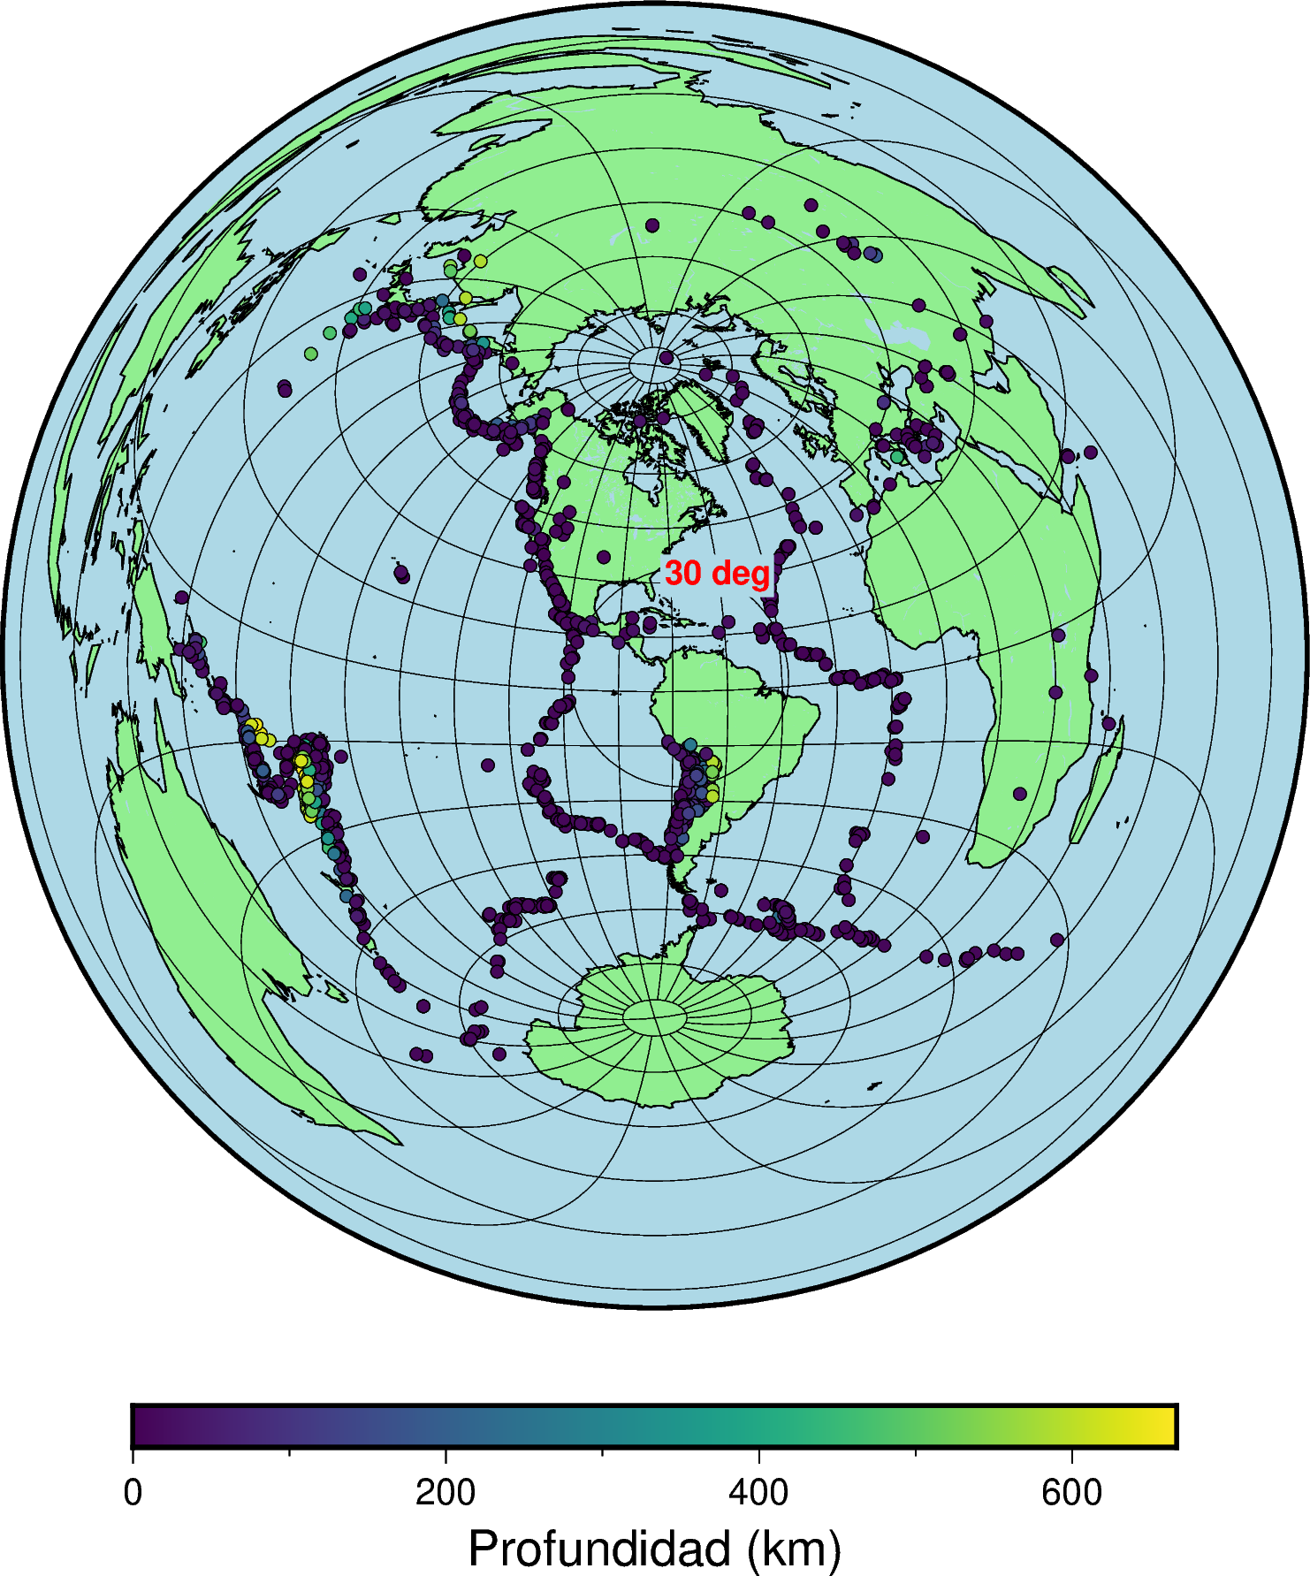
Method, Stations and Events
98 Stations
1854 Teleseismic events
4.7≤Mw≤8.1
30 − 130◦
RF estimated 66.277
HQ RF choised 15.049
Please do not use this space, a QR code will be automatically overlayed
P1.2-016

Slide 5
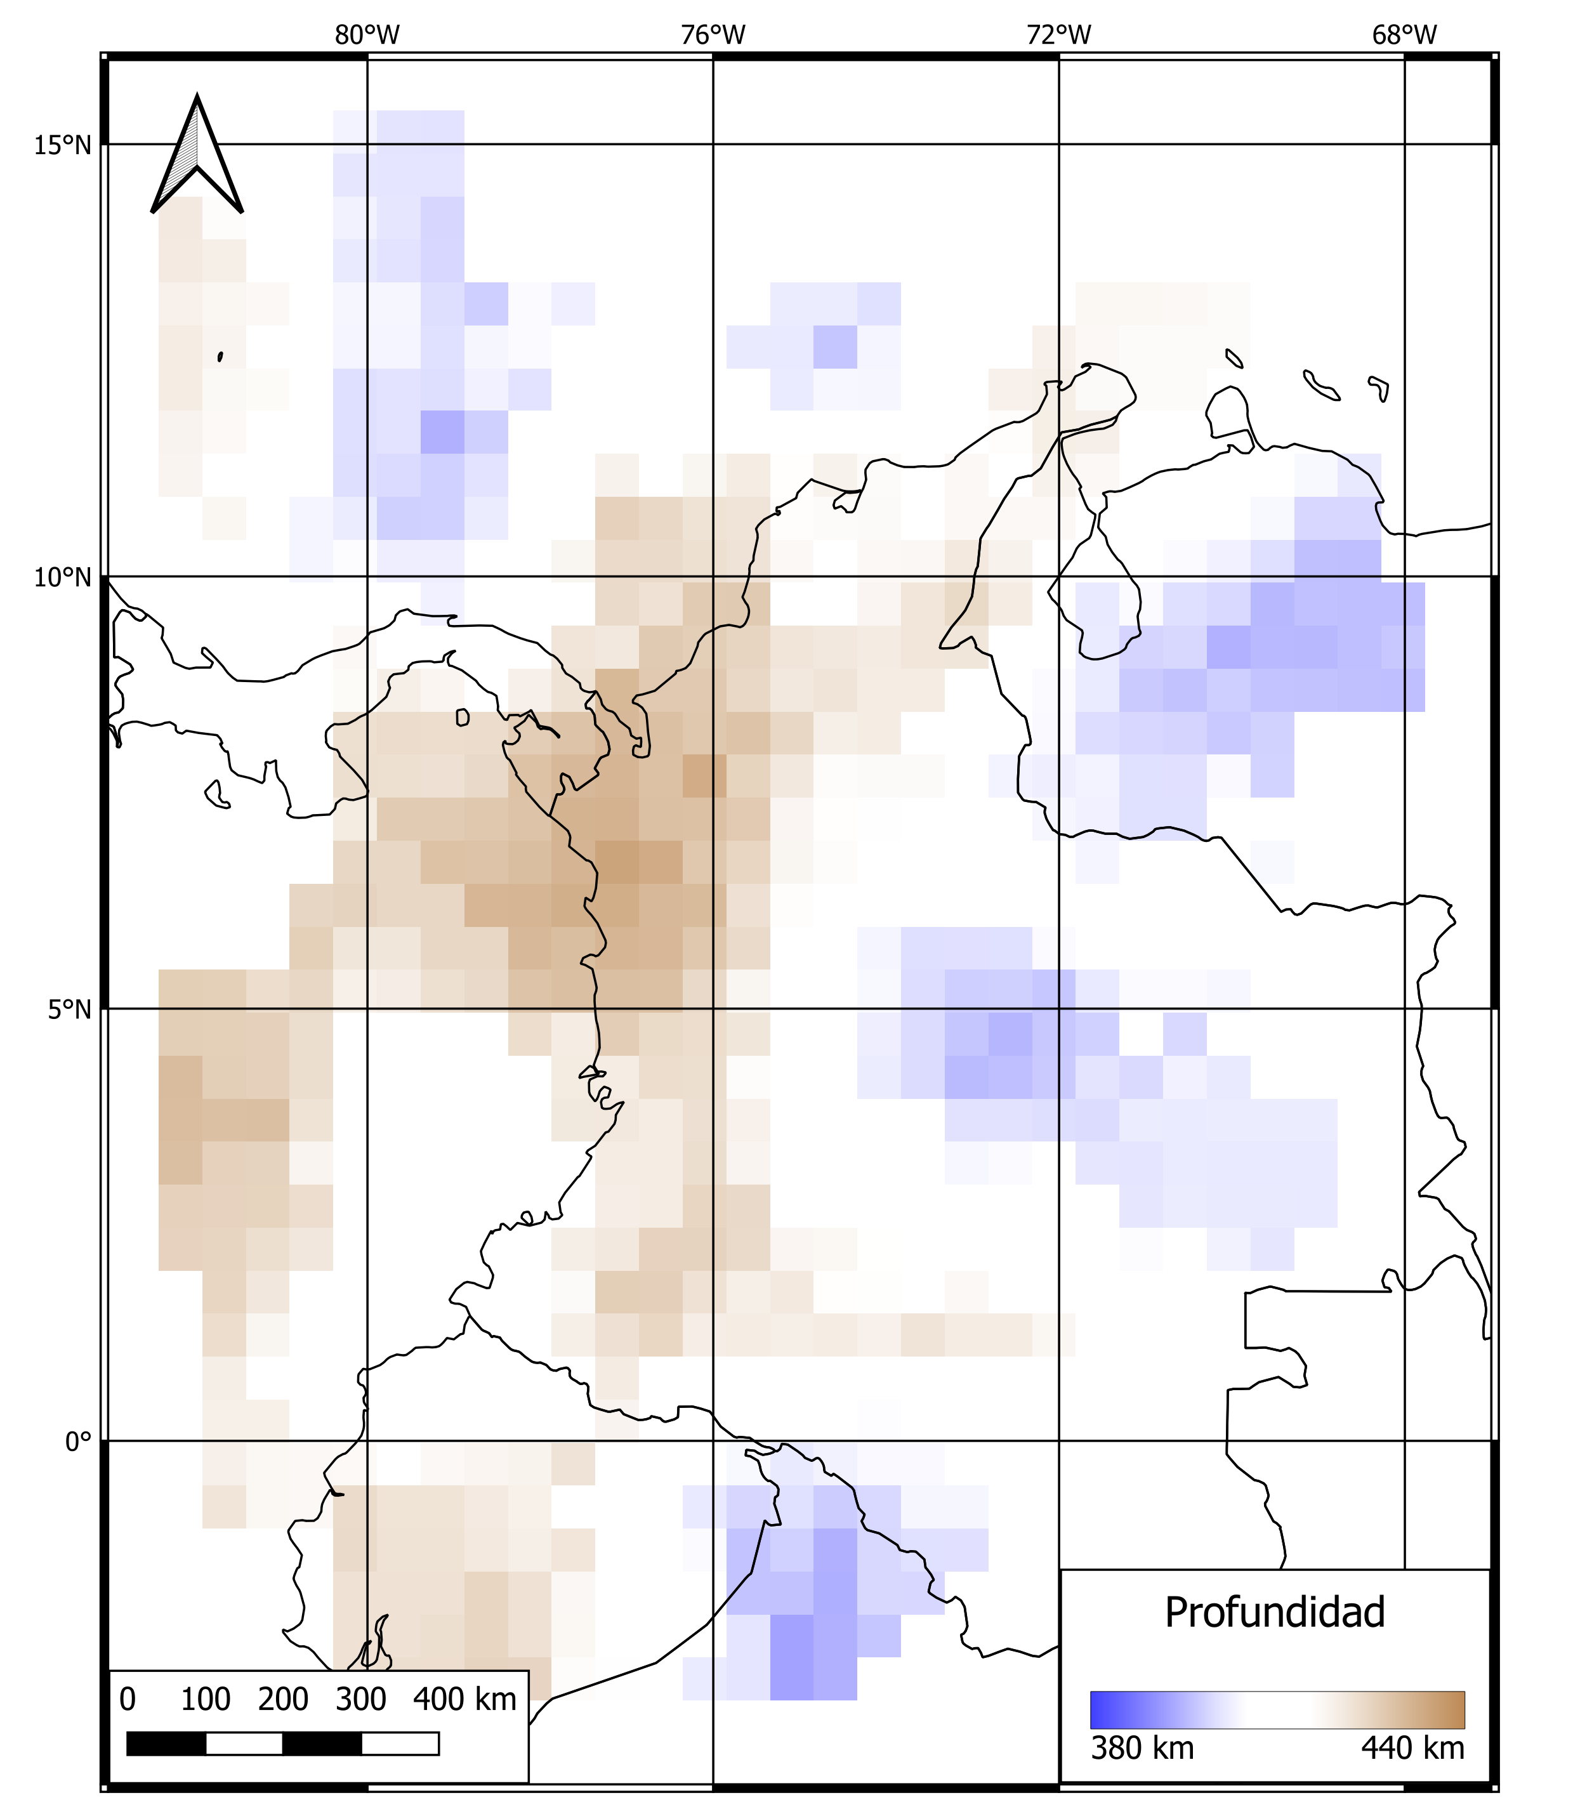
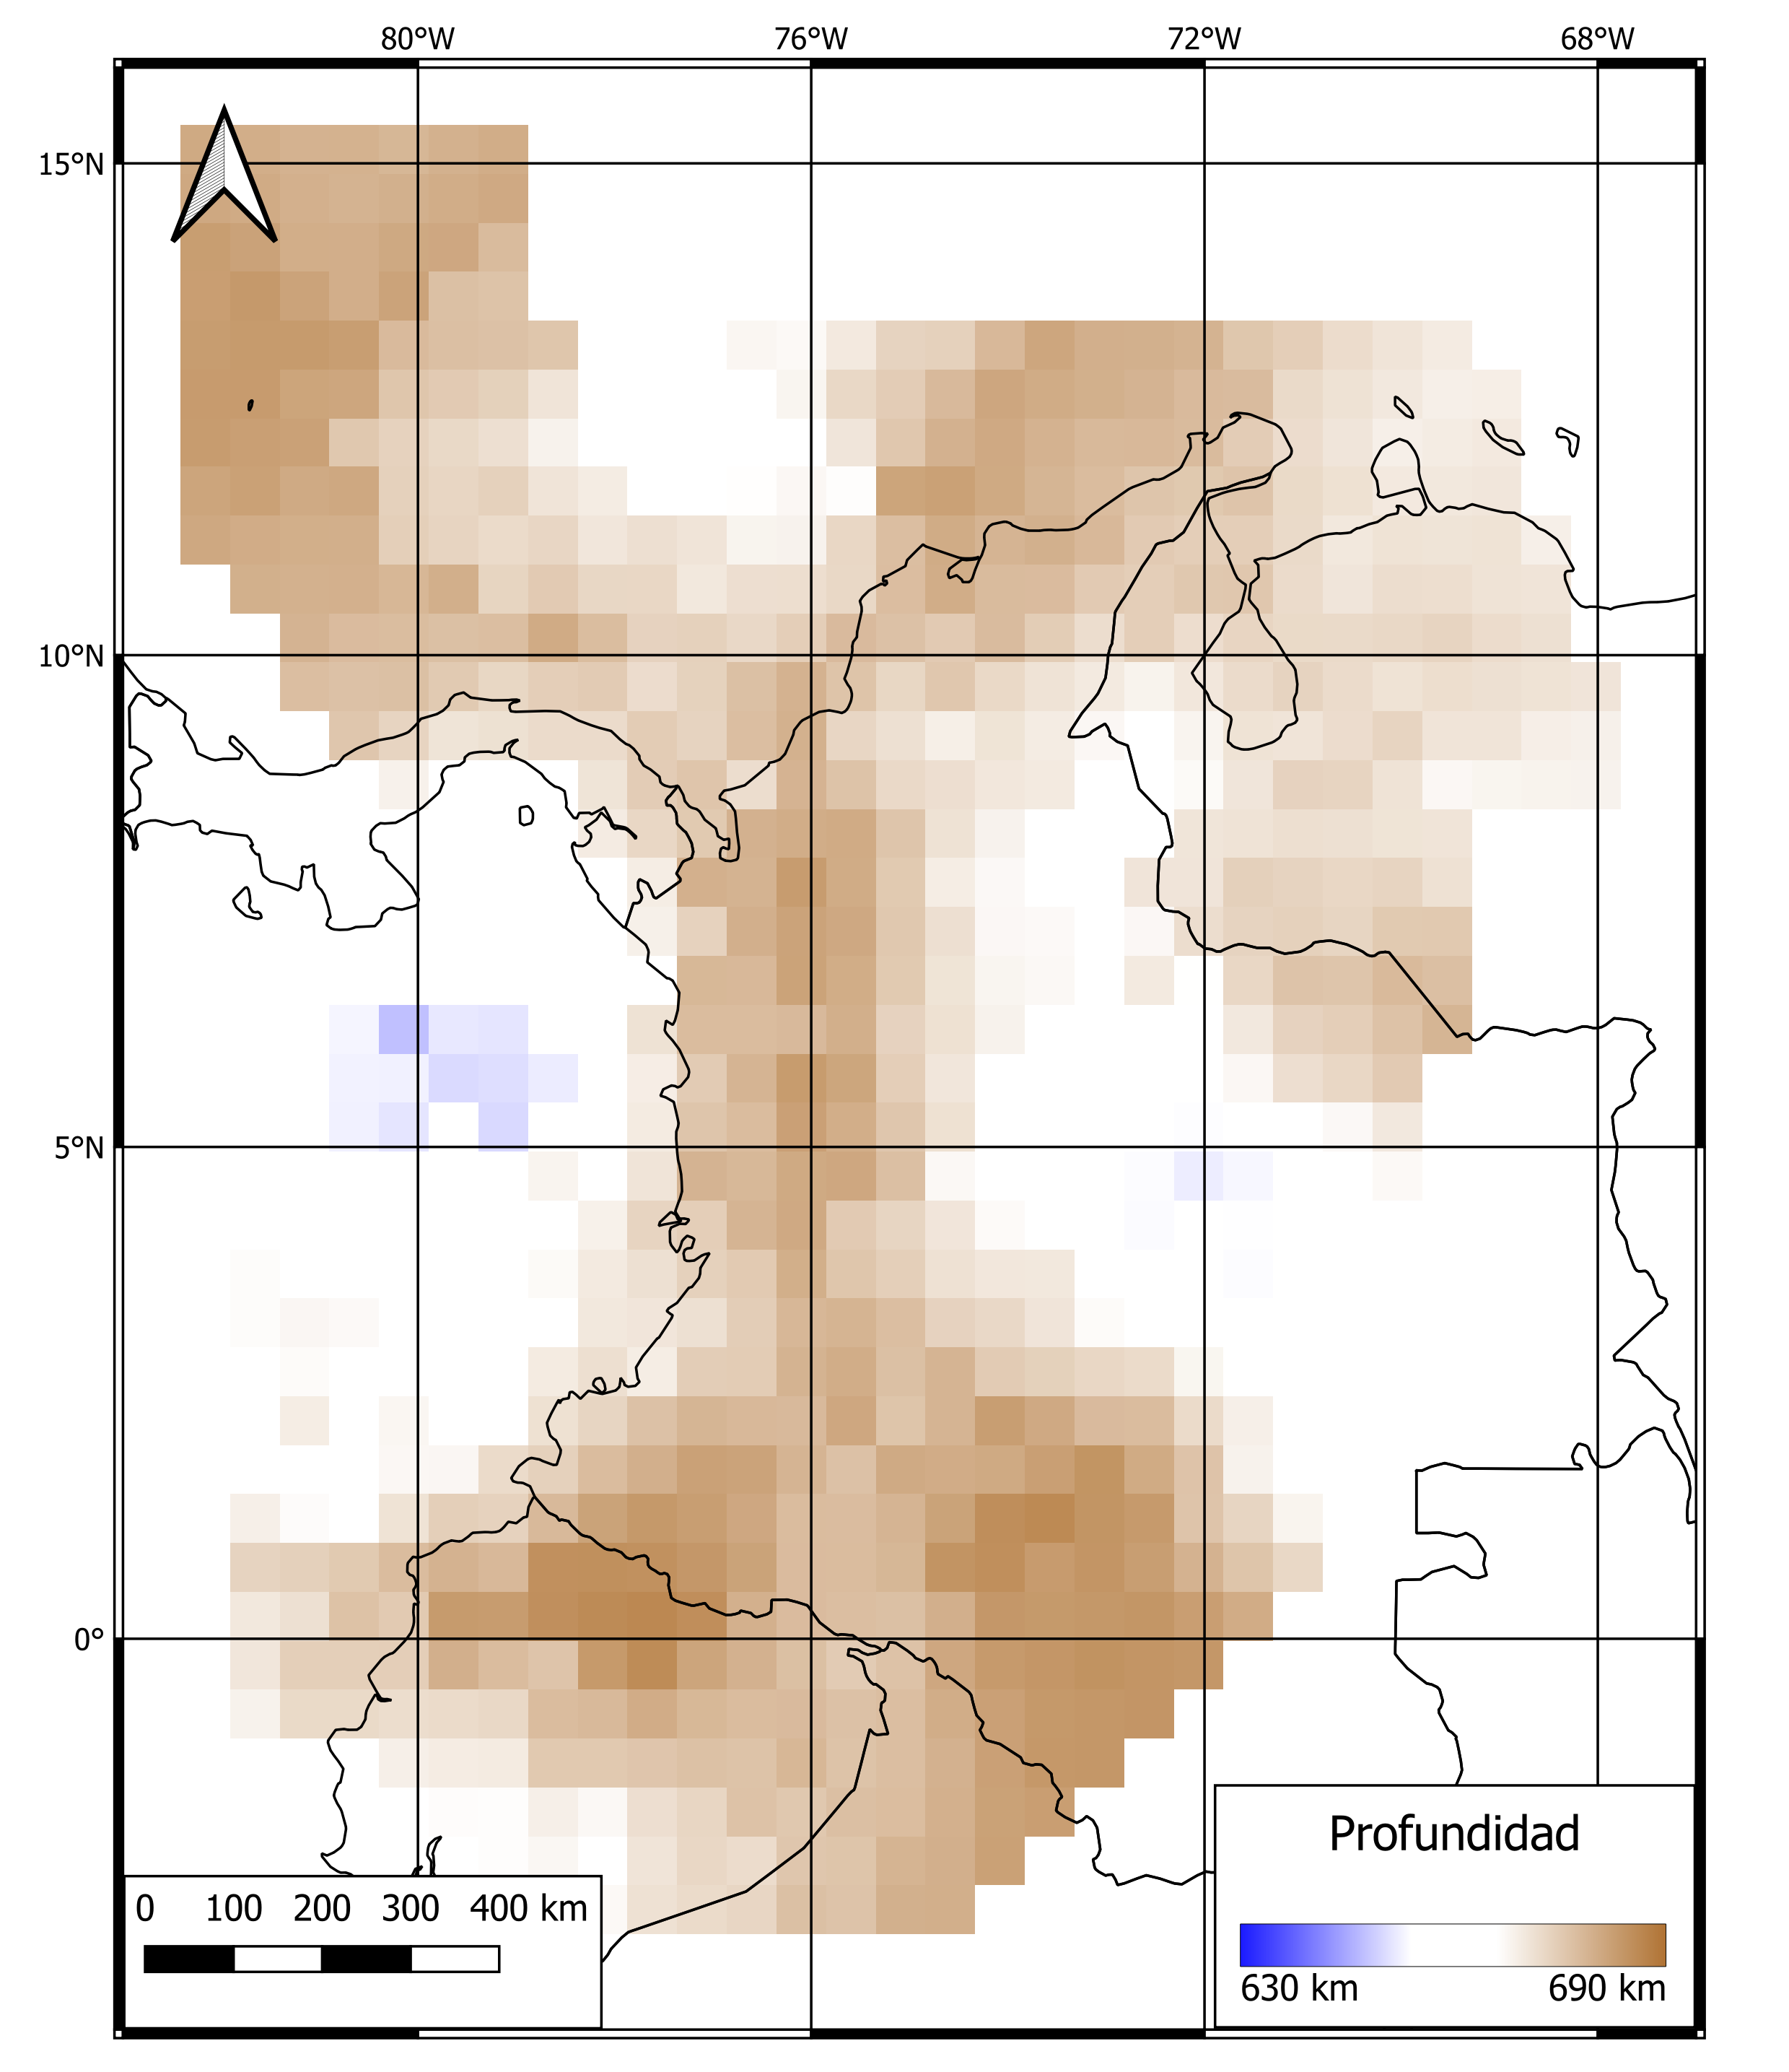
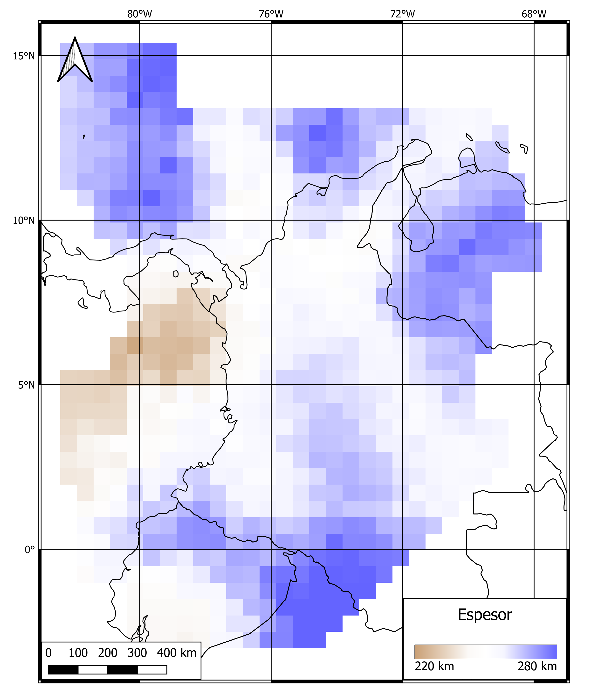
Results: Geometry and thickness between both mantle discontinuties
Morphology of the mantle discontinuities
Please do not use this space, a QR code will be automatically overlayed
410 km-Depth
(reference)
660 km-Depth
(reference)
250 km-thickness
(reference)
P1.2-016

Slide 6
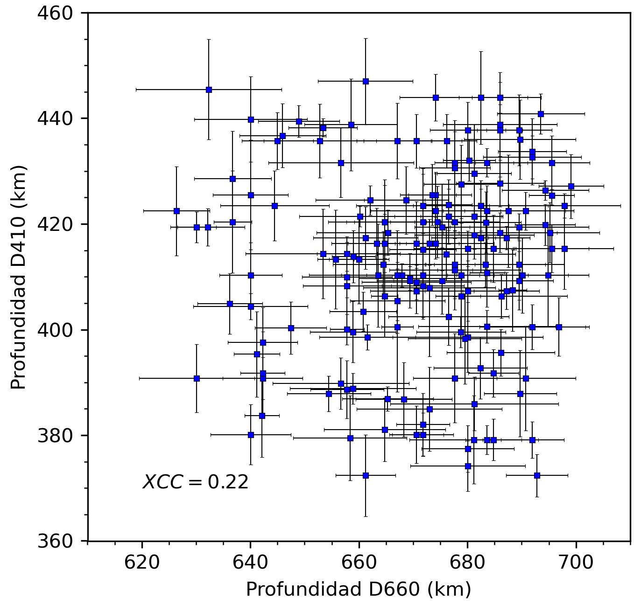
Conclusions
A low correlation coefficient between the depths of the mantle transition zone's discontinuities indicates a considerable variation in topography, possibly due to significant anomalies in temperature, water content, or seismic velocities.
The region that recorded the lowest thickness of the mantle's transition zone was under the Nazca plate, below the Malpelo Ridge. This tectonic feature could have its origin at the base of the upper mantle, causing an increase in temperature in the region and explaining its divergent behavior and cortical thinning.
Please do not use this space, a QR code will be automatically overlayed
P1.2-016

Slide 7
References
[Optional slide Font: Arial Regular Size 20]
Assumpcao, M., Bianchi, M., Kock, C., y Beck, S. (2021). Effect of the Cold Nazca Slab on the Depth of the 660km Discontinuity in South America. Journal of South American Earth Sciences, 112:103607.
Blanco, J. F., Vargas, C. A., y Monsalve, G. (2017). Lithospheric thickness estimation beneath Northwestern South America from an S-wave receiver function analysis. Geochemistry, Geophysics, Geosystems, 18(4):1376–1387.
Eulenfeld, T. (2020). rf: Receiver function calculation in seismology. Journal of Open Source Software, 5(48):1808.
Lawrence, J. F. y Shearer, P. M. (2006). A global study of transition zone thickness using receiver functions. Journal of Geophysical Research: Solid Earth, 111(B6).
Flanagan, M. P. y Shearer, P. M. (1998). Global mapping of topography on transition zone velocity discontinuities by stacking SS precursors. Journal of Geophysical Research: Solid Earth, 103(B2):2673–2692.
Please do not use this space, a QR code will be automatically overlayed
P1.2-016

