Slide 1
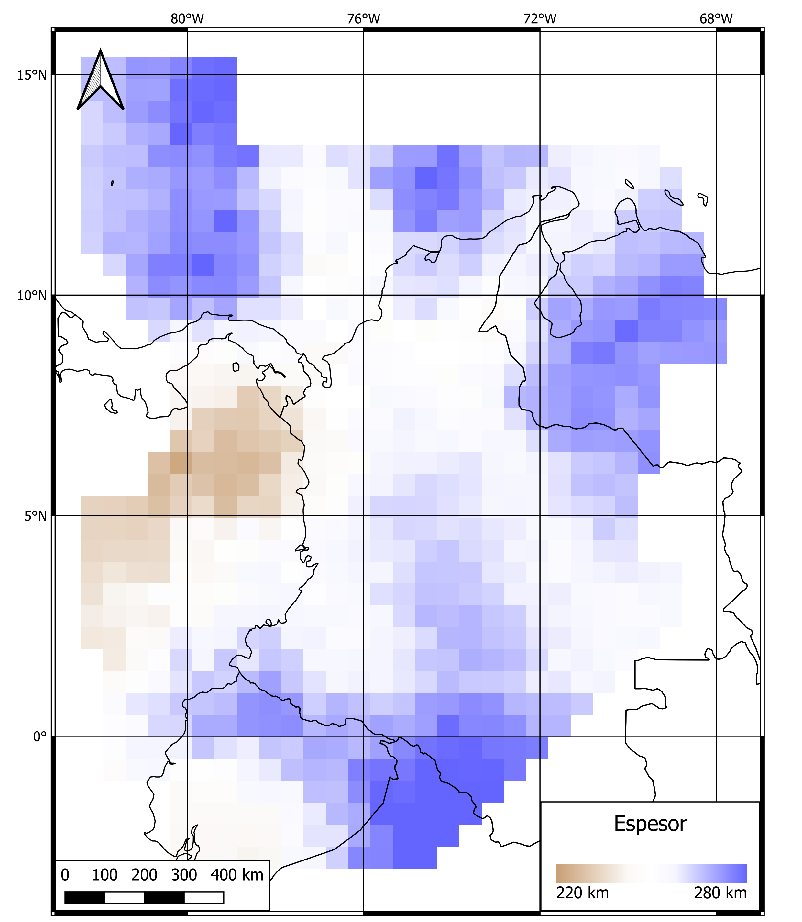
Estimation of the Mantle Transition Zone Seismic Discontinuities Beneath Northwestern South America from P Wave Receiver Function Analysis
Carlos Alberto Vargas – Jorge Enrique Cubillos
Department of Geosciences, Universidad Nacional de Colombia at Bogota
P1.2-016
Mantle transition zone is delimited by two seismic discontinuities at 410 km and 660 km. These were imaged under the northwestern corner of South America using the receiver function technique and a seismological record with up to 30 years-old registered by the National Seismological Network of Colombia. The mean depths for the mantle transition limits are 412±5.3 and 671±5.9 with a mean thickness of 258±6.5, this value is comparable to the global average. The low correlation between the discontinuities is caused by the significant depth variation and the thicker mantle transition zone in some areas, are possibly due to significant anomalies in temperature, water content, or mineralogical composition. On the other hand, mantle transition zone thinning beneath the Nazca plate possible is linked to the Malpelo ridge presence. These observations together with seismic tomography investigations could confirm the interaction of Nazca and Caribe plate within the upper mantle and mantle transition zone hydration.

