Slide 1
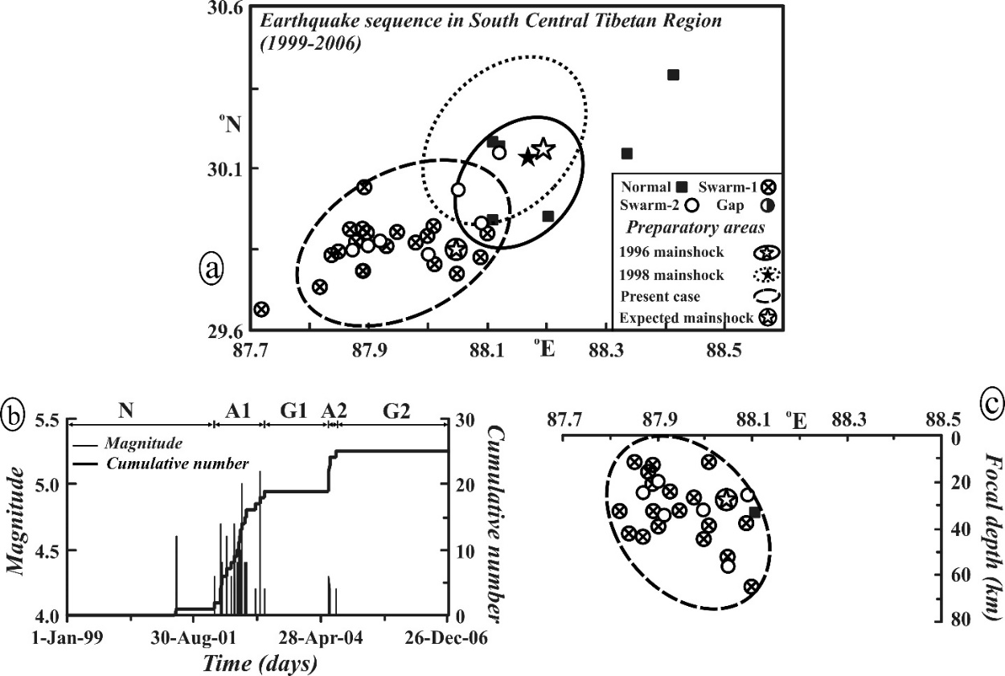
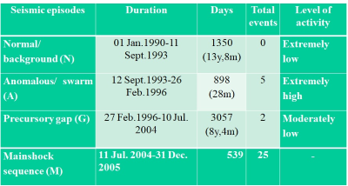
Understanding the Earthquake Occurrences and Looking for the Future in South Central Tibet (SCT) Himalaya
Daya Shanker1 and Harihar Paudyal2
¹Indian Institute of Technology Roorkee, Department of Earthquake Engineering, India
²Tribhuvan University, Nepal
P1.2-023
NAGM Seismicity patterns:
Various seismic precursors are known to be preceded to small to large earthquakes.
To ensure the anomalous seismic activity patterns 3-earthquake sequence occurred in 1996 (m_{b} 5.9), 1998 (m_{b} 5.8) and 2004-05 (m_{b} 6.2, 6.3) were investigated in details Using NAGM Seismicity Pattern and found that there are following NAGM pattern preceded by Precursory Swarm
Location
The expected mainshock (M≥6.0) may lie within the delineated elliptical area (~1.6 x 103 km²) bounded by 29.6-30.1º N and 87.8-88.1º E and in the depth range 25 ± 15 km.

