Slide 1

Understanding the Earthquake Occurrences and Looking for the Future in South Central Tibet (SCT) Himalaya
Daya Shanker¹ and Harihar Paudyal²
¹Indian Institute of Technology Roorkee, Department of Earthquake Engineering, India
²Tribhuvan University, Nepal
Prof. Daya Shanker is presently an Associate Professor of Engineering Seismology & Seismotectonics working as faculty since 1996 in the Department of Earthquake Engineering, Indian Institute of Technology Roorkee, India. He has produce 05 PhD and 23 M. Tech Thesis, 47 foreign visits, 180 publications.
Based on seismicity patterns:
The entire preparatory phenomena of seismicity fluctuation can be classified in four epeisode:
N– Normal seismicity Episode
A—Anomalous seismicity Episode
G—Precursory Gap Episode
M—Mainshock Episode
Following Low-High –Low
Seismicity data used (1963-2006)
In the South Central Tibet region, two anomalously high seismicity phases having analogous spatial and temporal characteristics, separated by about 1.3 years duration occurred during January 2002-February 2003 and June-August 2004 and were concentrated towards south-southwest of the preparatory areas of 1996 and 1998 mainshocks
In general, mains shock is 1 to 2 unit greater than the Precursory Magnitude (Mp), but in this case 1 to 1.4. Considering these facts, the expected mainshock (M≥6.0) may lie within the delineated elliptical area (~1.6 x 103 km²) bounded by 29.6-30.1º N and 87.8-88.1º E and in the depth range 25 ± 15 km.
Place your QR Code here after removing this text box!
P1.2-023

Slide 2

Introduction: Background Related to Topic
Why this region is seismically very active
The three subregions:
1. The Himalaya
2. The plain of Ganges and other
rivers
3. The peninsula
are very different in structure and
in geological history
Division of Himalayas
The study area is part of western Himalayas. From south to north the Himalayas are divided into the Sub-Himalaya, the Lesser Himalaya and the Higher Himalaya. The boundary between the Sub-Himalaya and Lesser Himalaya is marked by MBT, whereas the Lesser Himalaya separated from the Higher Himalaya by MCT. The major tectonic discontinuity, the MCT, is the predominant factor for major tectonic activity in the region. Geomorphologically, the area is characterized by a high-amplitude topography and great denudational slope
Higher Himalaya.
MCT I,
MCT II and
MCT III
MCT
Lesser Himalaya
MBT
Sub-Himalaya
Place your QR Code here after removing this text box!
MFT
Lower-Himalaya
(Shivalik)
P1.2-023

Slide 3
Methodology
Seismicity patterns
Identification of Seismicity patterns
The entire preparatory phenomena of seismicity fluctuation can be classified in four epeisode:
N– Normal seismicity Episode (or background)
- measured from the onset of swarm activity,
A—Anomalous seismicity Episode (or Precursory swarm Episode )
- period from the onset to end of swarm sequence
G—Precursory Gap Episode (or seismic quiescence)
- From the date of termination of swarm actitivy to the onset of the mainshock sequence
M—Mainshock Episode
Duration of main shock and its associated aftershocks.
Various seismic precursors are known to be preceded to small to large earthquakes such as:
Changes in b-values
Anomalous seismicity fluctuations (Singh et.al., 2005; Kanamori, 1981)
Precursory Swarm (Evison, 1977, 1982)
The swarms are a set of events occurring in an area over an interval of time which may continue to several months without any oustanding principal earthquake (Bullen, 1965)
The level of magnitude of events constituting the swarm is generally lower and of comparable sizes as compared to Mainshock (Evison, 1977)
The importance of precursory swarm sequence for long-range earthquake prediction demands for its identification in real sense of space and time domain.
Identification of precursory swarm requires spatial and temporal clustering of approximately similar magnitude events.
Precursory Swarm
Place your QR Code here after removing this text box!
P1.2-023

Slide 4
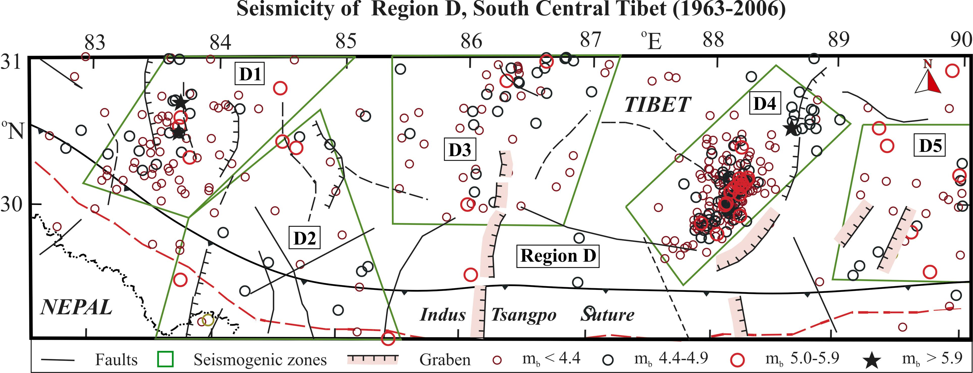
Region Under Investigation
The region D stretches in the east-west direction within South Central Tibet and is bounded between 29.2º-31.0º N and 82.5º-90º E with the ITS as the southernmost limit. The region is traversed by a dense normal faults/ graben structures trending north-south and northeast-southwest. In addition, the seismically inactive east-west trending and south dipping Indus Tsangpo Thrust traverses the entire region. The region has been quiet till 1962.
Place your QR Code here after removing this text box!
The region D can be divided into five active zones as D1, D2, D3, D4 and D5 based on the clustering pattern of seismic events. Since 1963, only three medium size earthquakes with m_{b} ≥ 6 have occurred: in 1980 in zone D4 and in 2004 and 2005 in zone D1 (Seismicity Data 1963-2006)
P1.2-023

Slide 5
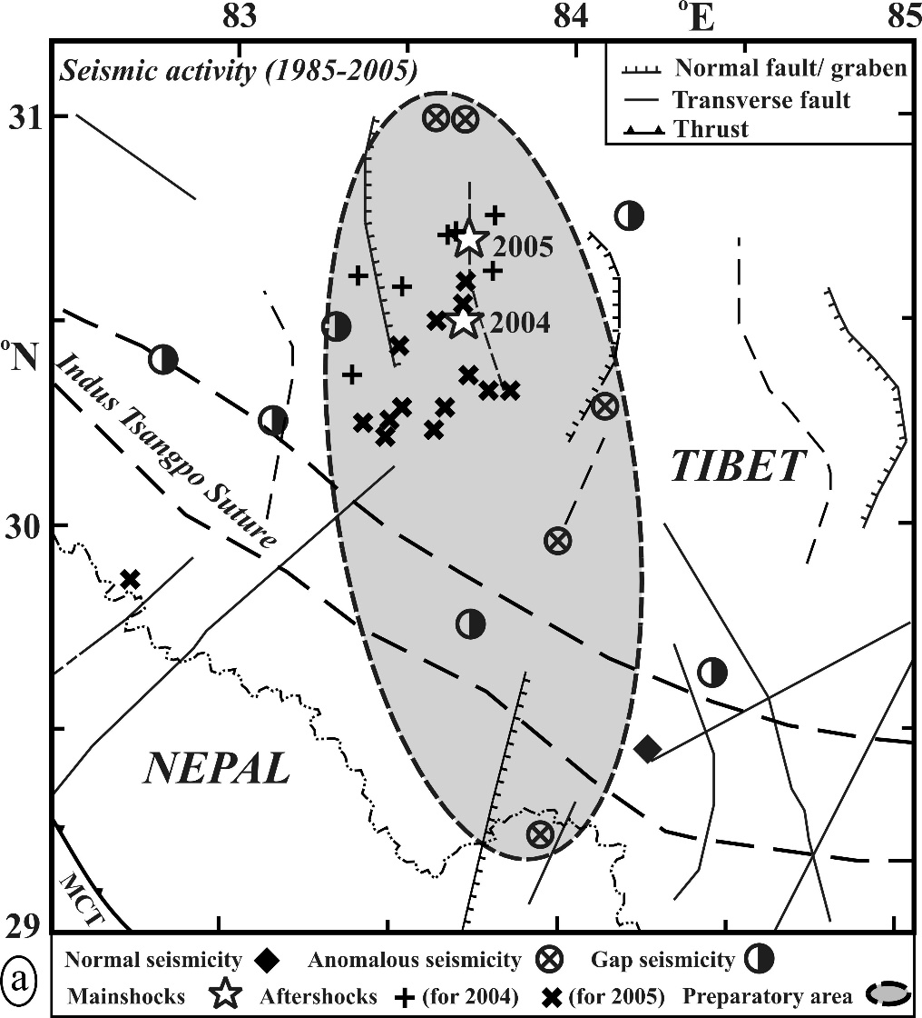
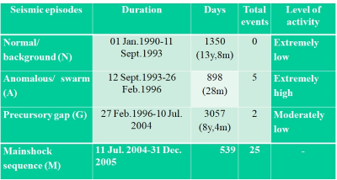
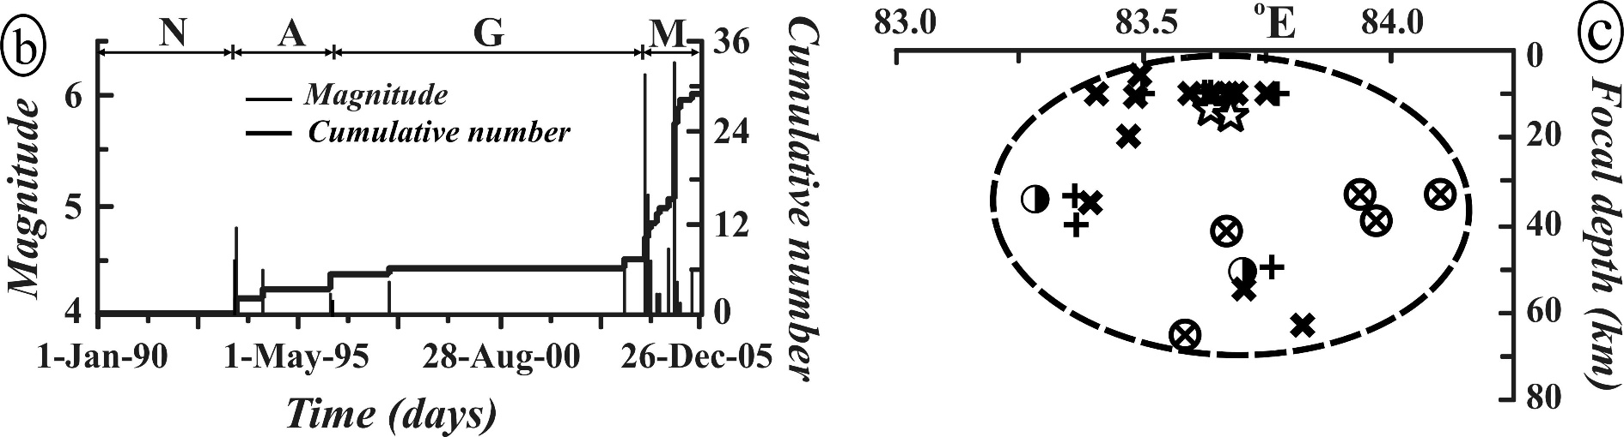
Data Analysis
To ensure the anomalous seismic activity patterns Three earthquake sequence occurred in 1996 (m_{b} 5.9),
1998 (m_{b} 5.8) and
2004-05 (m_{b} 6.2, 6.3) were investigated in details.
    Earthquakes of 11 July 2004 (m_{b} 6.2) and 07 April 2005 ( m_{b} 6.3)
Place your QR Code here after removing this text box!
P1.2-023

Slide 6
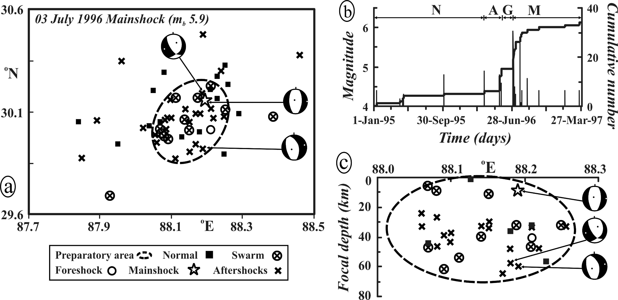
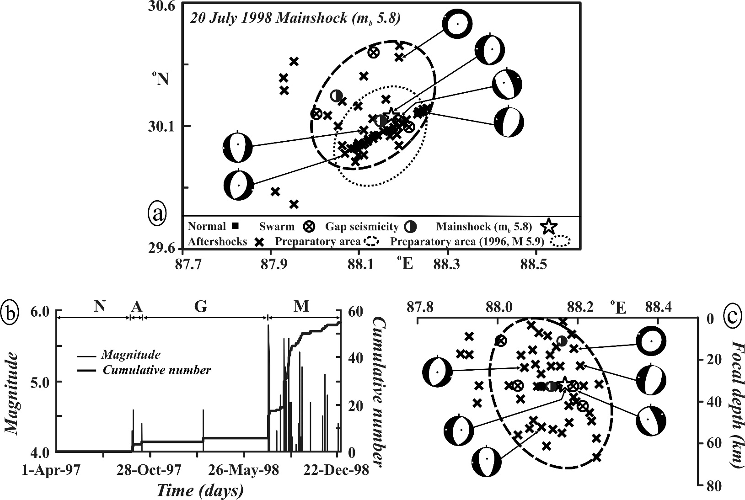
Data Analysis
Seismic episodes | Duration | Days | Total events | Level of activity
Normal/ background (N) | 01 Jan 1995-11 Mar 1996 | 436 | 5 | Moderately low
Anomalous/ swarm (A) | 12 Mar 1996-17 May 1996 | 67 | 10 | Extremely high
Precursory gap (G) | 18 May 1996-02 Jul 1996 | 46 | - | Extremely low
Mainshock sequence (M) | 03 Jul1996-31 Mar 1997 | 324 | 18 | -
Seismic episodes | Duration | Days | Total events | Level of activity
Normal/ background (N) | 01 Apr. 1997-12 Sept.1997 | 165 | 0 | Extremely low
Anomalous/ swarm (A) | 13 Sept.1997-05 Oct.1997 | 23 | 4 | Extremely high
Precursory gap (G) | 06 Oct.1997-19 Jul.1998 | 287 | 2 | Moderately low
Mainshock sequence (M) | 20 Jul.1998-25 Dec.1998 | 159 | 48 | -
Place your QR Code here after removing this text box!
P1.2-023

Slide 7
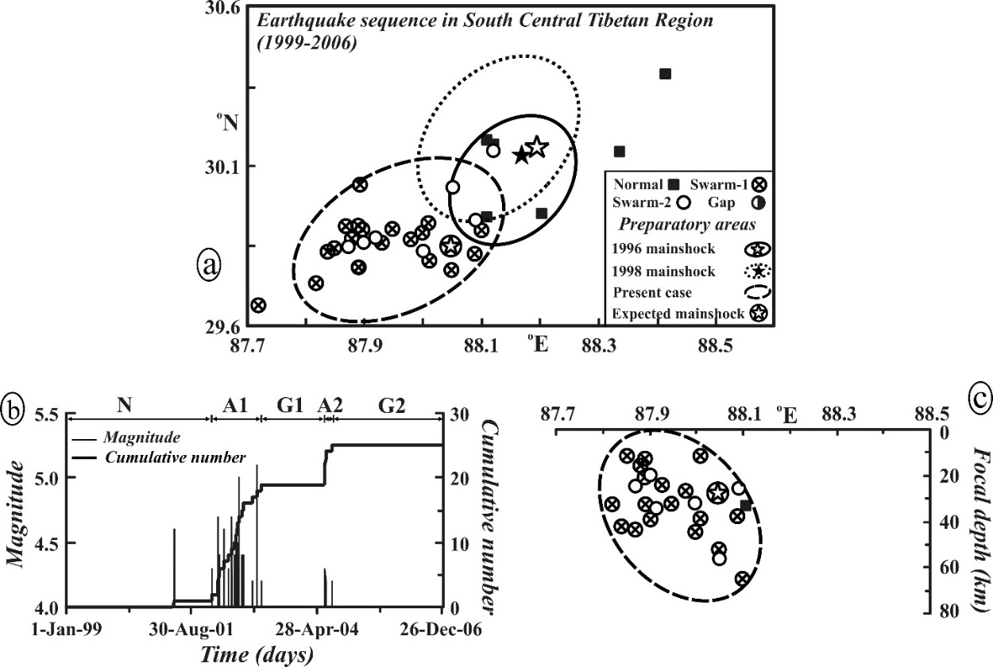
Results and Discussion
Anomalous Seismicity for Future Earthquakes in South Central Tibet
Seismic episodes | Duration | Days | Total events | Level of activity
Normal/ background (N) | 01 Jan.1999-30 Jan. 2002 | 1126 | 1 | Extremely low
Anomalous/ swarm (A1) | 31 Jan.2002-26 Feb.2003 | 392 | 18 | Extremely high
Precursory gap (G1) | 27 Feb. 2003-01 Jun.2004 | 461 | 0 | Extremely low
Anomalous/ swarm (A2) | 02 Jun.2004-21 Aug.2004 | 81 | 6 | Extremely high
Precursory gap (G2) | 22 Aug.2004-31 Dec.2006 | 862 | 0 | Extremely low
Mainshock (M) | Not yet occurred
Location
In this case, no mainshock has occurred so far
and the location of expected mainshock is
shown by circled open star. The elliptical area
delineated through dotted line is the preparatory
zone using spatial and temporal distribution of
normal (N), anomalous (A1 and A2) and gap(G1
and G2)events.
Place your QR Code here after removing this text box!
P1.2-023

Slide 8
Conclusions
In the South Central Tibet region, two anomalously high seismicity phases having analogous spatial and temporal characteristics, separated by about 1.3 years duration occurred during January 2002-February 2003 and June-August 2004 and were concentrated towards south-southwest of the preparatory areas of 1996 and 1998 mainshocks
In General, Mains shock is 1 to 2 unit greater than the Precursory Magnitude (Mp), but in this case 1 to 1.4. Considering this Magnitude will be ≥ 6.0
In both these cases, the spatial and the temporal clustering of swarm events are prominent, and they are confined in a vertical column of 10 to 45 km. Considering these facts, the expected mainshock (M≥6.0) may lie within the delineated elliptical area (~1.6 x 103 km²) bounded by 29.6-30.1º N and 87.8-88.1º E and in the depth range 25 ± 15 km.
Place your QR Code here after removing this text box!
P1.2-023

Slide 9
Bullen and Bolt B.A., An Introduction to the Theory of Seismology, Cambridge University Press, Cambridge, pp. 499, 1985
Bullen and Bolt B.A., An Introduction to the Theory of Seismology, Cambridge University Press, Cambridge, pp. 499, 1985
References
Evison, F.F., Fluctuation of seismicity before major earthquakes, Nature, 266, 710-712, 1977.
Evison, F.F., 1982. Generalized precursory swarm hypothesis. Journal of Physics of the Earth 30, 155–170.
Kanamori, H., 1981. The nature of seismicity patterns before large earthquakes, in earthquake prediction. In: Simpson, D.W., Richards, P.G. (Eds.). Maurice Ewing Series, vol. IV. AGU, Washington, DC, pp. 1–19.
Singh, H.N., Shanker, D., Singh, V.P., 2005. Occurrence of anomalous seismic activity preceding large to great earthquakes in northeast India region with special reference to 06 August 1988. Physics of the Earth and Planetary Interiors 148, 284–561.
Bullen and Bolt B.A., An Introduction to the Theory of Seismology, Cambridge University Press, Cambridge, pp. 499, 1965.
Place your QR Code here after removing this text box!
P1.2-023

