Slide 1
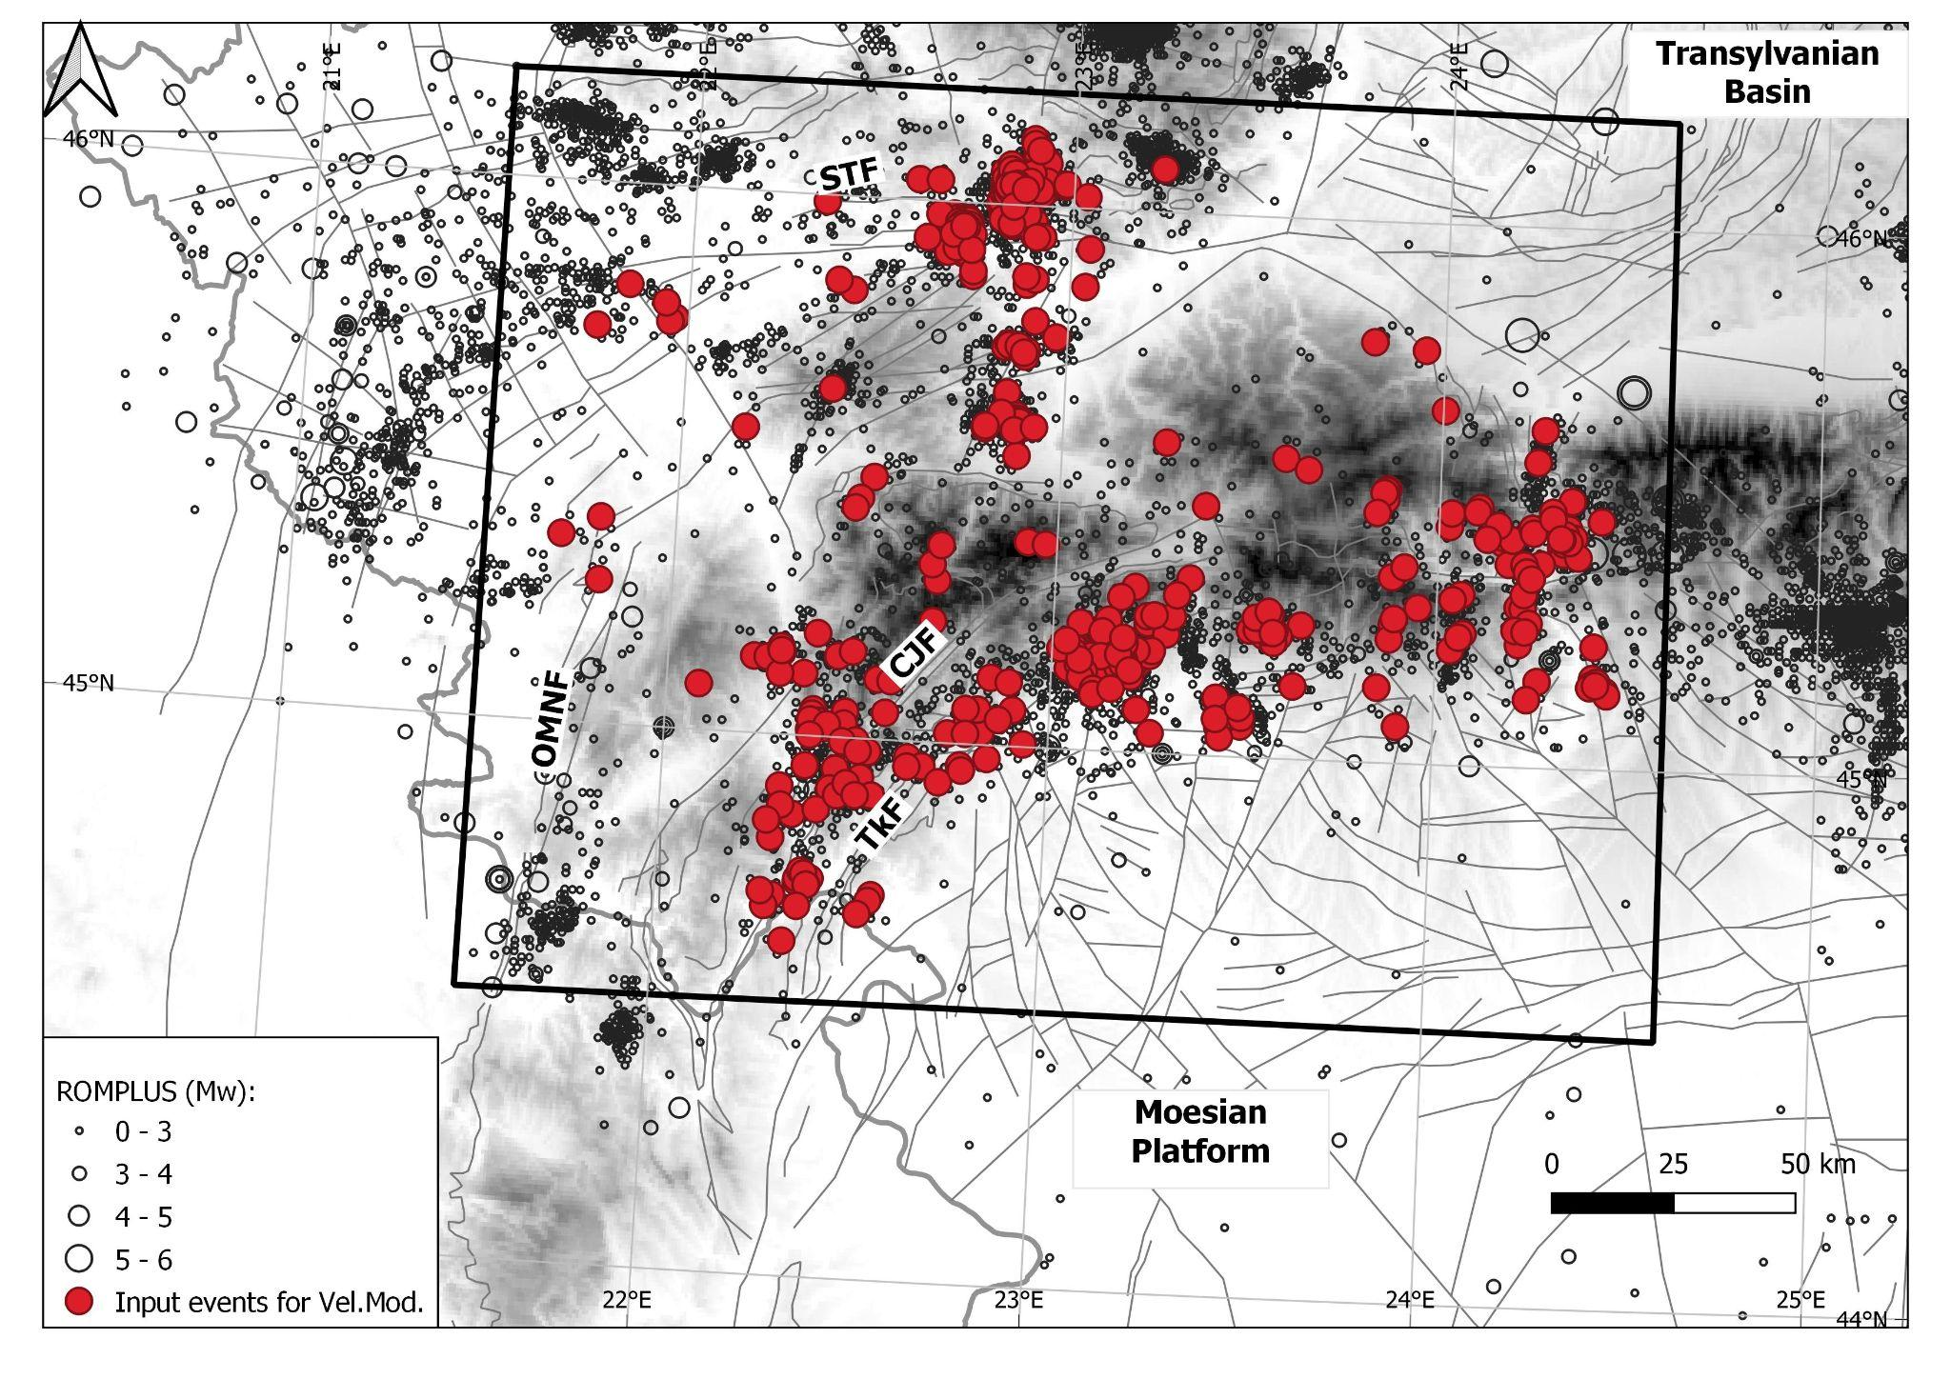
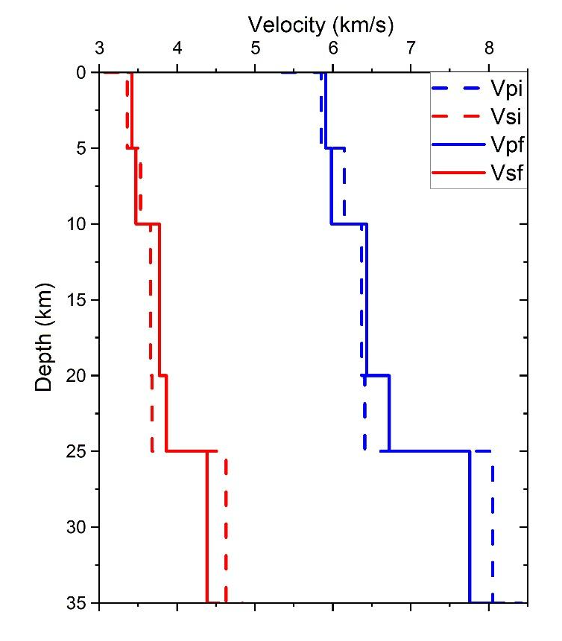
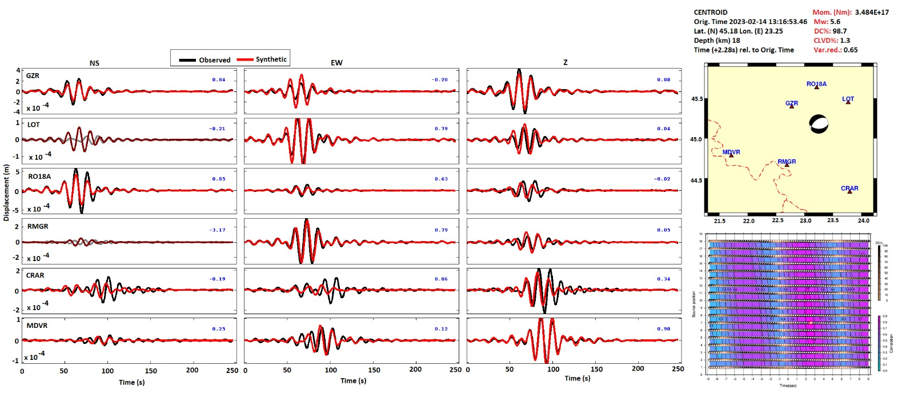
1-D Velocity Model at the Bending of the Southern Carpathians,
Inferred from the Analysis of Local Earthquakes
R. Dinescu
National Institute for Earth Physics; University of Bucharest, Faculty of Geology and Geophysics
P1.2-446
The main purposes of this study are the following:
to use the VELEST algorithm to construct the highest resolution 1D velocity model and associated station corrections for the bending of the Western Carpathian area (SWCBZ);
to better characterize major tectonic contacts by analyzing the spatial distribution of seismic events following relocation using the improved 1D velocity model as well as source parameter estimation based on waveform inversion;
to use the new velocity model to relocate the known blasts generated during the RomSeis 2014 (WARR) experiment.

