Slide 1
1-D Velocity Model at the Bending of the Southern Carpathians, Inferred from the Analysis of Local Earthquakes
R. Dinescu, F. Borleanu, M. Popa, N. Poiata, A. Chircea, I. Munteanu
National Institute for Earth Physics; University of Bucharest, Faculty
of Geology and Geophysics; Academy of Romanian Scientists, Romania; International Seismological Centre
A local velocity model is important to understand the seismic wave propagation through the Earth and to obtain a good image of the subsurface structures and layers.
We built a new velocity model for the South-Western Carpathian Bend Zone (SWCBZ)
The VELEST algorithm built in the SEISAN package is used to invert travel-time readings for P and S -waves in order to produce the new 1-D velocity model and corresponding station corrections.
We applied the algorithm to the set of selected earthquakes.
When compared to the average RMS of the initial velocity model, we obtained a reduction of up to 35% in the location RMS.
The newly determined velocity model also enhances the results of the algorithms based on waveform inversion to estimate the source parameters in the SWCBZ area.
We developed an enhanced 1-D velocity model that will be used on a regular basis for earthquake location and source parameter estimation throughout the SWCBZ area, as well as a reference model for future studies in this region.
The model matches well local geology and it has the highest resolution in the upper crust.
Please do not use this space, a QR code will be automatically overlayed
P1.2-446

Slide 2
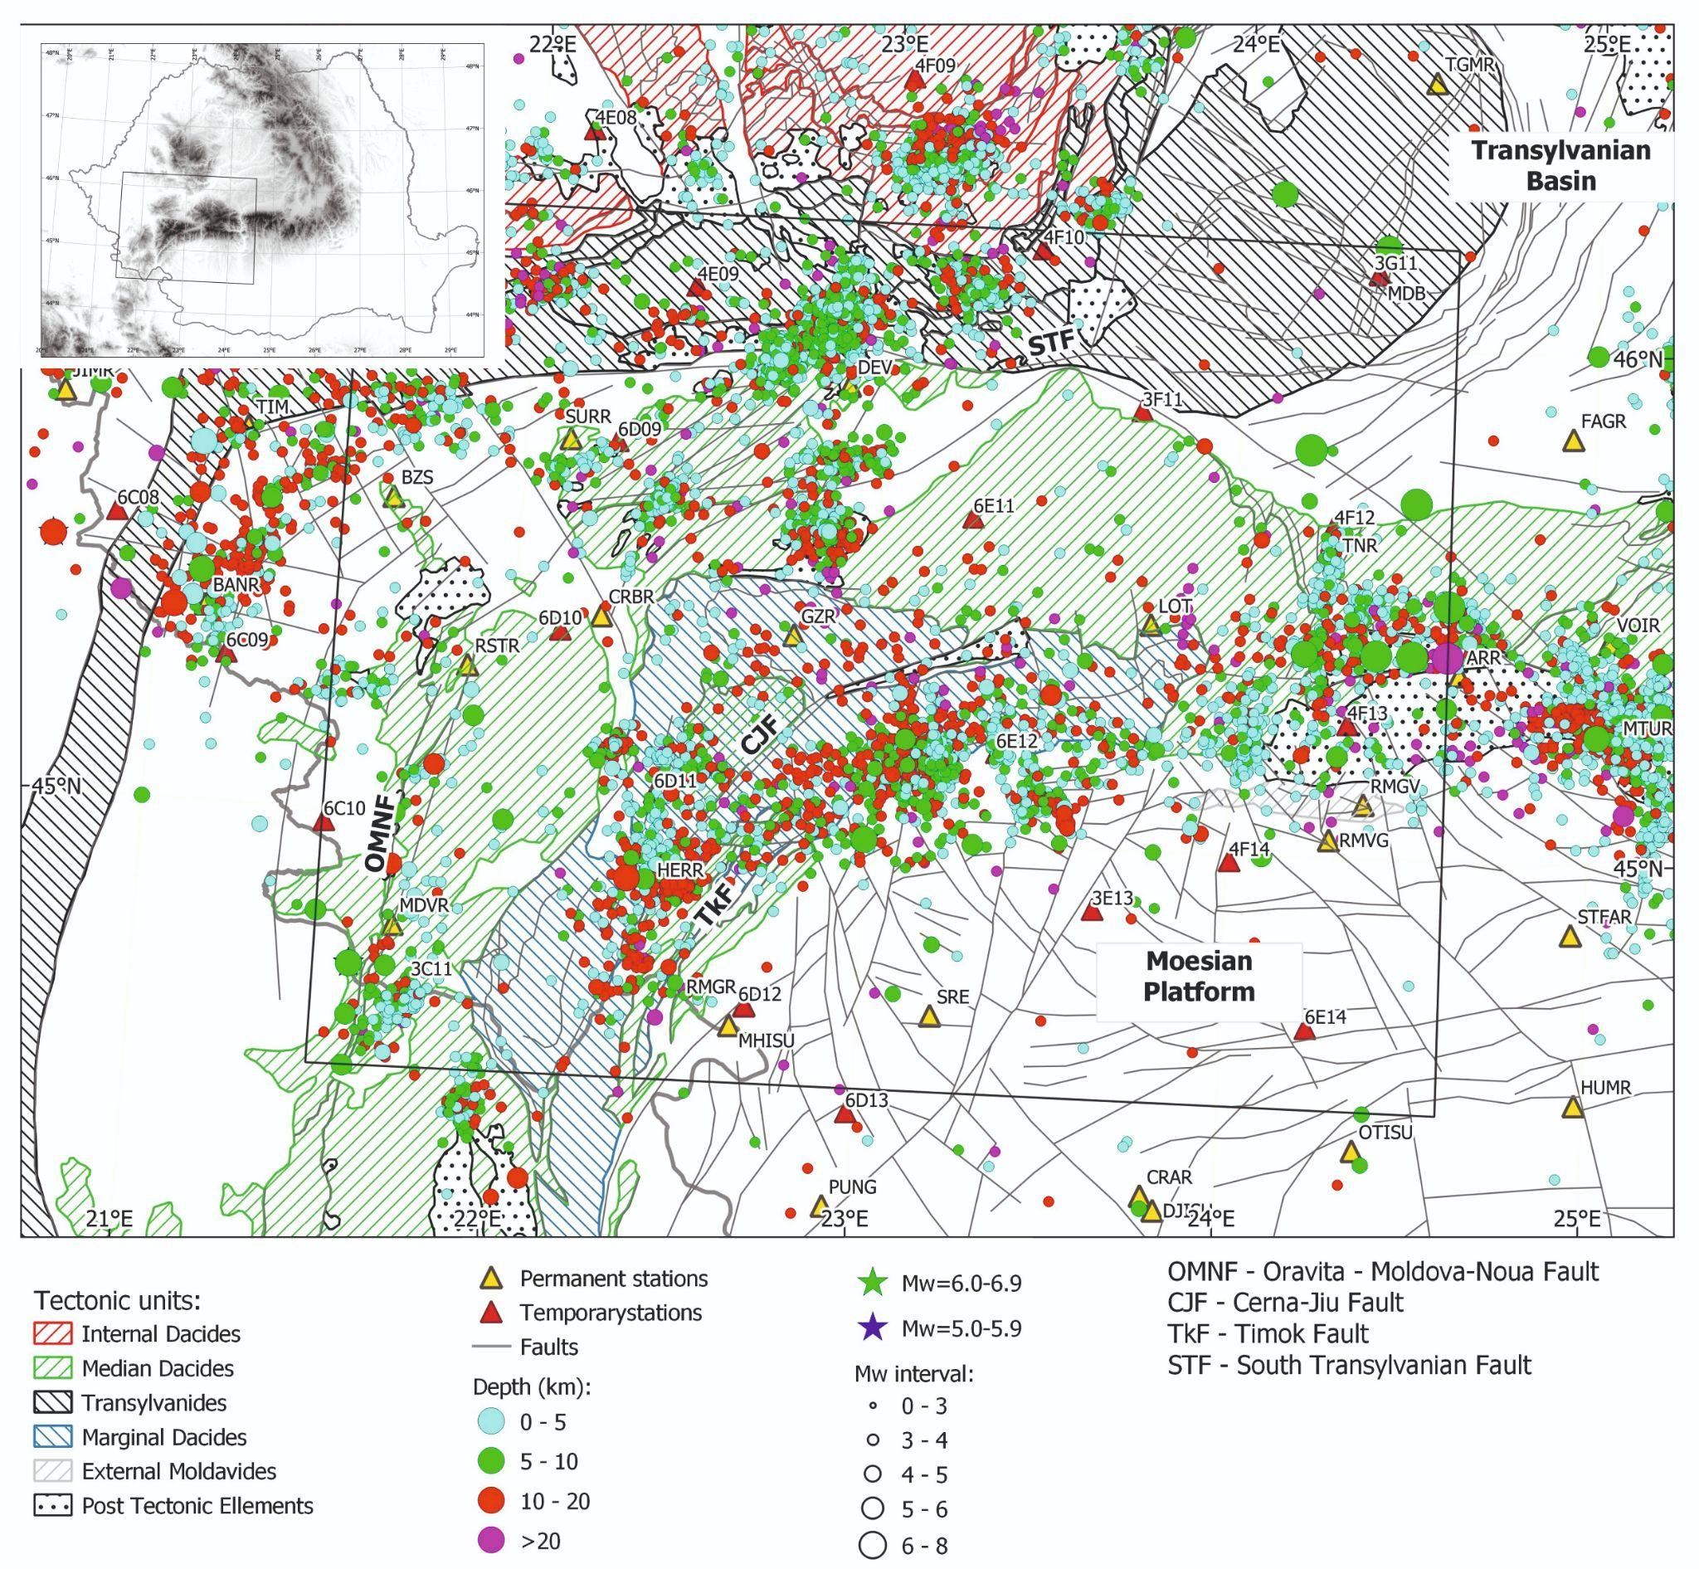
Introduction and Objectives
A velocity model of a region is based on a blending of data starting with data acquisition, processing and results interpretation in concordance with the geology and region tectonics.
The high number of stations in the region allows the building of a velocity model with a much higher accuracy, which can be used in seismic source determination and routine location processes
The South-Western part of the Carpathian Bend zone (SWCBZ) was the subject of several studies regarding the velocity models in the region (Oncescu et al. 1999; Raileanu et al. 2009; Zaharia et al, 2017).
The seismic activity in SWCBZ (Figure 1) is linked to the active tectonic deformation along the pull-apart basins. The NNE-SSW fault systems that dip to the west, such as the Oraviţa-Moldova Nouă (OMNF), Cerna-Jiu (CJF), Timok (TkF), in Figure 1, account for a large earthquake produced in the SWCBZ.
Objectives:
obtaining an improved 1-D velocity model for the SWCBZ for better definition of the major tectonic contacts and associated seismicity
obtaining the station corrections, important for event locations
Please do not use this space, a QR code will be automatically overlayed
Figure 1. Seismic activity in the SWCBZ area
P1.2-446

Slide 3
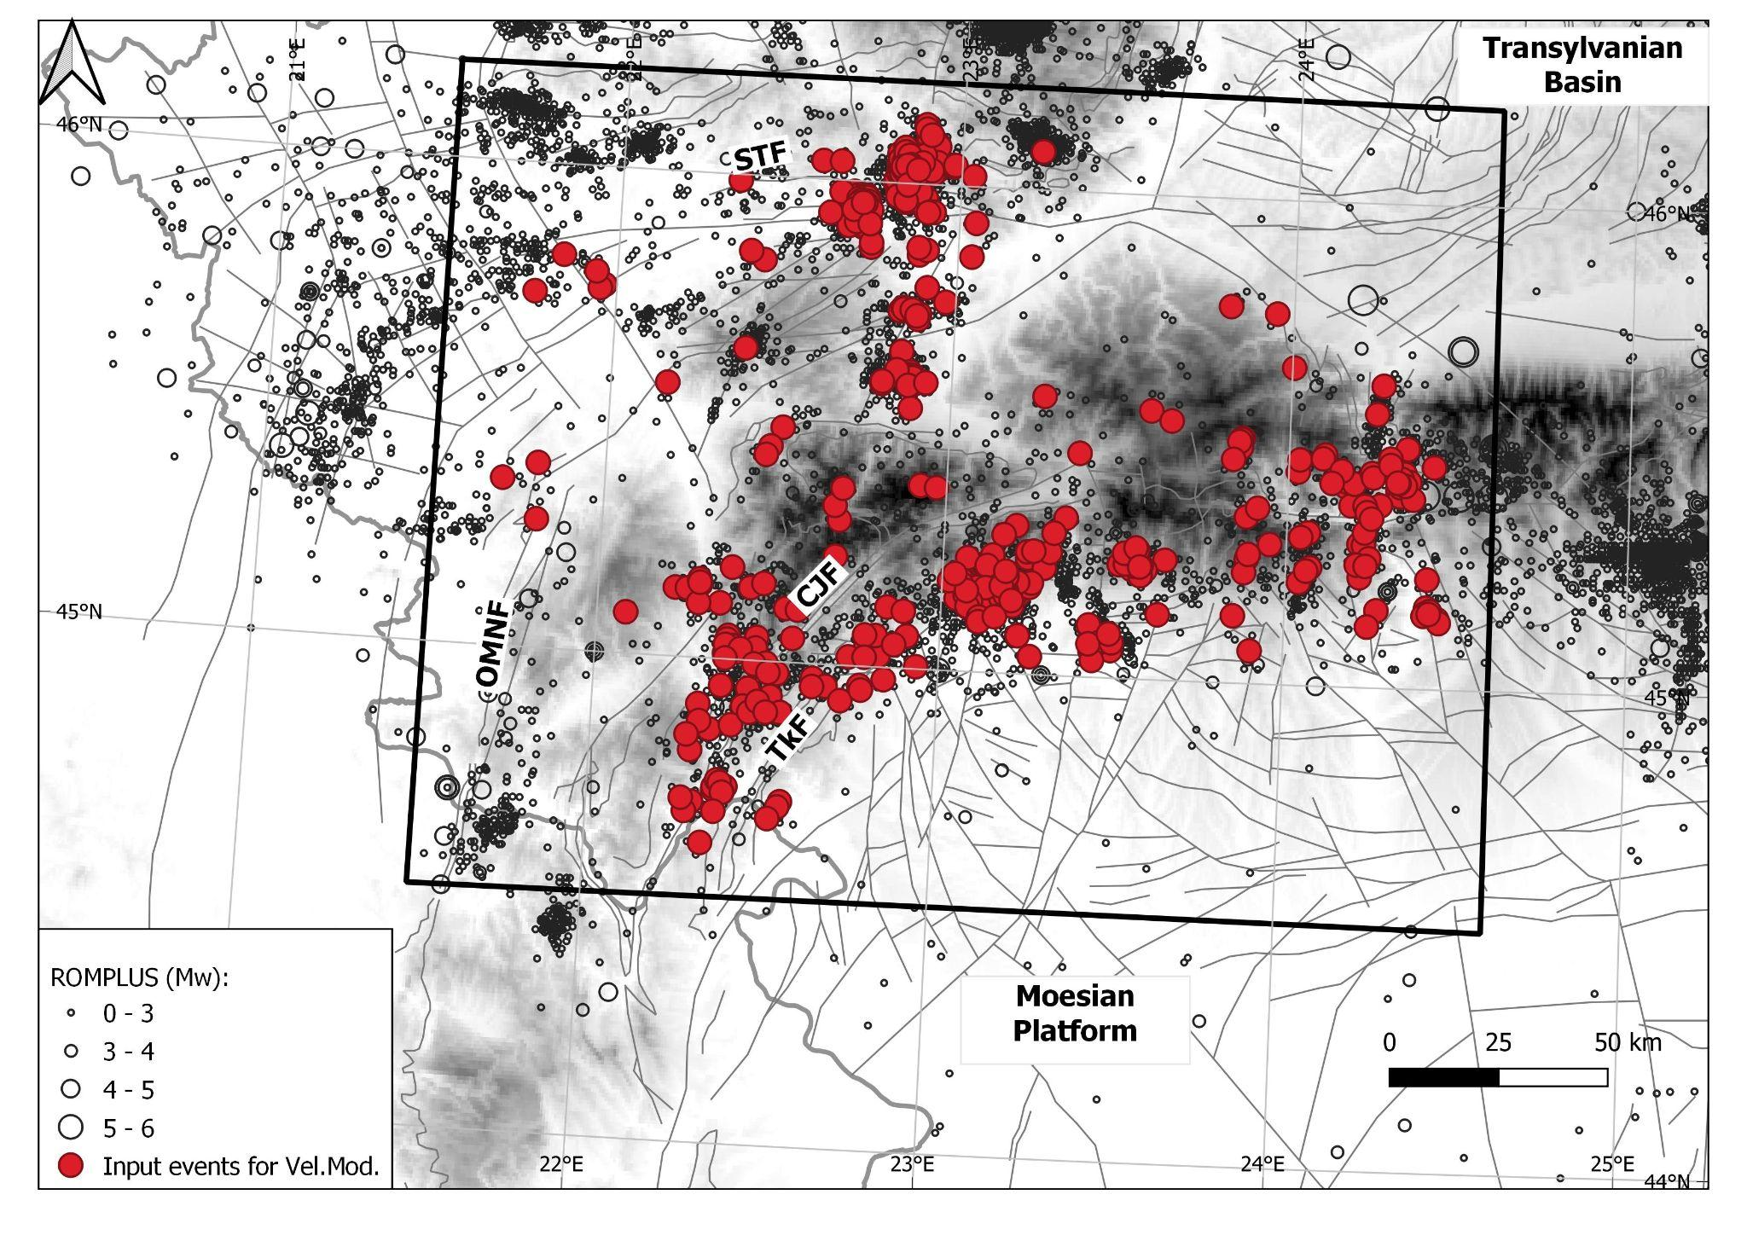
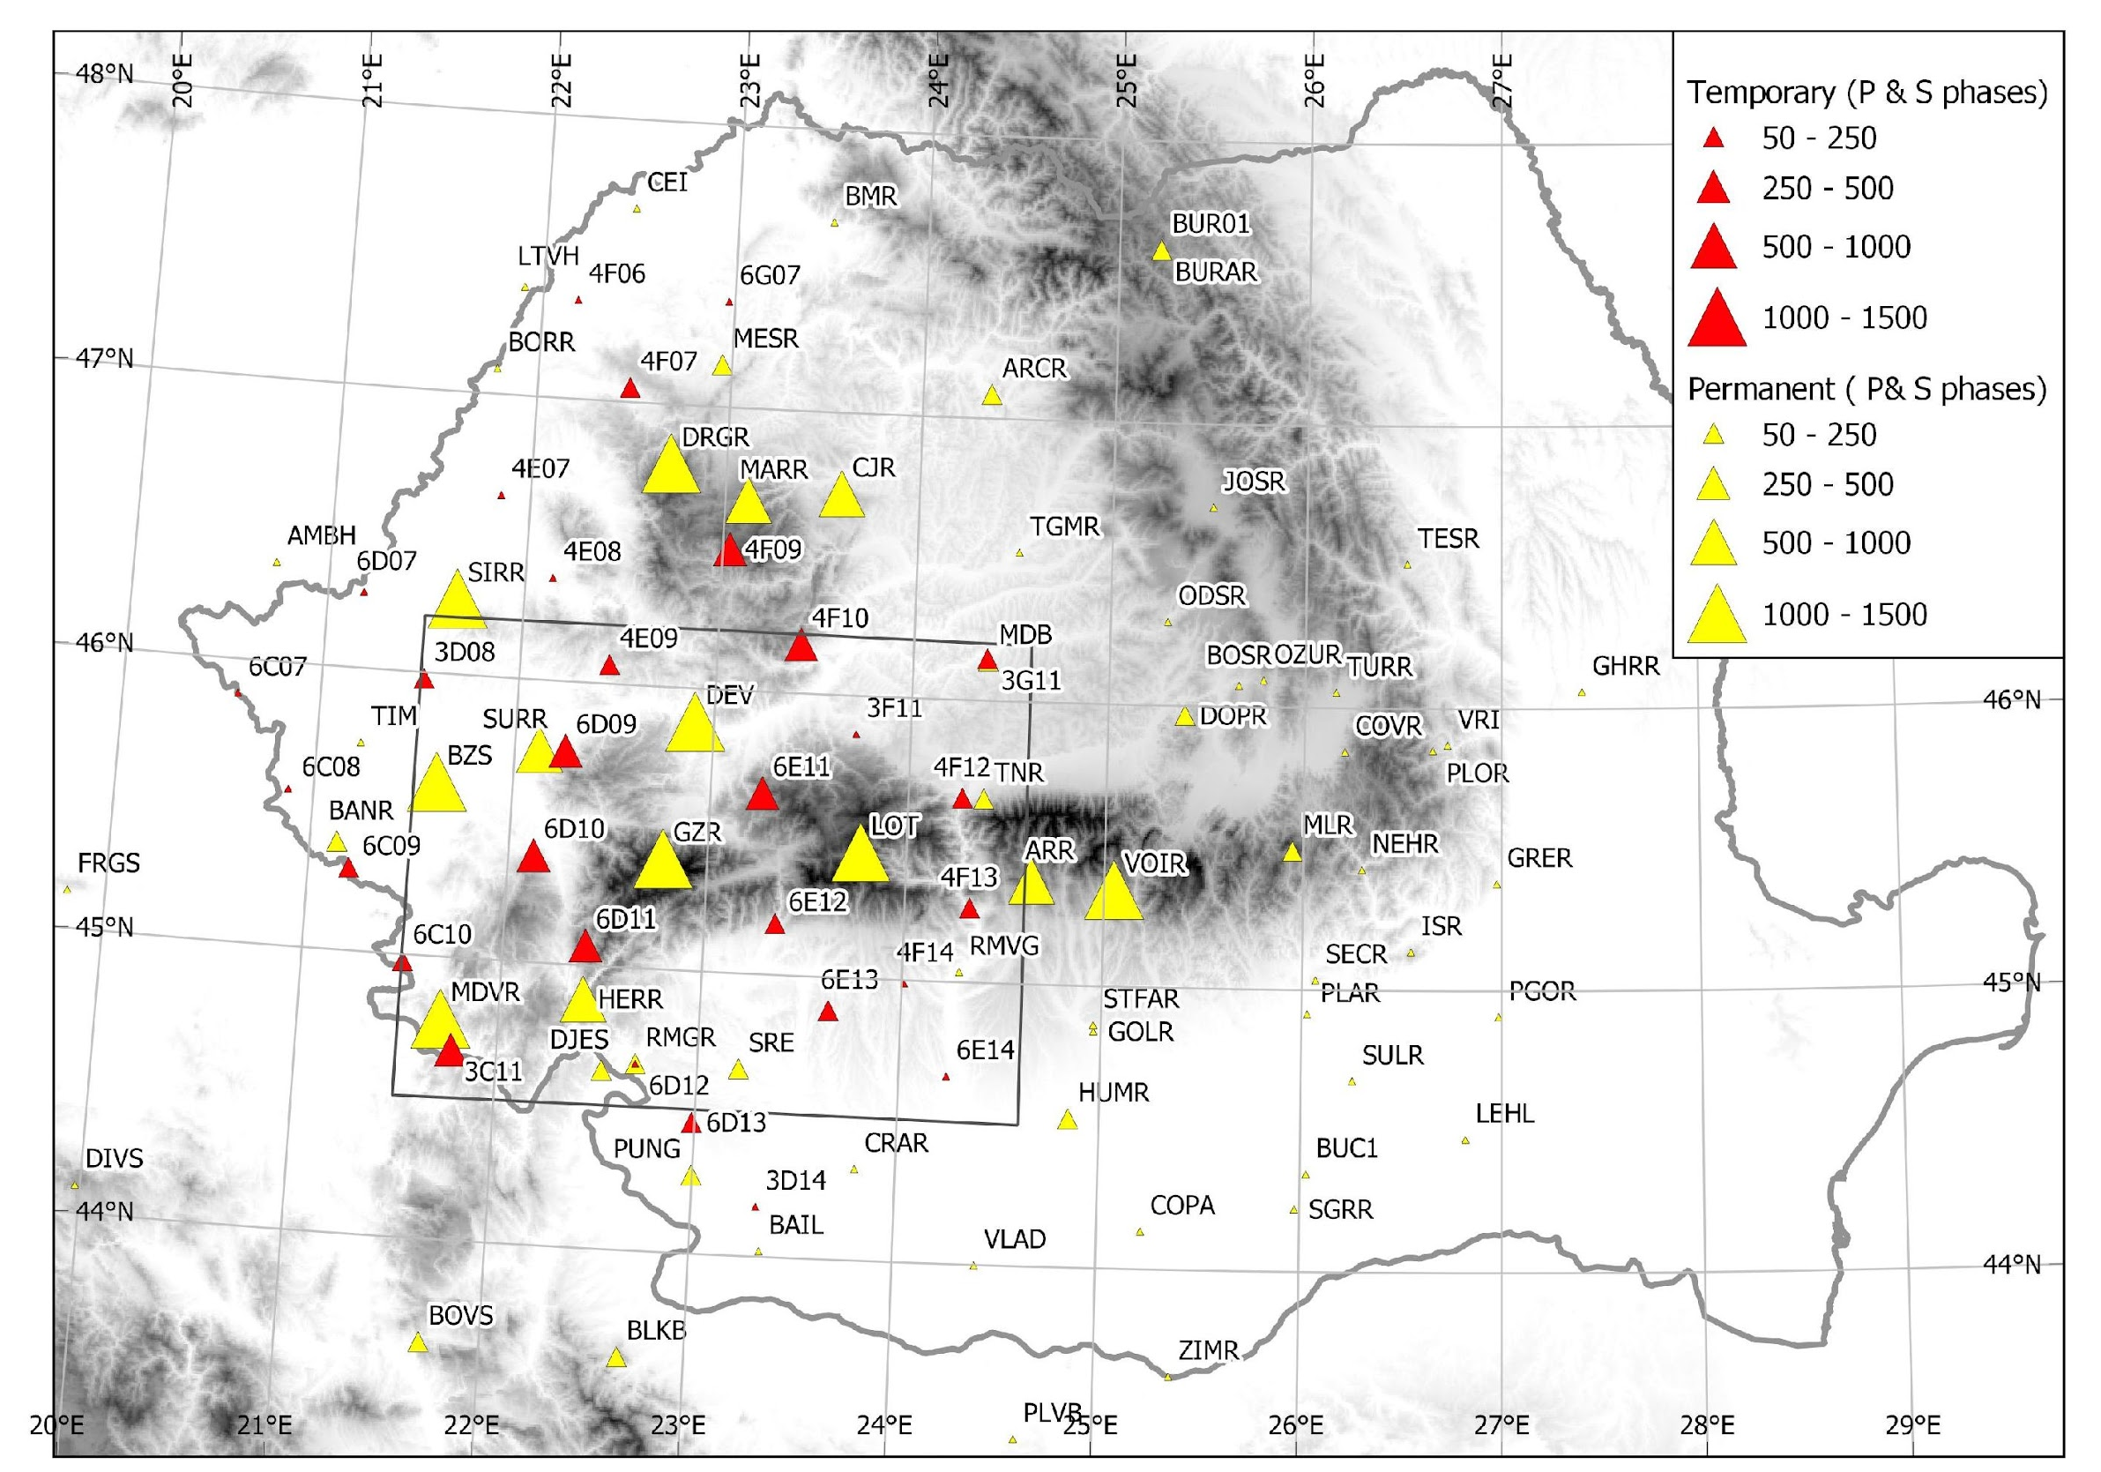
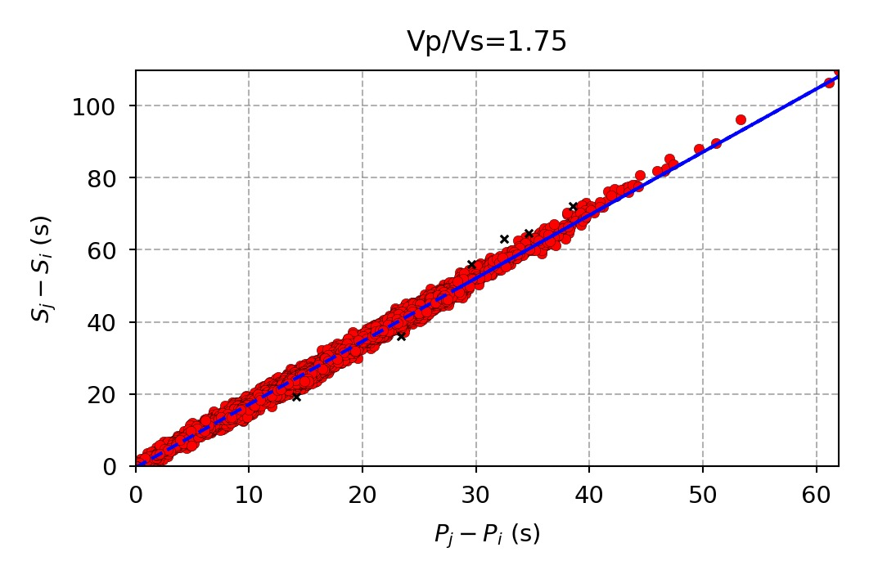
Methods
To obtain a new and more constrained velocity model for the SWCBZ and a high precision event locations and station corrections, VELEST software, a simultaneous inversion for the 1-D P-wave and S-wave velocities and the event depths was used (Kissling et al, 1994 ).
Figure 2. Distribution of the events used for the velocity model
Figure 3. Distribution of the stations used, depending on the number of identified phases
Data selection:
702 small to moderate events recorded between 2009 and 2021 by 98 broadband and short-period seismic stations
Depth interval = 0.1 – 25 km
Magnitude interval = 0.1 – 5.0 (Mw)
Minimum 10P and 10S-readings per event
Max RMS - 1.5 sec
Max GAP - 200 degrees
- 19438 P & S arrivals
Please do not use this space, a QR code will be automatically overlayed
Figure 4 The Wadati diagram
P1.2-446

Slide 4
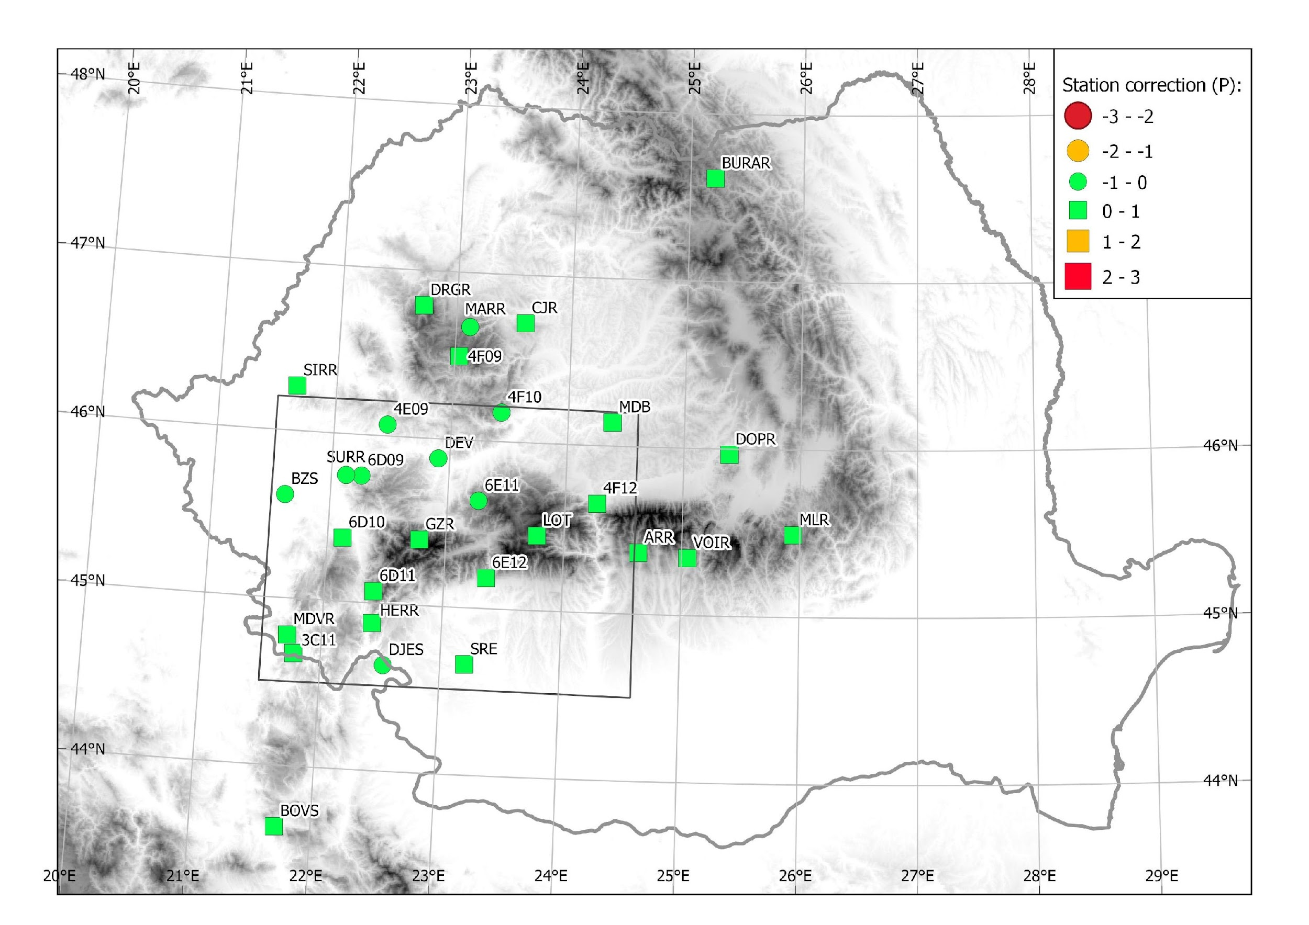
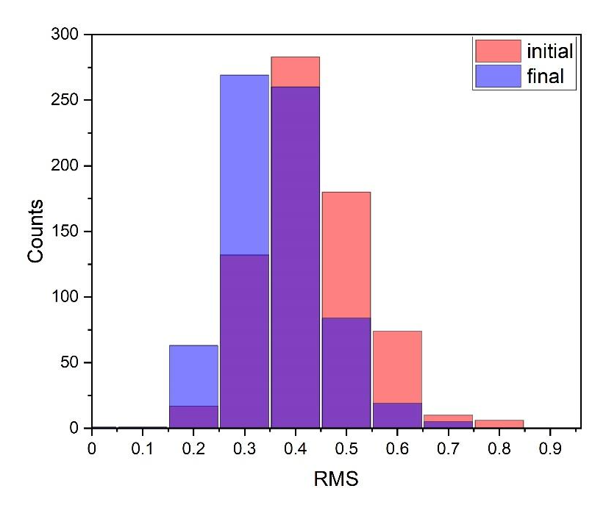
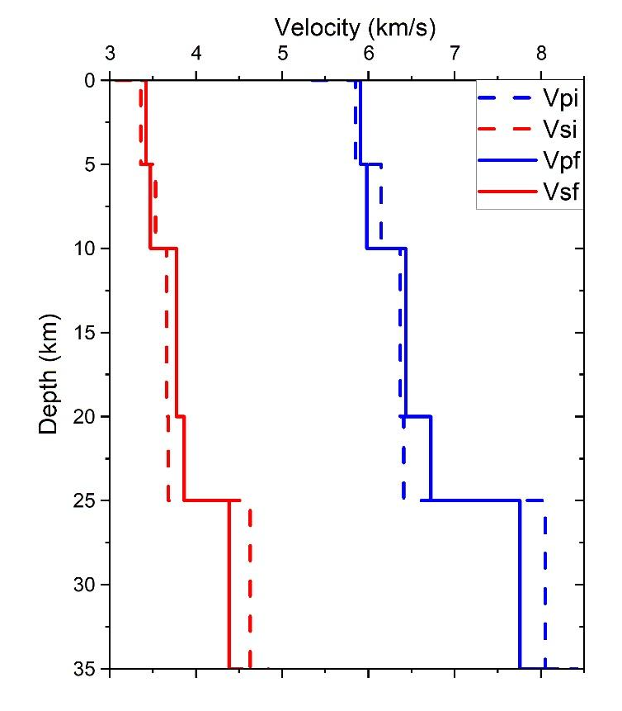
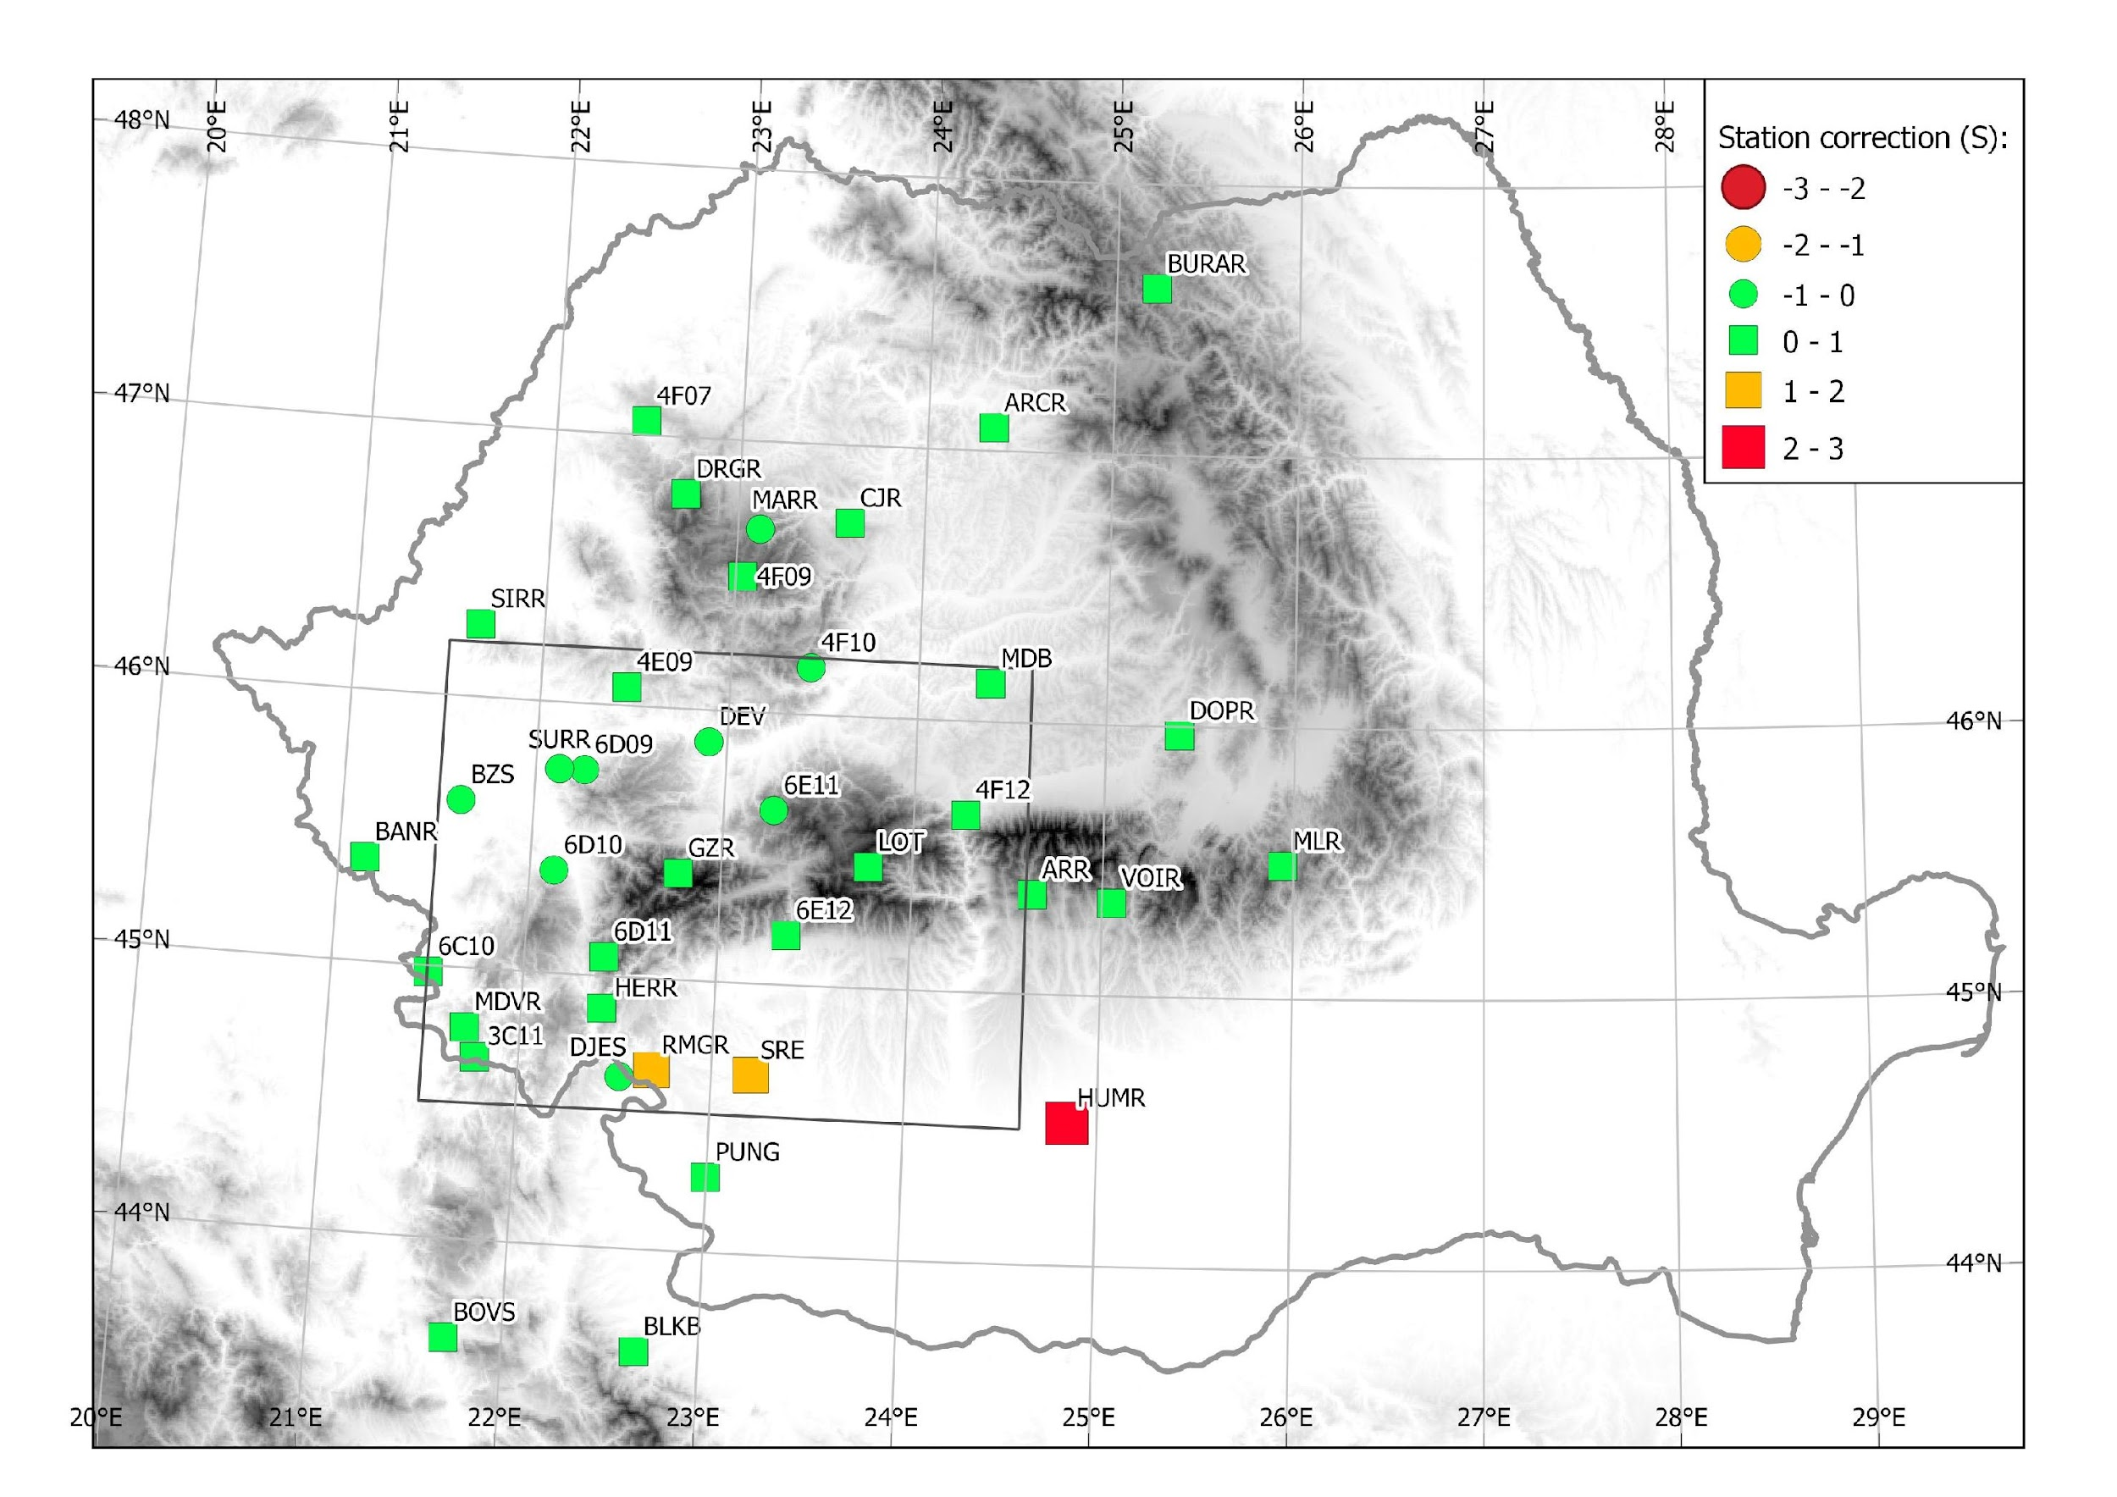
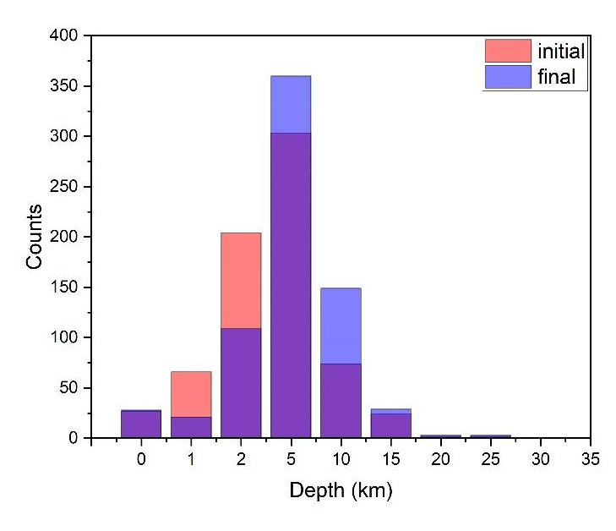
Results
Model improvements were possible by applying the VELEST algorithm (Kissling et al., 1994) to data. When compared to the average RMS of the initial model, we see a reduction of up to 35% in the location RMS for the best final velocity model.
Figure 7. RMS distribution
Please do not use this space, a QR code will be automatically overlayed
Figure 5. Initial (dotted line) and computed (solid line) for P and S velocity models SWCBZ
Figure 6. Station corrections (P-phase (up), S-phase (down), min 50 phases per station)
Figure 8. Depths distribution
P1.2-446

Slide 5
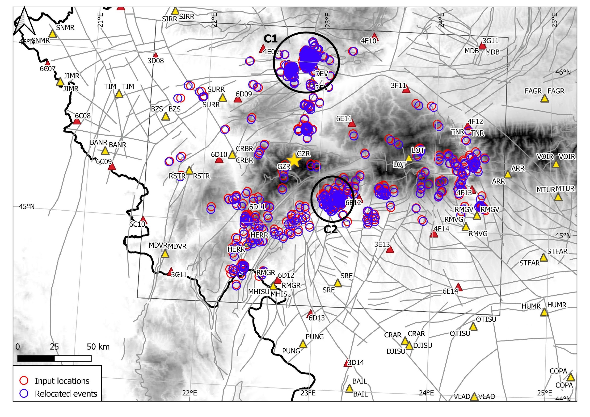
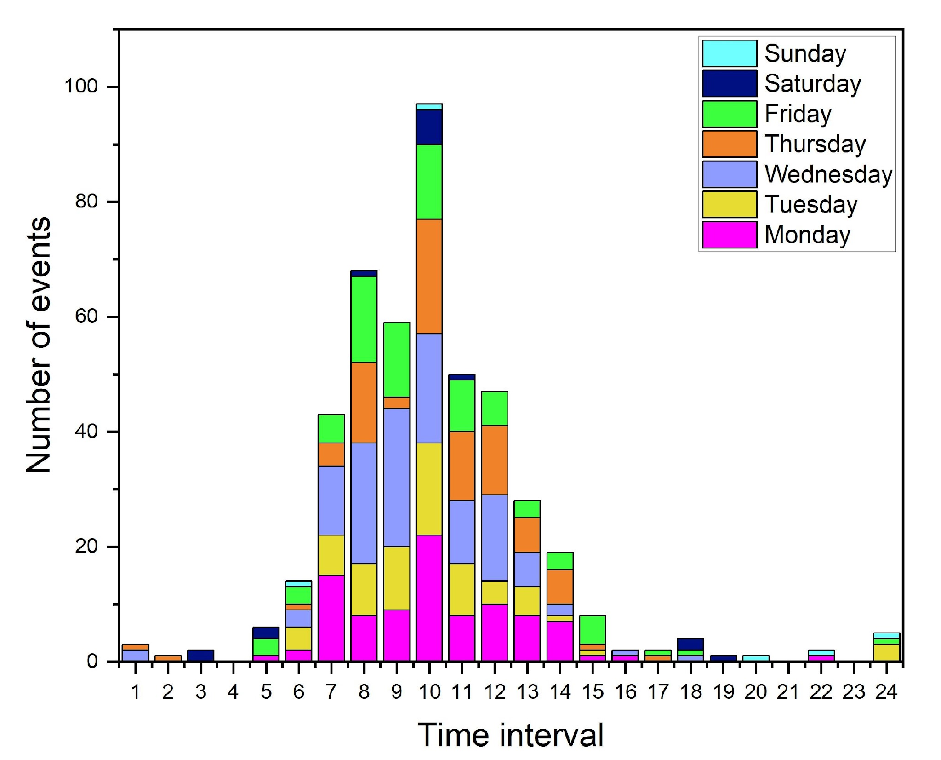
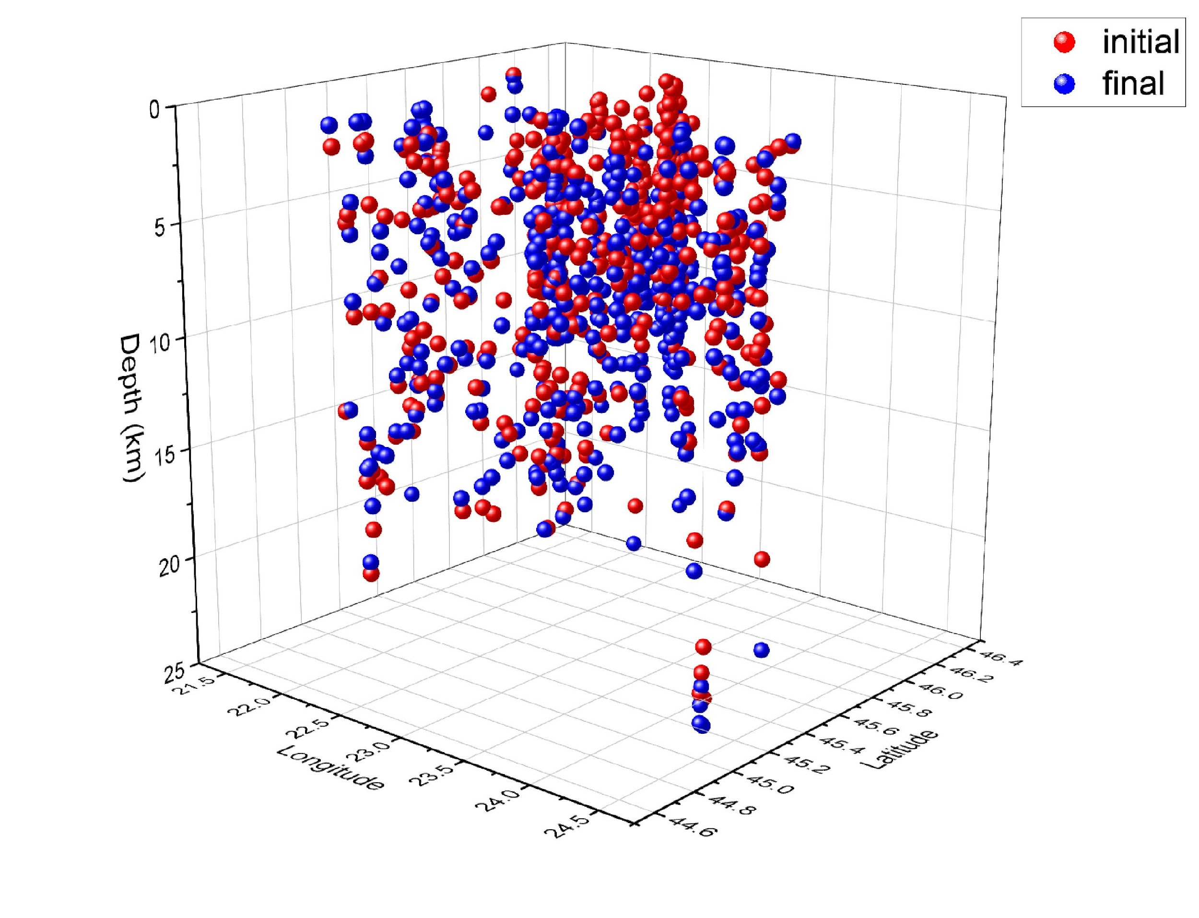
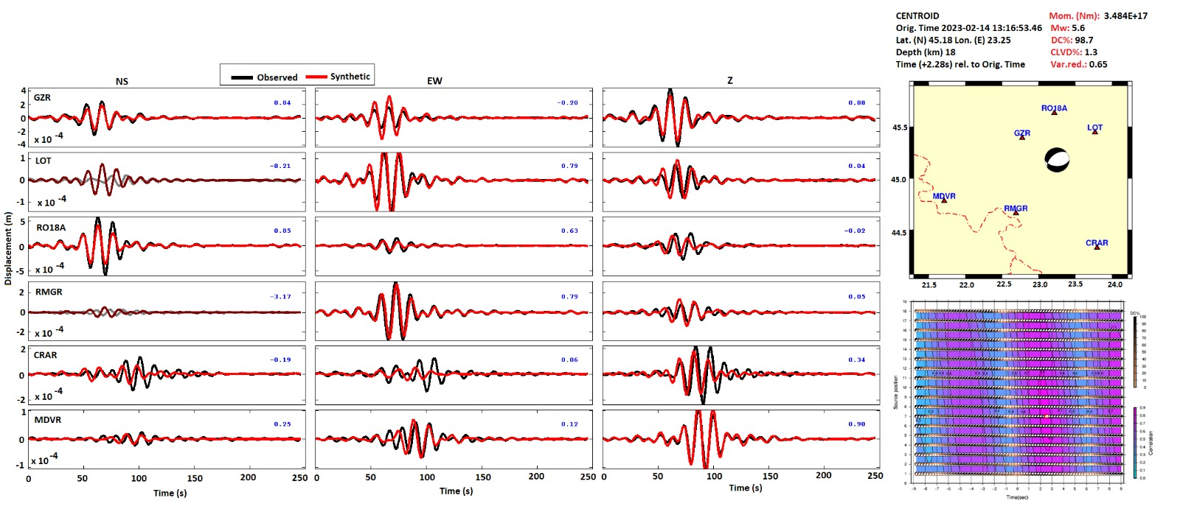
Results
Figure 9. The distribution of events before and after relocation using the determined 1-D velocity model, with highlight on the C1 and C2 clusters
Figure 10. Depth distribution inside the C1 and C2 clusters
Figure 11. Initial and final depth distribution.
The recomputed depth for the C1 and C2 clusters is limited
to a maximum depth of 2 km.
These results are consistent with recent studies that
suggest the ROMPLUS catalog is contaminated with anthropogenic events (Borleanu et al., 2016, Dinescu et al., 2021).
The distribution of relocated events, generally follows the
orientation of the major fault systems.
Please do not use this space, a QR code will be automatically overlayed
Figure 12. Example of focal mechanism estimation with waveform inversion using the ISOLA technique (Sokos and Zahradnik, 2008) and the new velocity model.
P1.2-446

Slide 6
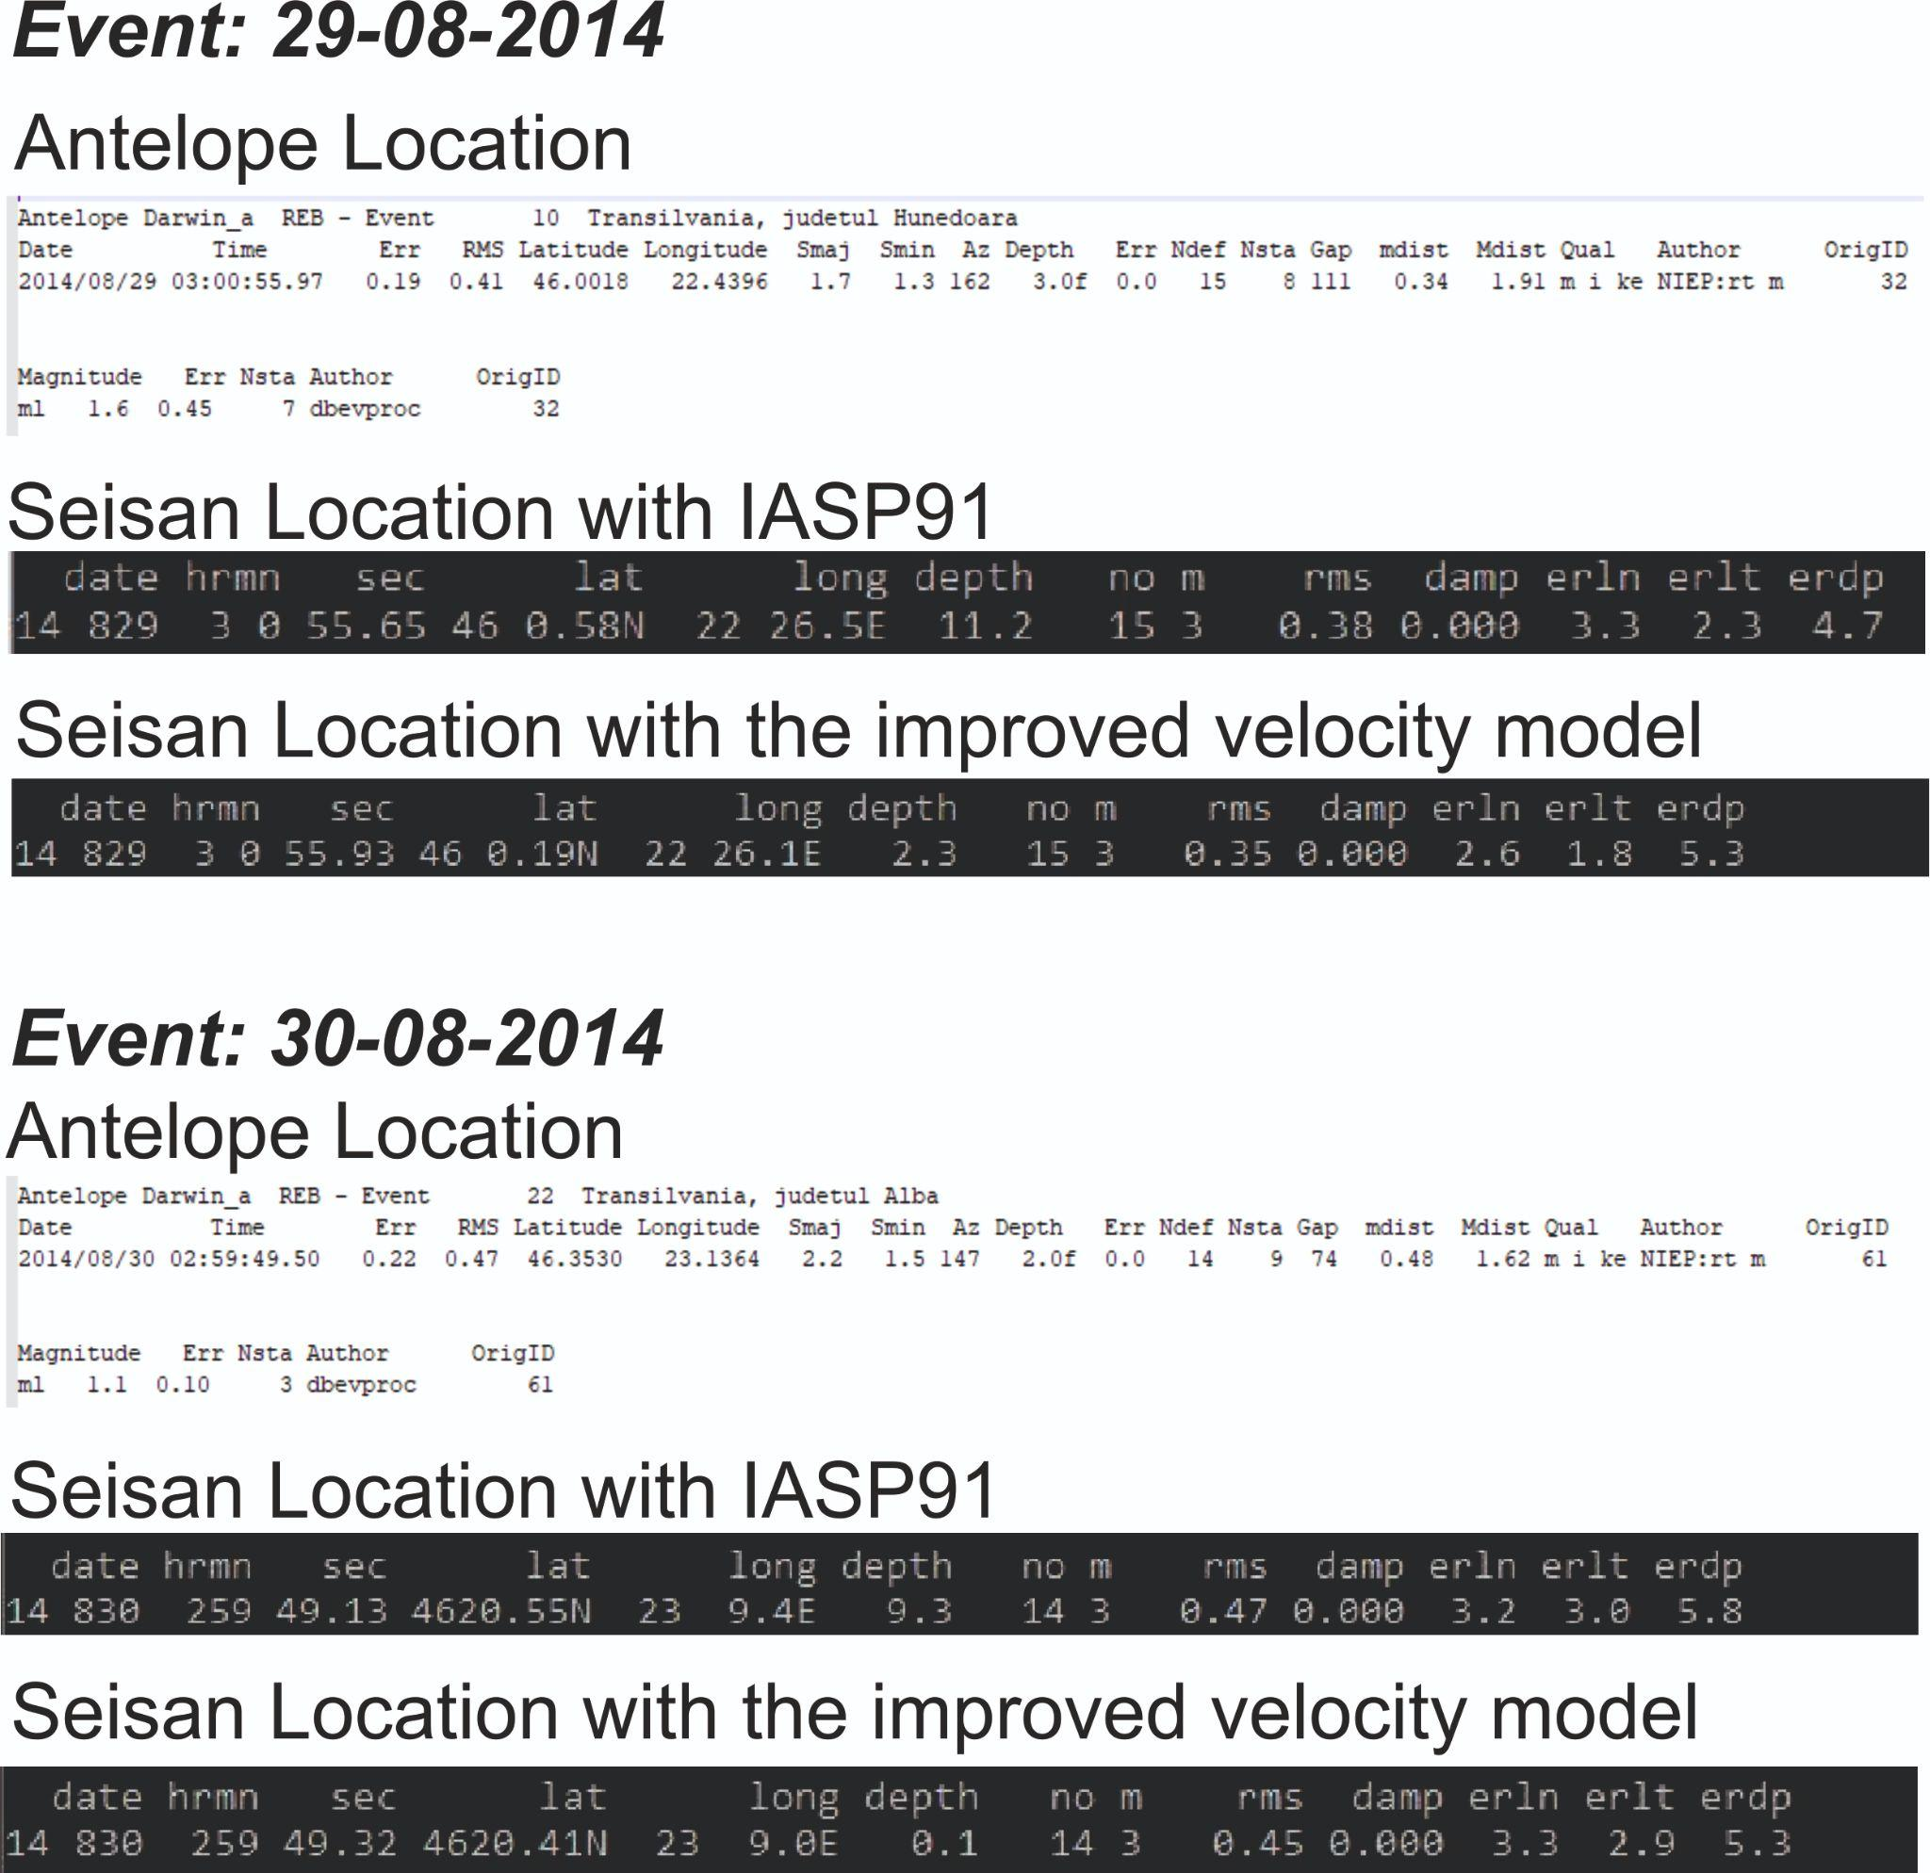
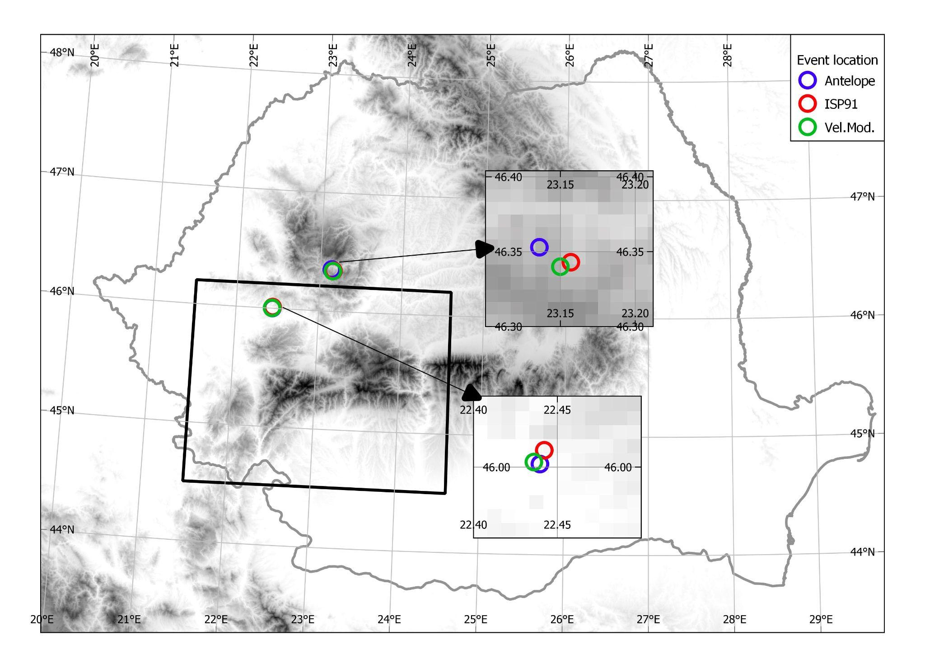
Conclusions
We developed an updated 1-D velocity model to be used for regular basis in
earthquake locations and source parameter computation throughout the SWCBZ area.
Two clusters of events with potential anthropic origins (C1 and C2) were
highlighted by our analysis.
Except for the two clusters, the distribution of relocated events typically
mirrors the direction of the main fault systems.
The updated 1-D velocity model increased seismic event location accuracy
by lowering RMS location errors by up to 35% and also enhanced the results of the waveform inversion technique for source parameter computation.
The two figures shown here provide a conclusive example of the location
improvement for two known blasts from the RomSeis 2014 (WARR) project.
Please do not use this space, a QR code will be automatically overlayed
Figure 13. Event relocation using Seisan software
P1.2-446

Slide 7
References and Acknowledgments
F. Borleanu, B. Grecu, M. Popa, M. Radulian. Use of various techniques to separate small magnitude events occurred in the northern part of Romania. In Eds. R. Vacareanu and C. Ionescu, The 1940 Vrancea Earthquake. Issues, Insights and Lessons Learnt, Springer Natural Hazards. DOI 10.1007/978-3-319-29843_10
E. Kissling. Geotomography with local earthquake data. Reviews Of Geophysics, 26, 659-698 (1988).
E. Kissling, W. L. Ellsworth, D. Ederhartphillips and U. Kradolfer. Initial reference models in local earthquake tomography. J. Geophys. Res., 99, 19635-19646 (1994).
E. Kissling. Velest User’s Guide. Int. Report, Inst. Geophys., ETH Zurich, 1—26 (1995)
M.C. Oncescu, V.I. Marza, M. Rizescu and M. Popa. The Romanian earthquake catalogue between 984-1997. In: F. Wenzel and D. Lungu (eds), Contributions from the First International Workshop on Vrancea Earthquakes, Bucharest, Romania, November 1-4, 1997, Kluwer Academic Publishers, 43-48. https://doi.org/10.1007/978-94-011-4748-4_4 (1999).
M. Popa, A. Chircea, R. Dinescu, C. Neagoe, B. Grecu and F. Borleanu. Romanian Earthquake Catalogue (ROMPLUS). Mendeley Data, V2, Doi: 10.17632/tdfb4fgghy.2 (2022)
V. Raileanu. The geological characterization and elastic parameters of seismological and accelerometer station sites in the INC-D Earth Physics network; in Vol. Research on disaster management generated by Romanian earthquakes. (in Romanian) Ed. Gheorghe Marmureanu; Ed. Tehnopress, (2009)
B. Zaharia, B. Grecu, M. Popa, E. Oros and M. Radulian. Crustal Structure in the Western Part of Romania from Local Seismic Tomography. IOP Conference Series: Earth and Environmental Science. 95. 032019. 10.1088/1755-1315/95/3/032019 (2017).
J. Havskov. The SEISAN earthquake analysis Software for the IBM PC and SUN Version 6.0 manual. Institute of Solid Earth Physics, University of Bergen, 236 pp (1997)
B.L.N. Kennett and E.R. Engdahl. Travel times for global earthquake location and phase association. Geophysical Journal International, 105:429-465 (1991)
Sokos, E. N., and J. Zahradnik (2008), ISOLA a Fortran code and a Matlab GUI to perform multiple-point source inversion of seismic data, Computers & Geosciences, 34(8),967–977, doi:10.1016/j.cageo.2007.07.005
We would like to express our gratitude to CTBTO for their generous funding support that made our participation at the SnT2023 conference possible.
Please do not use this space, a QR code will be automatically overlayed
The present study was partially funded by the NUCLEU Project PN 19080101, supported by the Ministry of Research, Innovation and Digitalization, the SETTING project (Integrated thematic services in the field of Earth System Observation - a national platform for innovation), cofounded from the Regional Development European Fund (FEDR) through the Operational Competitivity Programme 2014-2020, Contract No. 336/390012 and by the TE-DISSA (Data-intensive study of intermediate-depth and shallow seismic activity in Romania, from regular earthquakes to tectonic tremor) project PN-III-P1-1.1-TE-2019-1797, supported by UEFISCDI (Executive Agency for Higher Education, Research, Development and Innovation Funding), Romania. The data processed in this paper are recorded by Romanian Seismic Network (https://doi.org/10.7914/SN/RO) and earthquake locations were taken from the ROMPLUS catalogue (https://data.mendeley.com/datasets/tdfb4fgghy).
P1.2-446

