Slide 1
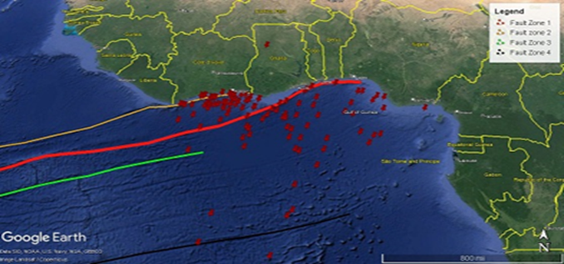
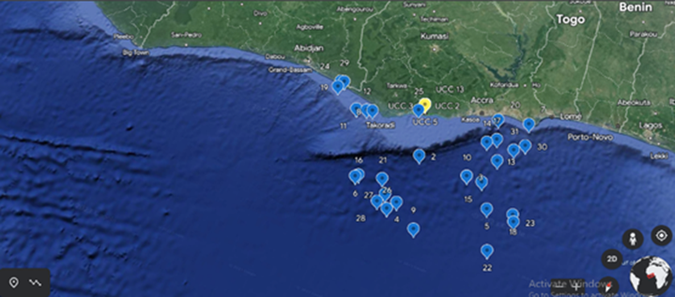
Seismic hazard assessment along the Central Region coast of Ghana.
[Ruth A. T. Annan]
[National Data Centre, Ghana Atomic Energy Commission
P. O. Box LG 80, Legon, Accra, Ghana]
Conclusion
P1.2-353
Introduction: Seismicity in Southern Ghana
Results
Ghana is part of West Africa Craton which has a stable seismicity, yet the region had experienced earthquakes activities for centuries.
The study area is assumed to be free of seismic activities since the fault lines are inactive.
The people have been experiencing tremor activities causing cracks on the residential structures.
Fig. 4: Map showing seismic events in the Gulf of Guinea along the coast of West Africa (Data source: IDC/IMS)
Fig 5: Close-up of the study area showing seismic events along the coast of Ghana. The yellow point is the University of Cape Coast (UCC)
Methodology
Compilation of seismic data from IDC/IMS.
Data used to plot map on Google earth map.
Conclusion
Seismic data plotted showed that there are seismic activities occurring in the Gulf of Guinea along the coast of Ghana which might be due to the active St Paul and Romanche fracture zones.
The intensity of these fault zones are what is felt onshore by the residences of UCC and causing cracks on the buildings.

