Slide 1
Crustal Attenuation with Seismic T waves in Southern Africa
Yong Zhou, Xiaofei Chen, Sidao Ni, Yunyi Qian, Yayun Zhang, Chuanhai Yu, Zhong Qiu, Tingting Zheng, Min Xu
South China Sea Institute of Oceanology, Chinese Academy of Sciences; et al.
Crustal attenuation structure is one of the essential parameters for quantitative modeling of ground motion due to earthquake shaking. However, it is difficult to infer the Q structure in stable continents where with only a few intraplate earthquake.
We identify the T-P and T-S phase from the seismograms recorded by seismic array XA deployed in the southern Africa in 1997 to 1999. Then the Q structure is inferred with the extended coda normalization method.
The frequency depended crustal attenuation structure for P and S wave is obtained.
Our work shows the potential to constrain the crustal attenuation structure with the seismic T phase, which can be extended to other regions without high seismicity.
Please do not use this space, a QR code will be automatically overlayed
P1.3-552

Slide 2
Introduction: The attenuation structure inversion in stable continents
﻿Although intraplate seismicity is lower than interplate seismicity, Seismic hazards in stable continents are not negligible.
﻿Crustal attenuation structure is one of the essential parameters for quantitative modeling of ground motion due to earthquake shaking, especially in high-frequency (f > 1 Hz) simulations.
It is important to resolve the attenuation structure in stable continents for constructing reliable seismic risk assessments.
Please do not use this space, a QR code will be automatically overlayed
P1.3-522

Slide 3
Objectives
﻿We have three objectives:
Determine the components in observed T waves in seismic array XA.
Propose new method to invert the frequency depended attenuation characteristics with T waves.
Obtain the attenuation structure in southern Africa and discuss the possible mechanism.
Please do not use this space, a QR code will be automatically overlayed
P1.3-522

Slide 4
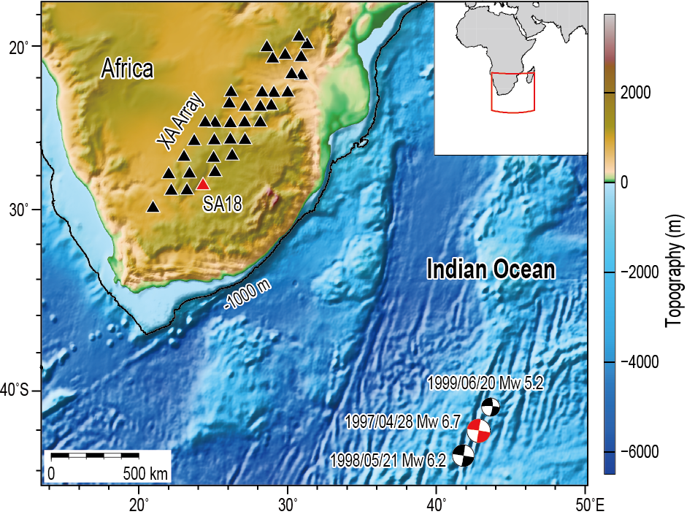
Data and Method
Data:
The T-P and T-S phases are identified in the seismograms recorded at seismic array XA.
Method:
The extended coda normalization method is used in Q structure inversion.
Please do not use this space, a QR code will be automatically overlayed
$$ln\left[\frac{A_{T−P/S}\left(f,r\right)r}{A_{c}\left(f,tc\right)}\right]=−\frac{πf}{Q_{P/S}{\left(f\right)V}_{P/S}}+const\left(f\right)$$
P1.3-522

Slide 5
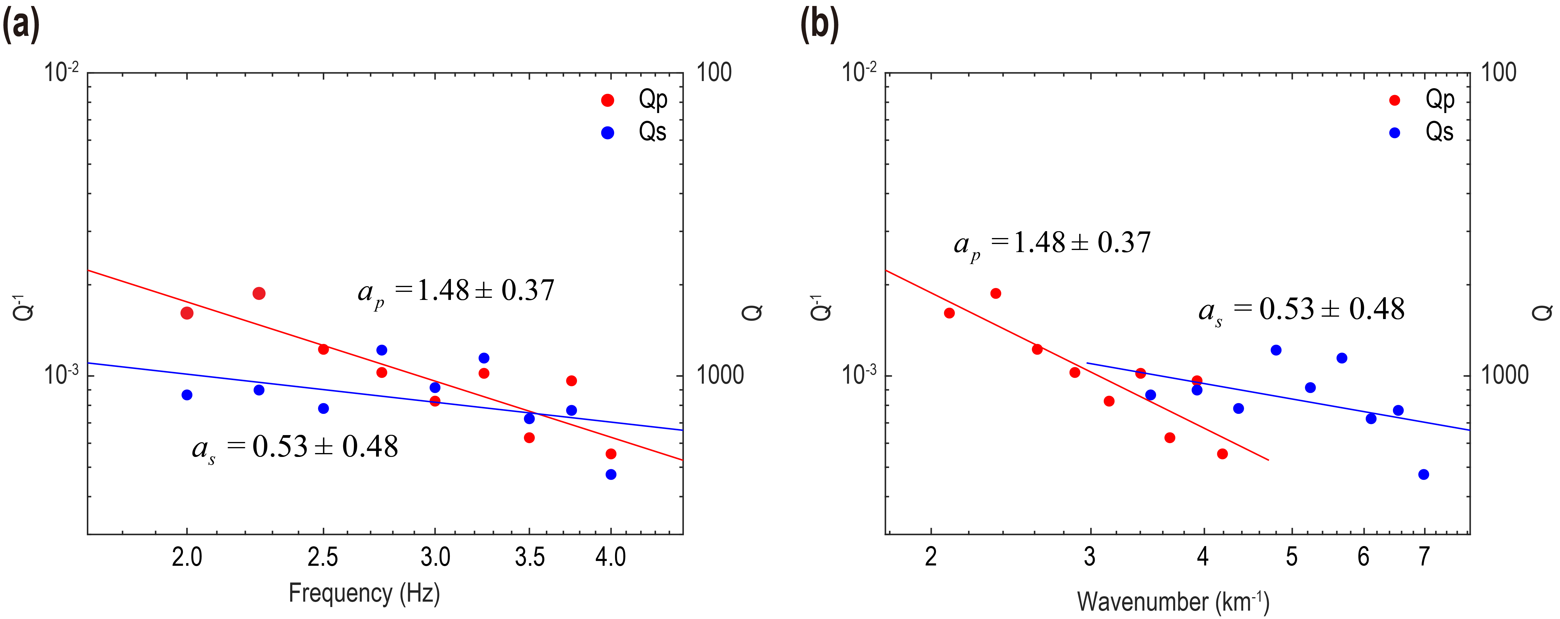
Results
$$Q_{P}\left(f\right)=\left(204±82\right)f^{\left(1.48±0.37\right)}$$
$$Q_{S}\left(f\right)=\left(685±359\right)f^{\left(0.53±0.48\right)}$$
Please do not use this space, a QR code will be automatically overlayed
Qp and Qs for crustal attenuation depended with frequncey and wavenumber.
P1.3-522

Slide 6
Conclusion
﻿We investigated the seismic T waves recorded on the XA array (deployed in southern Africa) from earthquakes generated in the Indian Ocean.
The T-P_local and T-S_local phases were identified using waveform, travel time, polarization, and F-K analyses.
Then, the frequency-dependent Qp (204 f1.48) and Qs (685 f0.53) curves in southern Africa were estimated with the characteristics of the converted T phases.
Our work shows the potential to constrain the crustal attenuation structure with the seismic T phase, which can be extended to other regions without high seismicity, such as Australia, eastern America, eastern South America, and South India.
Please do not use this space, a QR code will be automatically overlayed
P1.3-522

Slide 7
References
﻿Zhou, Y., Chen, X., Ni, S., Qian, Y., Zhang, Y., Yu, C., Zhong, Q., Zheng, T., & Xu, M. (2021). Determining Crustal Attenuation With Seismic T Waves in Southern Africa. Geophysical Research Letters, 48, e2021GL094410. https://doi.org/10.1029/2021GL094410
Please do not use this space, a QR code will be automatically overlayed
P1.3-522

