Slide 1
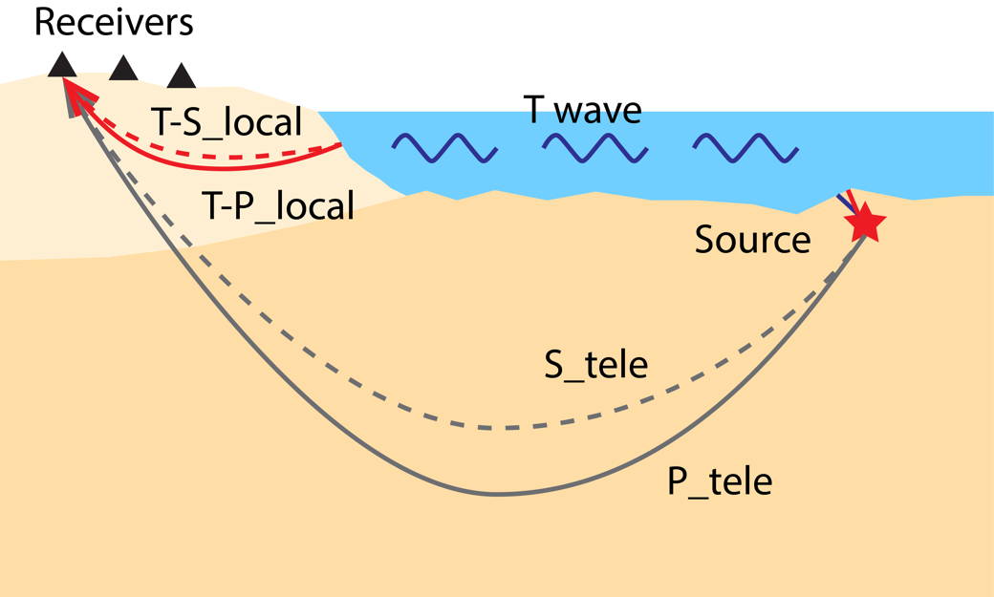
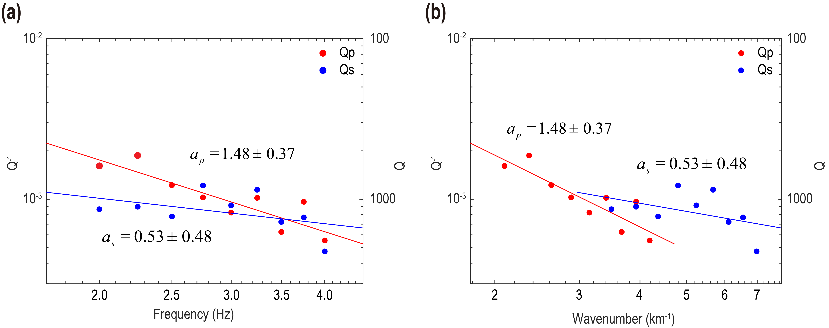
Crustal Attenuation with Seismic T waves in Southern Africa
Yong Zhou, Xiaofei Chen, Sidao Ni, Yunyi Qian, Yayun Zhang, Chuanhai Yu, Zhong Qiu, Tingting Zheng, Min Xu
South China Sea Institute of Oceanology, Chinese Academy of Sciences; et al.
P1.3-552
There are 3 key points:
﻿We demonstrate the potential of employing T waves for inverting crustal attenuation structure in coastal regions of stable continents.
﻿The converted T-P/S_local phases were identified by analyzing the seismic waveform, travel time, polarization, and array techniques.
﻿The crustal attenuation of and Qs obtained in southern Africa match well with the previous results.
If you want to learn more about this, come see my e-poster during session P1.3 on this date or access it online on the SnT2023 Conference platform!

