Slide 1
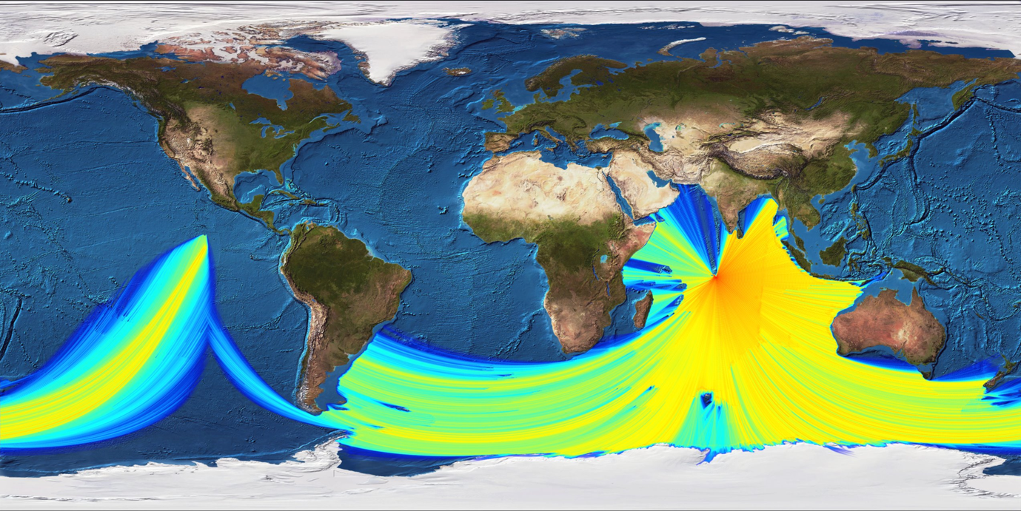
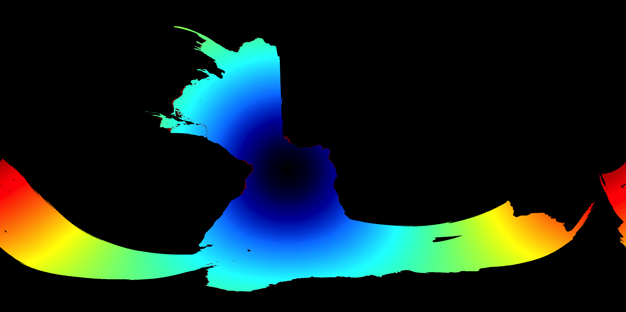
Improvements to Hydroacoustic Processing Utilizing Three-Dimensional Ocean Acoustic Propagation
Kevin Heaney, Emanuel Coelho, Mark Prior, Tiago Oliveira, Mario Zampolli, Georgios Harallabus, Applied Ocean Sciences and CTBTO
P1.3-858
A modeling approach to include 3-dimensional propagation (out-of-plane) has been developed and will be integrated into the Automated hydroacoustic event association algorithm:
For 5-20 Hz sound, the ocean can be considered shallow
Diffraction and refraction (bending) of sound leads to errors in event association (and therefore event localization)
A validation analysis of a set of 3D computational ocean acoustics codes was conducted in Phase I (2020)
A set of 3D models has been assembled to compute receiver hydroacoustic coverage maps, travel-time tables and ray-path identification
Next steps are to integrate these models into real-time automated processing and analyst workflow.
3D Parabolic Equation for Coverage Maps
3D Travel-Time Tables

