Slide 1
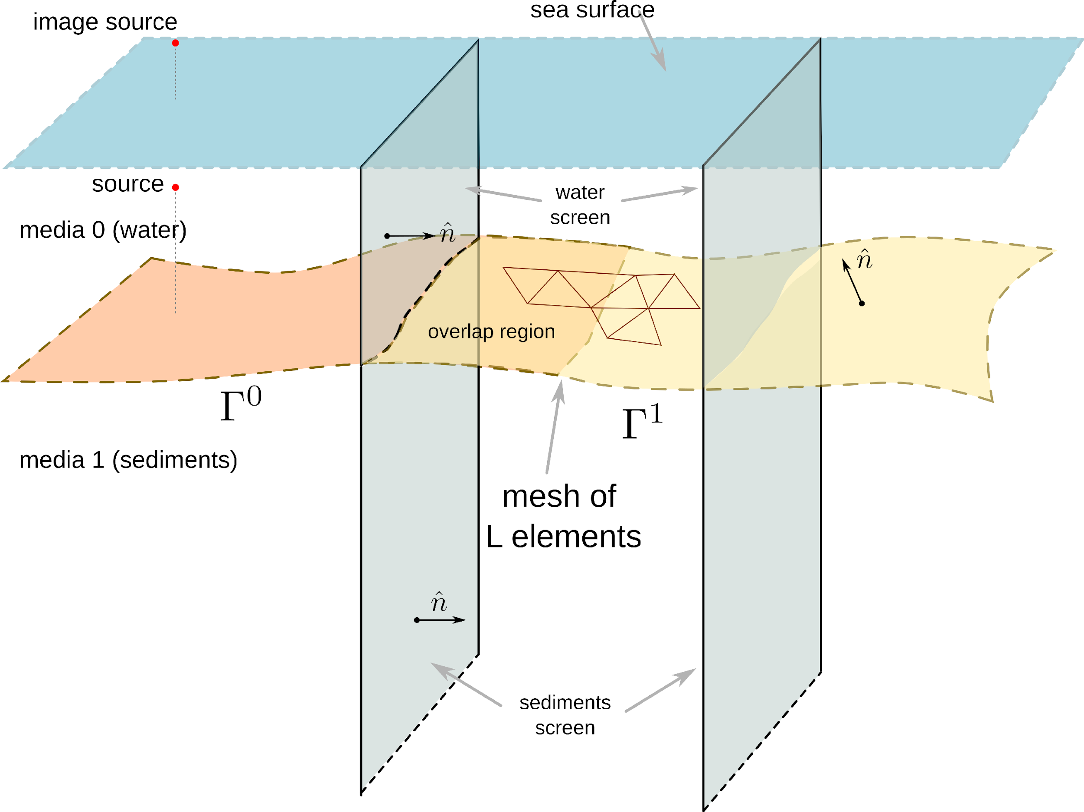
Extending the Boundary Element Method to 3D
acoustic propagation problems in the ocean
GONZALEZ, Juan Domingo & LAVIA, Edmundo Federico
Argentinian Navy Research Office (DIIV/ARA) & UNIDEF (CONICET/MinDef)
P1.3-534
The Boundary Element Method (BEM) can solve propagation problems in 3D homogeneous media but it is expensive in computational resources when long ranges are desired.
To cut down on the computational cost a marching scheme is envisioned: the propagation problem is solved in successive range steps.
The complete theoretical formulation and a first numerical test are presented.
Results are encouraging although certain errors demand
further research.

