Slide 1
Extending the Boundary Element Method to 3D
acoustic propagation problems in the ocean
GONZALEZ, Juan Domingo & LAVIA, Edmundo Federico
Acoustic Propagation Department - Argentinian Navy Research Office (DIIV/ARA)
& UNIDEF (CONICET/MinDef)
The Boundary Element Method (BEM) for a propagation problem
A marching scheme is formulated to extend the BEM method
The theoretical foundation and a minimal first test
Further steps to improve the formulation
Please do not use this space, a QR code will be automatically overlayed
P1.3-534

Slide 2
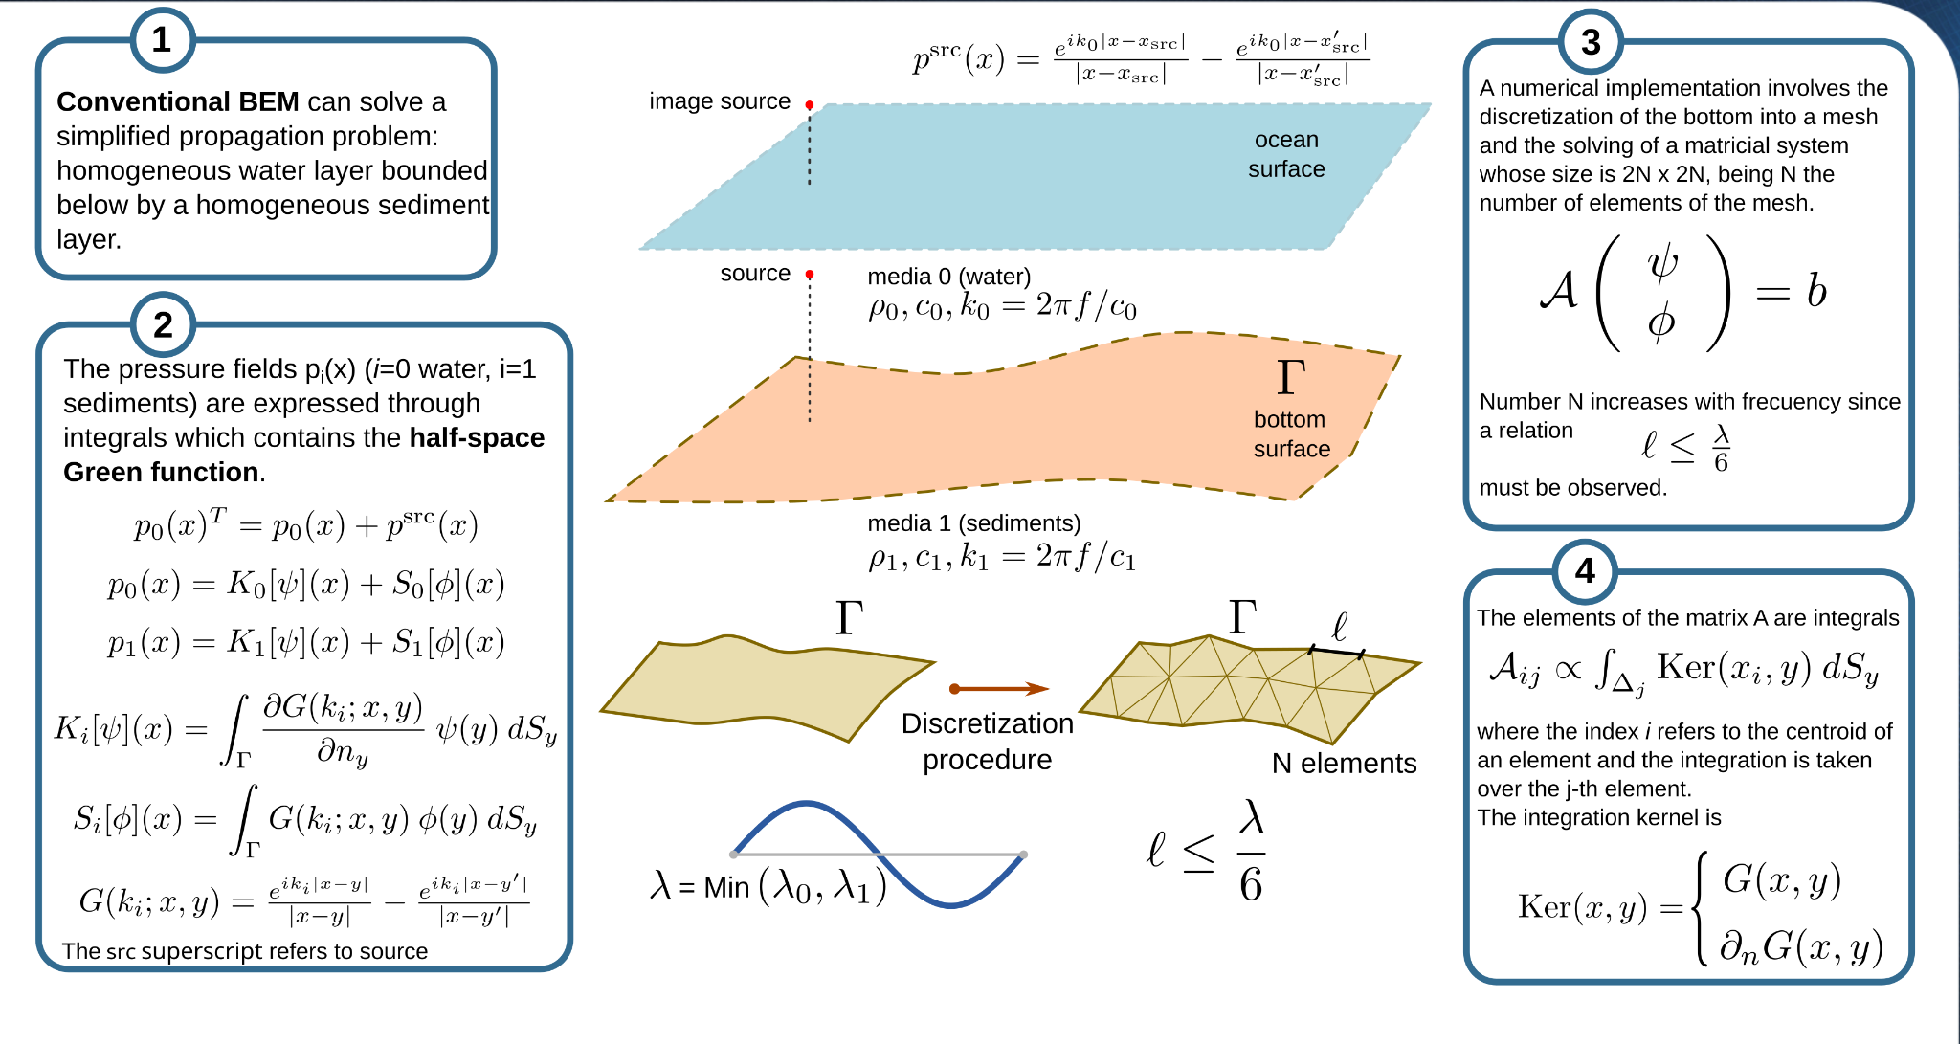
Introduction
Please do not use this space, a QR code will be automatically overlayed
P1.3-534

Slide 3
Previous work
(Link)
Please do not use this space, a QR code will be automatically overlayed
P1.3-534

Slide 4
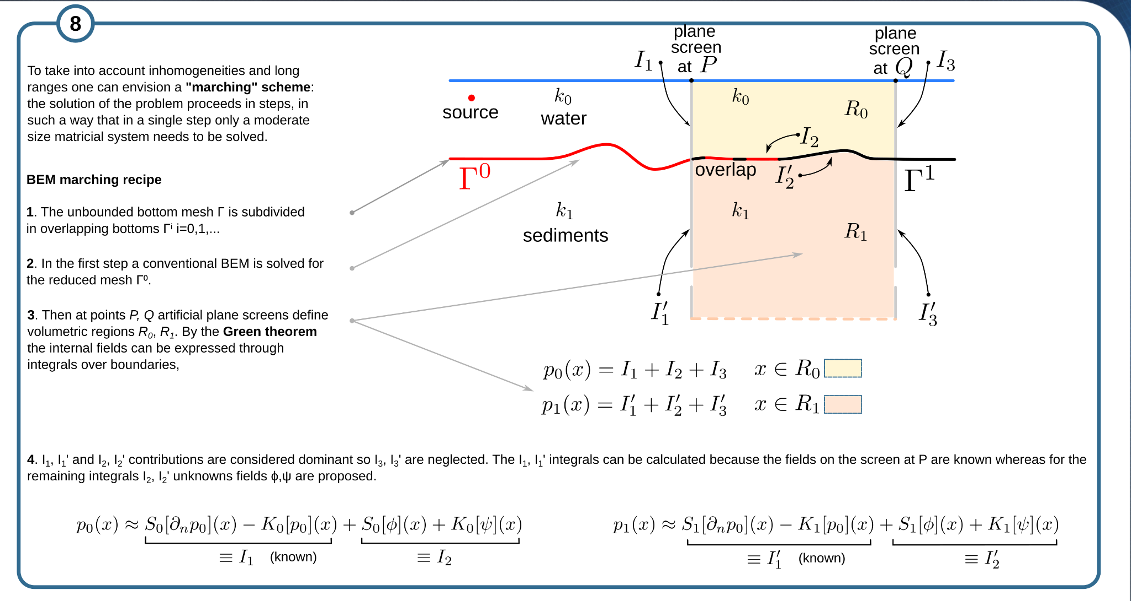
Methods (1)
Please do not use this space, a QR code will be automatically overlayed
P1.3-534

Slide 5
Methods (2) and results
Please do not use this space, a QR code will be automatically overlayed
P1.3-534

Slide 6
Conclusions
Please do not use this space, a QR code will be automatically overlayed
P1.3-534

