Slide 1
Retrieval of Sea Surface Current using Himawari-8 SST Data and Particle Image Velocimetry Method in the Flores Sea
[K. Setiya Wati¹, P.P. Hadi Wiguna², T. Osawa³, I W.G.A. Karang⁴]
¹²Meteorological, Climatological, and Geophysical Agency, Indonesia/
³Yamaguchi University/ ⁴Udayana University
Ocean currents are one of the key maritime parameters, but in Indonesia observations of ocean currents are still limited to certain locations. There needs to be a method to estimate sea surface currents.
This study used Himari-8 SST data processed using the Particle Image Velocimetry method.
Results are obtained with varying accuracy. It has been discovered that the most accurate estimation results are often seen south of the Flores HF radar.
Himawari-8 SST data as well as the PIV method are capable of describing ocean surface currents, especially in the Flores Sea. It should be noted, however, that further research is still required in this area.
Please do not use this space, a QR code will be automatically overlayed
P1.3-738

Slide 2
INTRODUCTION
The majority of human activity in the ocean occurs at the surface, where surface currents influence it (Röhrs et al., 2021).
Observations of real-time ocean surface currents allow search and rescue at ocean disaster sites and research into ocean contaminants surface transport. Although real-time surface currents have been mapped by high-frequency (HF) radar, shipboard instruments, satellite altimetry, and surface drifters (Choi et al., 2021), surface current processes are more difficult to resolve using in situ data due to two types of issues. First and most importantly, temporal and spatial resolutions prevent us from calculating precise surface currents. Second, collecting in-situ data is expensive and time-consuming (Ghalenoei & Hasanlou, 2017).
Due to the limited real-time observation of surface currents in Indonesia, Himawari-8 SST data and the PIV method will be attempted. Currently, surface current observations in real-time are made using HF radar installed at 4 locations, including the Flores Sea. The Flores Sea was chosen because of its popular local and international tourism routes that demand ferry safety (Supriyadi et al., 2021). Besides that, the Flores Sea is part of a large area in the Indonesian Seas that is critical for understanding the inter-ocean transport process around sea areas (Karang et al., 2020).
It is hoped that this strategy can be applied to other areas in Indonesia that do not have a network of in-situ marine observation stations yet.
Please do not use this space, a QR code will be automatically overlayed
P1.3-738

Slide 3
OBJECTIVES
To evaluate the accuracy of ocean surface currents retrieved from Himawari-8 SST data in the Flores Sea.
Please do not use this space, a QR code will be automatically overlayed
P1.3-738

Slide 4
METHODS/DATA
The study from July 29, 2022, at 00.00 UTC, through July 30, 2022, at 23.20 UTC. The data used in this study include:
The SST data used is level 2 data with a time resolution of 10 minutes and a spatial resolution of 2 km. The data were produced by JAXA Himawari Monitor System and downloaded from the website http://www.eorc.jaxa.jp/ptree/index.html.
The HF radar data has a spatial resolution of 1 km and a temporal resolution of 20 minutes. HF radar data in the Flores Sea were obtained from the BMKG Maritime Meteorological Center.
In PIV, an interrogation window subsamples two sequential digital images, and the location of the correlation peak is directly related to particle displacement. The average velocity of particles within these interrogation windows can be calculated using the following formula (Hsu et al., 2011): $\vec{v}=\frac{Δ\vec{X}}{Δt}$
Refers to Fujita et al. (1998), the interrogation area (IA) in the first image and interrogation areas in a search area (SA) in the second image is calculated using Cross-correlation. The pair of particles with the highest cross-correlation coefficient is chosen as a candidate vector. Cross-correlation is shown in equation below (Balamurugan & Jeeva, 2019): $R(s,t)=\frac{1}{N^{2}}\sum_{j=0}^{N−1}{ }\sum_{j=0}^{N−1}{ }F_{I,J}^{′}(i,j)F_{I,J}^{′′}(i+s,j+t)$
Accuracy assessment using:
$ε_{rms}=\sqrt{\frac{1}{n}\sum_{i=1}^{n}{ }{\left(d_{\text{mean} }−d_{\text{estimated},i}\right)}^{2}}$ $ε_{\text{bias} }=\frac{1}{n}\sum_{i=1}^{n}{ }d_{\text{estimated},i}−d_{\text{true} \text{value} }$ $d=1−\frac{\sum_{i=1}^{n}{ }{\left(P_{i}−O_{i}\right)}^{2}}{\sum_{i=1}^{n}{ }{\left(\left|P_{i}−\overline{O}\right|+\left|O_{i}−\overline{O}\right|\right)}^{2}}$
Please do not use this space, a QR code will be automatically overlayed
P1.3-738

Slide 5
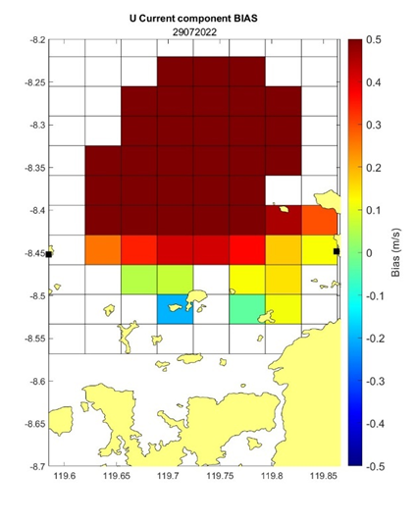
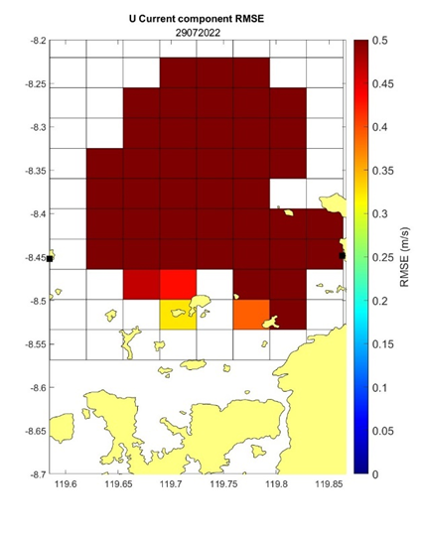
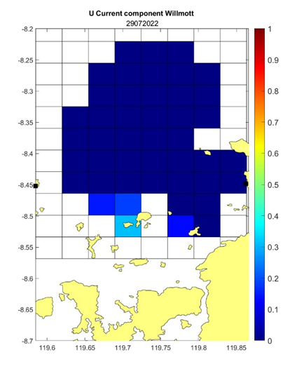
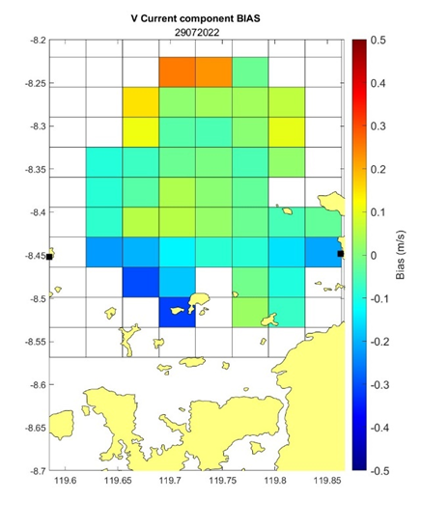
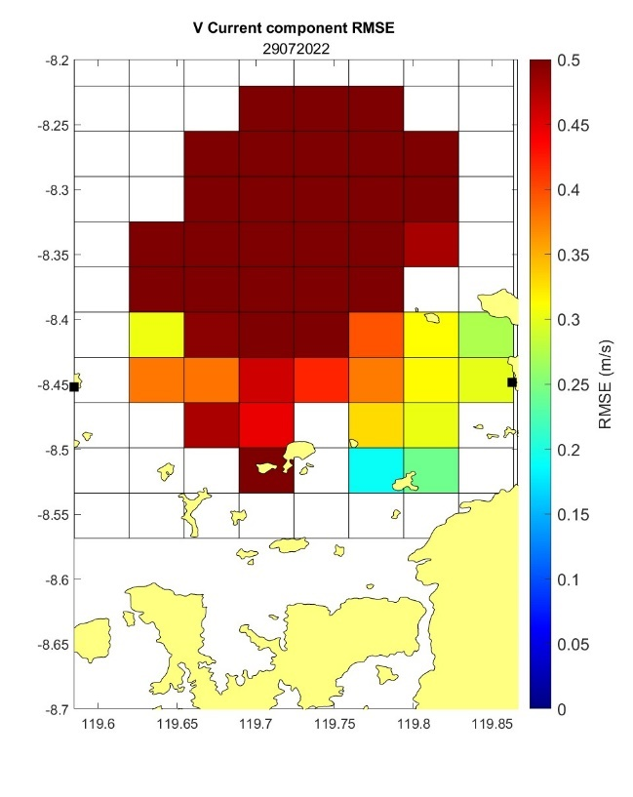
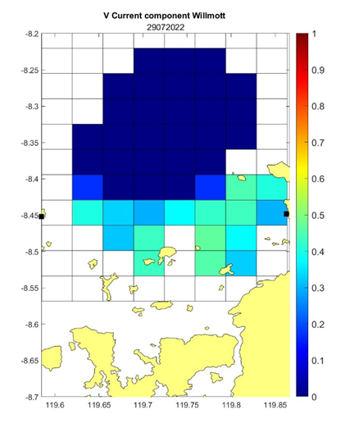
RESULTS
The U component has a larger bias error than the V component. The highest bias error in the U component is 0.4–0.5 ms⁻¹ north of the HF radar. For the V component, the bias error is 0–0.2 ms⁻¹ in the same area. HF radar's outermost area has the largest V component bias error of 0.2–0.3 ms⁻¹. The U component has a bias error of -0.2 to 0.2 ms⁻¹ in the area south of the HF radar position, compared to the north. V component conditions differ. This area's V component has a bias error of -0.4–0 ms⁻¹. In the north, the V component bias error arises in the outermost HF radar range. The water area between LAWA and KARA radar HF demonstrates that the bias error of the U component is higher than that of the V component. This is at 0.1 to 0.4 ms⁻¹ and -0.2 to 0 ms⁻¹, respectively.
HF radar grids in the north and south generally have a 0.5 ms⁻¹ U component RMSE. On the southernmost grid around Sebayur Island, the RMSE is 0.3–0.35 ms⁻¹. The V component has a substantial RMSE of 0.5 ms⁻¹ throughout most of the validation area, especially in the north. The V component's minimal RMSE is 0.15–0.3 ms-1 at 3-8 km from the KARA HF radar.
The Willmott index for the major u component is 0–0.1, hence Himawari and HF radar have low concordance for sea current U components. The V component shows better outcomes, with the northern area having an inadequate agreement with values from 0 to 0.1 and the southern area having a better deal with values from 0.3 to 0.5.
Please do not use this space, a QR code will be automatically overlayed
P1.3-738

Slide 6
CONCLUSIONS
As a result of using SST data in conjunction with the PIV method to calculate surface currents in the Flores Sea, results are obtained with varying degrees of accuracy. It has been observed that the most accurate estimation results are often seen around Komodo National Park or south of the Flores HF radar. However, one must consider that the northeast part of the HF radar range tends to overestimate the estimated value. In other words, the current component velocity is expected to be higher than what the HF radar observed. This is the reason for the higher estimated velocity. It has been found that better estimates are produced in areas where current speeds are relatively calm.
Himawari-8 SST data and the PIV method can describe ocean surface currents, especially in the Flores Sea. However, further research is still needed regarding adjusting PIV calculation methods such as interrogation windows, post-processing, etc., to produce better estimation data accuracy.
Please do not use this space, a QR code will be automatically overlayed
P1.3-738

Slide 7
REFERENCES
Balamurugan, R., & Jeeva, B. (2019). Micron size particle image velocimetry by fast Fourier transform. 020156. https://doi.org/10.1063/1.5130366
Choi, J. M., Kim, W., Hong, T. T. M., & Park, Y. G. (2021). Derivation and Evaluation of Satellite-Based Surface Current. Frontiers in Marine Science, 8. https://doi.org/10.3389/fmars.2021.695780
Fujita, I., Muste, M., & Kruger, A. (1998). Large-scale particle image velocimetry for flow analysis in hydraulic engineering applications. Journal of Hydraulic Research, 36(3), 397–414. https://doi.org/10.1080/00221689809498626
Ghalenoei, E., & Hasanlou, M. (2017). Monitoring of sea surface currents by using sea surface temperature and satellite altimetry data in the Caspian Sea Uav photogrammetry View project SAR Polarimetry Information Extraction View project Monitoring of sea surface currents by using sea surface temperature and satellite altimetry data in the Caspian Sea. Earth Observation and Geomatics Engineering, 1(1), 36–46. https://doi.org/10.22059/eoge.2017.226309.1001
Hsu, T.-W., Shin, C.-Y., Ou, S.-H., & Li, Y.-T. (2011). Multi-Cross-Correlation Method in Particle Image Velocimetry. Journal of Mechanics, 27(3), 365–377. https://doi.org/10.1017/jmech.2011.39
Karang, I. W. G. A., Chonnaniyah, & Osawa, T. (2020). Internal solitary wave observations in the Flores Sea using the Himawari-8 geostationary satellite. International Journal of Remote Sensing, 41(15), 5726–5742. https://doi.org/10.1080/01431161.2019.1693079
Röhrs, J., Sutherland, G., Jeans, G., Bedington, M., Sperrevik, A. K., Dagestad, K. F., Gusdal, Y., Mauritzen, C., Dale, A., & LaCasce, J. H. (2021). Surface currents in operational oceanography: Key applications, mechanisms, and methods. Journal of Operational Oceanography. https://doi.org/10.1080/1755876X.2021.1903221
Supriyadi, E., Hidayat, R., Santikayasa, P., & Ramdhani, A. (2021). An Analysis of Surface Ocean Currents from HF Radar Measurements in the Bali Strait and the Flores Sea, Indonesia. International Journal on Advanced Science, Engineering and Information Technology, 11(4).
Willmott, C. J., Robeson, S. M., & Matsuura, K. (2011). A refined index of model performance. International Journal of Climatology, 32(13), 2088–2094. https://doi.org/10.1002/joc.2419 AND OTHERS…
Please do not use this space, a QR code will be automatically overlayed
P1.3-738

