Slide 1
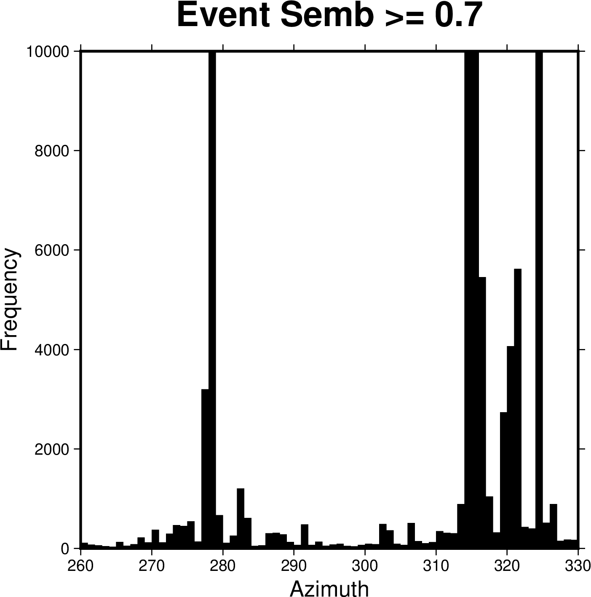
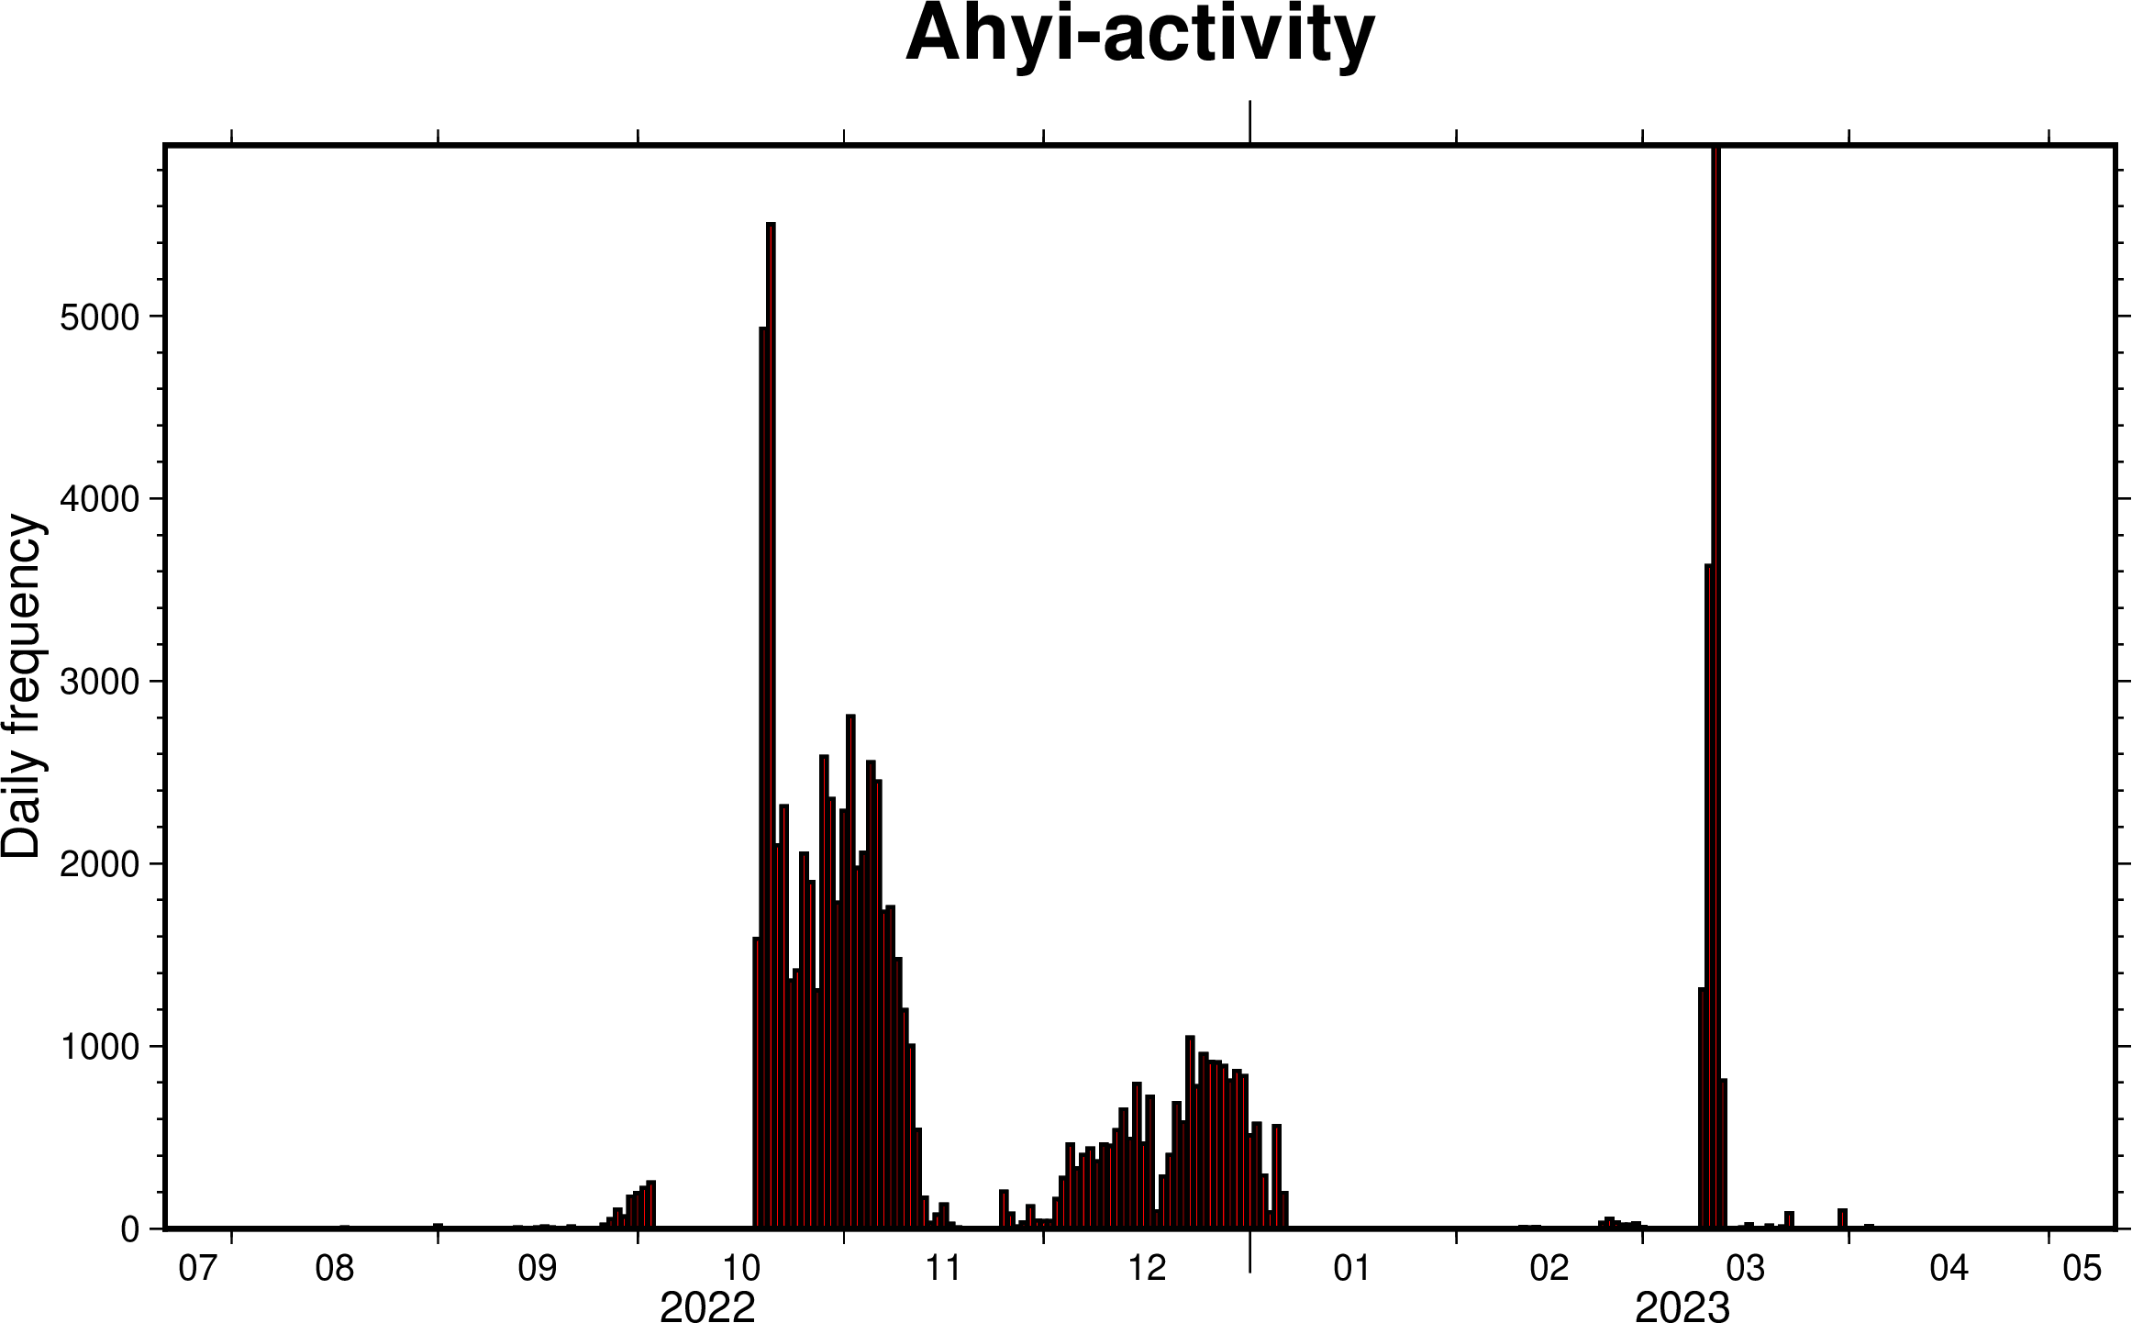
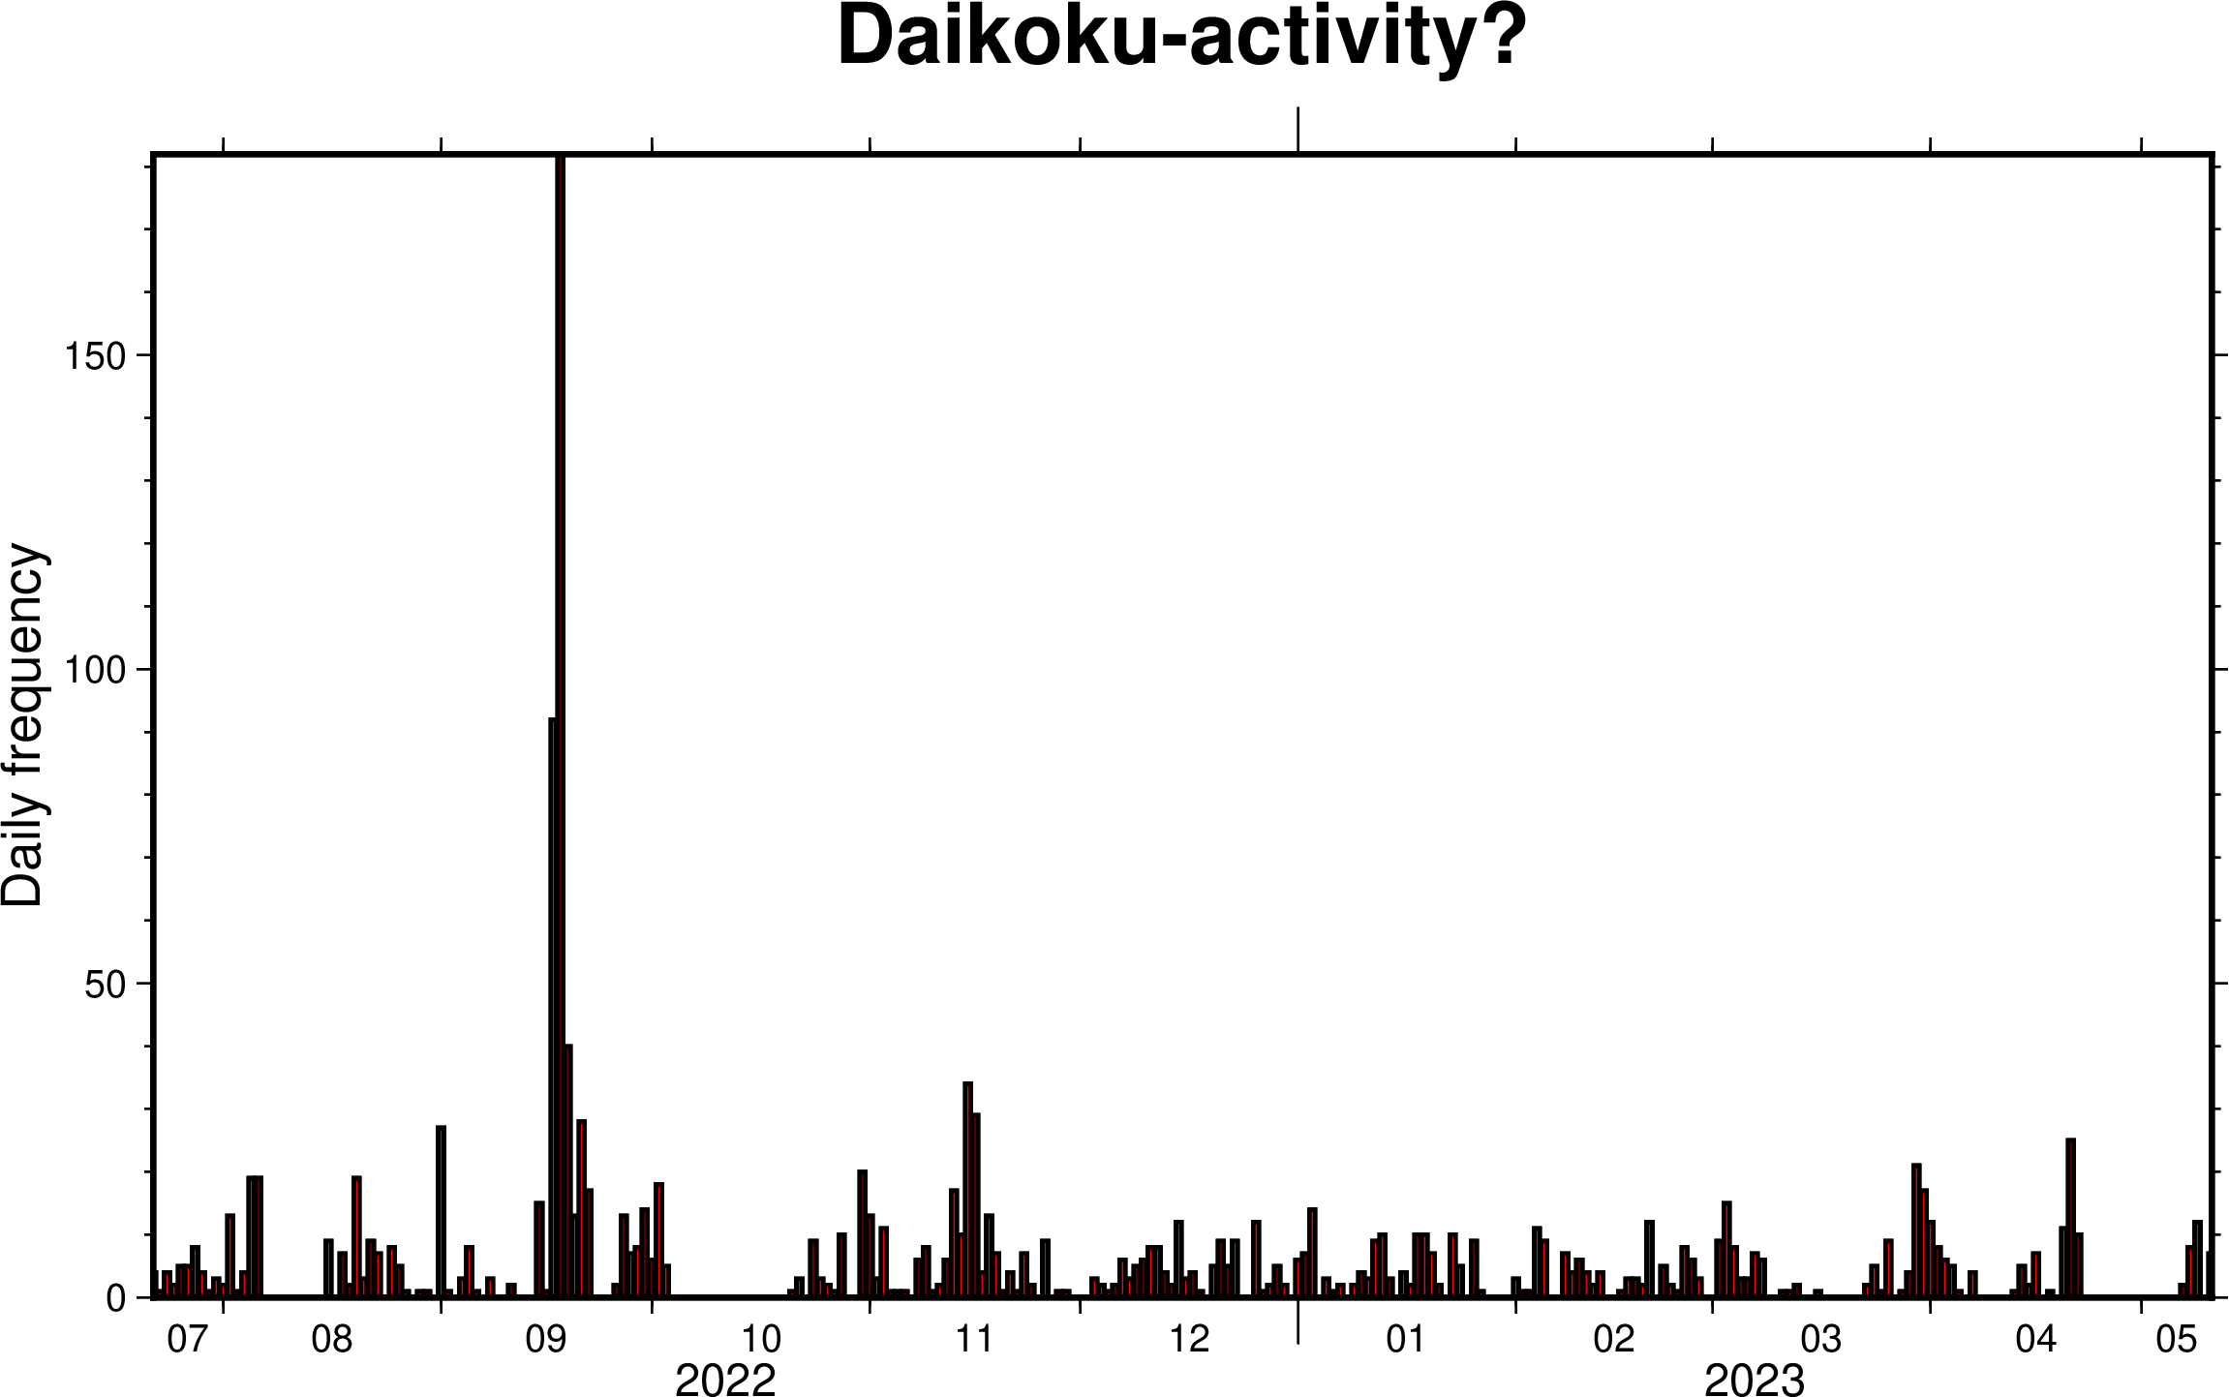
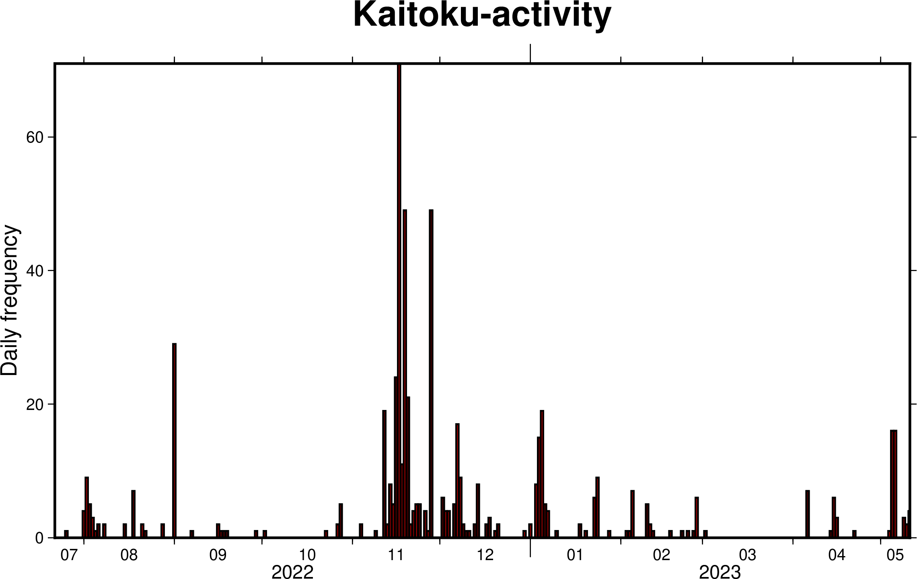
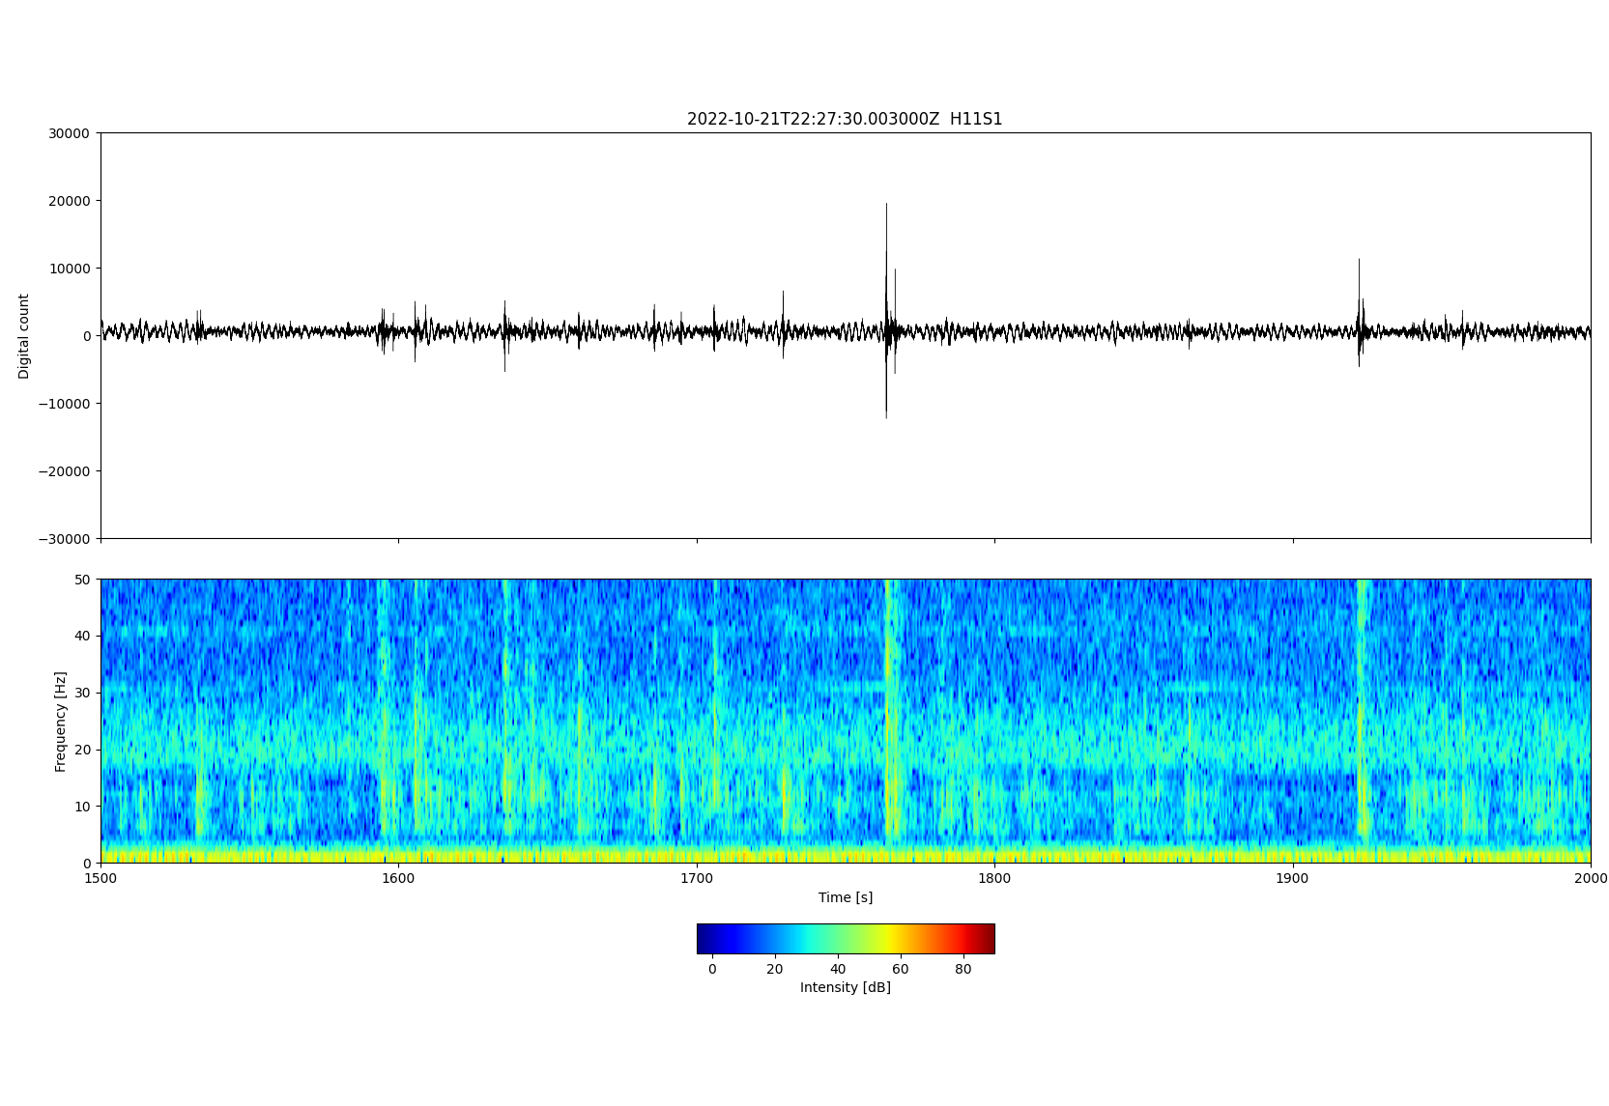
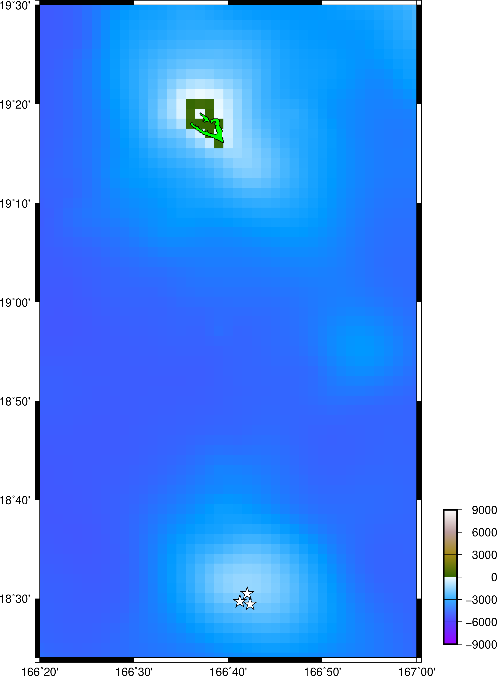
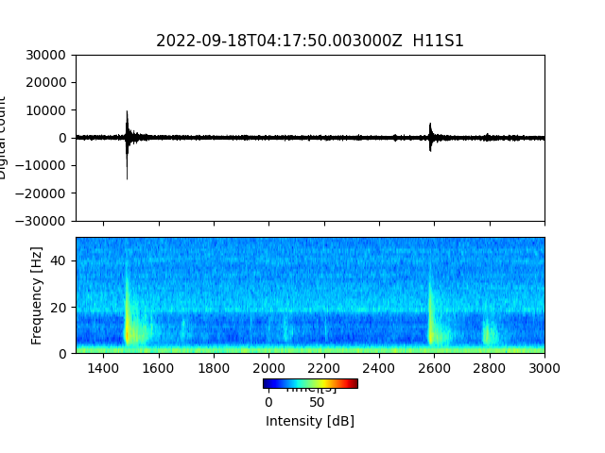
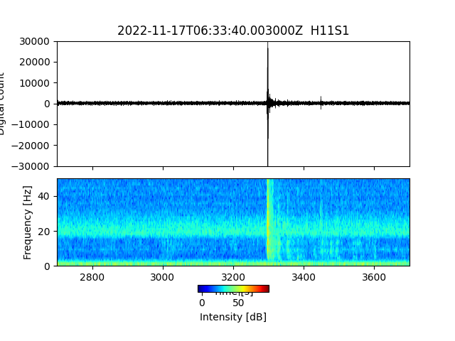
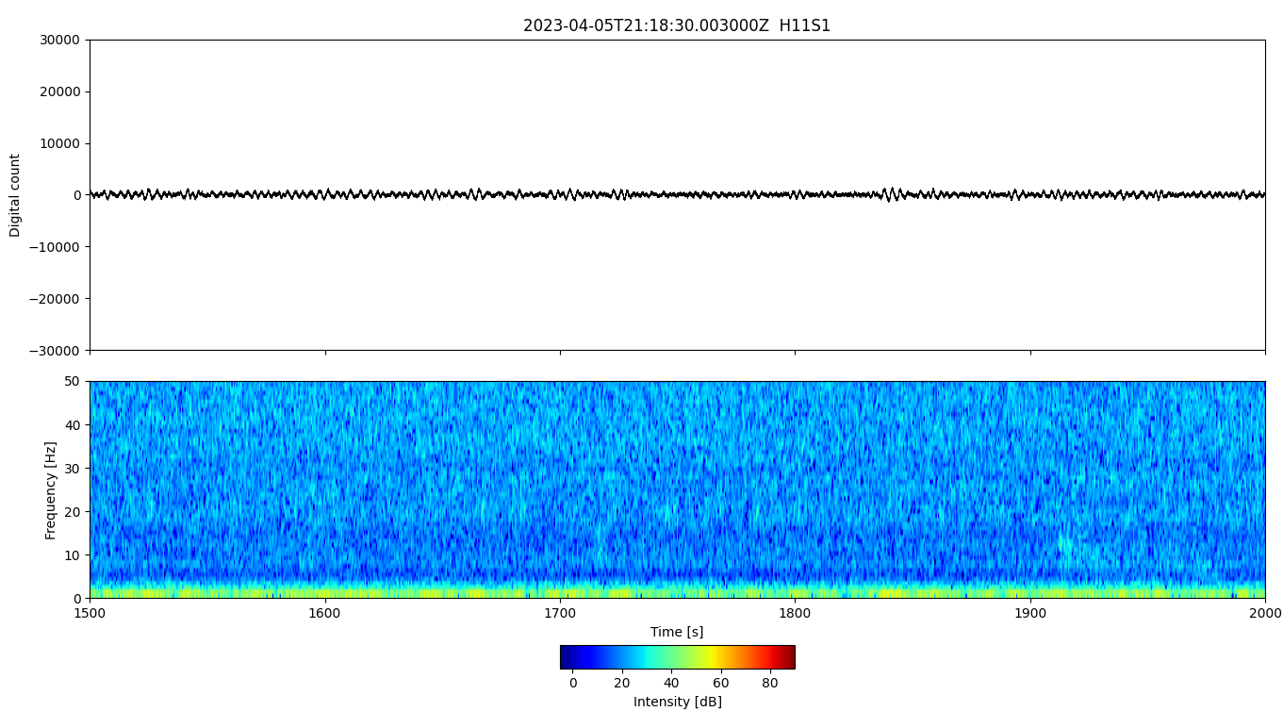
Continuous analysis of IMS hydrophone array signals
for the detection of submarine volcanic activity
S. Tanaka, M. Obayashi, M. Nakano, J. Yoshimitsu, and D. Metz† (JAMSTEC, † Now at CTBTO)
Px.x-xxx
Detection numbers (Semblance ≥ 0.7) from July 21, 2022 to April 12, 2023
Azimuths are limited from 260° to 330°
Long term activity from July 21, 2022 to May 5, 2023 for 3 directions
Volcanic activities?
in the IBM arc
No data
Human activities
Example records and spectrograms for active periods
Topo & bathymetry (m)
Azimuth Corresponding Volcano
278° Ahyi
282° Daikoku?
291° Kaitoku
Example record and spectrogram for
a quiet period
H11
S1
Example records from 3 array elements
S3
S2
Impulsive!
Wide frequency range
Long duration!
Low frequency
Impulsive!
Wide frequency range

